Slide 1
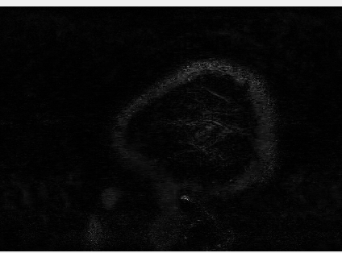
Suppl. video 1: High-resolution CSF-signal in the entire human brain
CSF-signal
Notes:
Supplementary video 1: High-resolution, whole brain CSF-signal. Whole brain CSF-signal measured using the non-motion-sensitized reference scan, shown in one individual.

Slide 2

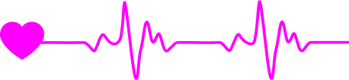
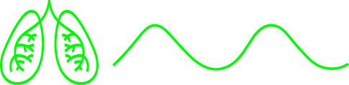
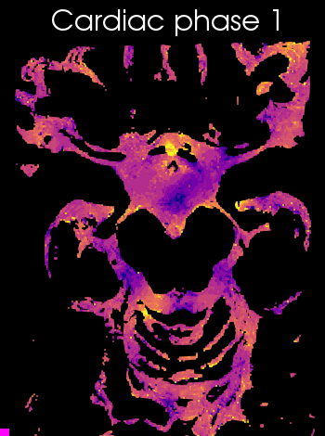
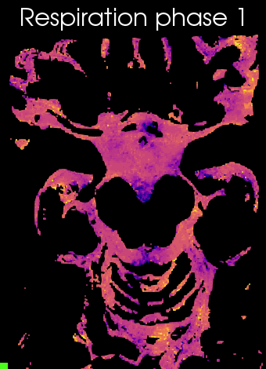
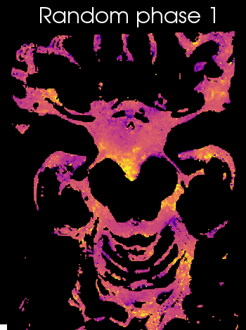
Suppl. video 2: Animation of CSF-mobility change across driving forces in the subarachnoid space around the circle of Willis
-10
CSF-mobility change (%)
10
Notes:
Supplementary video 2: Animation of CSF-mobility change across driving forces in the subarachnoid space around the circle of Willis. CSF-mobility change from the mean value over phases (in %) across the cardiac (left), respiration (middle) and random (right) cycles in one representative individual (same data as in Fig. 3, but as a gif).

Slide 3
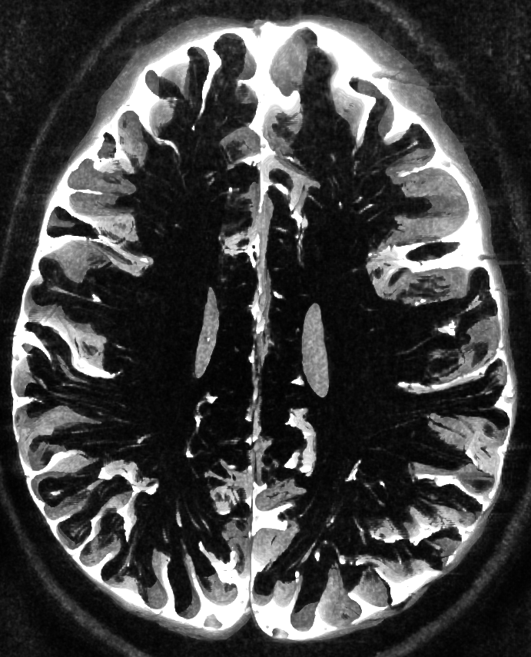
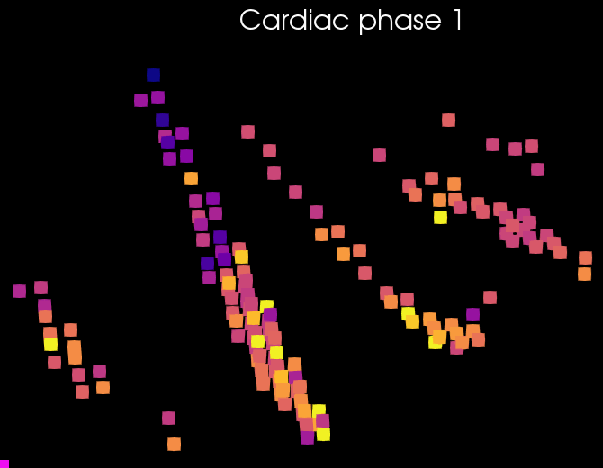
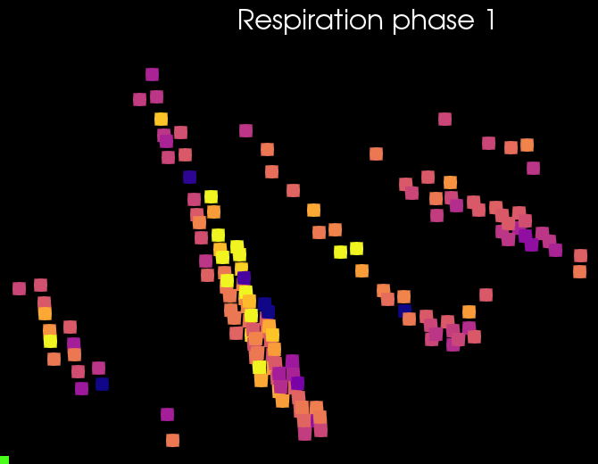
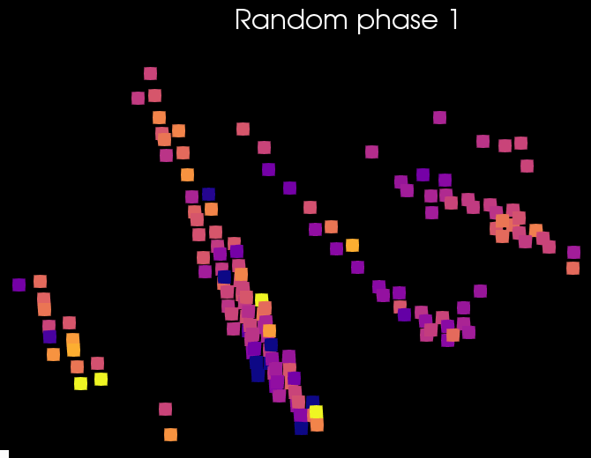
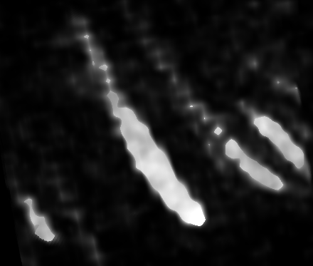
Suppl. video 3: Animation of CSF-mobility change across driving forces in PVS around penetrating arteries
-10
CSF-mobility change (%)
10
Notes:
Supplementary video 3: Animation of CSF-mobility change across driving forces in PVS around penetrating arteries. CSF-mobility change from the mean value over phases (in %) across the cardiac (left), respiration (middle) and random (right) cycles in one representative individual (same data as in Fig. 4, but as a gif).

