Slide 1
“Mortuus Magister”
By - Dissection table 10
1st Year M.B.B.S
Roll no : 181-201

Slide 2
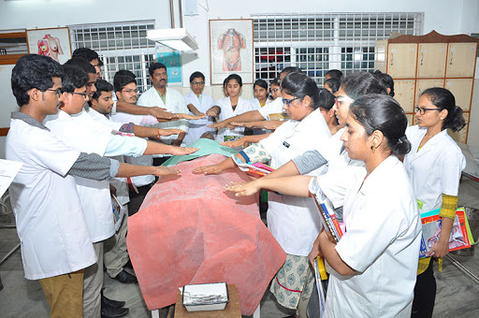
“The Cadeveric Oath”
Cadaveric Oath emphasises on proper handling of cadaver and paying tribute to the soul.
It made us feel that we have to work with the Cadaver, not on the Cadaver.

Slide 3
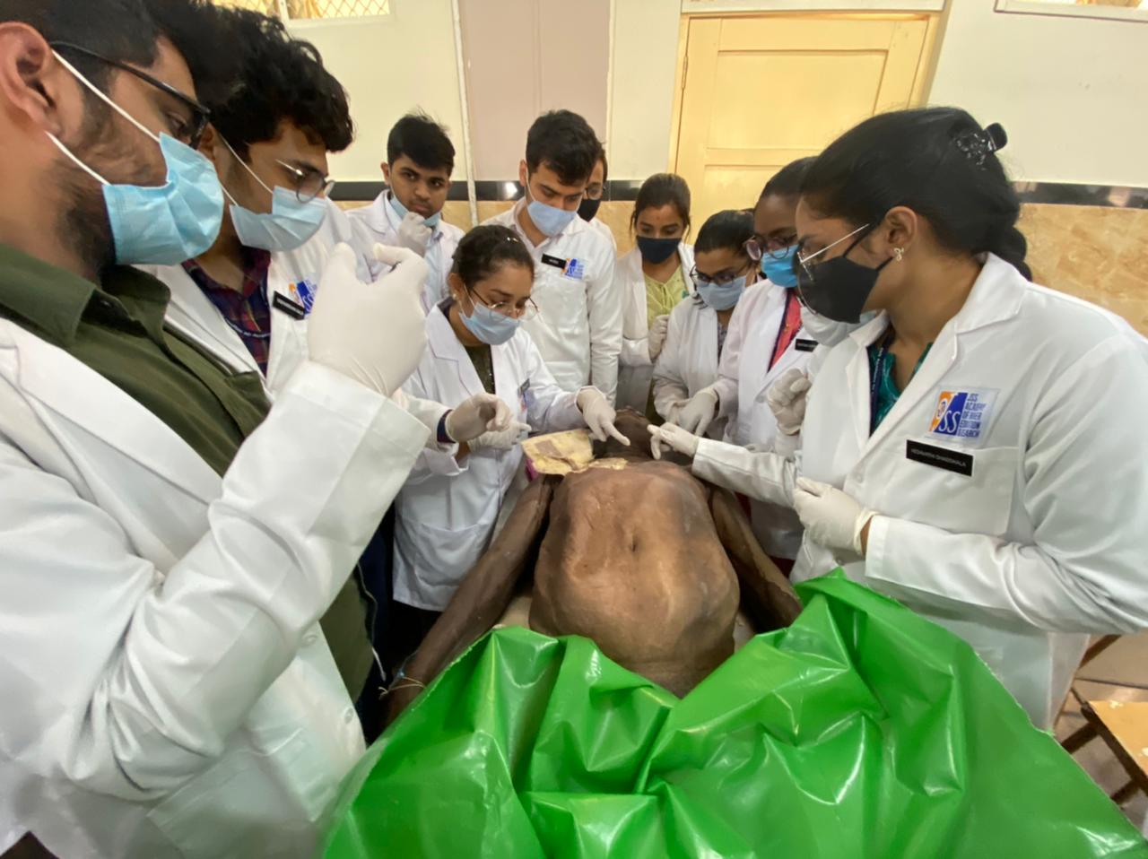
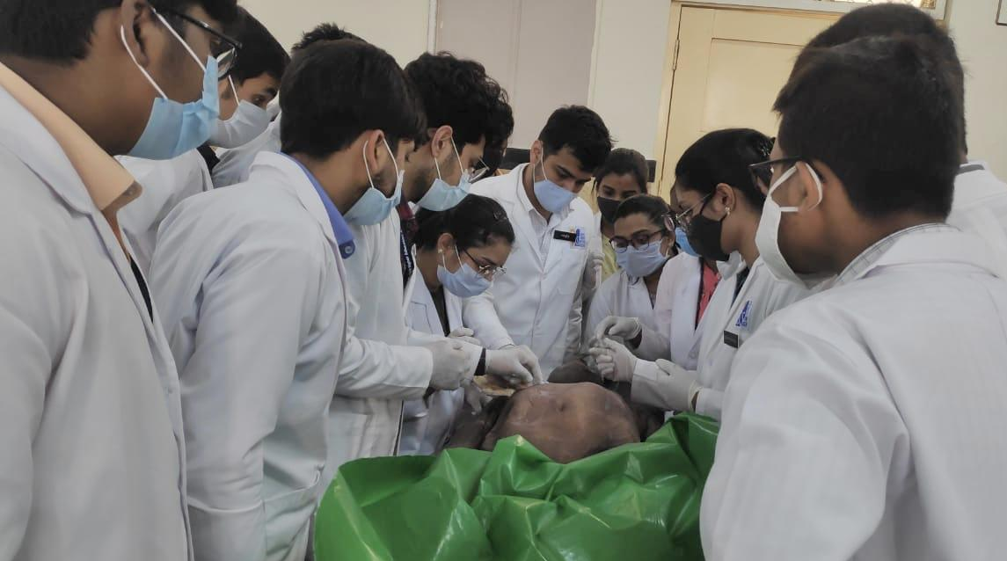
First encounter with the
Cadaver
The fear before unveiling The Cadaver.
Acceptance of the fact that Cadaver will now be a part of our day to day life.

Slide 4
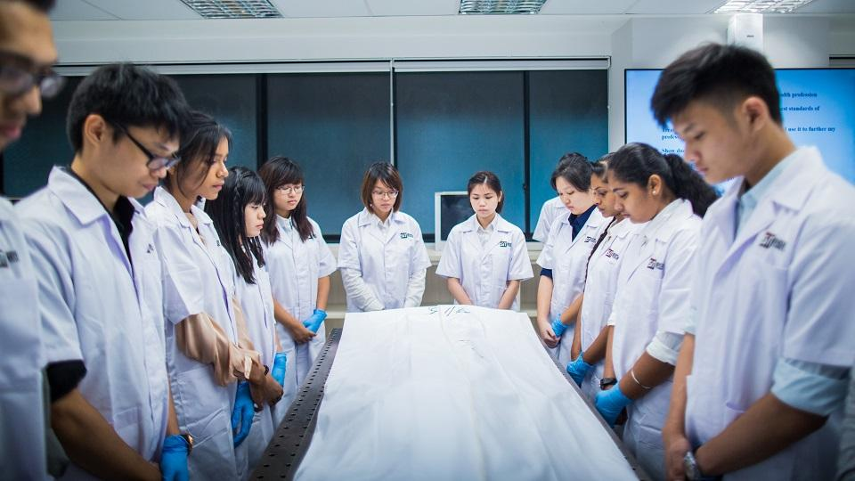
Gratitude to the dead
We should empathize and give respect to the person gone to eternal rest as once they too were humans at their best...

Slide 5
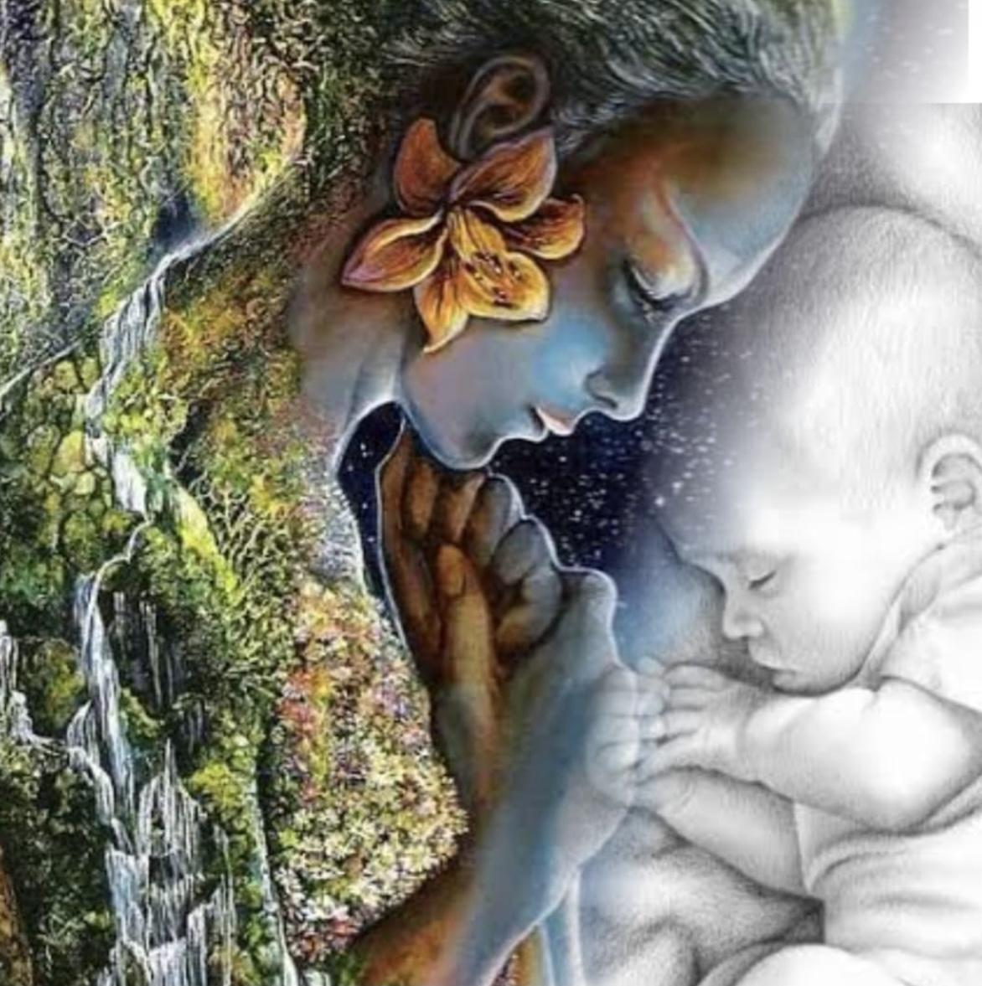
“NATURE : AN ARCHITECT”
The fact that even a human isn’t well equipped and skilled enough to manufacture its own body shows what a great sculptor nature is………….

Slide 6
THANK YOU!!

