Slide 1
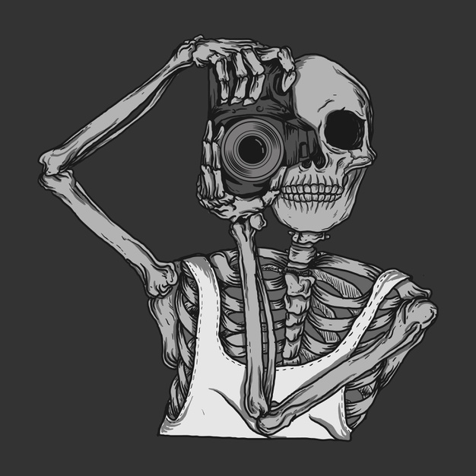
CADAVER THROUGH MY LENS

Slide 2
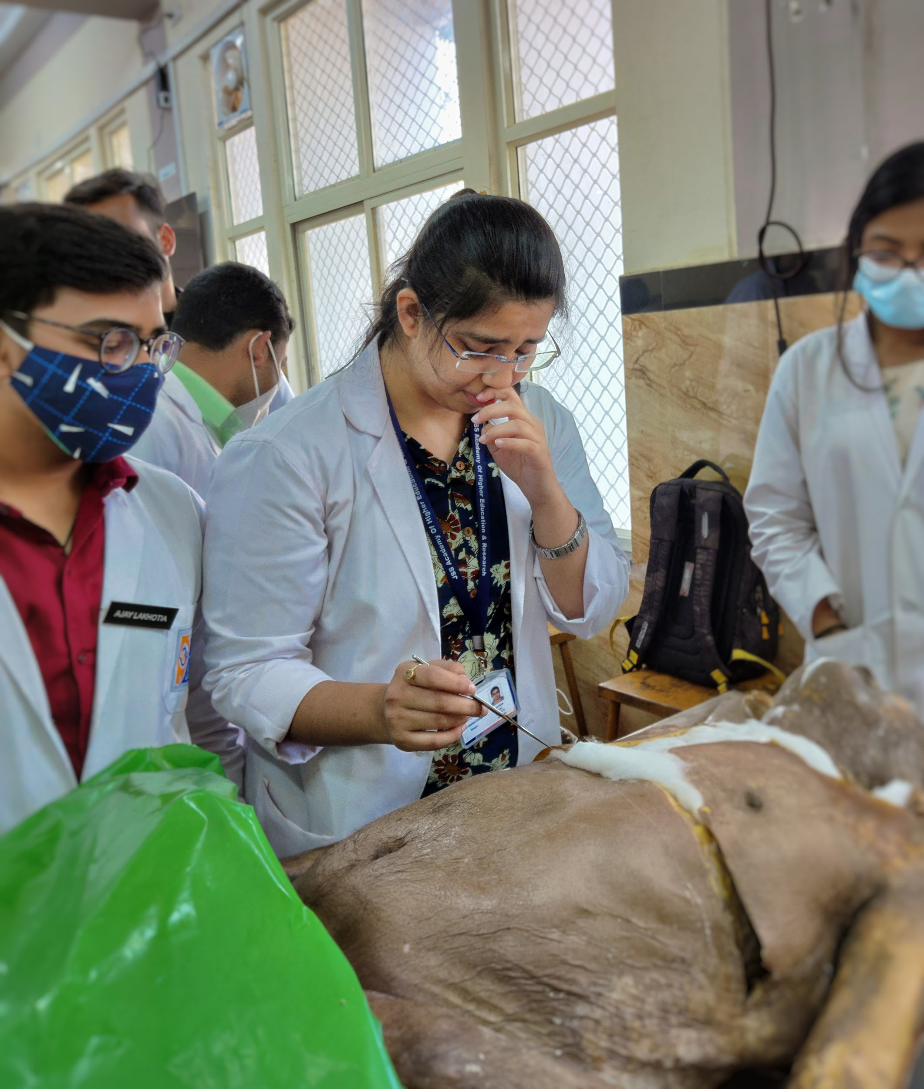
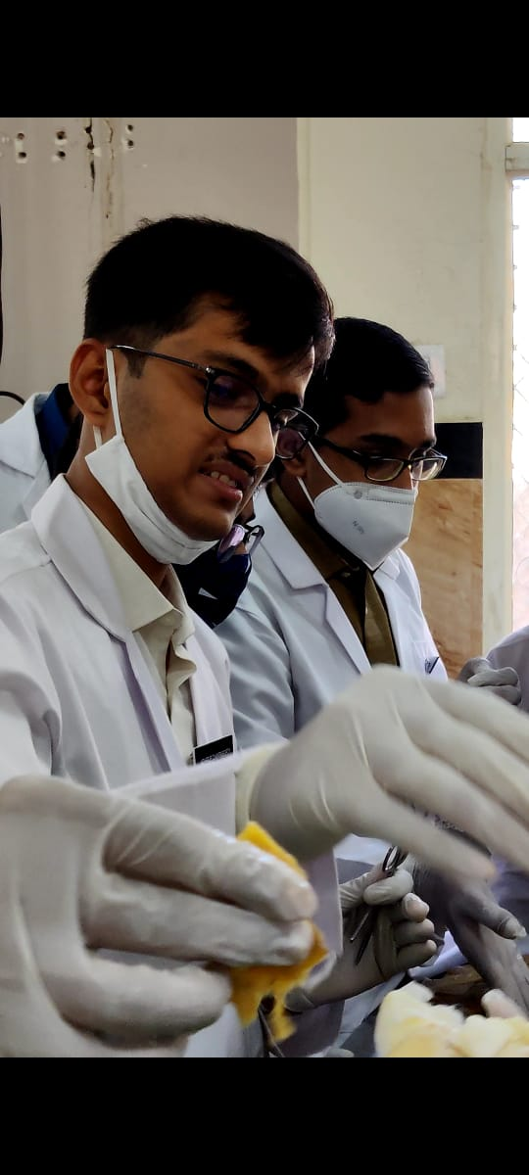
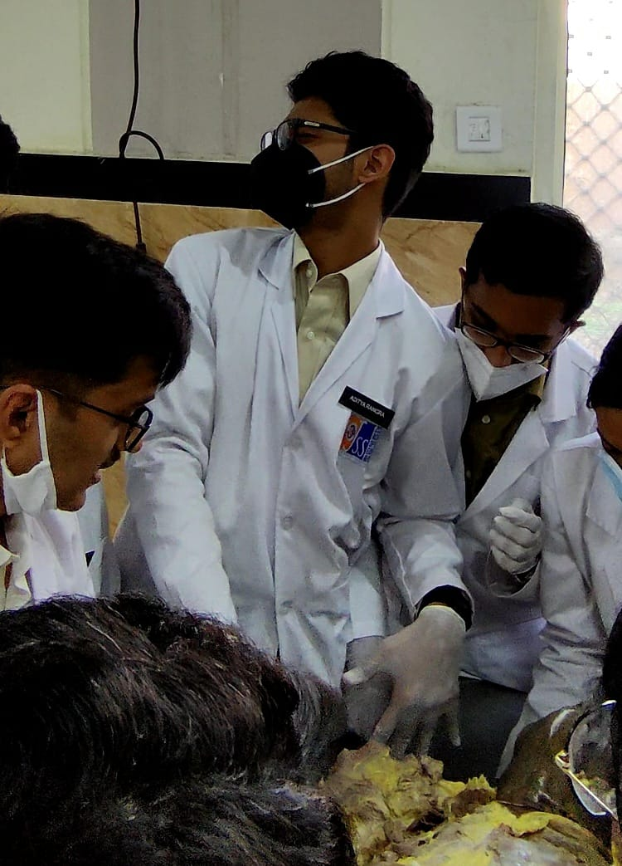
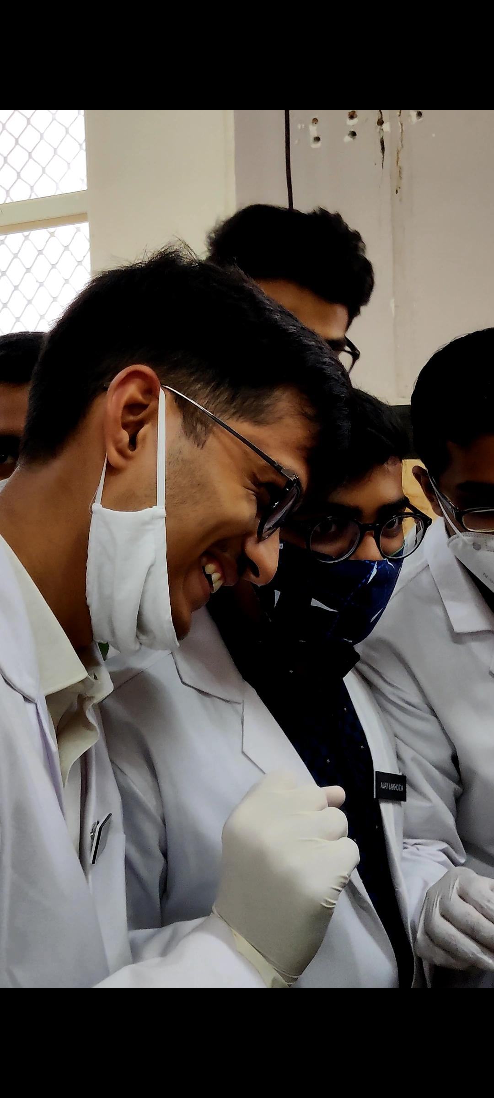
The Gift of Knowing You
Nevri’kos
(nervous)
Aida’zon
(disgusted)
Fovisme’nos
(scared)
Enthosiasme’nos
(excited)

Slide 3
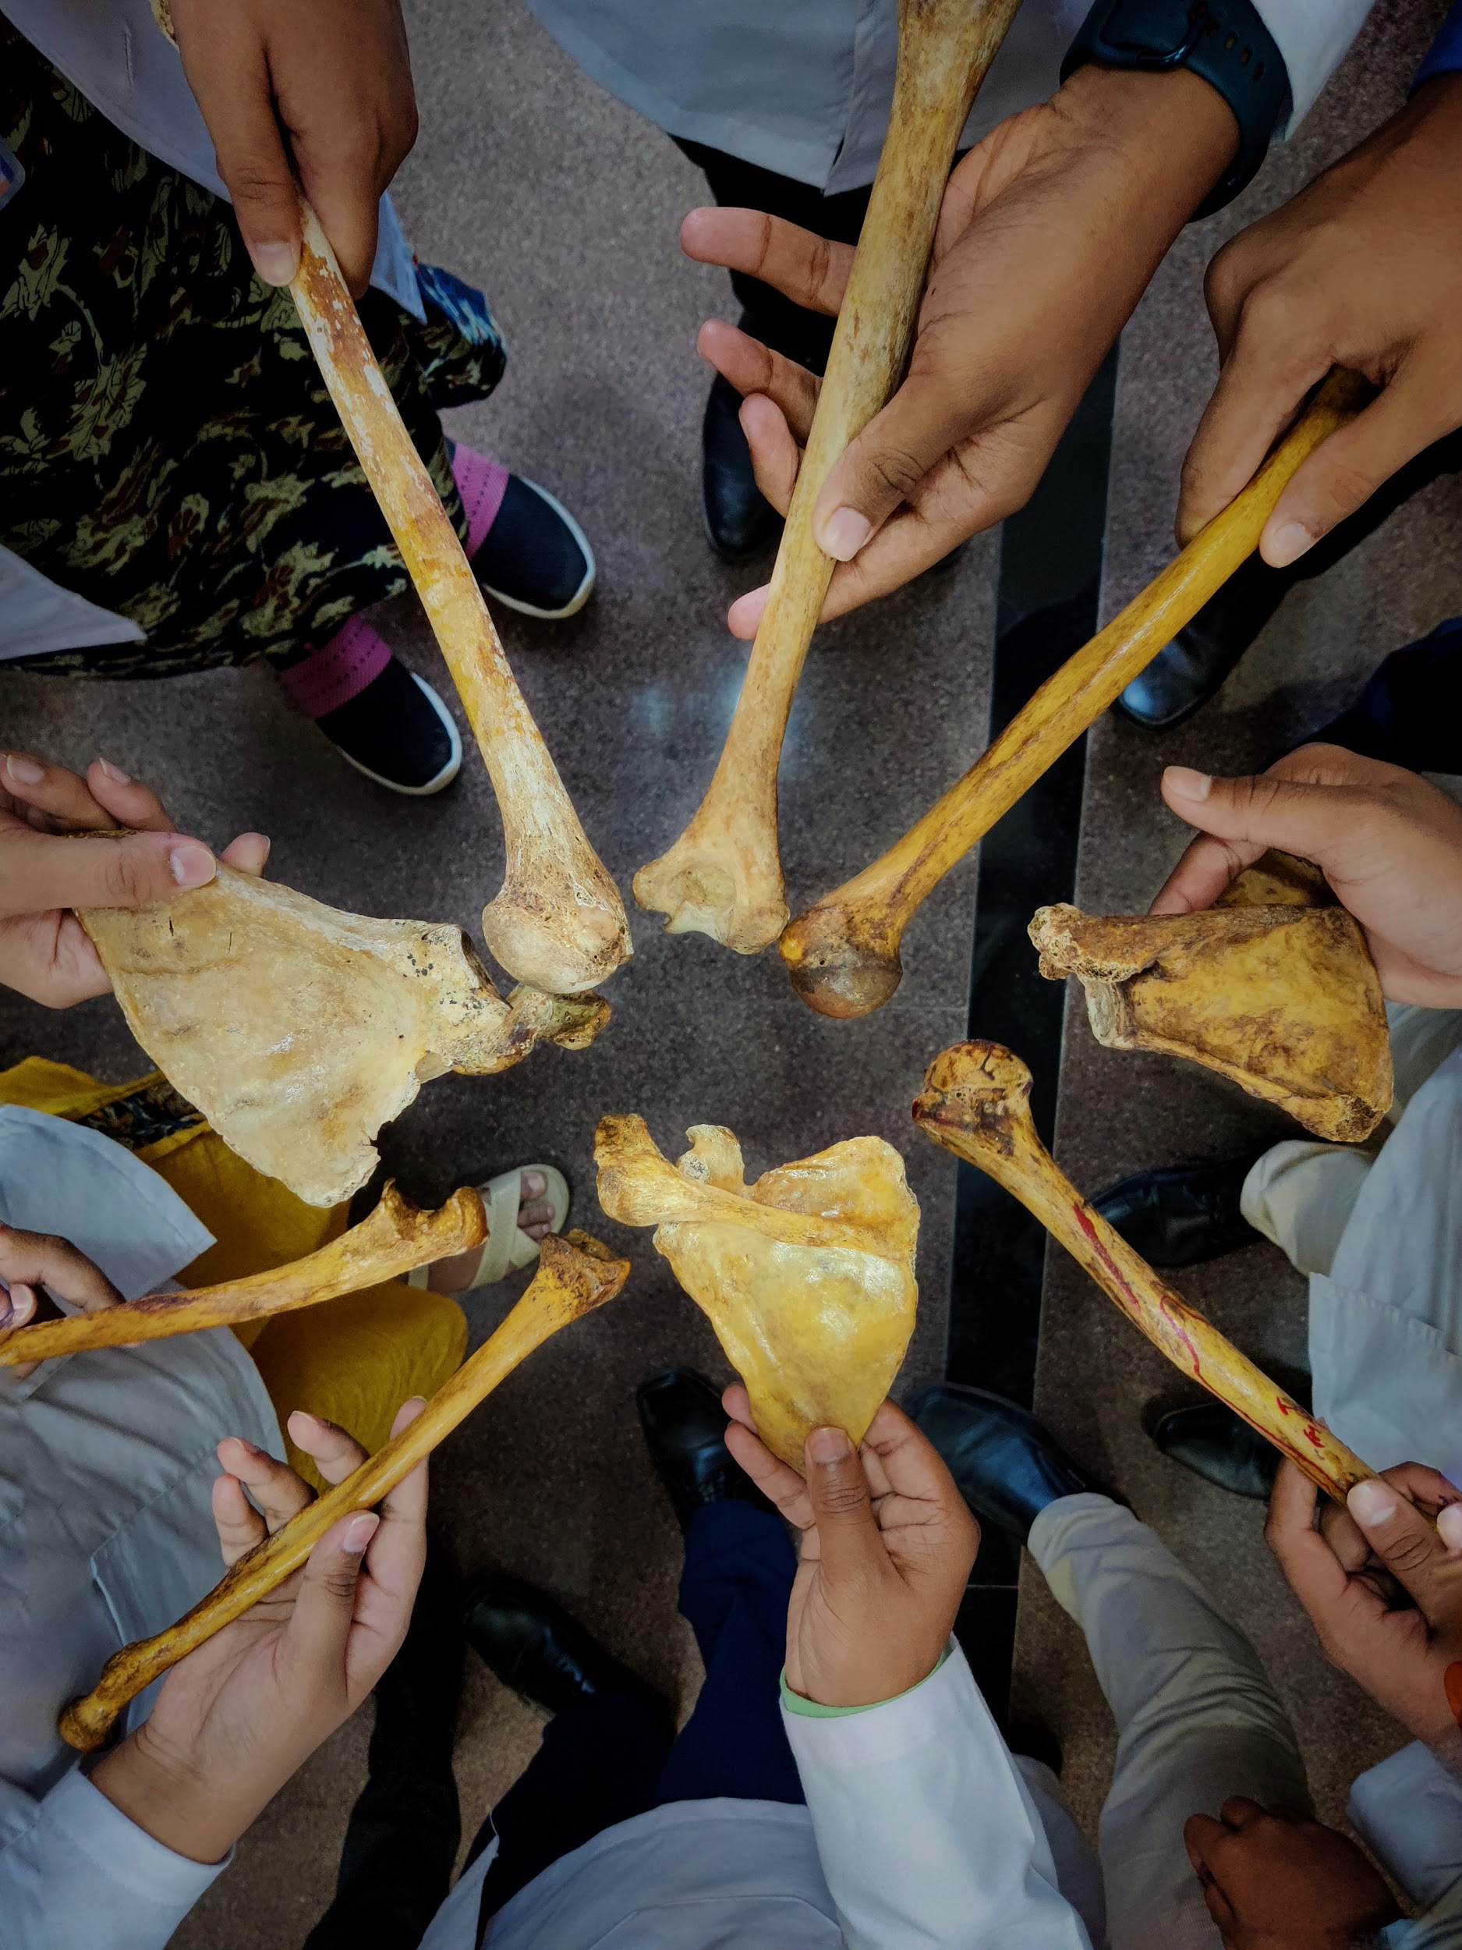
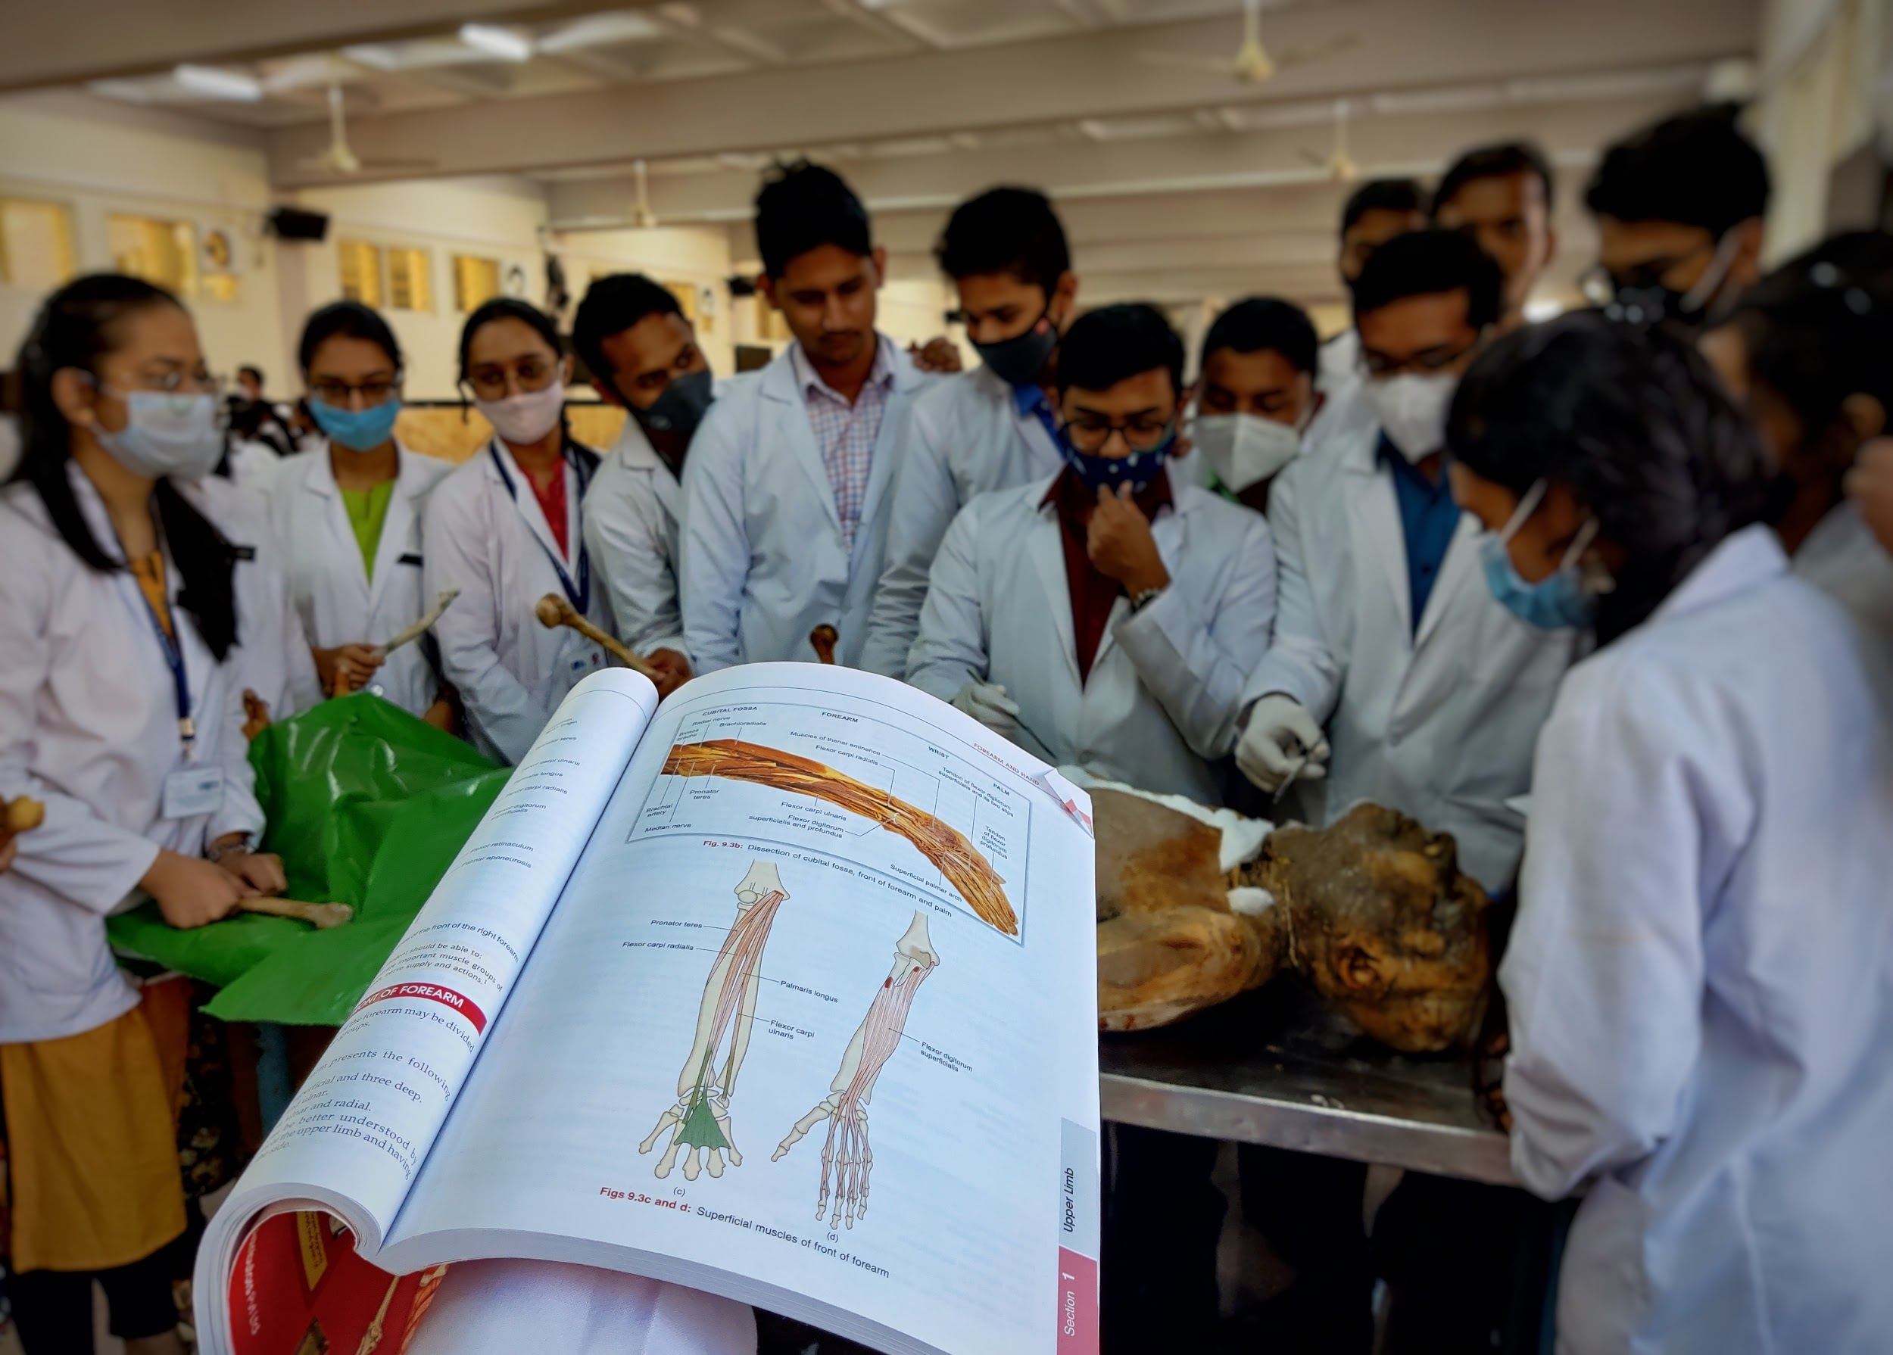
Cadaver : “The ultimate gift of body donors”

Slide 4
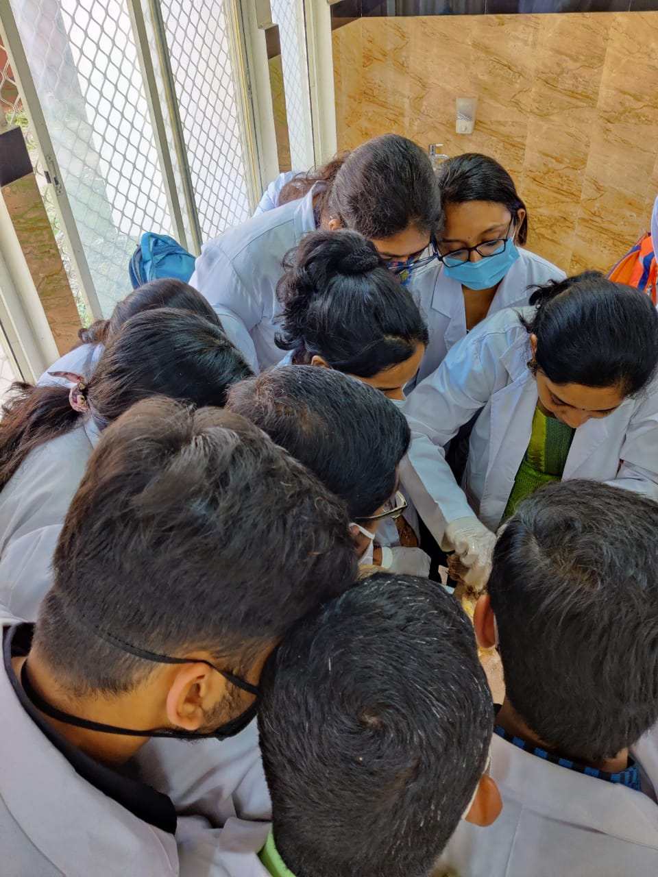
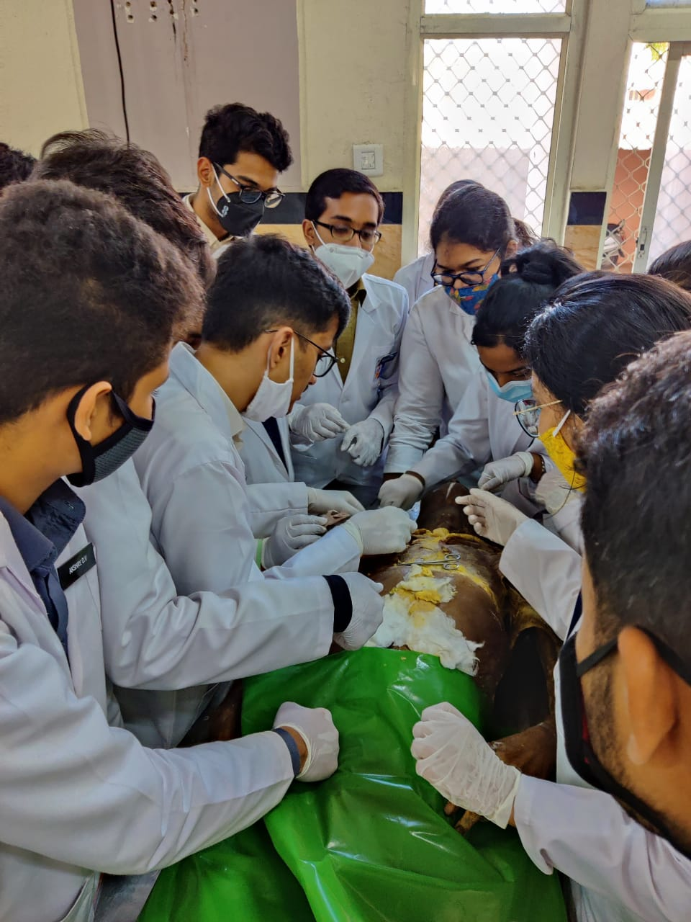
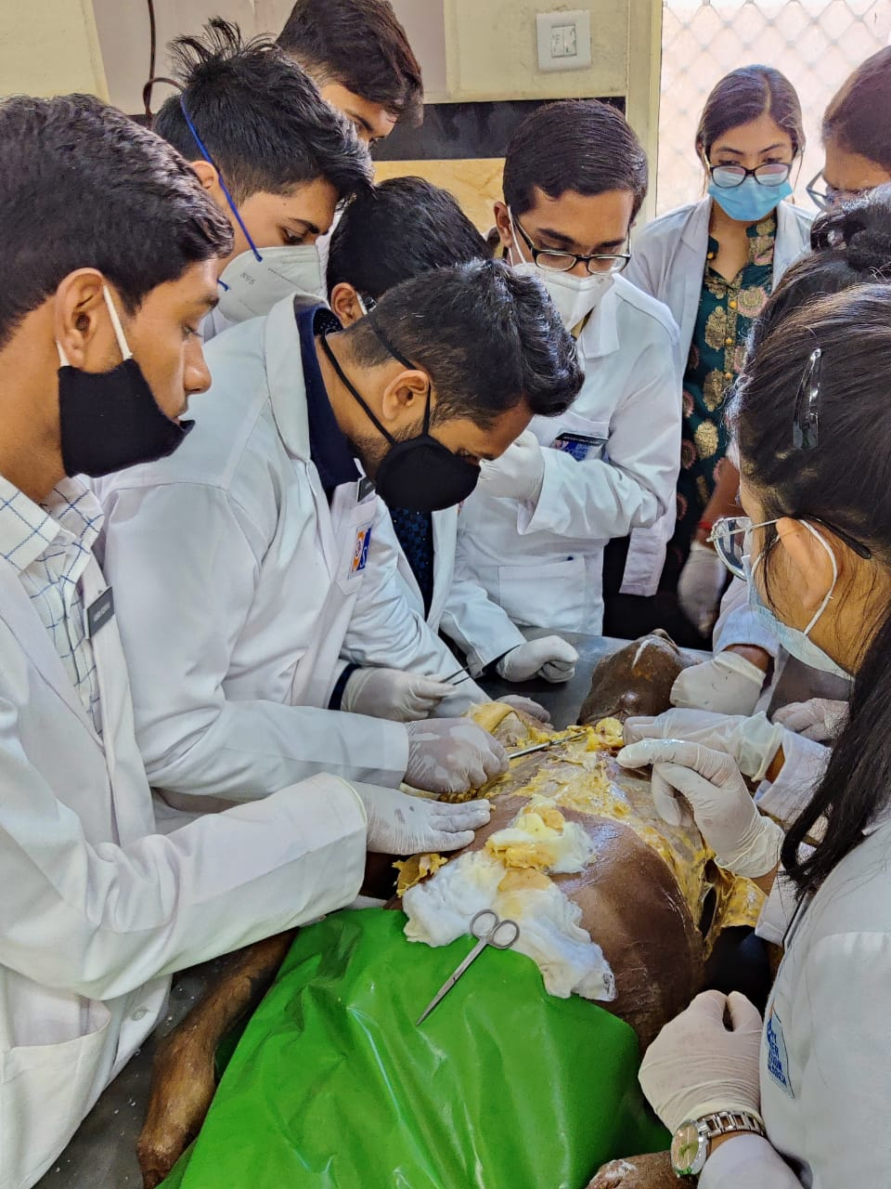
Silent Teachers of Tomorrow’s Doctors

Slide 5
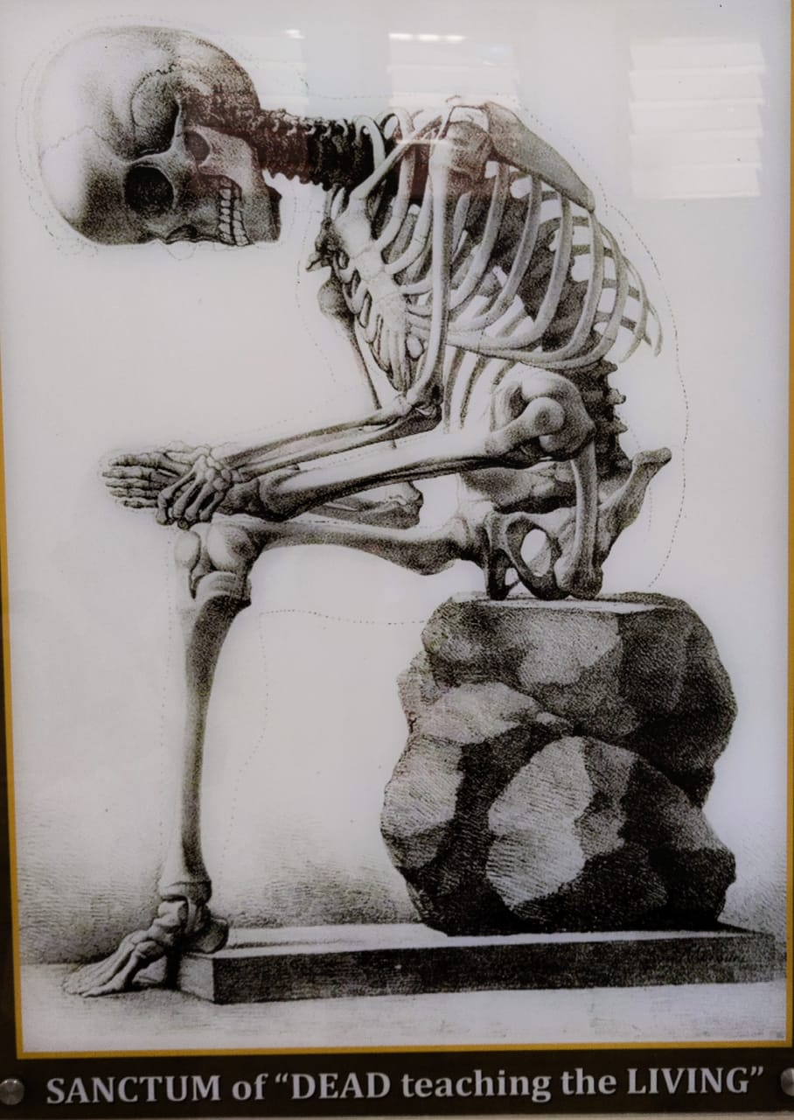
We owe this to the “First Teacher in anatomy’’
A Doctor’s
CadaveR As our First Teacher

Slide 6
THANK YOU
by Dissection Table - 1

