Slide 1
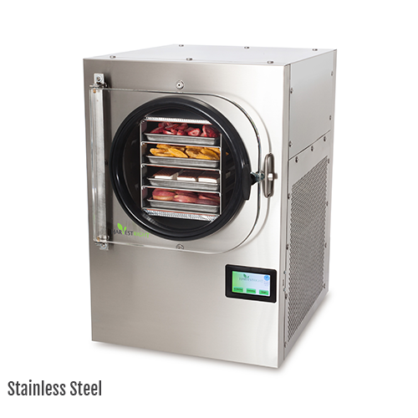
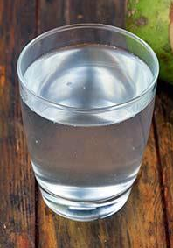

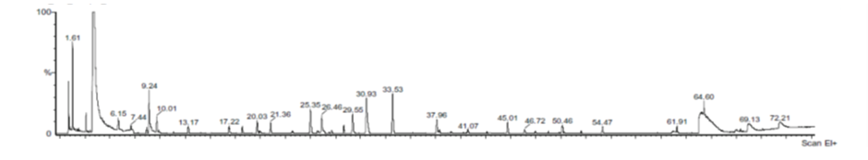
Encapsulating agents
Maltodextrin
Polydextrose
Xantham gum
Physicochemical characteristics
Volatile aroma
Freeze dryer
Coconut water

