Slide 1
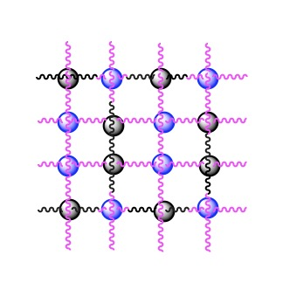
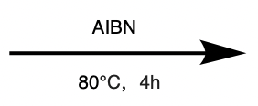


SO-DB
Vis
UV
PMCH
PMC
UV-light
15s

