Slide 1
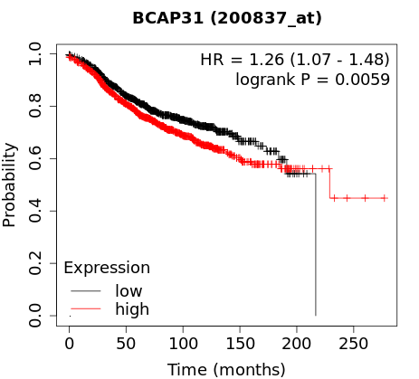
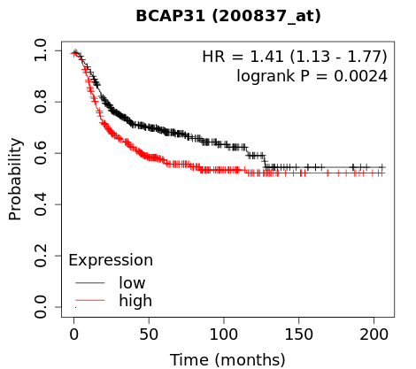
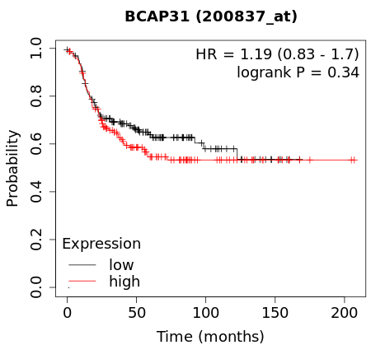
Supplementary Figure 1 (related to Figure 1)
a
c
BAP31 High
BAP31 Low
DRFS
(GSE22220)
b
TCGA datasets
GSE22220
Parameter | N | BAP31 high (>11.05) n (%) | P value
Tumor Size (mm)
<25 | 1014 | 470(46.4) | ***
≥25 | 872 | 474(54.4)
Neoplasm Histologic Grade
1,2 | 905 | 360(39.8) | ***
3 | 927 | 556(60.0)
Tumor Stage
0,1 | 479 | 195(40.7) | ***
2,3,4 | 924 | 487(52.7)
Age
<55 | 615 | 298(48.5) | 0.413
≥55 | 1289 | 652(50.6)
ER status
positive | 1459 | 662(45.4) | ***
negative | 445 | 288(64.7)
PR status
positive | 1009 | 431(42.7) | ***
negative | 895 | 519(58.0)
HER2 status
positive | 236 | 153(64.8) | ***
negative | 1668 | 797(47.8)
Parameter | N | BAP31 high (>11.22) n (%) | P value
Tumor size(mm)
<25 | 115 | 28(24.3) | **
≥25 | 101 | 43(42.6)
Tumor grade
1,2 | 128 | 34(26.6) | *
3 | 63 | 29(46.0)
Distant relapse
0 | 134 | 36(26.9) | *
1 | 82 | 35(42.7)
Age
<55 | 103 | 23(22.3) | **
≥55 | 113 | 48(42.5)
Nodes involved
0 | 125 | 40(32.0) | 0.863
>0 | 91 | 31(34.1)
ER status
positive | 134 | 38(28.36) | 0.098
negative | 82 | 33(40.24)
d
Luminal subtype
Basal-like subtype
Her2(+) subtype
Notes:
Supplementary Figure S1, (a) Kaplan-Meier analysis of the relationship of BAP31 expression levels and distant-relapse free survival (DRFS) of breast cancer patients in GSE22220. (b) The relationship between BAP31 and other clinicopathological characteristics in breast cancer patients in TCGA datasets and GSE22220. (c) qRT-PCR analysis of BAP31 expression in 2 non-tumorigenic cell lines and 9 cancer cell lines.

Slide 2








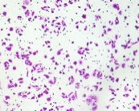
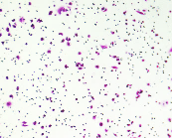
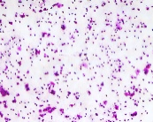
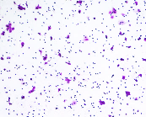
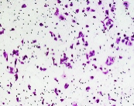
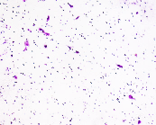
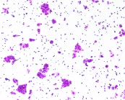

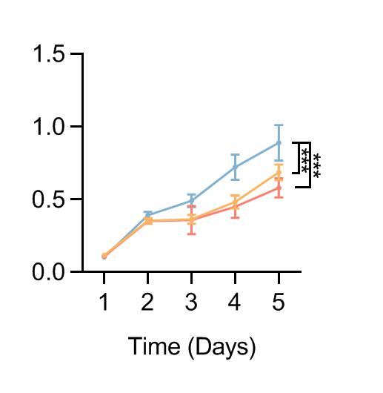
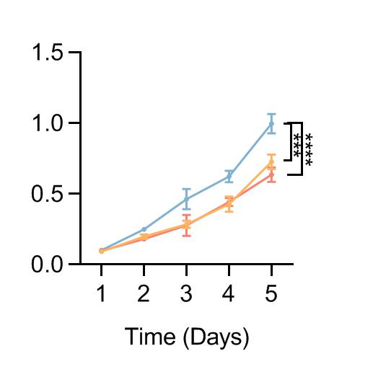
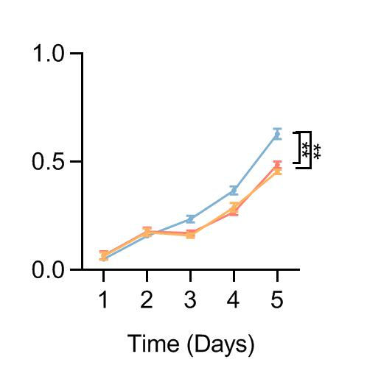
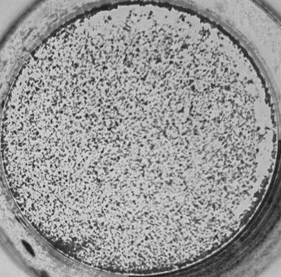
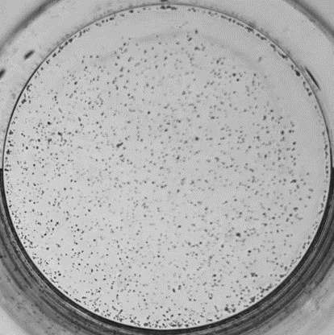
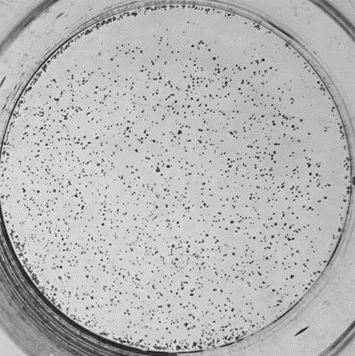

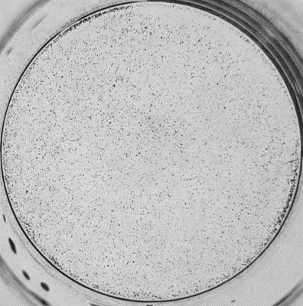
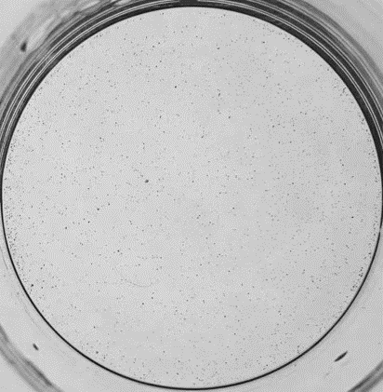
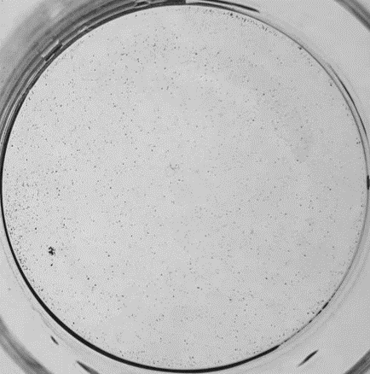
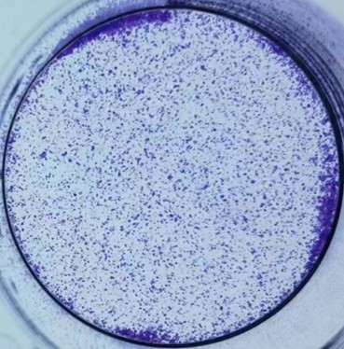
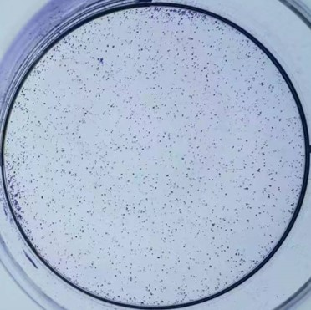
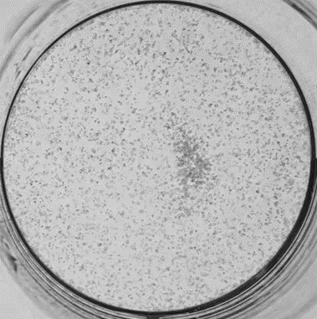
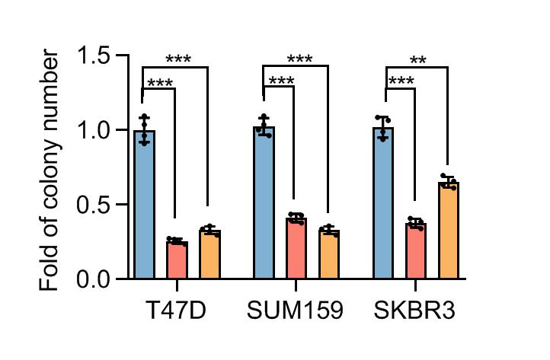
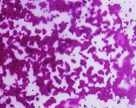
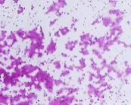
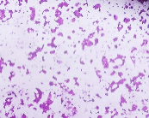
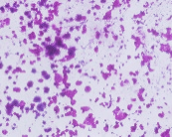
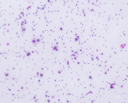
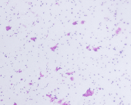
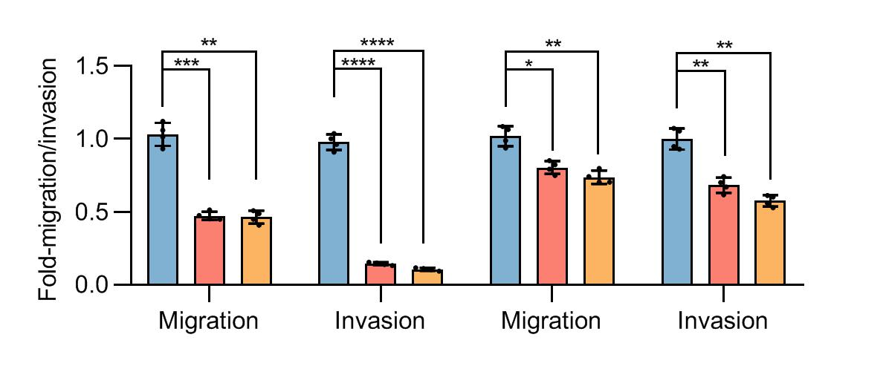
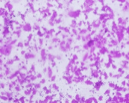
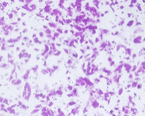
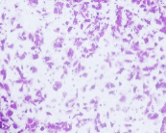
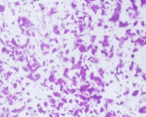
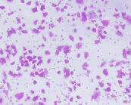
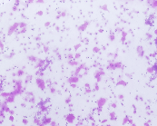
Supplementary Figure 2 (related to Figure 2 and 3)
a
b
MDA-MB-231
MCF-7
c
d
sgCtrl
sgBAP31
BAP31
MDA-MB-231
sgCtrl
sgCtrl
sgCtrl
sgBAP31
sgBAP31
sgBAP31
MDA-MB-231
β-ACTIN
MCF-7
BAP31
MCF-7
β-ACTIN
sgCtrl
sgBAP31
e
MDA-MB-231
MCF-7
f
sgCtrl
sgBAP31
sgCtrl
sgBAP31
sgCtrl
Migration
sgBAP31
Invasion
g
MDA-MB-231
MCF-7
T47D
SUM159
SKBR3
h
shCtrl
shBAP31-1
shBAP31-2
shCtrl
shCtrl
shCtrl
shBAP31-1
shBAP31-1
shBAP31-1
shBAP31-2
shBAP31-2
shBAP31-2
T47D
SUM159
i
shCtrl
shBAP31-1
shBAP31-2
SKBR3
j
shCtrl
shBAP31-1
shBAP31-2
Migration
SUM159
k
shCtrl
shBAP31-1
shBAP31-2
Invasion
Migration
SKBR3
Invasion
SUM159
SKBR3
Notes:
Supplementary Figure, BAP31 KO decreased invasion capacity of breast cancer cell. (a) Western blot analysis of BAP31 levels in MDA-MB-231 and MCF-7 cells with BAP31 Knock-out. （b）Cell viabilities of MDA-MB-231 and MCF-7 cells infected with lentivirus plasmids containing BAP31 sgRNA or control sgRNA. (c) Colony formation assay of aforementioned MDA-MB-231 and MCF-7 cells. (d) Quantification of the colony numbers presented as fold changes relative to the control cells. (e-f) Representative pictures of transwell migration and invasion assays in MDA-MB-231 and MCF-7 cells with knock-out of BAP31. Scale bars, 200μm (e). Results are presented as fold changes relative to the control cells (f).

Slide 3
Supplementary Figure 3 (related to Figure 4)
a
SERCA2 Site313(1~313AA)
TAA
SERCA2 Site807(1~807AA)
TAA
SERCA2 SiteR757(757~1042AA)
ATG
SERCA2 CDSFL(full length)
Transmembrane helix
cytosolic domain
b
BAP31 Site123(1~123AA)
BAP31 CDSFL(full length)
cytosolic domain
Notes:
Supplementary Figure, force expression of BAP31 increased cell viability and colony formation ability of breast cancer cell in low FBS condition. (a) Western blot analysis of BAP31 levels in MDA-MB-231 cells with BAP31 overexpression. （b）Cell viabilities of MDA-MB-231 infected with lentivirus plasmids containing BAP31 CDS or EGFP. (c) Colony formation assay of aforementioned MDA-MB-231 cells. Quantification of the colony numbers presented as fold changes relative to the control cells. (d)Domains of SERCA2(Monteith GR et al. Nat Rev Cancer. 2007).(e)Segments of SERCA2.(f)Domains of BAP31(Kim WT et al. Plos One. 2015).(g)Segments of BAP31.

Slide 4
Supplementary Table
Table S1. qRT-PCR primers used in this study
BAP31 QPCR | F | GCCACCTTCCTCTATG
 | R | GACACTAACAACTCCACC
SERCA2 QPCR | F | GCATCGGCATCTTCG
 | R | GCCATCGCCAGTCAT
β-ACTIN QPCR | F | GGAAATCGTGCGTGAC
 | R | ATGCCCAGGAAGGAA
Table S2. PCR primers used in this study
pSin-BAP31-HA | F | TGACACGCGTATGAGTCTGCAGTGGAC
 | R | TGACACTAGTTTACTCTTCCTTCTTGTC
pSin-SERCA2-3xFlag | F | TATCACGCGTATGGAGAACGCGCACAC
 | R | CCGGACTAGTTCAAGACCAGAACATATCGC
LentiCRISPR.V2- shCtrl | F | CACCGGTCGAAGTACTCGTTAAATG
 | R | AAACCATTTAACGAGTACTTCGACC
LentiCRISPR.V2-shBAP31 | F | CACCGCAACAAAGACCTCCGCATAG
 | R | AAACCTATGCGGAGGTCTTTGTTGC
Table S3. shRNAs used in this study
Control shRNA | F | CCGGTTCTCCGAACGTGTCACGTCTCGAGACGTGACACGTTCGGAGAATTTTTG
 | R | AATTCAAAAATTCTCCGAACGTGTCACGTCTCGAGACGTGACACGTTCGGAGAA
shBAP31-1 | F | CCGGGGTGAACCTCCAGAACAATCTCGAGATTGTTCTGGAGGTTCACCTTTTTG
 | R | AATTCAAAAAGGTGAACCTCCAGAACAATCTCGAGATTGTTCTGGAGGTTCACC
shBAP31-2 | F | CCGGCATGGACAAGAAGGAAGAGTACTCGAGTACTCTTCCTTCTTGTCCATGTTTTTTG
 | R | AATTCAAAAAACATGGACAAGAAGGAAGAGTACTCGAGCATGGACAAGAAGGAAGAGTA
shSERCA2-1 | F | CCGGCCTGGTGATATTGTAGAAATTCTCGAGAATTTCTACAATATCACCAGGTTTTTG
 | R | AATTCAAAAACCTGGTGATATTGTAGAAATTCTCGAGAATTTCTACAATATCACCAGG
shSERCA2-2 | F | CCGGCCATCAAATCTACCACACTAACTCGAGTTAGTGTGGTAGATTTGATGGTTTTTG
 | R | AATTCAAAAACCATCAAATCTACCACACTAACTCGAGTTAGTGTGGTAGATTTGATGG

Slide 5
Supplementary Table
Table S4. Antibodies used in this study
Antibodies | Company | Catlog
BAP31 | Proteintech | 11200-1-AP
SERCA2 (used in IF, WB) | Abcam | ab2817
SERCA2 (used in WB) | Santa Cruz | sc-376235
VIM | BD, Pharmingen | 550513
ZEB1 | Santa Cruz | sc-25338
ZEB2 | Santa Cruz | sc-48789
EZH2 | CST | 5246
β-ACTIN | Proteintech | 60008-1-AP
IgG (Rb) | Proteintech | B900610
Flag (Rb) | Proteintech | 20543-1-AP
Flag (Ms) | Proteintech | 66008-3-Ig
HA (Rb) | Proteintech | 66006-2-Ig
HA (Ms) | Proteintech | 51064-2-AP
p-AKT | CST | 92715
t-AKT | Santa Cruz | sc-5298
p-EIF2α | CST | 3398T
EIF2α | Proteintech | 11170-1-AP
CHOP | Proteintech | 15204-1-AP
Goat anti Mounse Alexa Fluor 488 | ThermoFisher Scientific | A-11001
Goat anti Rabbit Alexa Fluor 594 | ThermoFisher Scientific | A-11012
Peroxidase-AffiniPure Goat Anti-Mouse IgG (H+L) | Jackson | 115-035-003
Peroxidase-AffiniPure Goat Anti-Rabbit IgG (H+L) | Jackson | 111-035-003

