Slide 1
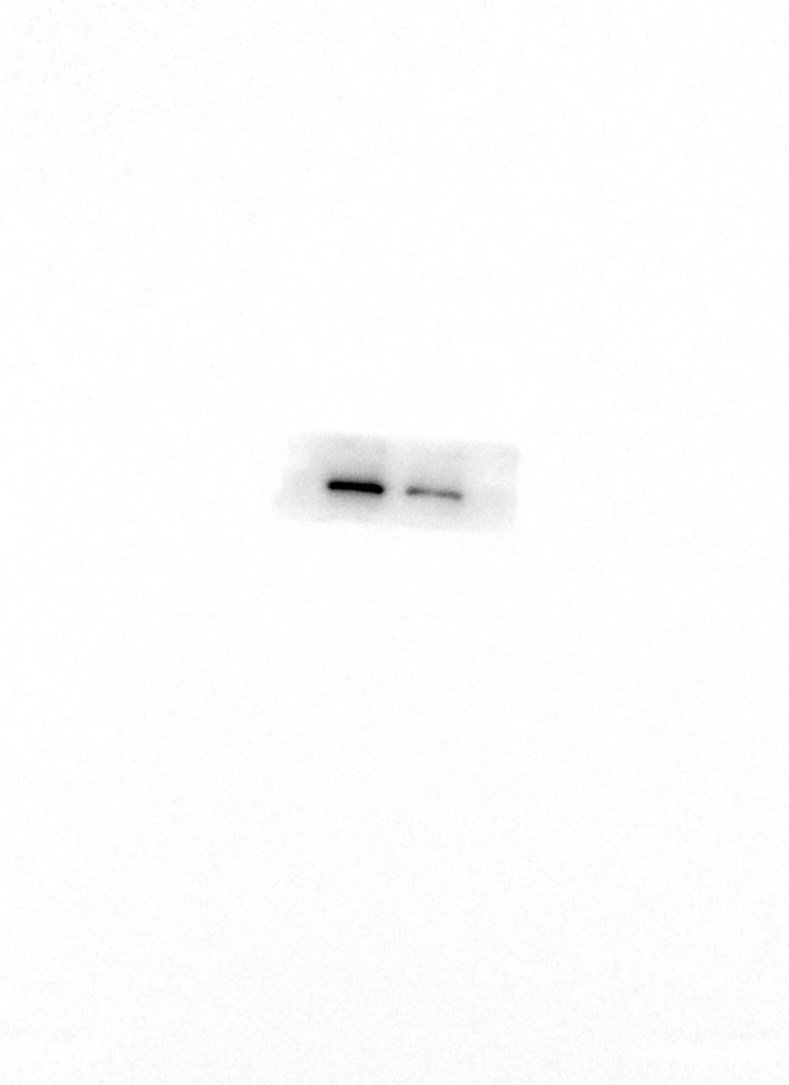
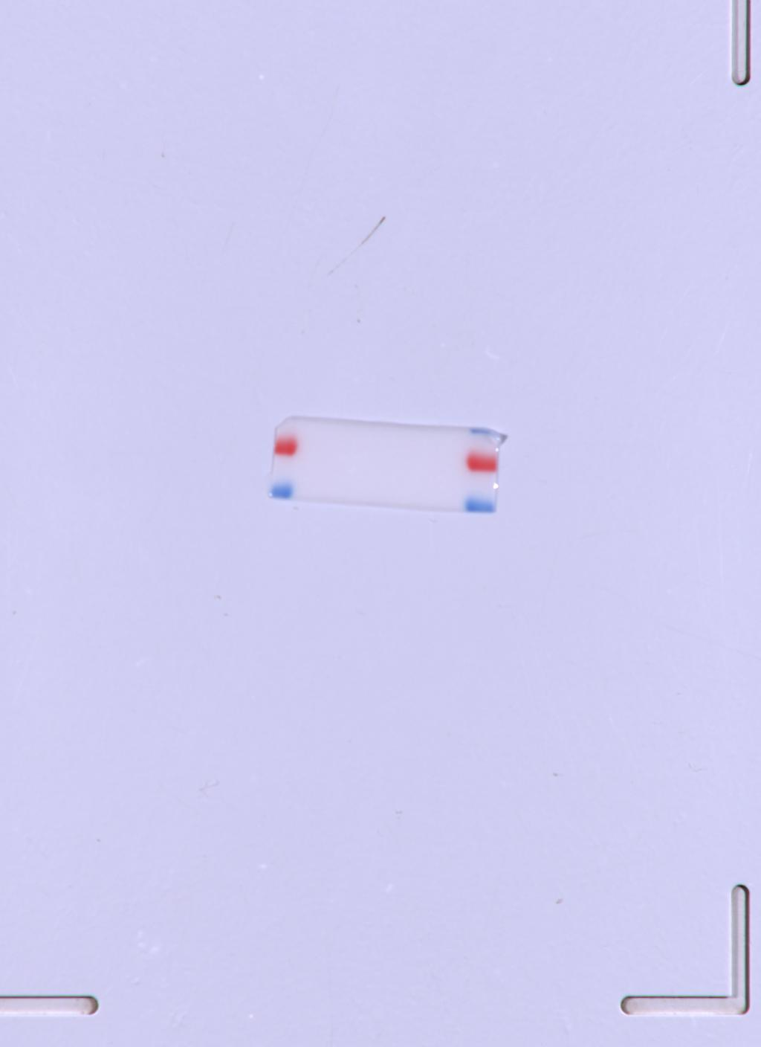

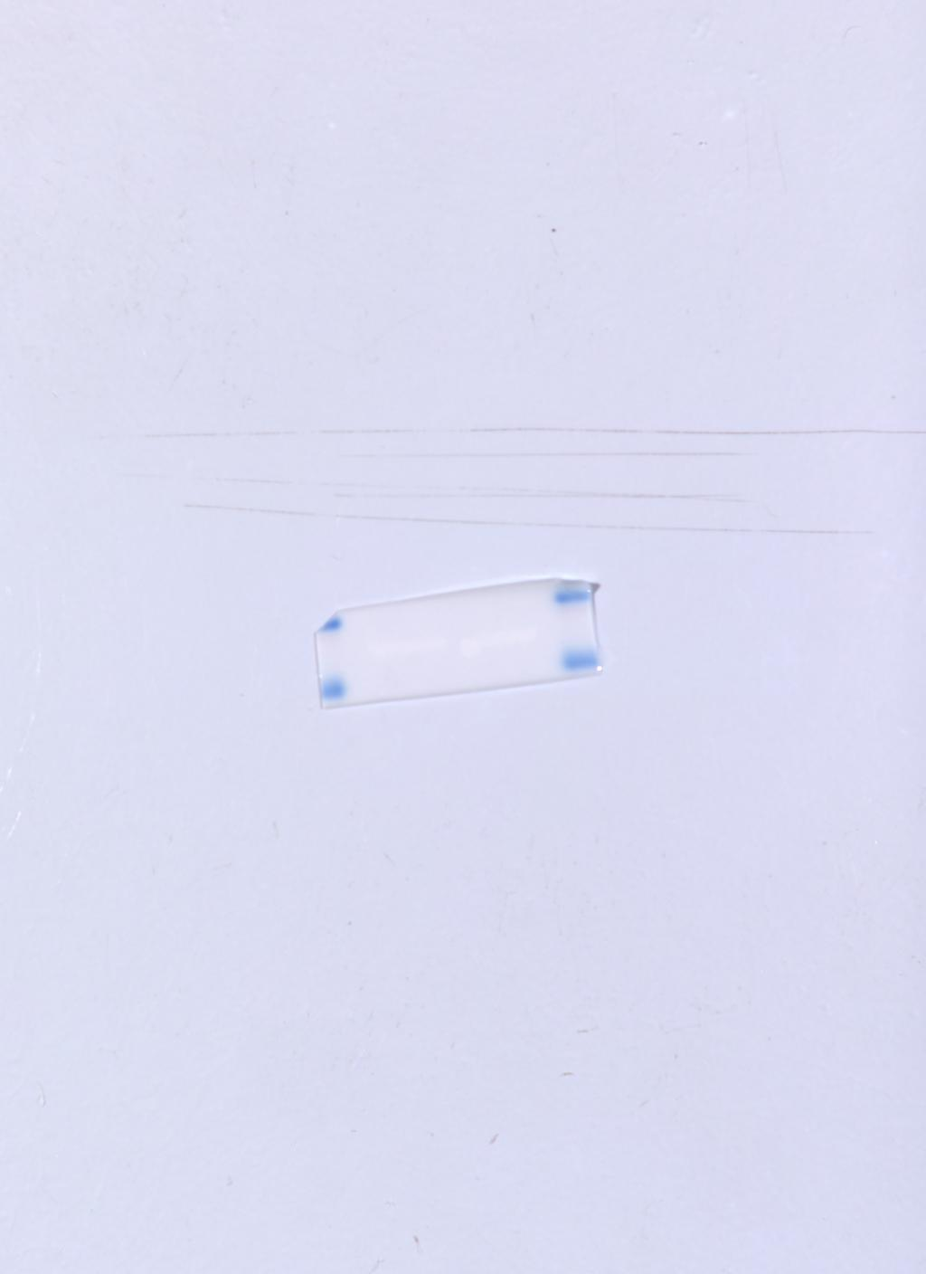
Figure 2C BT-549
BT-549 CDC73
BT-549 CDC73 M
BT-549 GADPH
BT-549 GADPH M

Slide 2
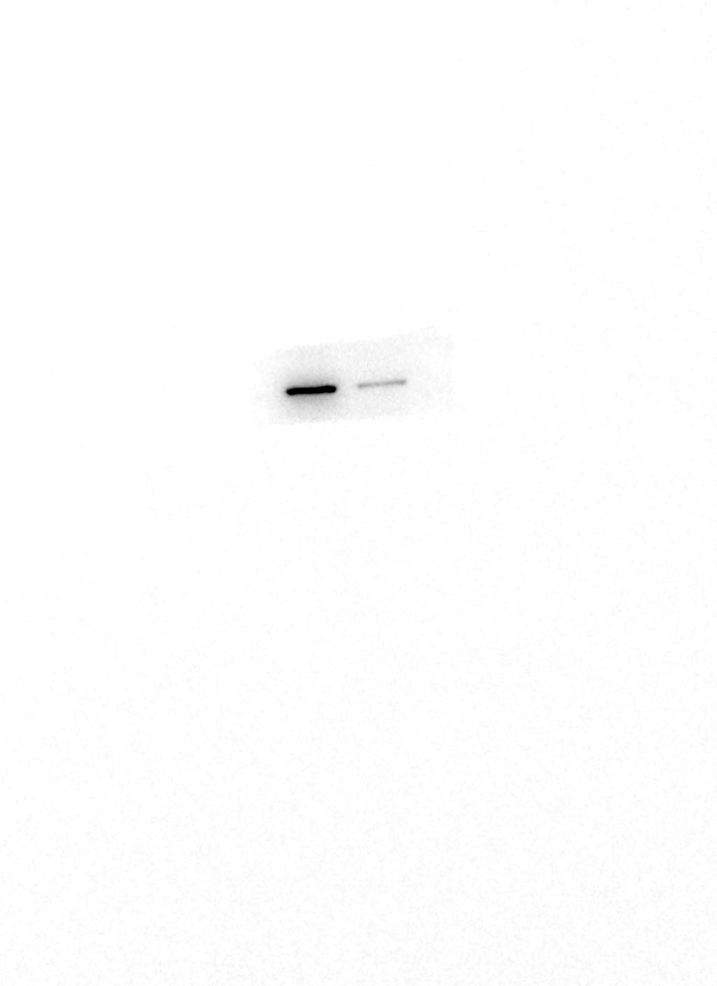
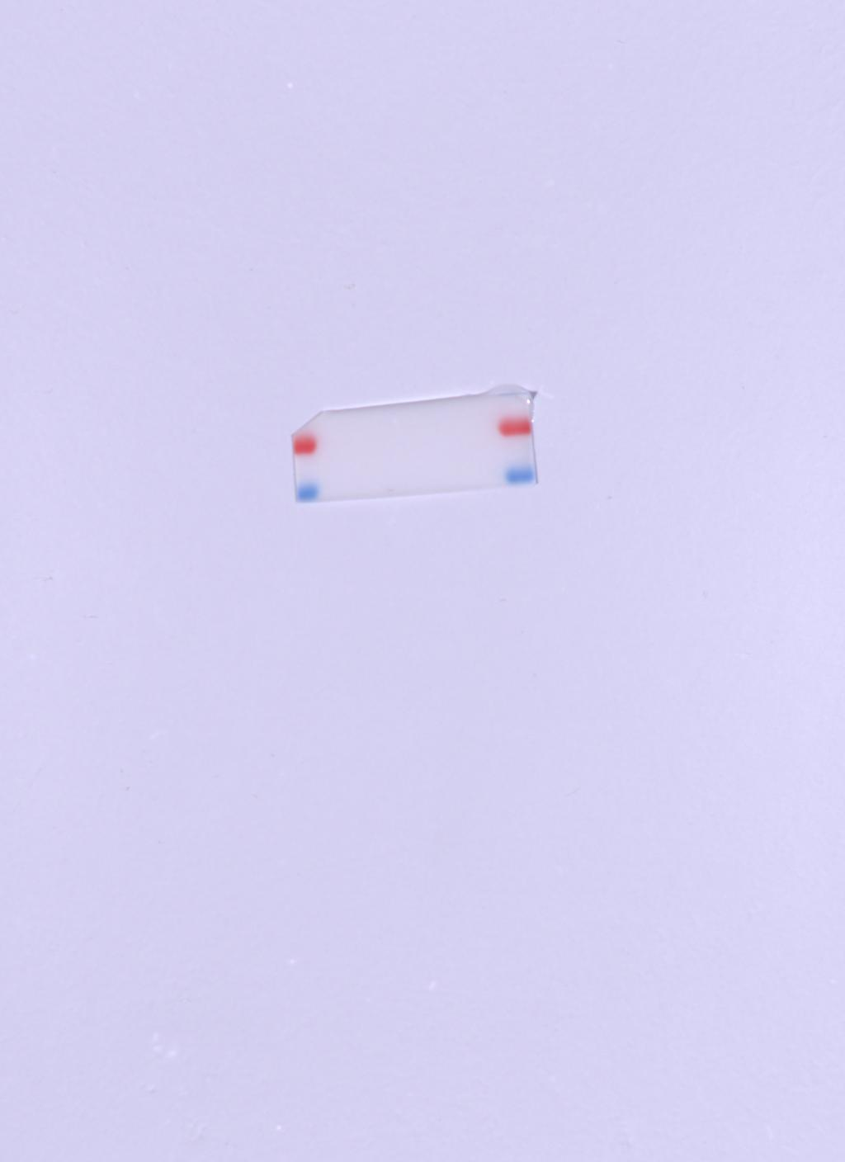
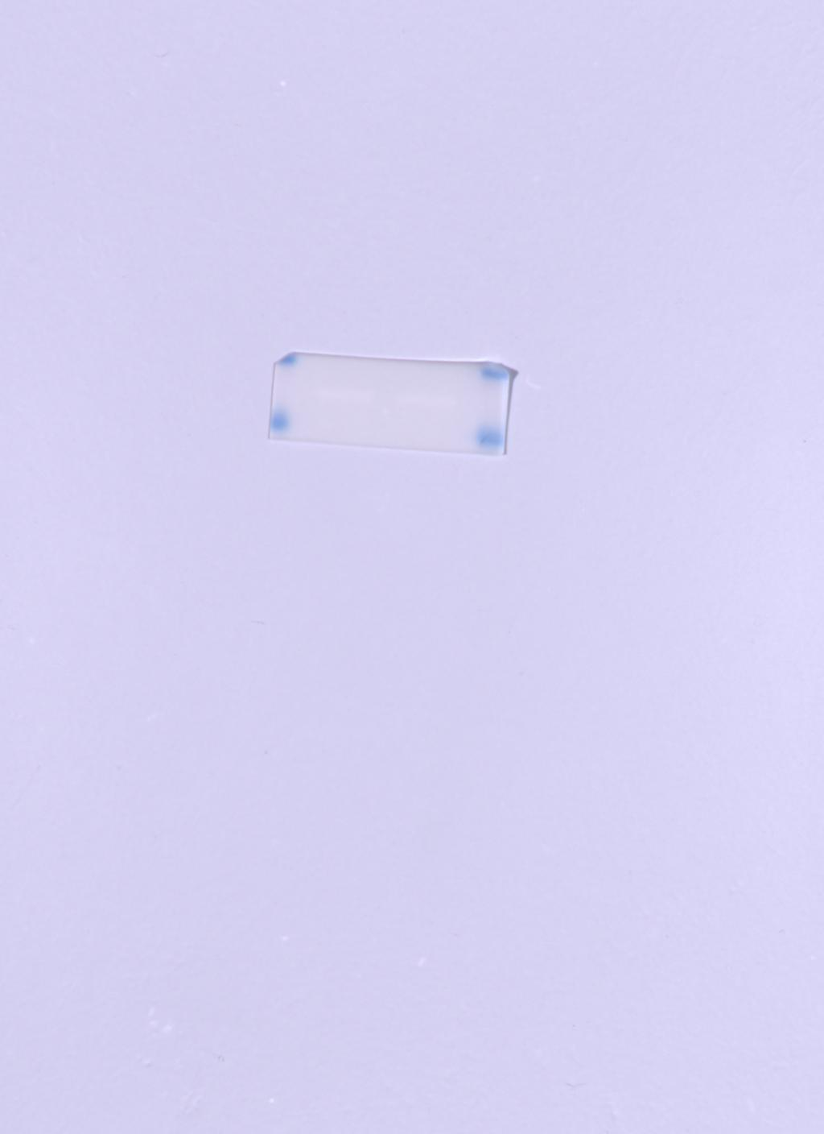
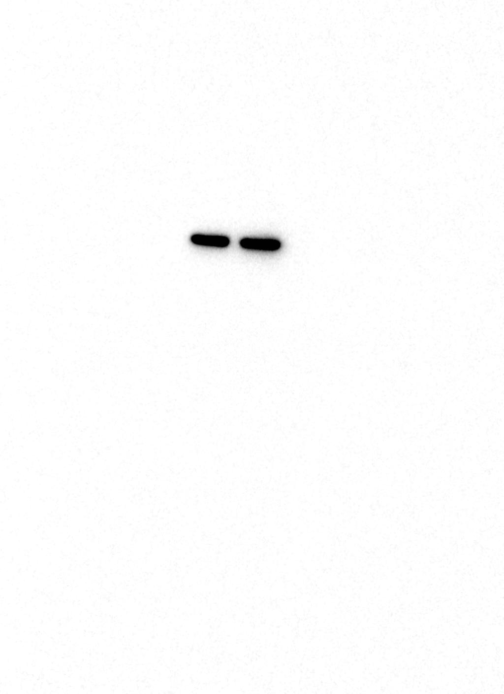
Figure 2C MDA-MB-231
MDA-MB-231 CDC73
MDA-MB-231 CDC73 M
MDA-MB-231 GAPDH
MDA-MB-231 GAPDH M

Slide 3
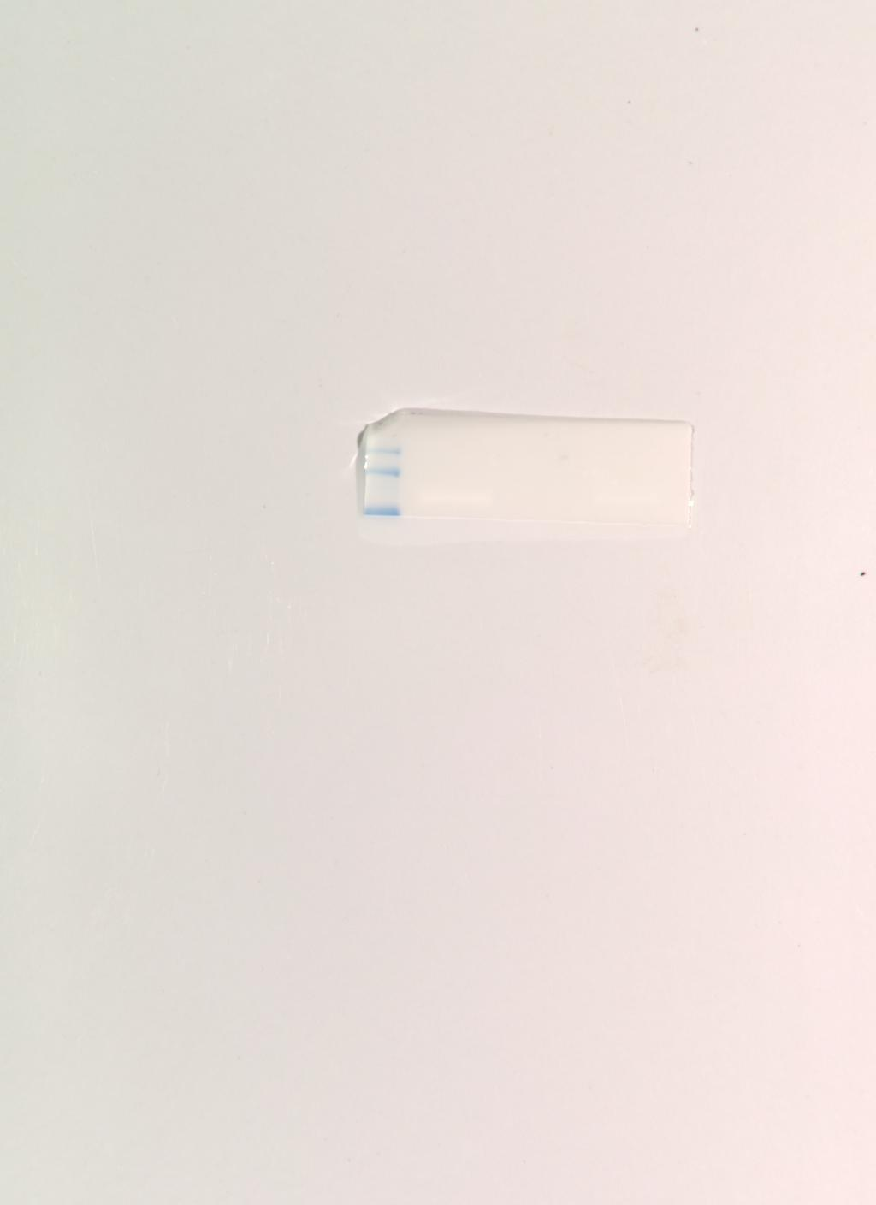
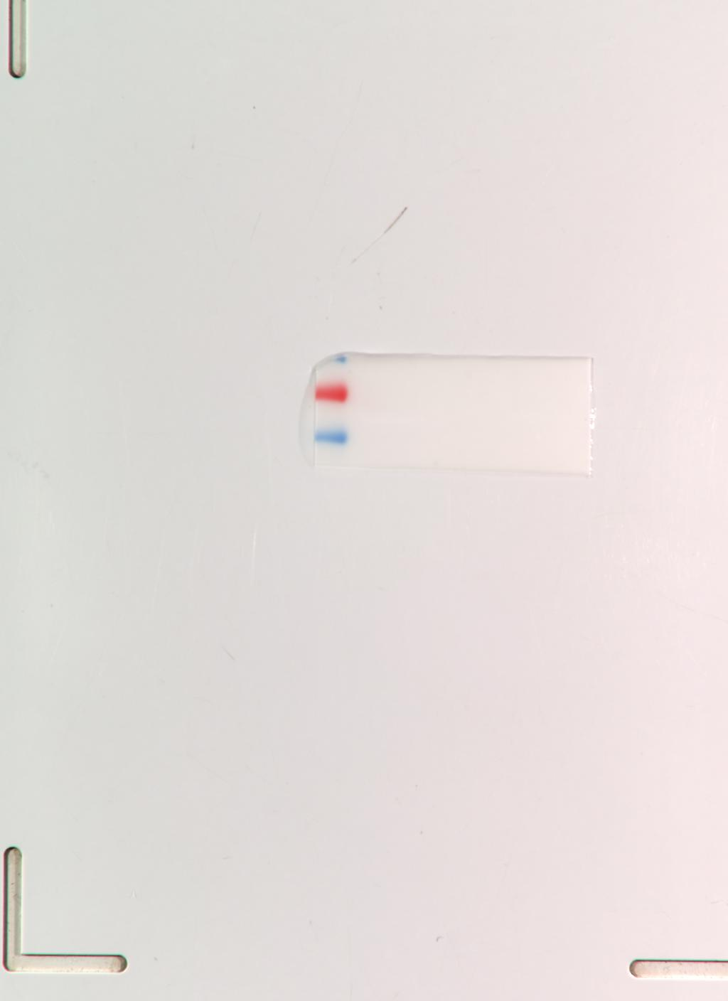


Figure 3C
CBL
CBL M
CDC73
CDC73 M

Slide 4



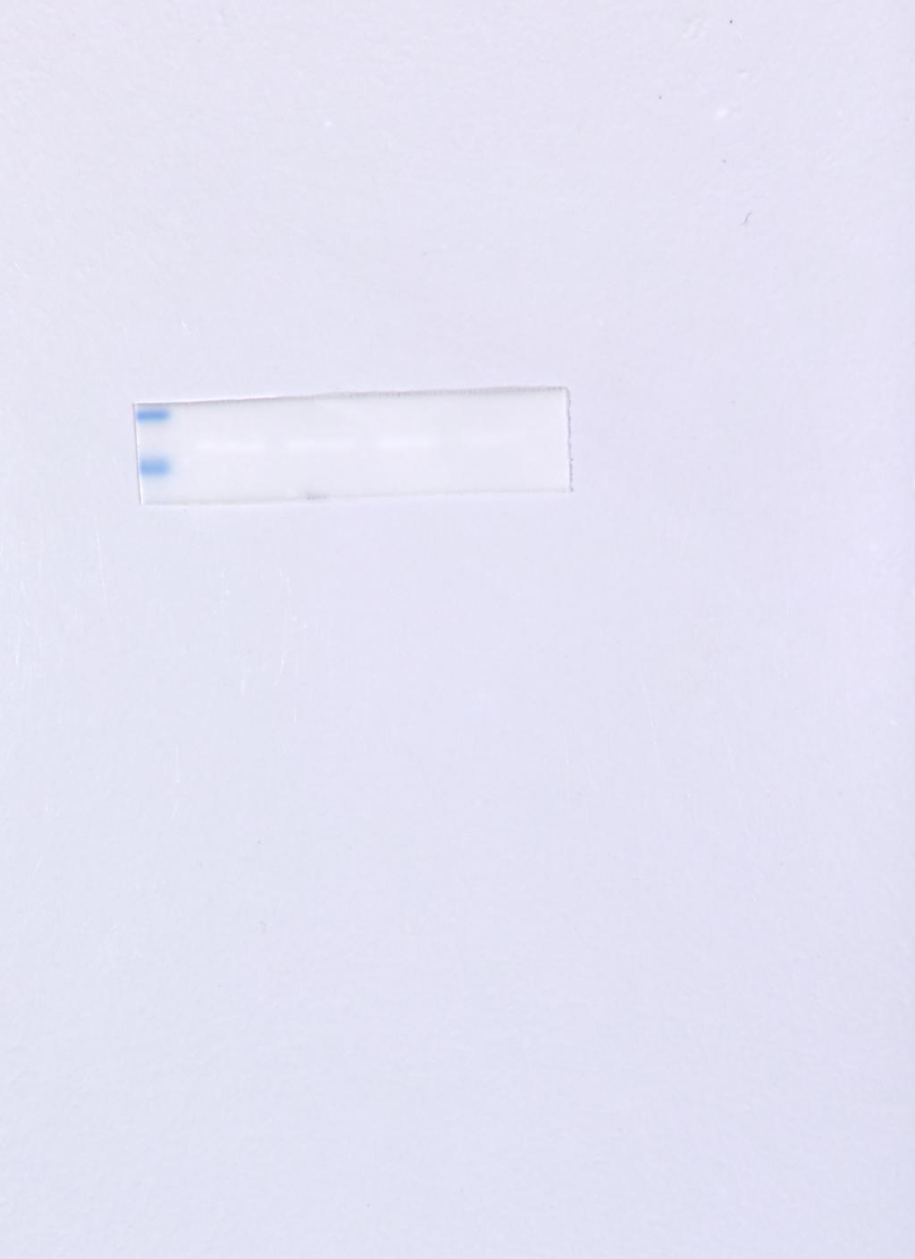
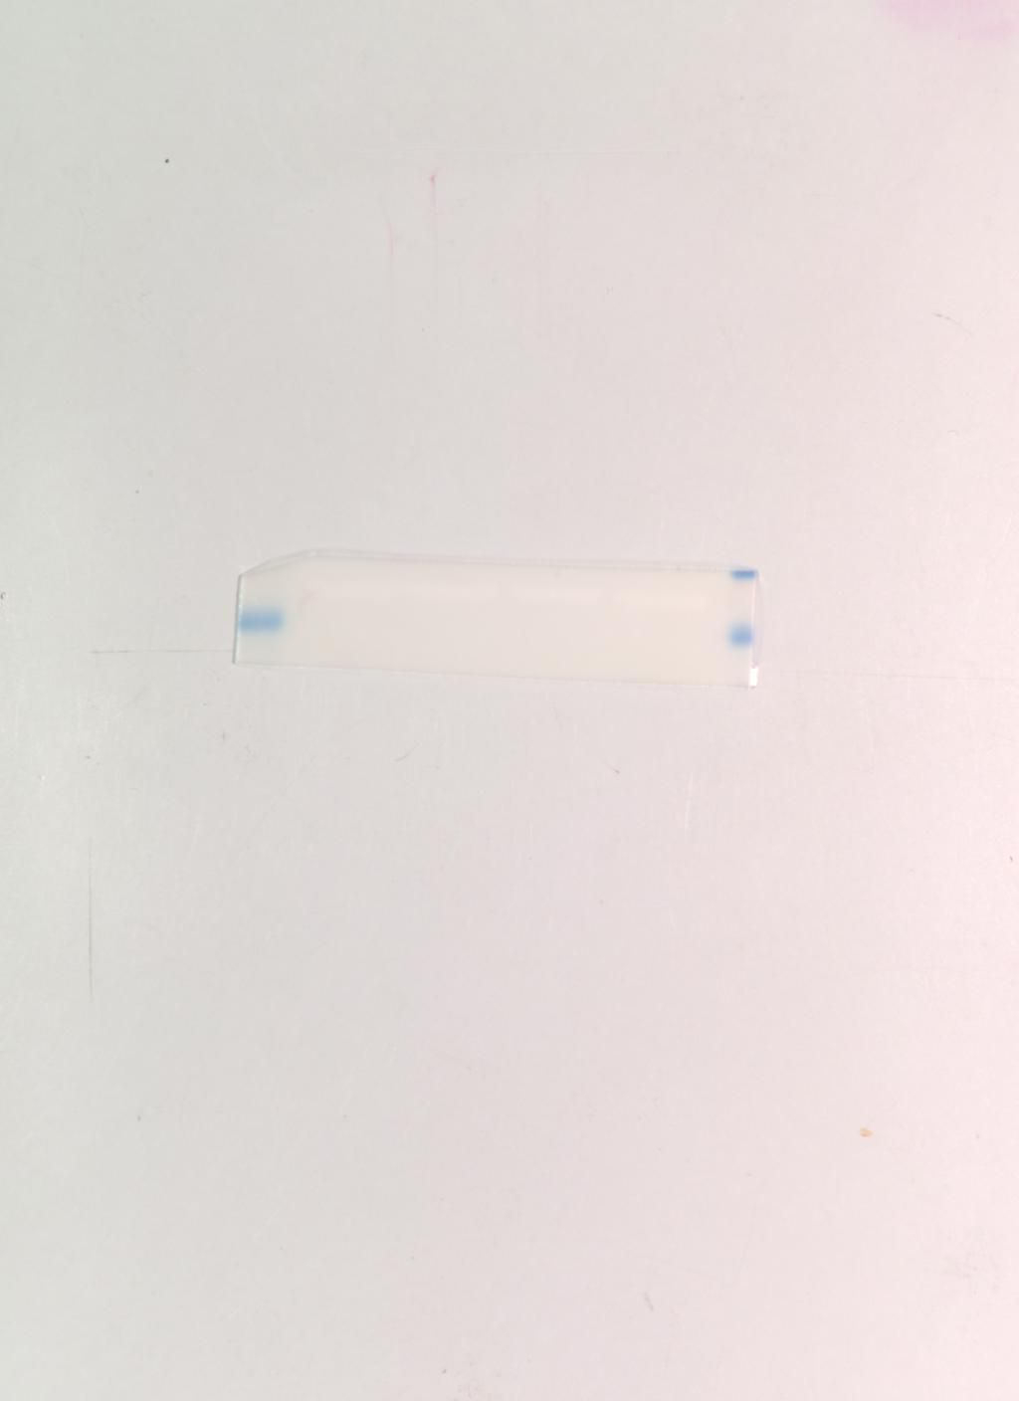
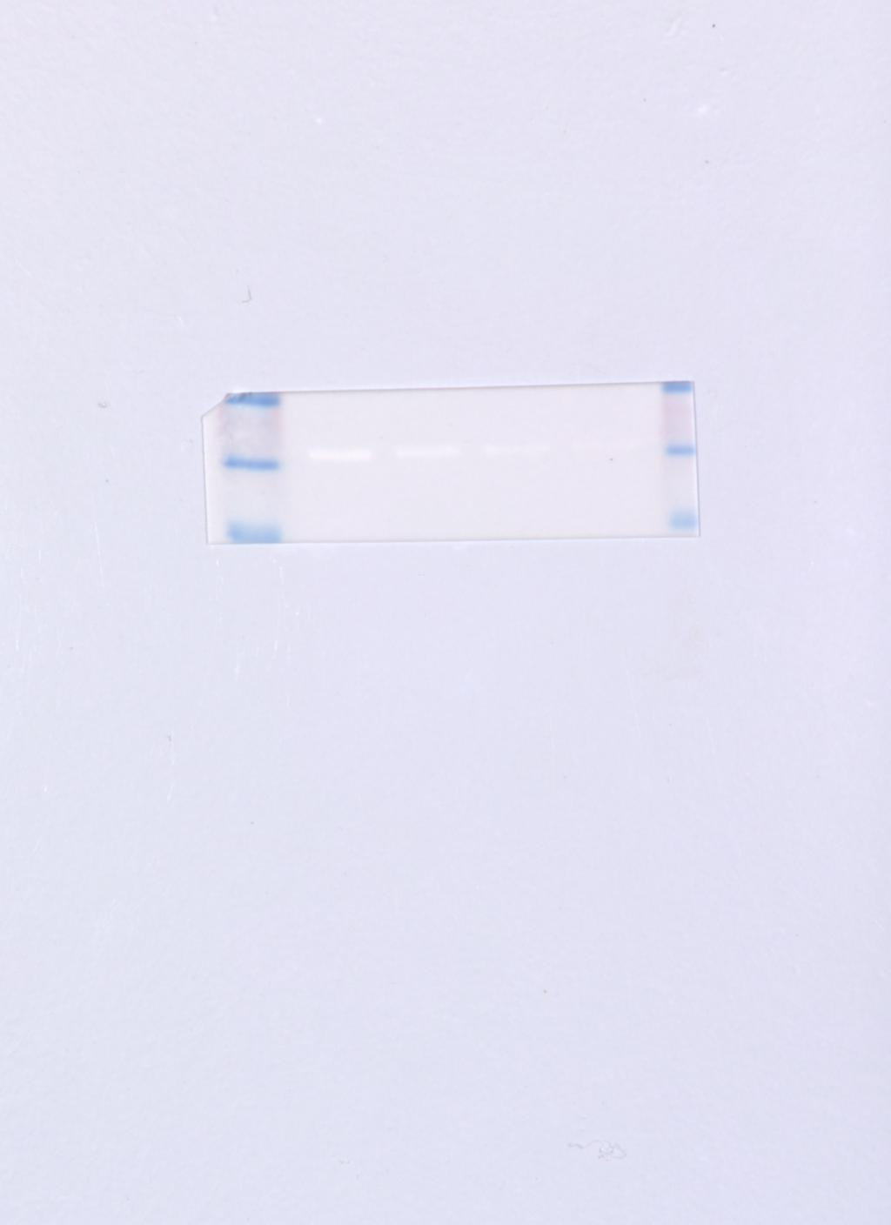
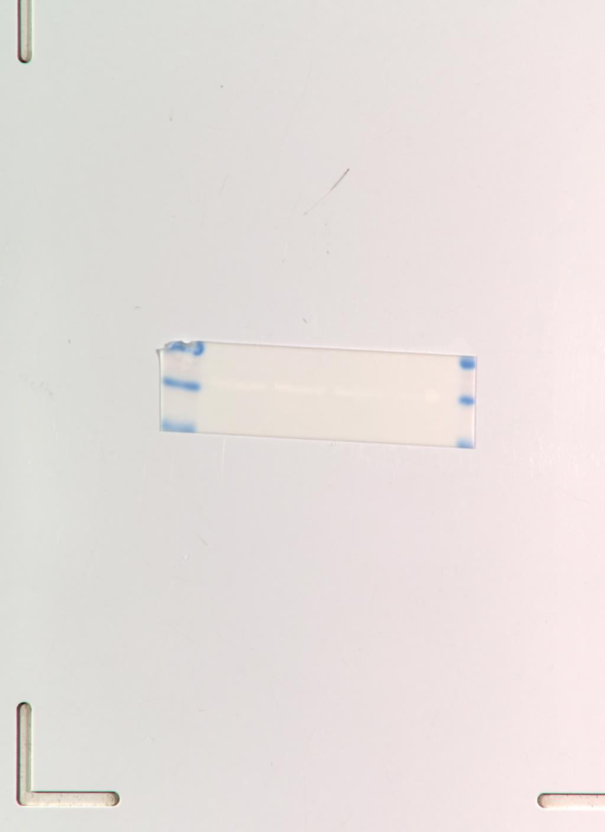
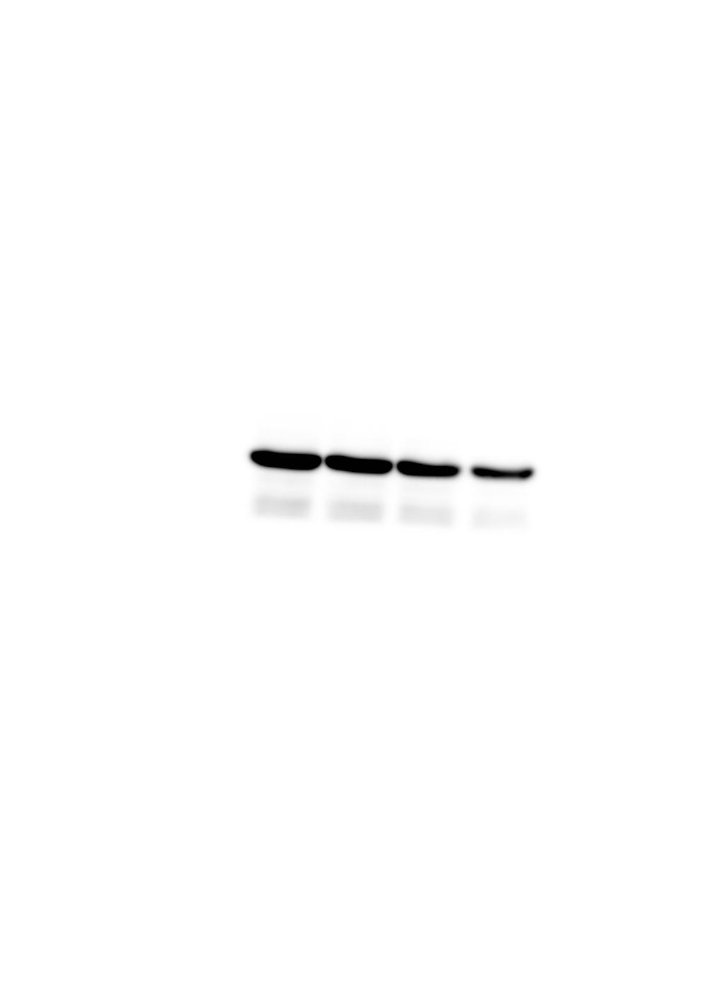
Figure 3E CBL
GAPDH KD
GAPDH M KD
GAPDH M NC
GAPDH NC
MAPK1 KD
MAPK1 KD M
MAPK1 M NC
MAPK1 NC

Slide 5

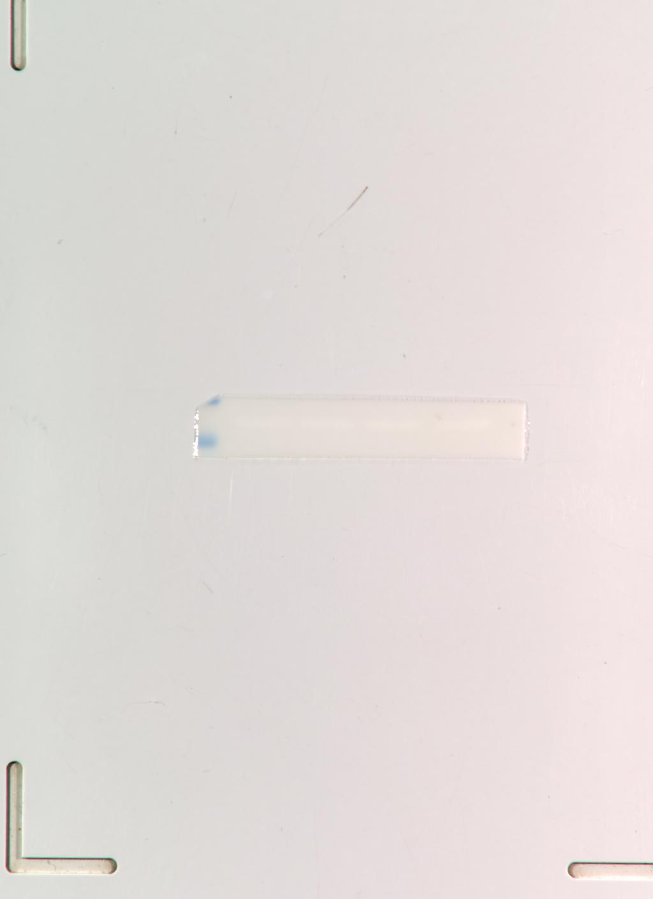
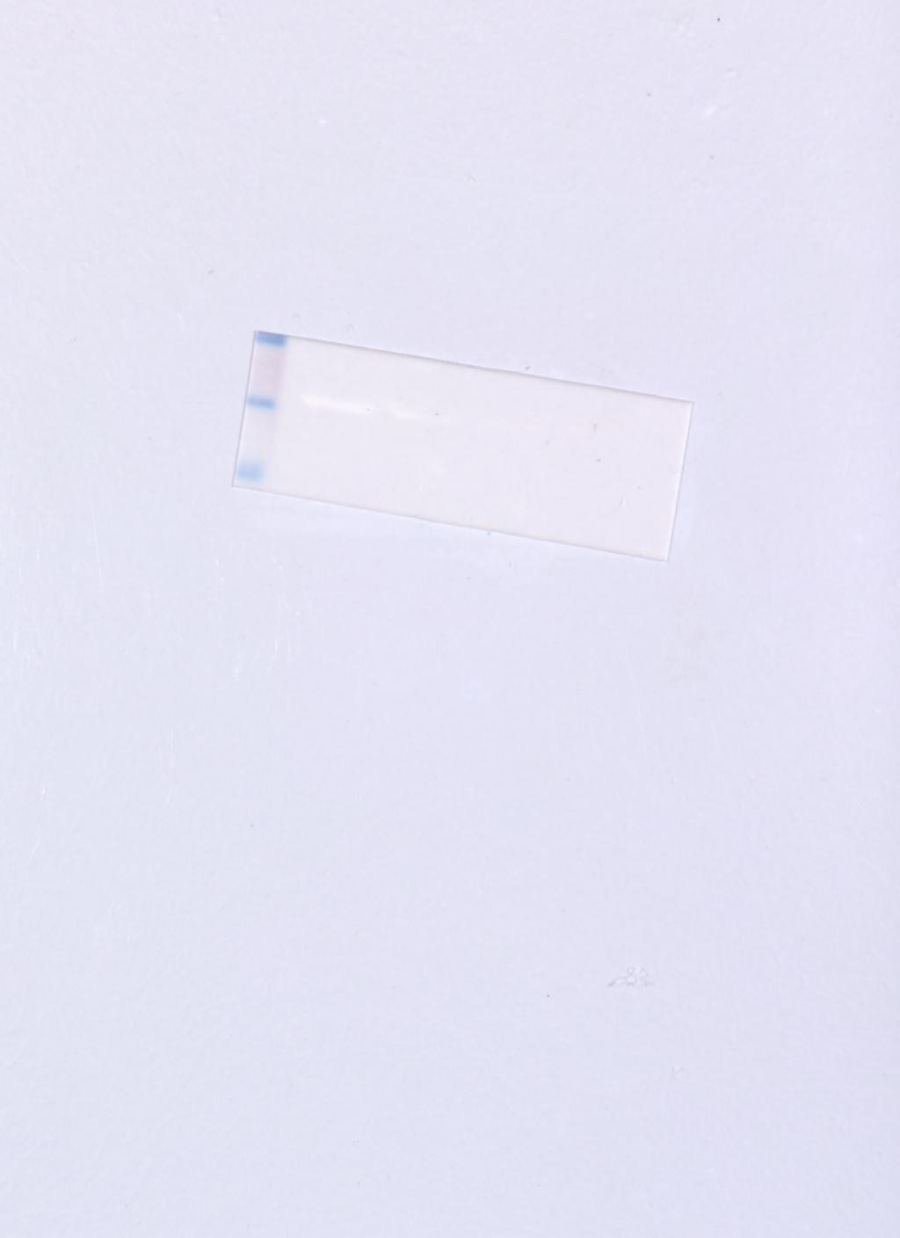
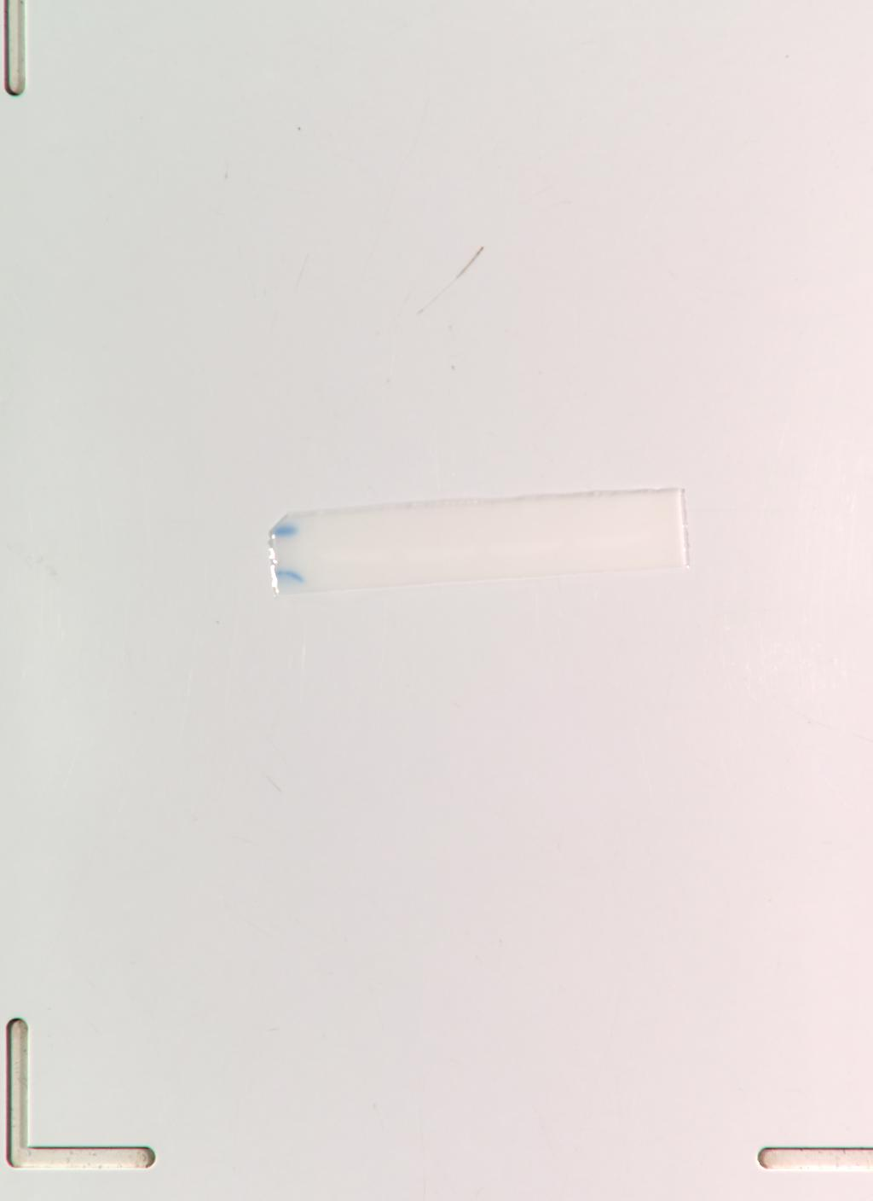

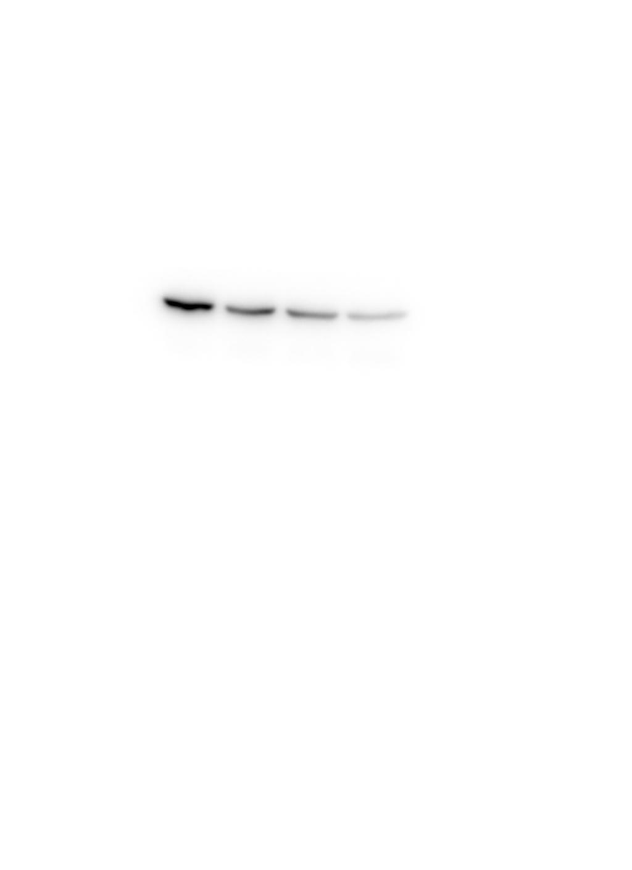
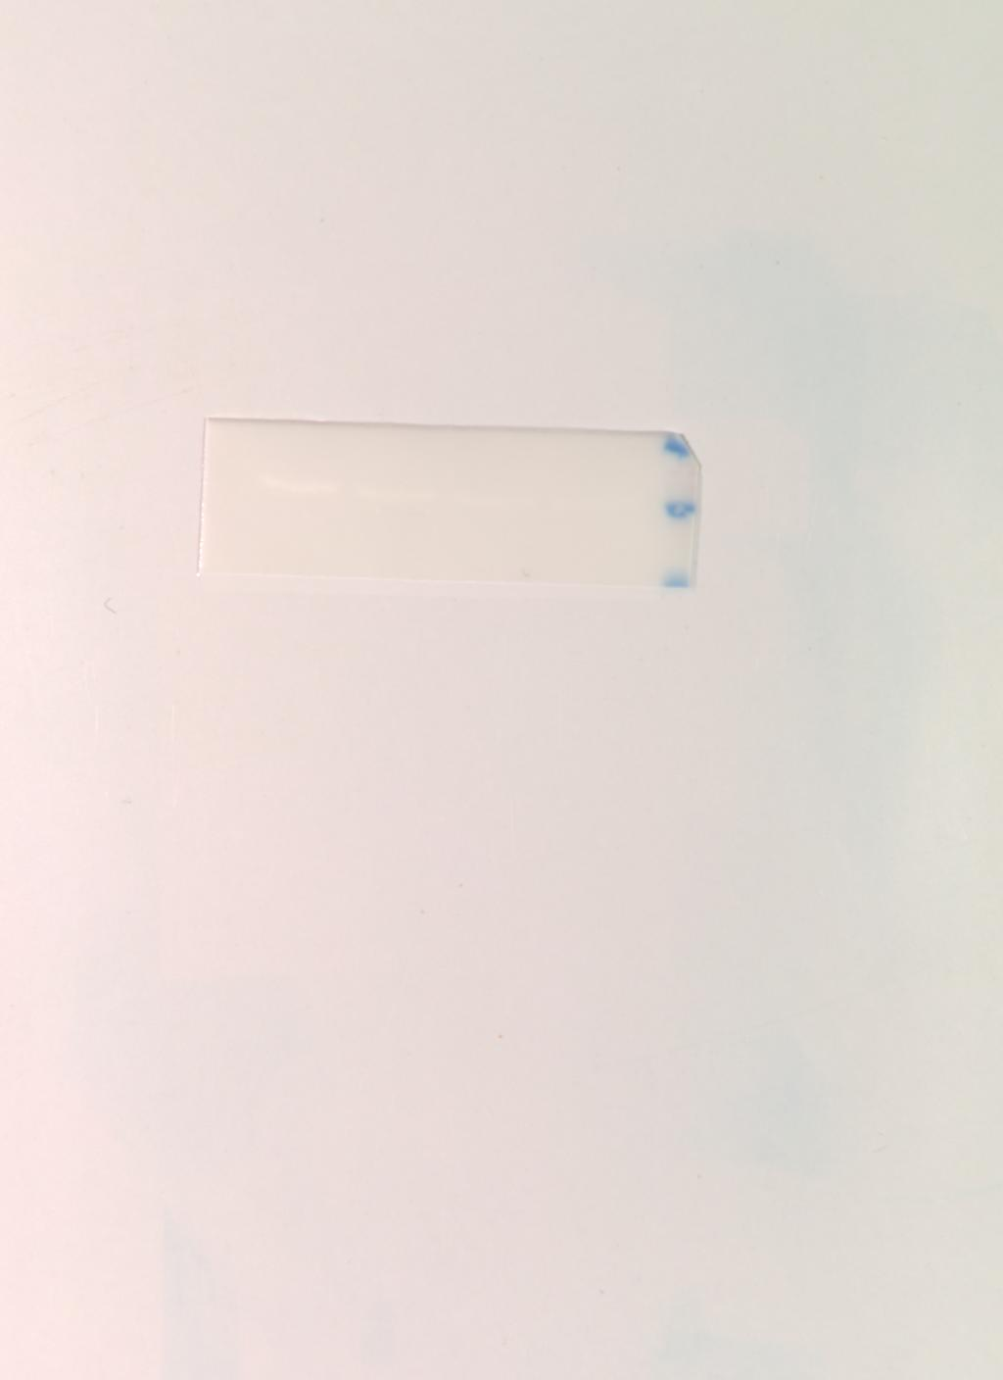

Figure 3E shCDC73
GAPDH KD
GAPDH M KD
GAPDH M NC
GAPDH NC
MAPK1 KD
MAPK1 KD M
MAPK1 M NC
MAPK1 NC

Slide 6


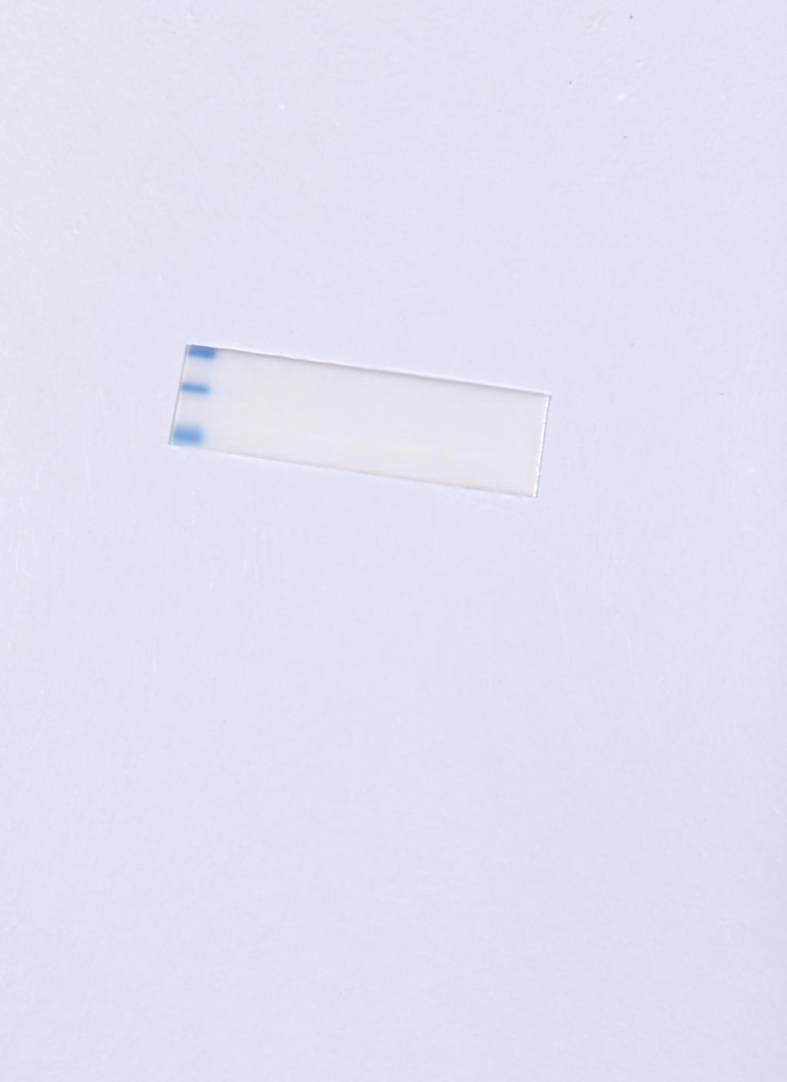
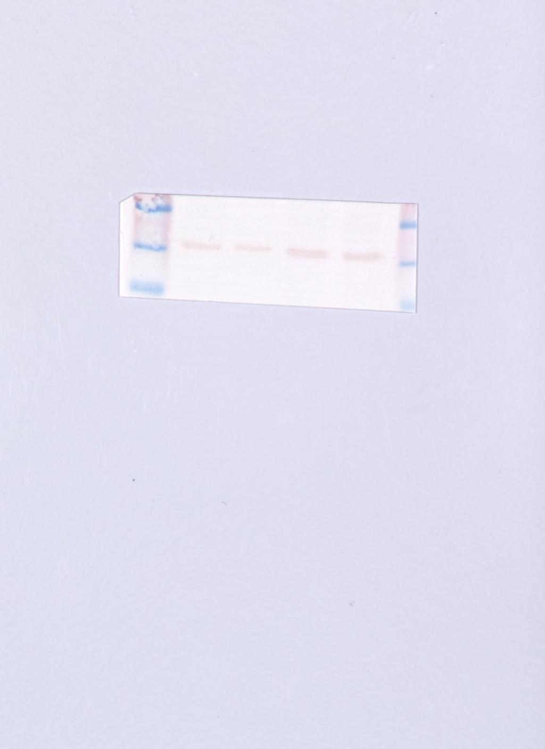
Figure 3F CBL
GAPDH
GAPDH M
MAPK1
MAPK1 M

Slide 7

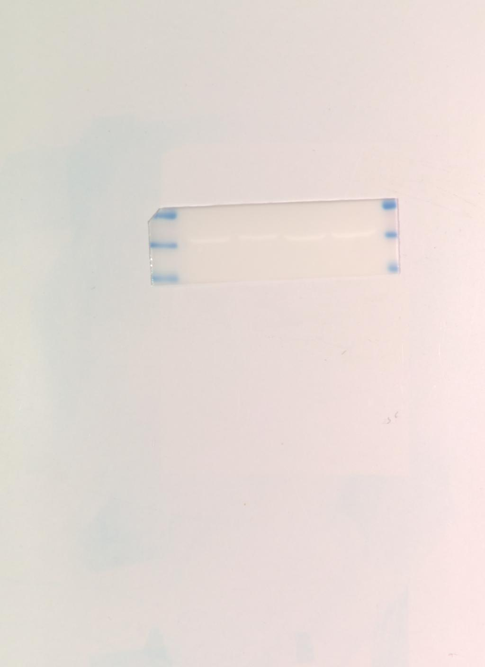
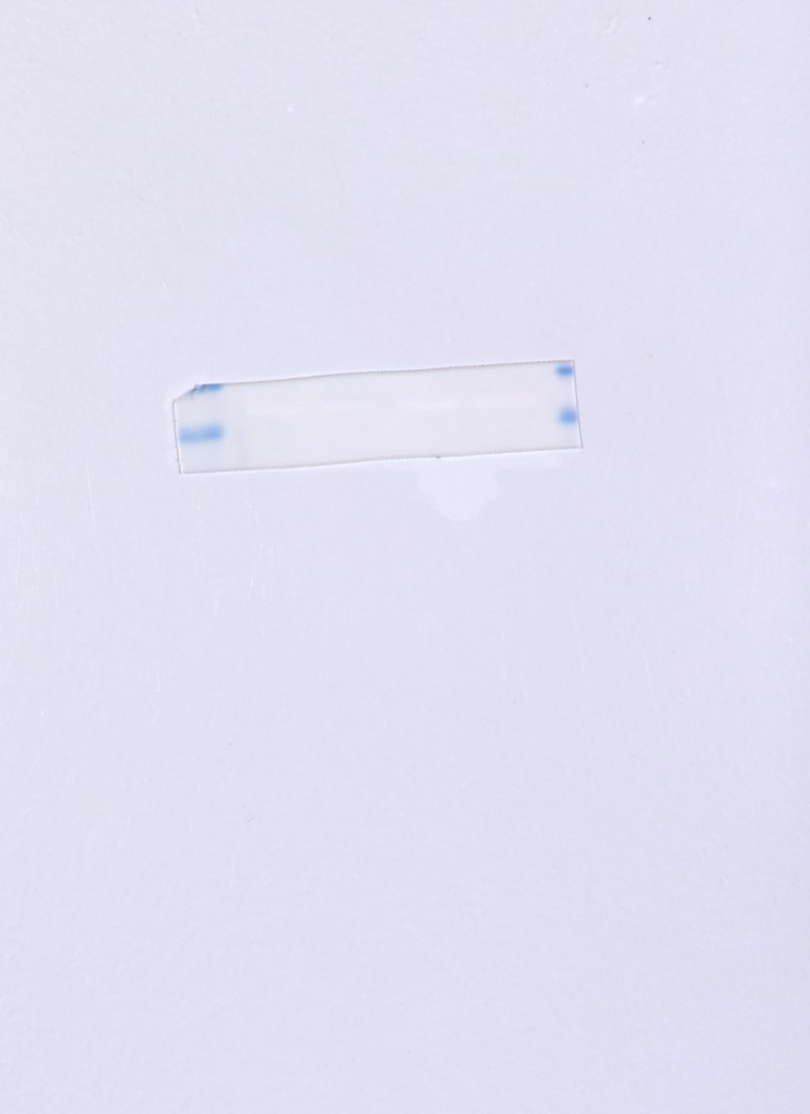
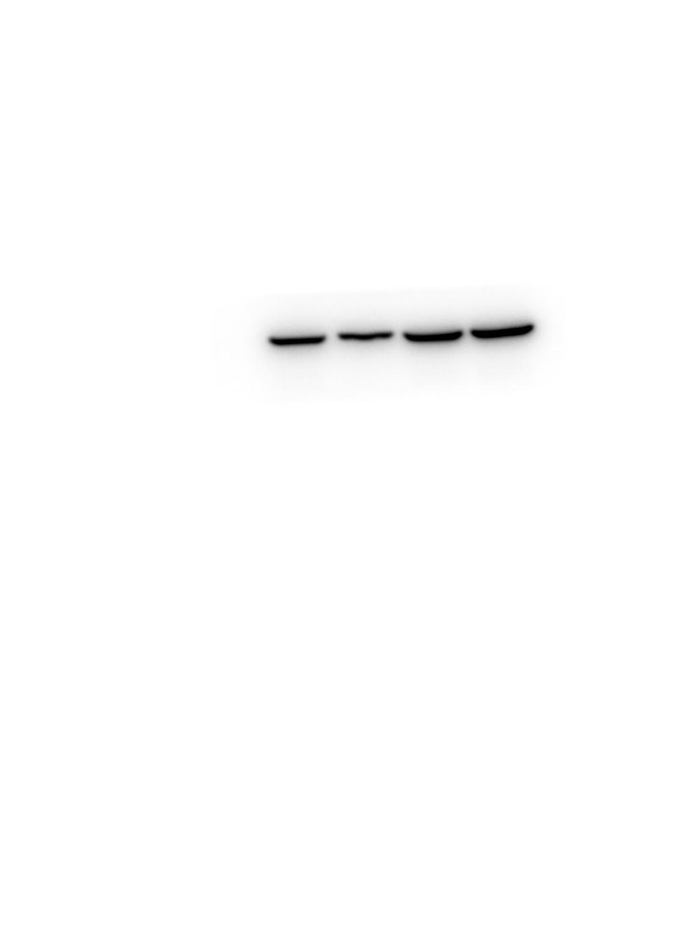
Figure 3F shCDC73
GAPDH
GAPDH M
MAPK1
MAPK1 M

Slide 8
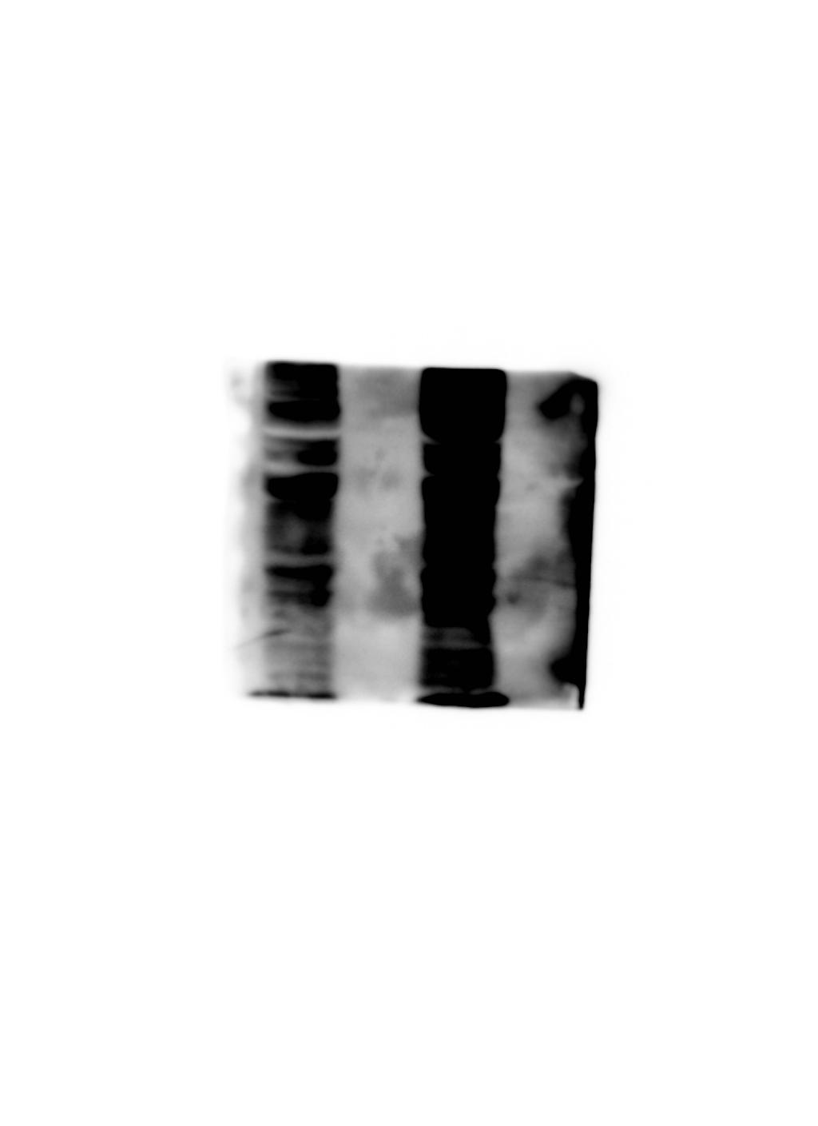
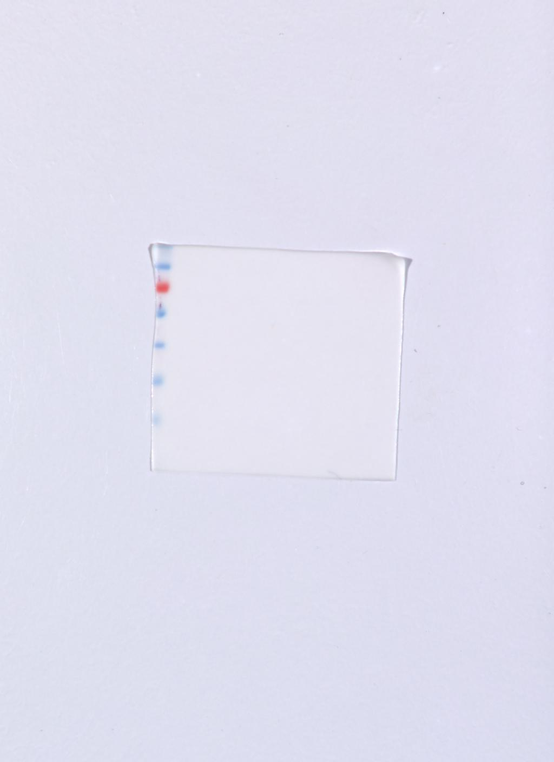
Figure 3G CBL
Ubiquitin
Ubiquitin M

Slide 9
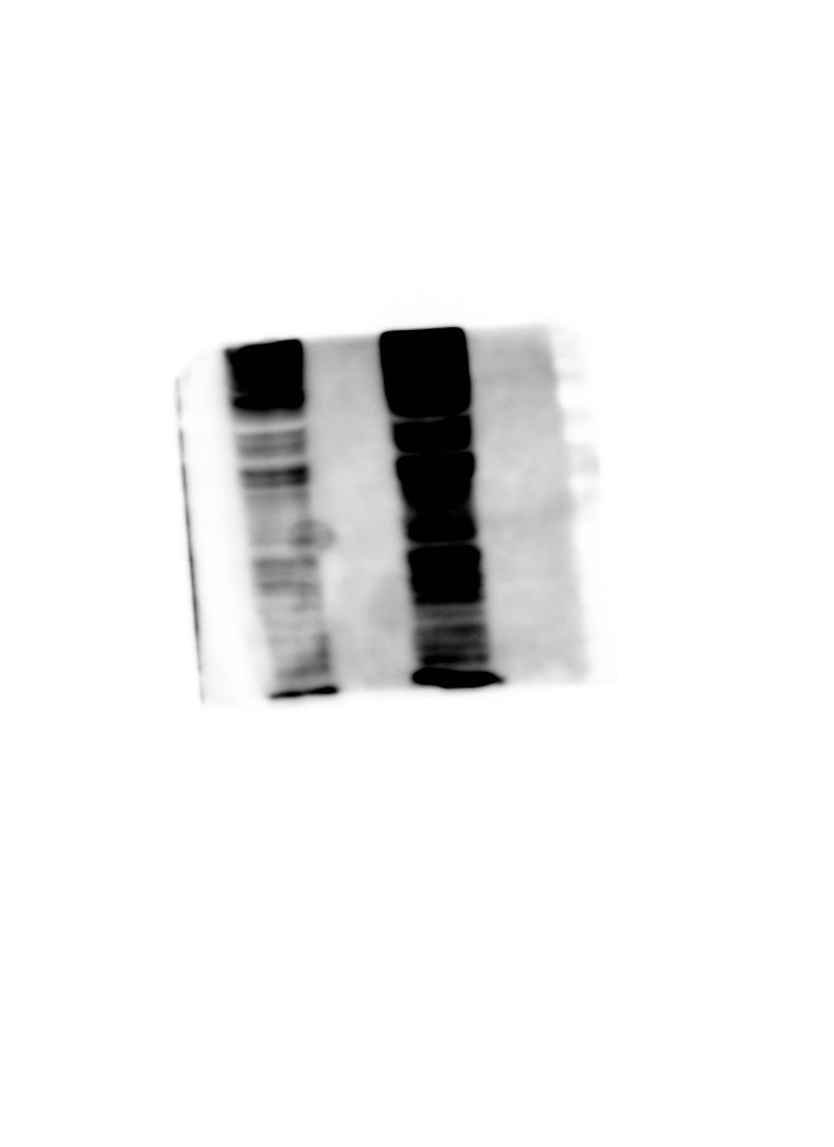
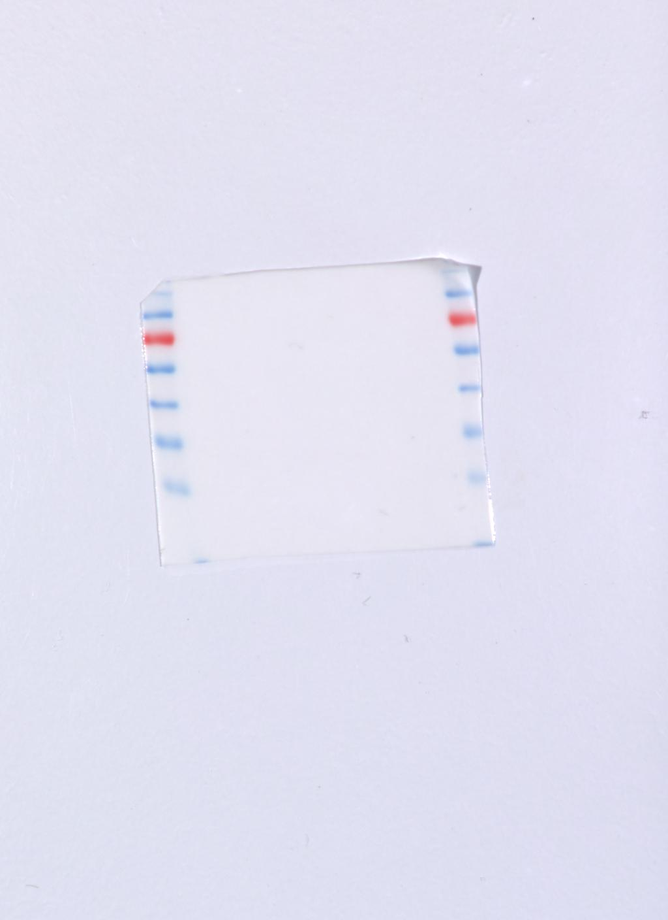
Figure 3G shCDC73
Ubiquitin
Ubiquitin M

Slide 10
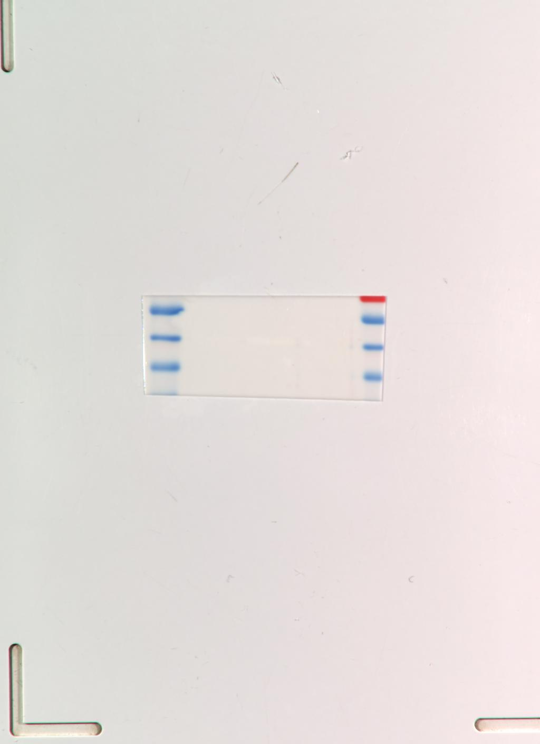

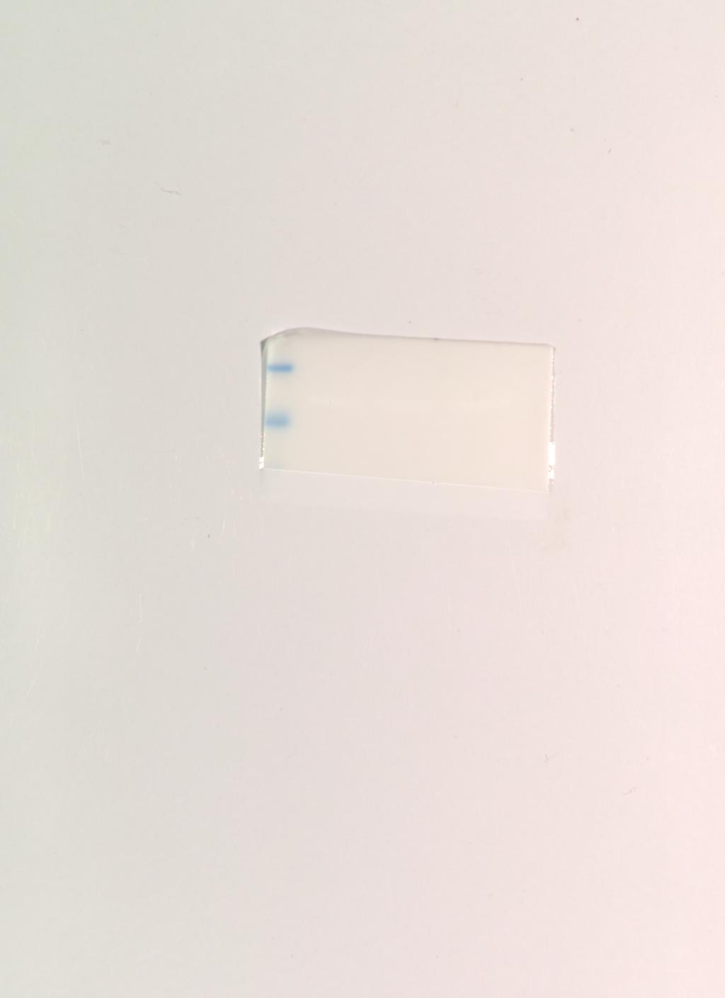

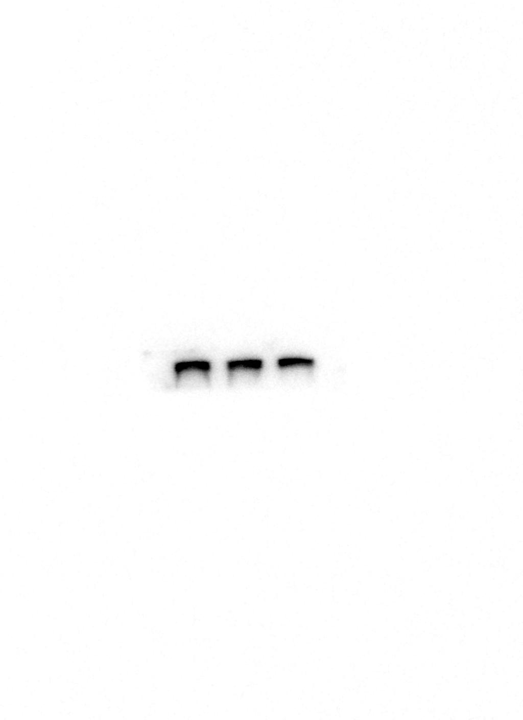
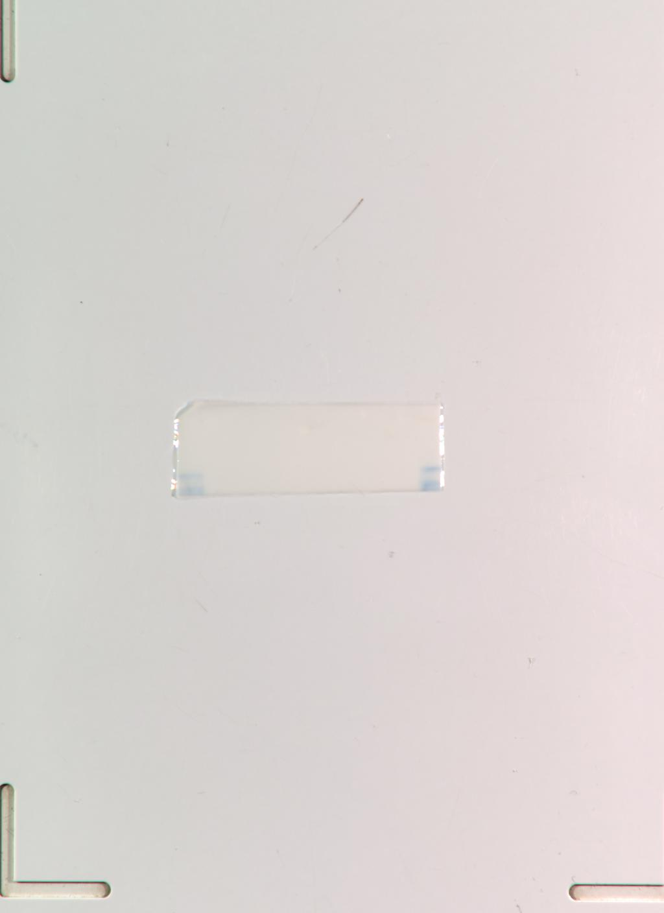
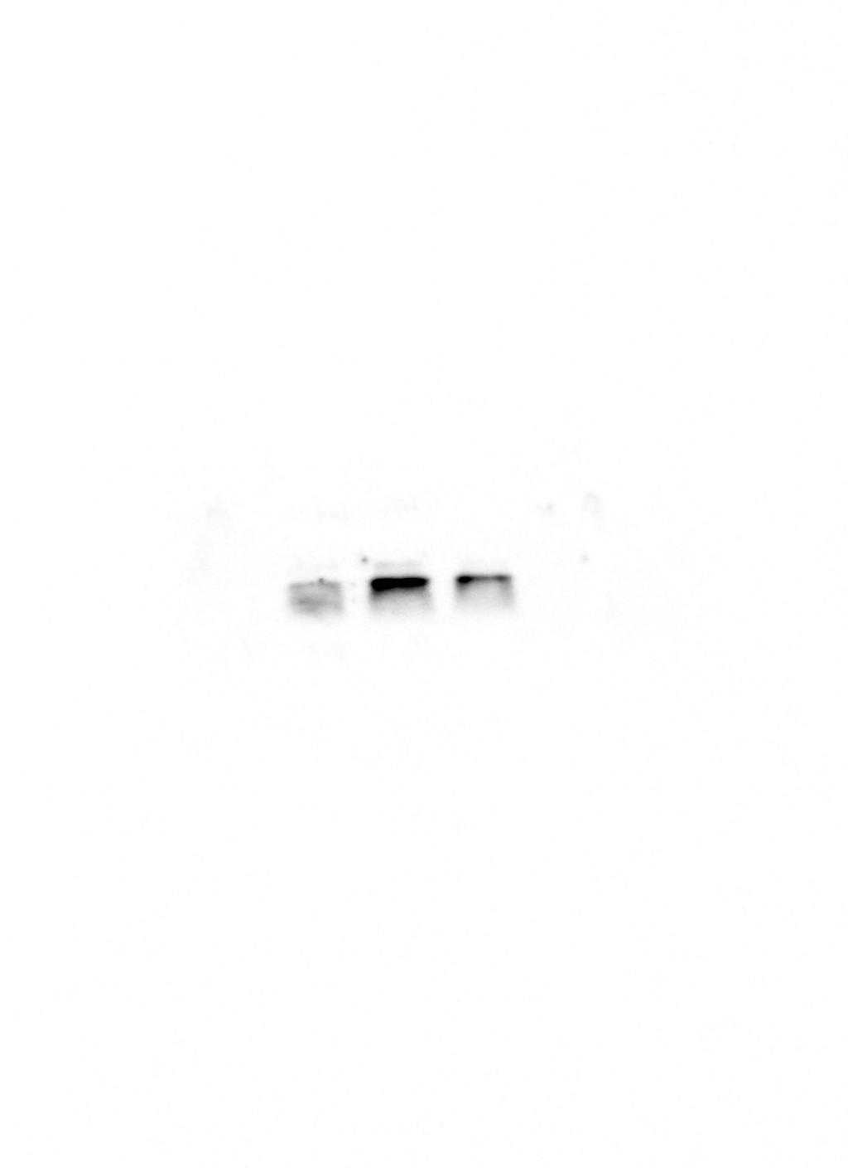
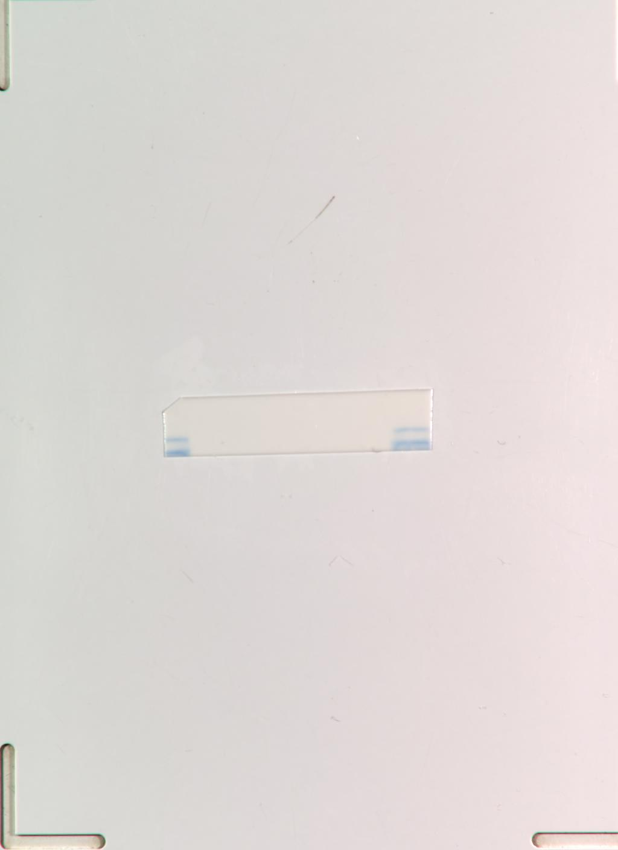
Figure 5A BT549
GAPDH
MAPK1
GAPDH M
MAPK1 M
mTOR
mTOR M
p-Mtor
p-Mtor M

Slide 11

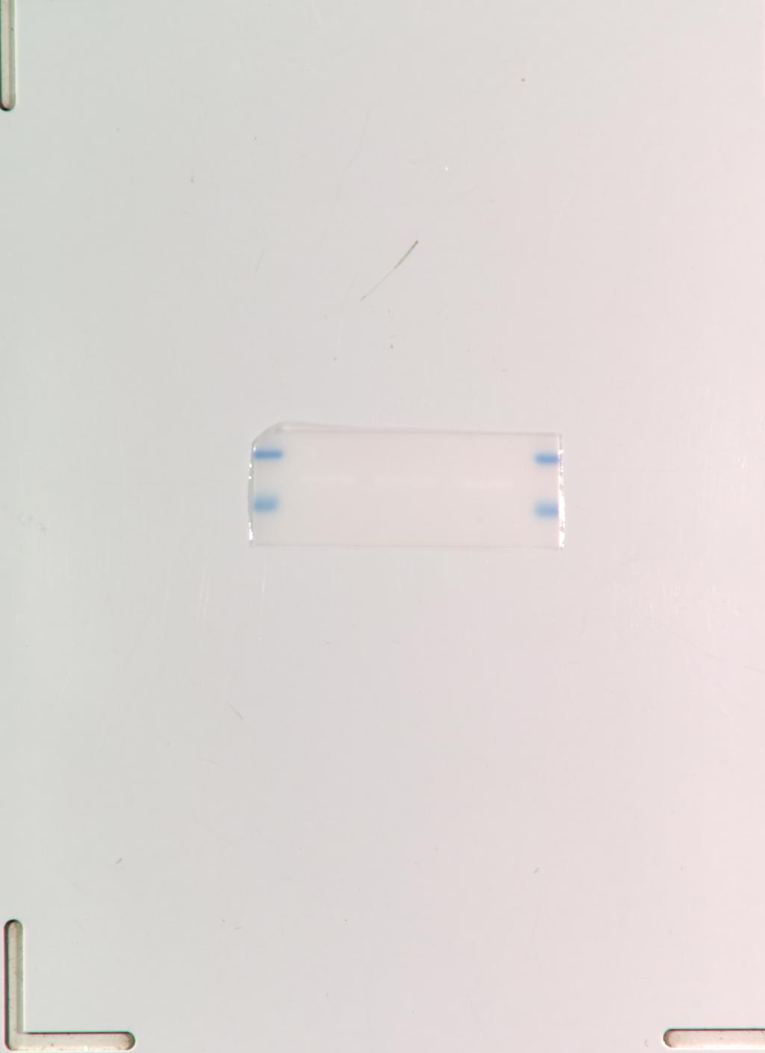
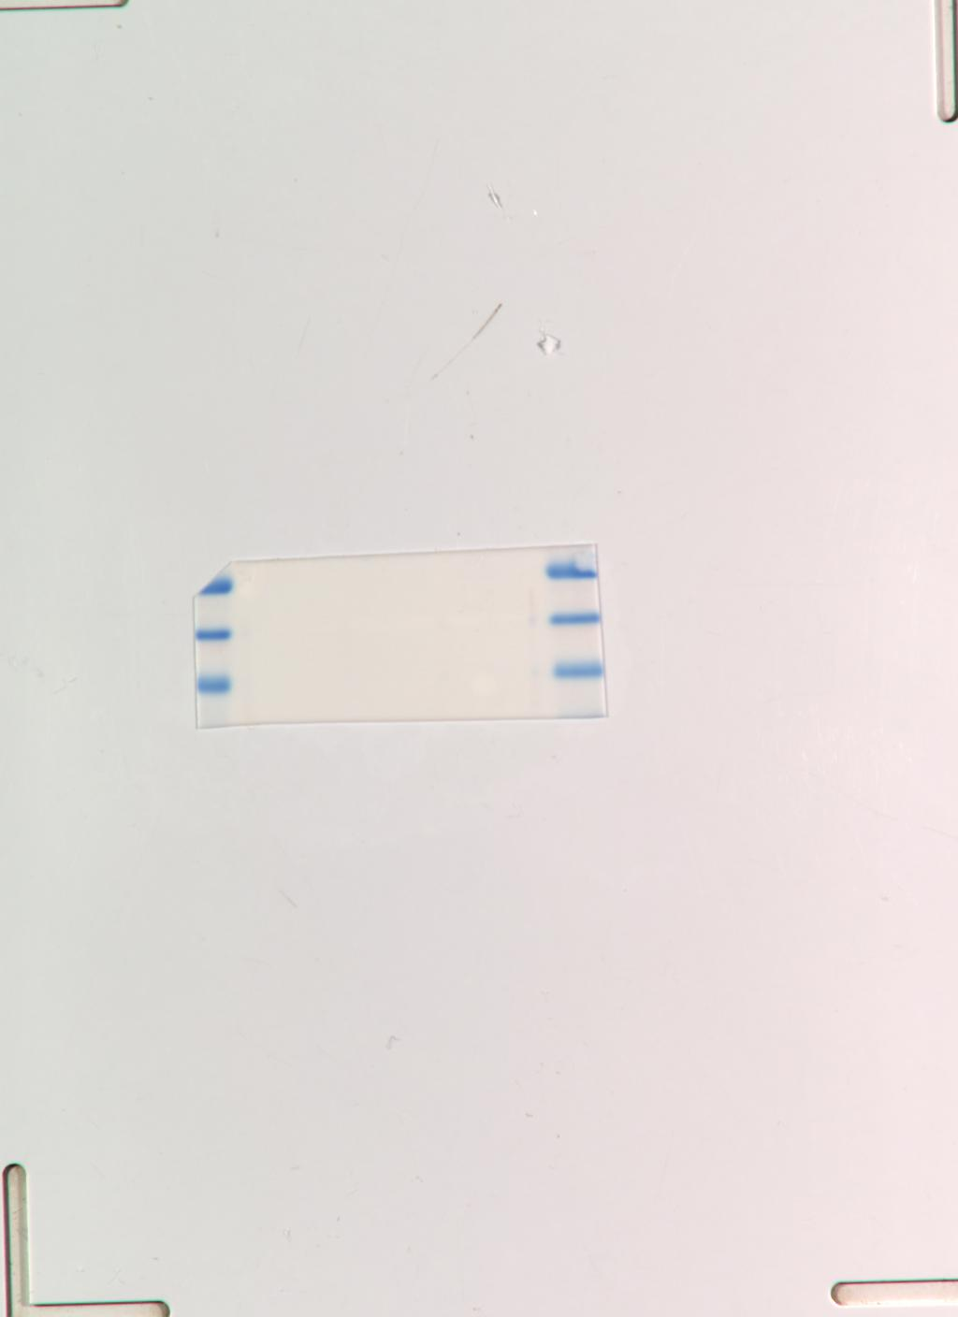



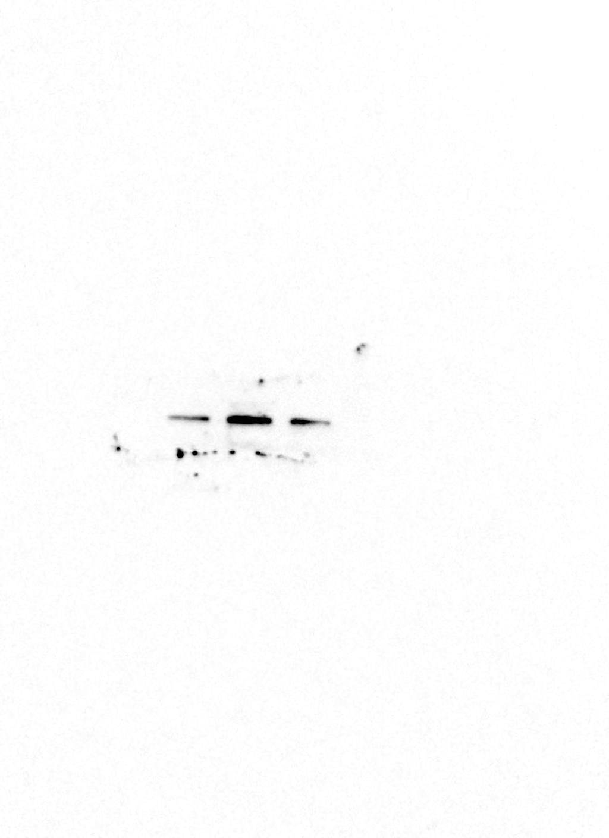
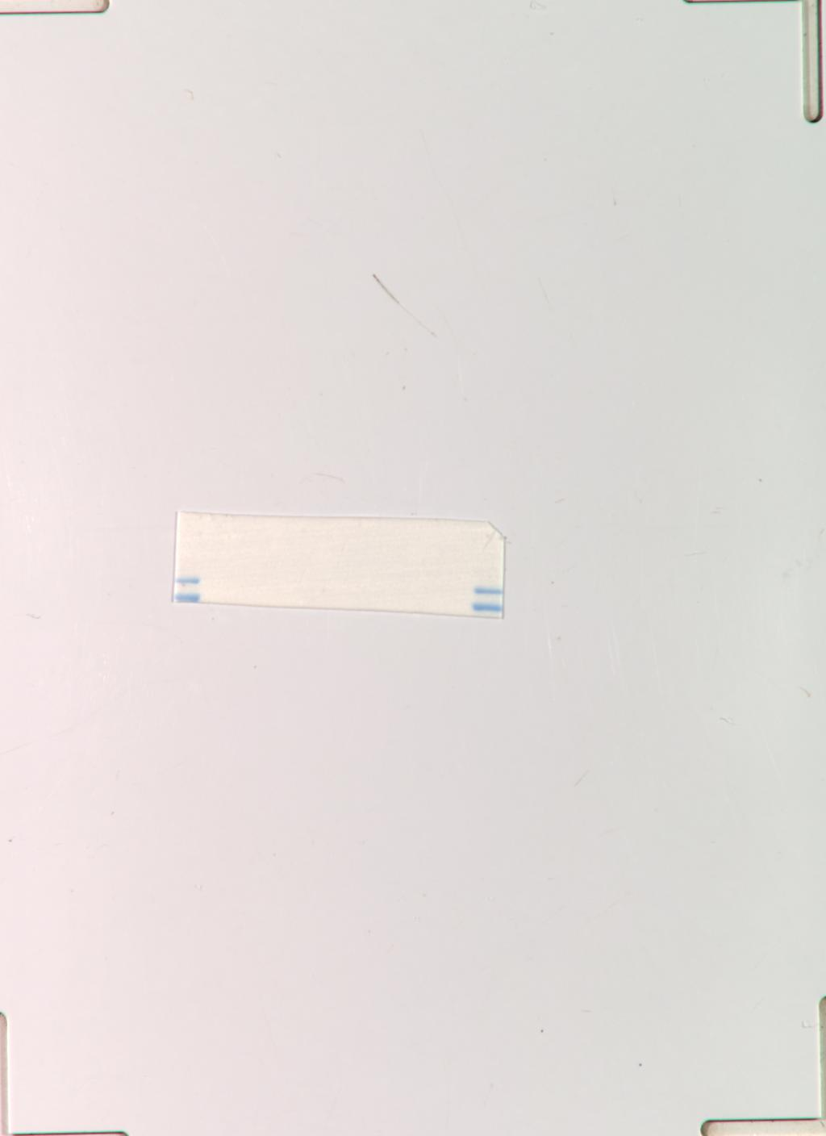
Figure 5A MDA-MB-231
GAPDH
MAPK1
GAPDH M
MAPK1 M
mTOR
mTOR M
p-Mtor
p-Mtor M

Slide 12
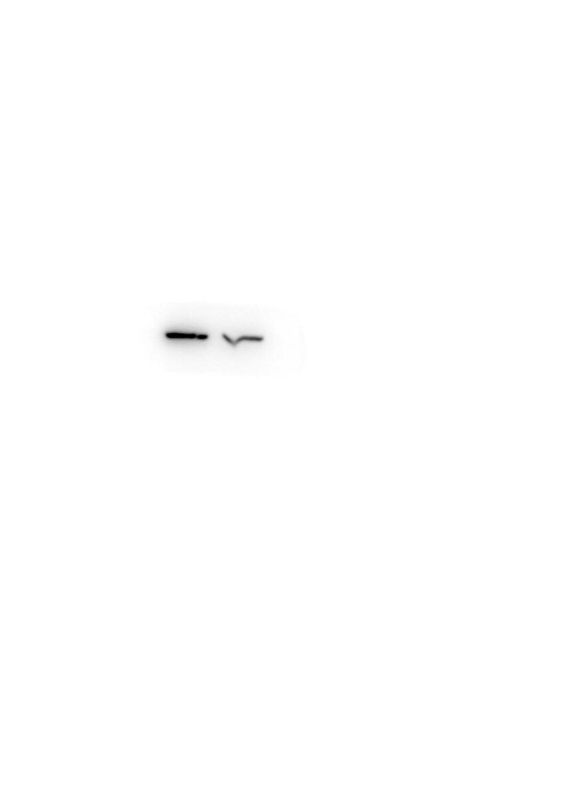
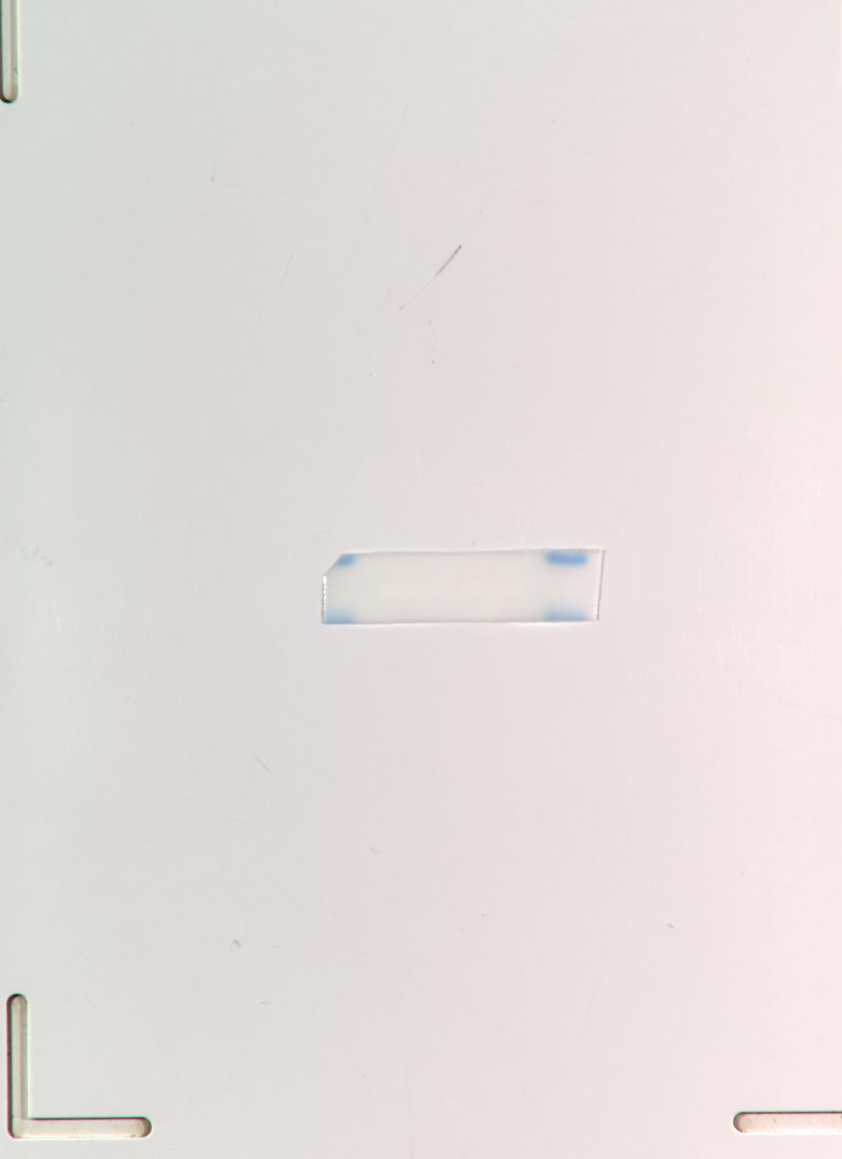

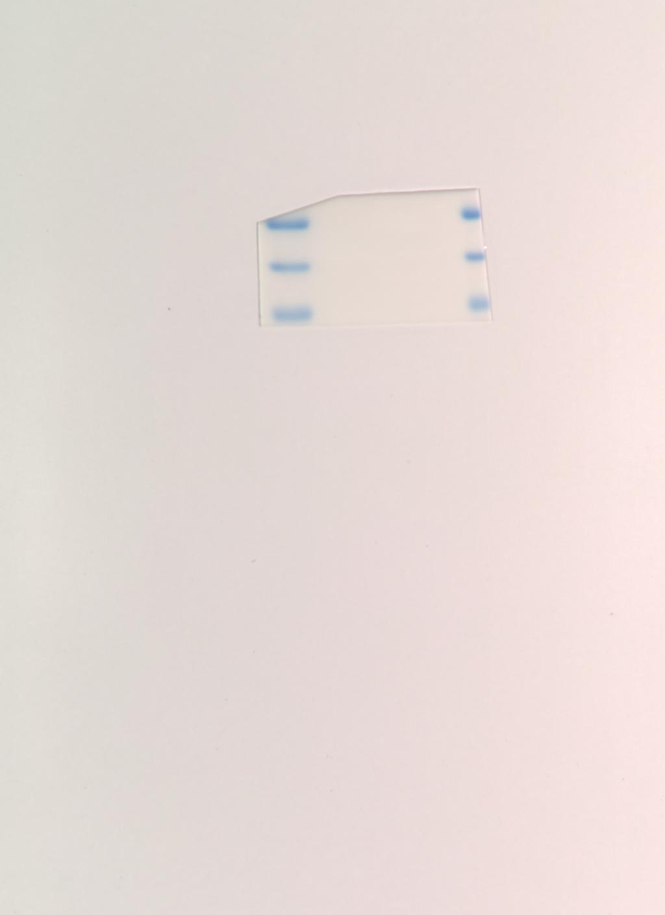
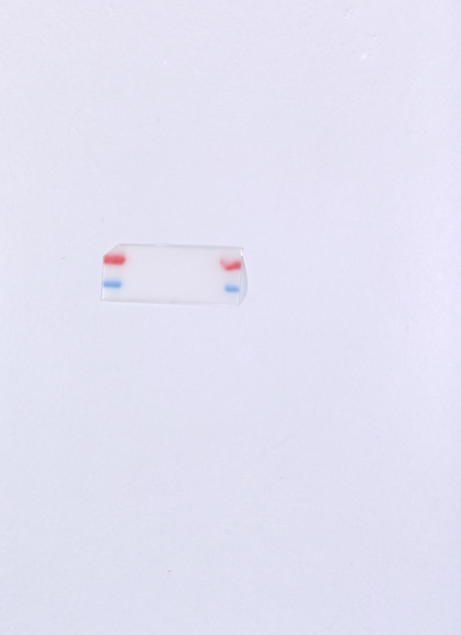

Figure S1B BT549
CDC73
CDC73 M
GAPDH
GAPDH M
MAPK1
MAPK1 M

Slide 13

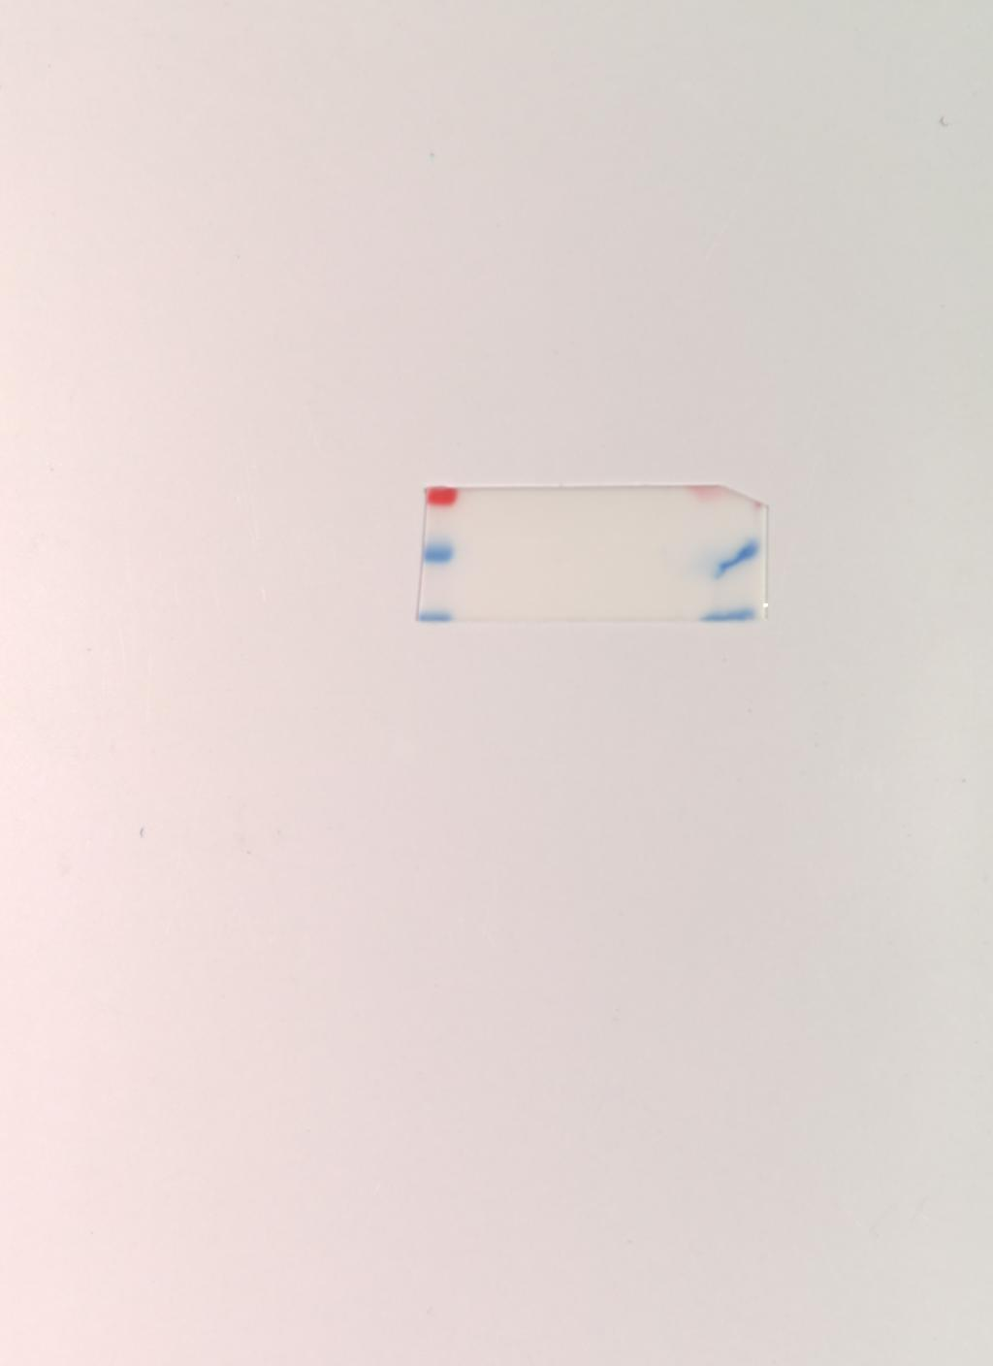
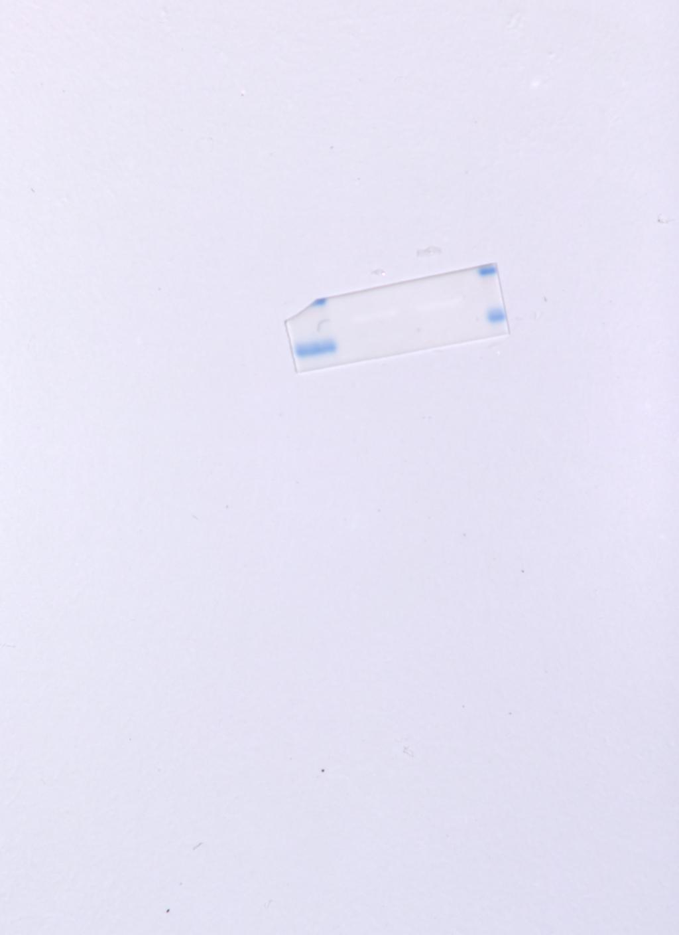
Figure S1B MDA-MB-231
CDC73
CDC73 M
GAPDH
GAPDH M

