Slide 1
Supplementary Video
Unique Hyperspectral Response Design in High-Speed Photodetectors Enabled by Periodic Surface Textures
Ahasan Ahamed†, Amita Rawat†, Ahmed S. Mayet, Lisa N McPhillips and M Saif Islam* *Contributing authors: sislam@ucdavis.edu †These authors contributed equally to this work.

Slide 2
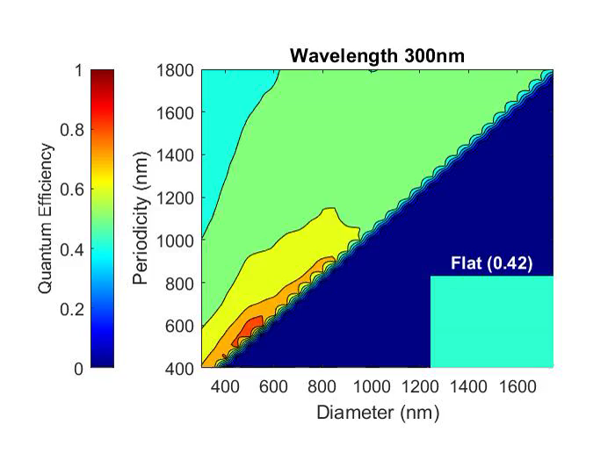
The video presents the compilation of Lumerical FDTD simulation results of quantum efficiency (QE) for multiple photon-trapping surface textured (PTST) devices with varying periodicity and diameter compared with the planar flat device without PTST (bottom right). We see that with increasing wavelength from 300 nm to 1100 nm, the maximum QE is shifting diagonally from the bottom left towards the top right, depicting a strong coupling with the periodicity and a weak coupling with the diameter of the PTST.
Unique Hyperspectral Response Design in High-Speed Photodetectors Enabled by Periodic Surface Textures

