Slide 1
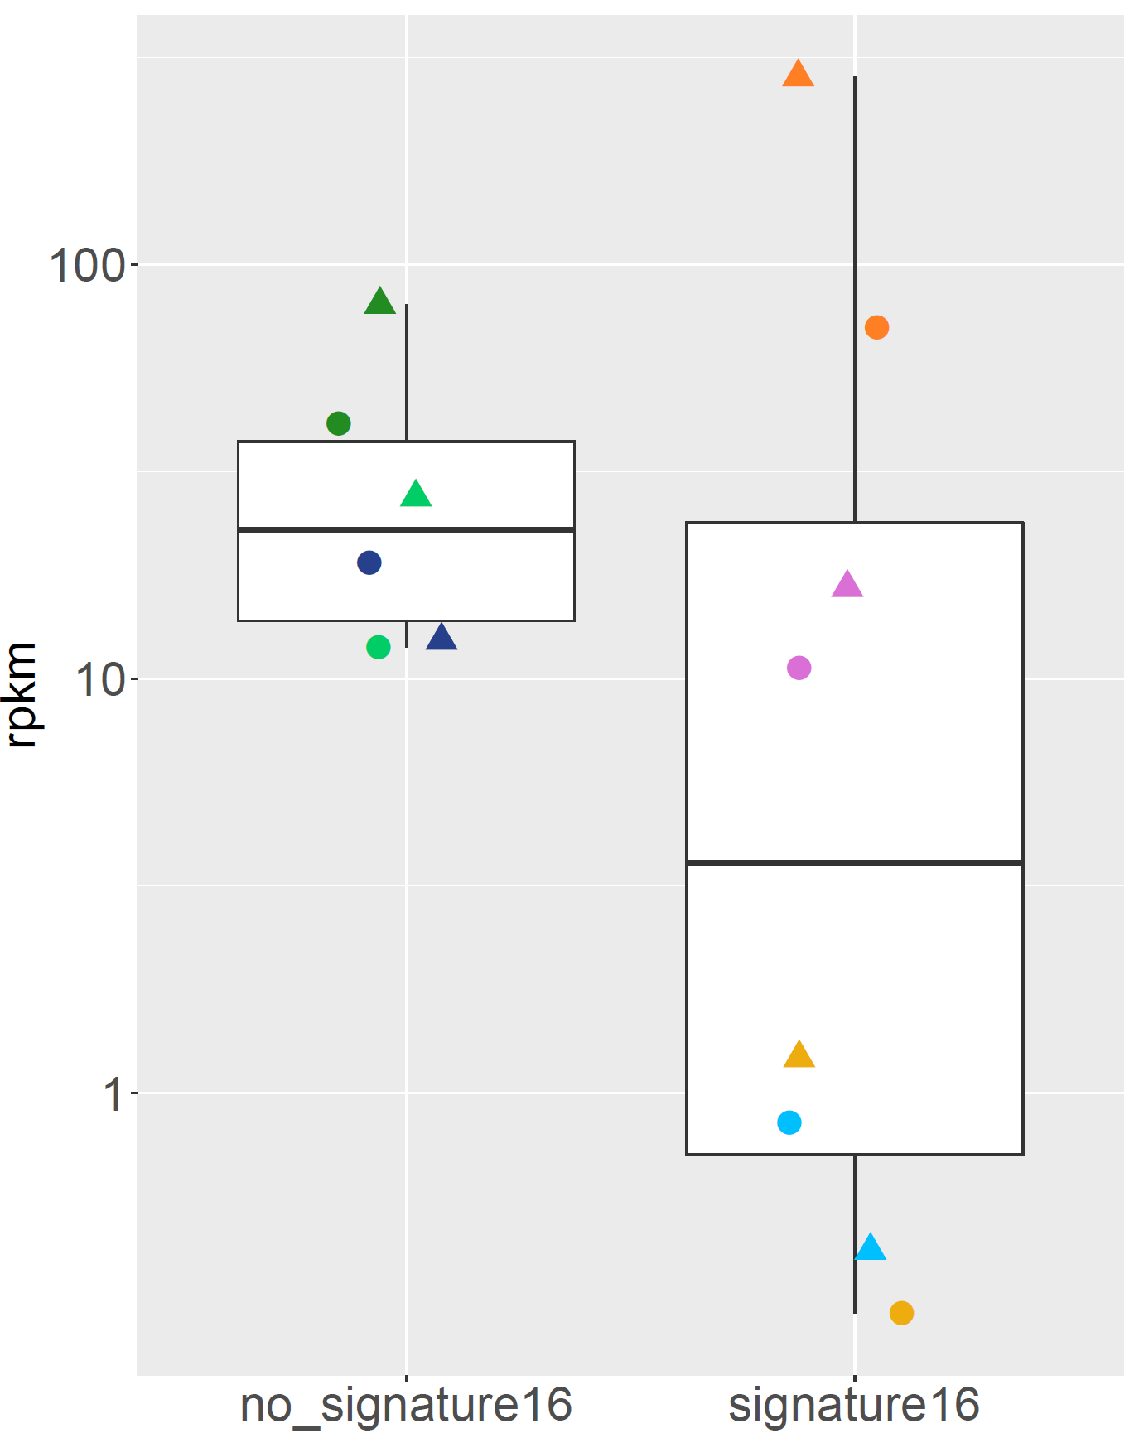
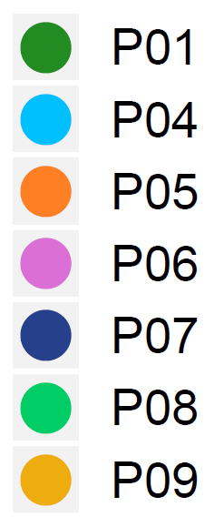

Figure S1
Fig. S1: CDKN2A expression in tumour samples of patients where signature 16 (associated to tobacco and alcohol consumption, p16 negativity) was found (right) or not found (left). Median RPKM expression of CDKN2A appears lower in patients where signature 16 is frequent than in the remaining patients, but the difference is not statistically significant (Wilcoxon test p-value = 0.09). R/M = recurrence/metastasis.

Slide 2
Figure S2
Biopsy right anterior floor of mouth (T1)
Biopsy submental mass
(pre-treatment) – R1
Biopsy submental mass
(during treatment) – R2
Disease progression
Continuing good
partial response
Sept 2014
Oct 2014
June 2015
July 2015
Oct 2015
July 2016
Aug 2016 - Aug 2018
Time of analysis
Resection of primary tumour
No adjuvant RT
Recurrence: primary site, right neck nodes, liver, lung
Palliative cisplatin,
5FU and cetuximab
Pembrolizumab and T-VEC
P01*
Biopsy right tongue (T1)
Completed post RT to right tongue and neck
Left neck dissection:
left neck mass (R1)
Incisional biopsy
left neck fungating mass (R2)
Incisional biopsy
left neck ulcer (R3)
Patient passed away
2014
Mar 2014
June 2014
Jan 2015
May 2015
June 2015
Sept 2015
Q4 2015
Resection of primary tumour
+ right neck dissection
Completed postoperative RT to left neck
No further treatment,
best supportive care
P06
Biopsy right tongue
Completed post chemo-RT
Biopsy local recurrence
mandible (R1)
Biopsy lip recurrence (R3)
Patient passed away
2014
Sept 2014
Dec 2014
May 2015
July 2015
Sept 2015
Q4 2015
@Anthony: do you know when the patient passed away?
Resection of primary tumour (T1)
+ bilateral neck dissection
Resection of mandible and tongue
No further adjuvant treatment
mm yyyy
P09
Fig. S2: Medical history and treatment journeys of patients P01, P06 and P09, for whom multiple R/M samples could be obtained. Identifiers of samples used in the analyses are shown in red. RT = radiotherapy, 5FU = 5-fluoruracil, T-VEC = talimogene laherparepvec. *P01 was still alive at the time of analysis.

Slide 3
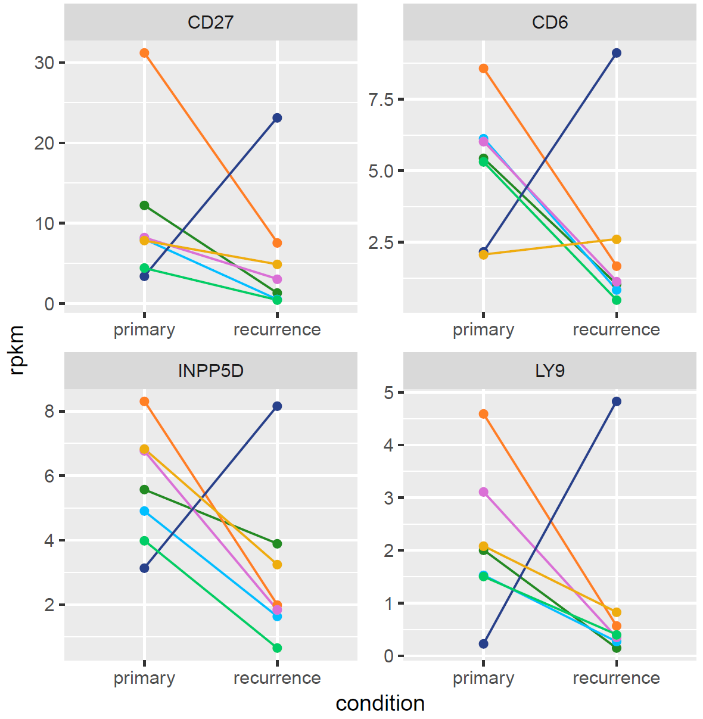
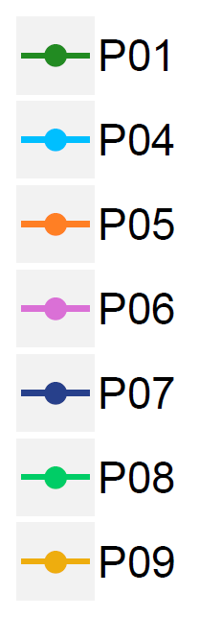
Figure S3
a
Biopsy exophytic mass in right oropharynx (R1)
Biopsy right tongue (T1)
Alive and well with no R/M
May 2014
Dec 2014
Feb 2015 - Mar 2015
Time of analysis
Right partial glossectomy
and right neck dissection
Declined adjuvant RT
Postoperative radiotherapy with
concurrent cisplatin chemotherapy
P07*
b
Fig. S3: History and gene expression of patient P07. (a) Diagnosis and treatment history of patient P07. Identifiers of samples used in the analyses are shown in red. (b) This patient showed opposite expression patterns in primary and R/M compared to the remaining patients for some immune-relevant genes. Here, examples of CD27, CD6, INPP5D and LY9 are shown. RT = radiotherapy. *P07 was alive and well at the time of analysis.

