Slide 1
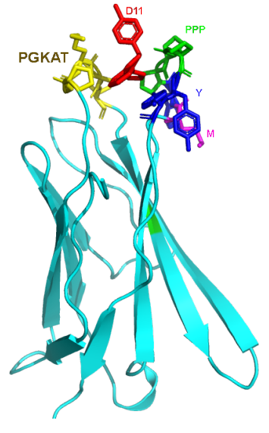
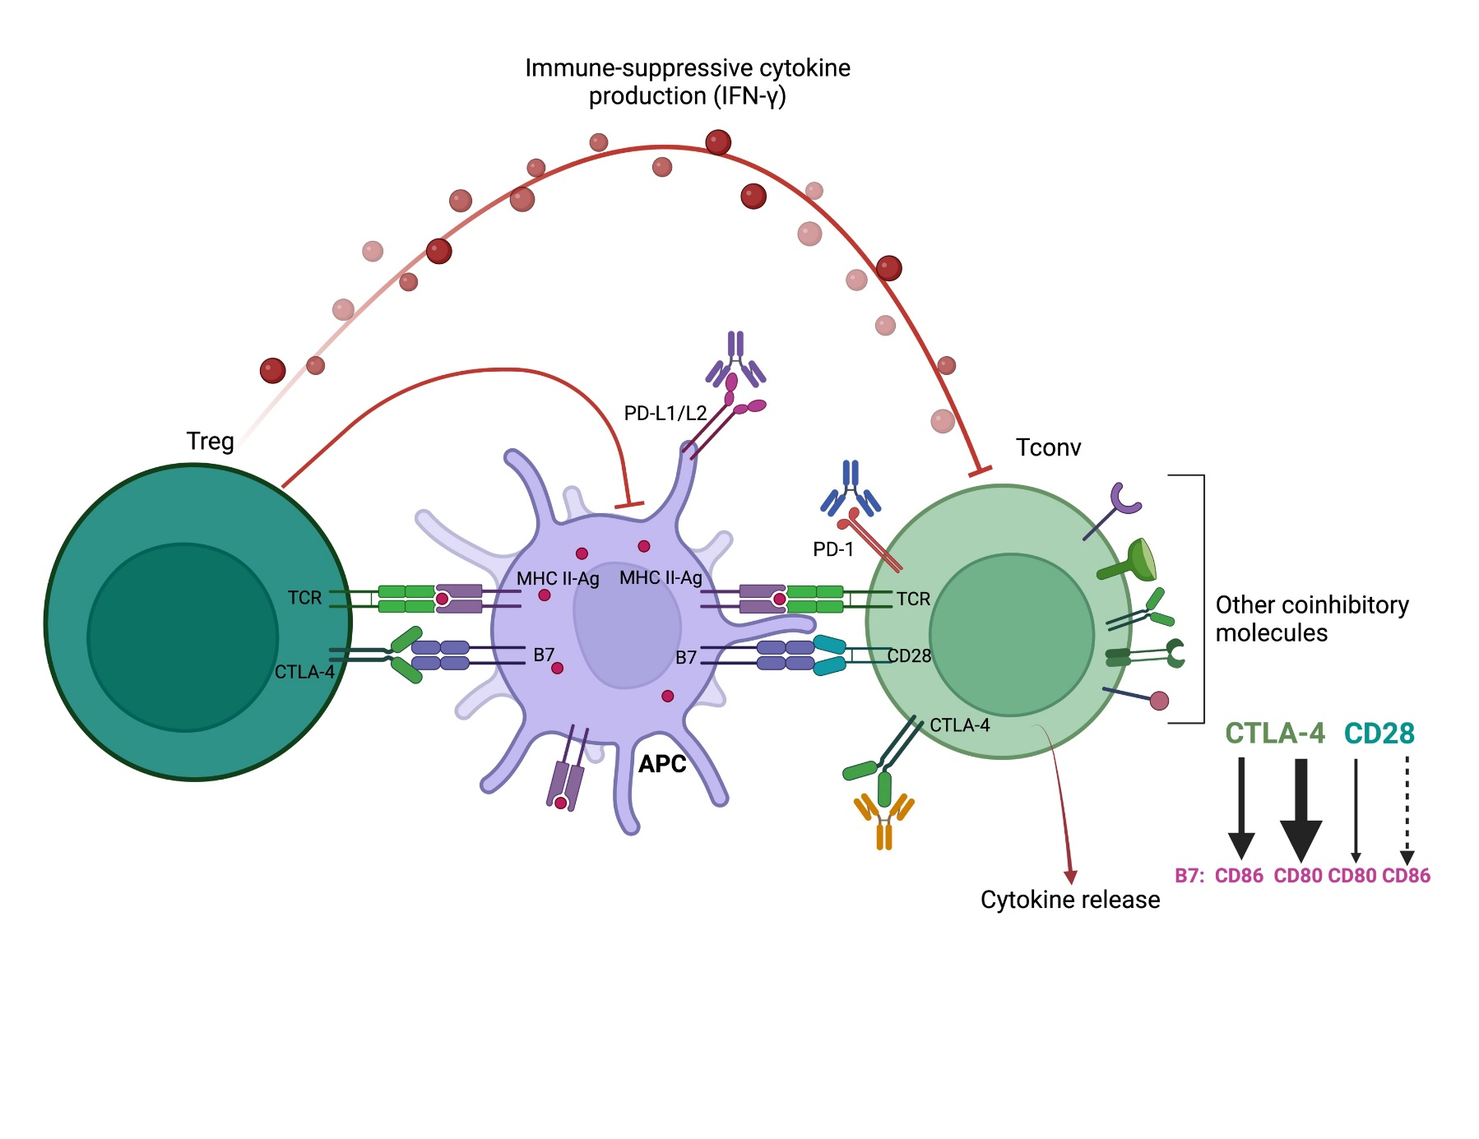
a
b
Notes:
Schematic representation of AI-assisted anti-CTLA-4 drug discovery. (a) The extracellular domain of CTLA-4 with residues around the binding site is shown in yellow (₂₆PGKAT) and other colors (₉₈MYPPPYY₁₀₄). (b) The interactions between B7 (CD80 and CD86) and CTLA-4 or CD28 occurring with varying affinities are represented by the thickness of the arrows.

Slide 2
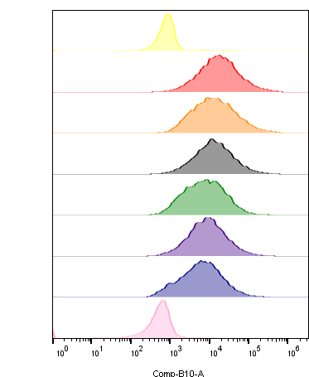
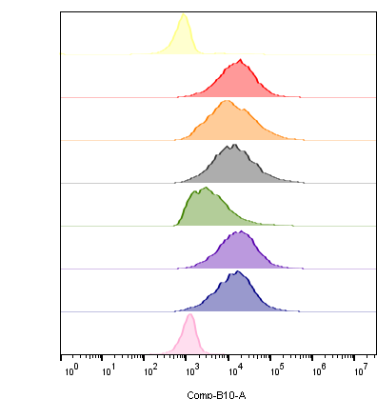
a
b
T0- 45 min
T1- 24h
10000
Untreated Unstained
10000
Untreated Unstained
Untreated Stained
9729
Untreated Stained
10273
A6
8208
A6
9500
A9
9747
A9
10336
B10
4292
B10
8681
D7
D7
9732
10023
D11
9349
D11
8729
Ipilimumab
11944
Ipilimumab
10740
hCTLA-4
hCTLA-4
Notes:
Supplementary information, Figure S1 cell surface hCTLA-4 protein displacement and luciferase reporter bioassay of anti-CTLA-4 leads.

Slide 3
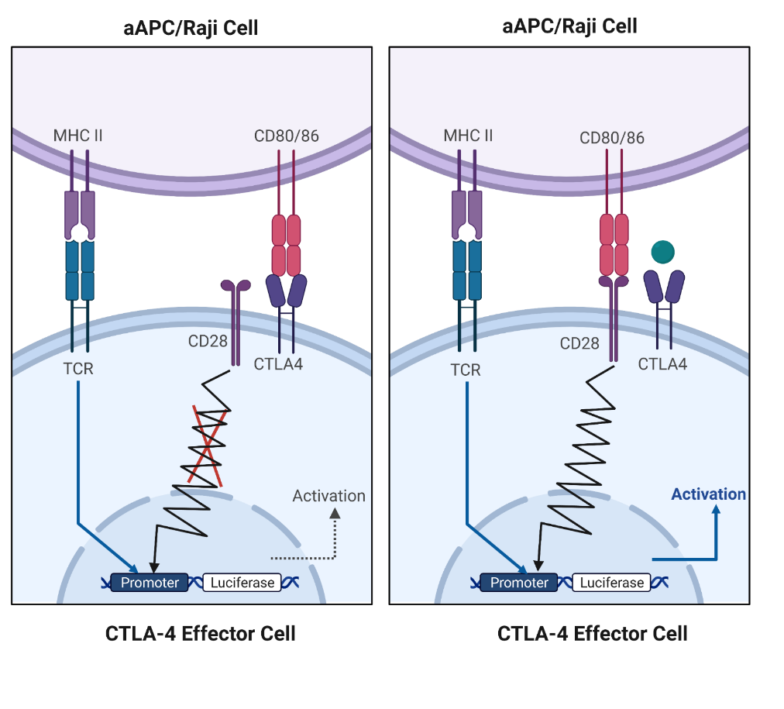
c
d

Slide 4
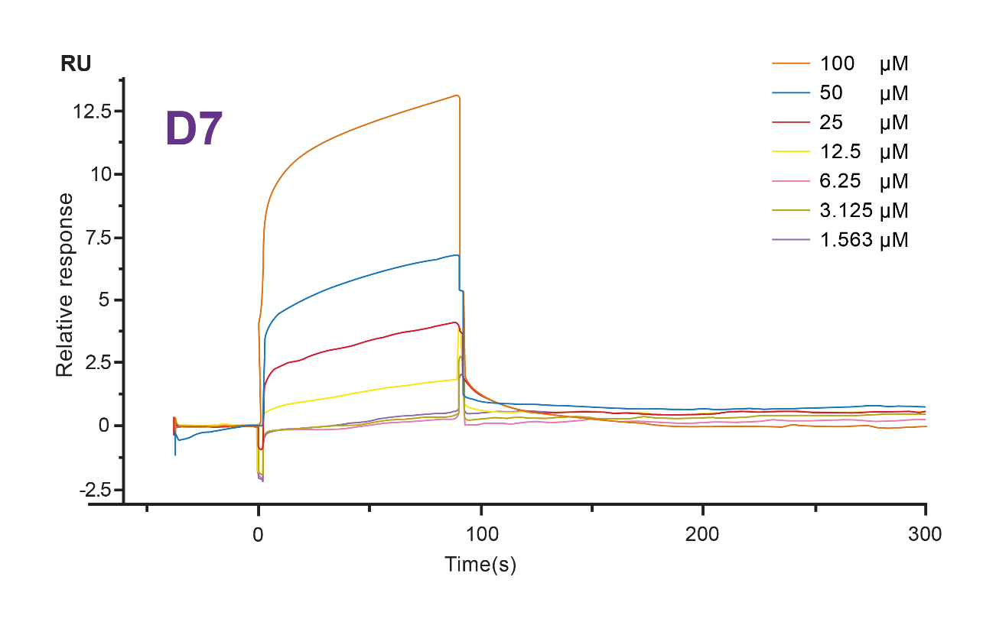
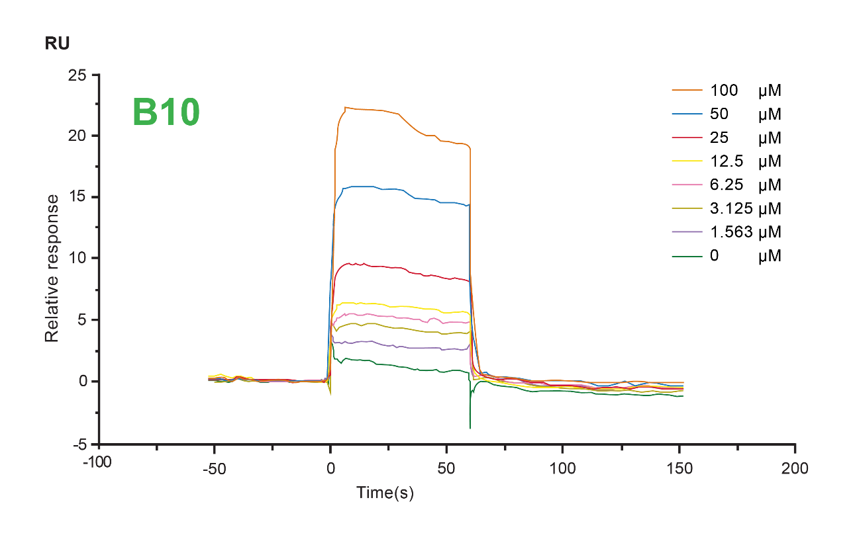
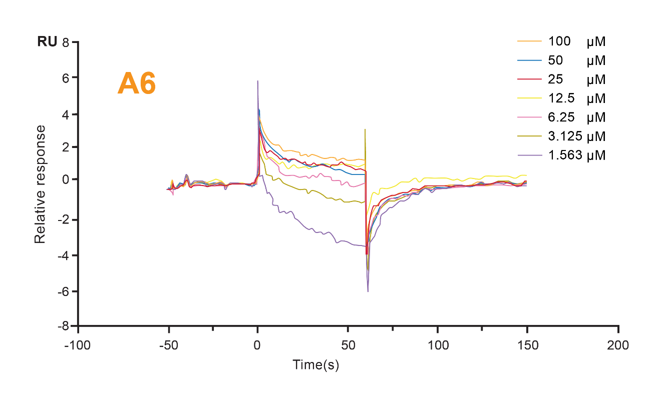
a
b
c
Notes:
Supplementary information, Figure S2 Surface Plasmon Resonance (SPR).

Slide 5
FSC SSC
T cell gate
a
Vehicle
Ipilimumab
A9 10 μM
SSC-A
A9 50 μM
D11 10 μM
D11 50 μM
FSC-A
Notes:
Supplementary information, Figure S3 T conventional and T conventional/ T regulatory cells treated with CTLA-4 inhibitors.

Slide 6
T_{reg} to T_{conv} ratio
b
Vehicle
Ipilimumab
A9 10 μM
Foxp3
A9 50 μM
D11 10 μM
D11 50 μM
CD4

Slide 7
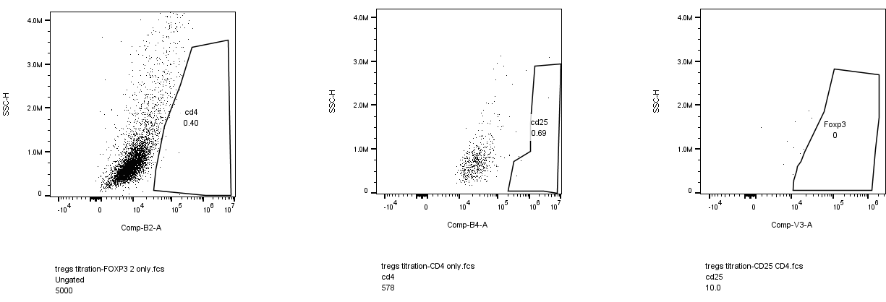
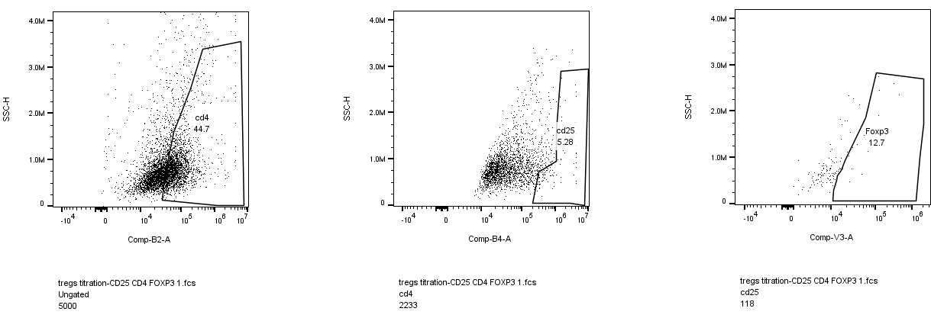
c
SSC-H
CD4-
CD4-CD25-
CD4-CD25-Foxp3-
SSC-H
CD4+
CD4+CD25+
CD4+ CD25+FOXP3

Slide 8
d

Slide 9
a
Tumor-free mice
re-challenged with
200,000 MC38 cells
Notes:
Supplementary information, Figure S4 Tumor inhibition in C57/B6 mice.

Slide 10
b

Slide 11
c

Slide 12
d

Slide 13
Notes:
Supplementary information, Figure S5 Tumor inhibition in humanized CTLA-4 C57/B6 mice.

Slide 14
Note: replace X subtitle “Drugs” with D11
Notes:
Supplementary information, Figure S5 Cell Viability in HCT-116 and MDA-MB-231.

Slide 15
Notes:
Supplementary information, Figure S6 Tumor inhibition in humanized CTLA-4 C57/B6 mice.

Slide 16
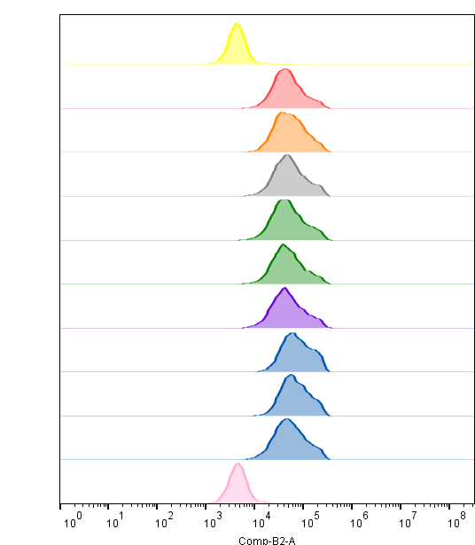
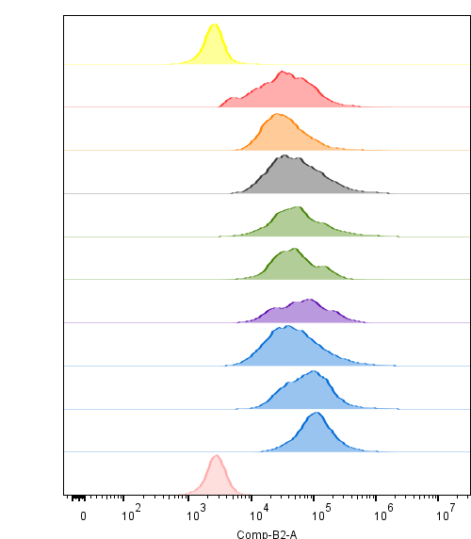
a
b
T0- 45 min
T1- 24h
Untreated Unstained
10000
Untreated Unstained
10000
Untreated Stained
9073
Untreated Stained
4706
A6.1
8384
A6.1
1793
A9.1
9214
A9.1
2747
B10.1
8598
B10.1
3432
B10.2
8632
B10.2
3088
D7.1
8384
D7.1
5454
D11.1
7743
D11.1
3844
D11.2
8081
D11.2
3572
D11.3
8236
D11.3
3949
Ipilimumab
10000
Ipilimumab
11944
hCTLA-4
hCTLA-4
Notes:
Supplementary information, Figure S7 cell surface hCTLA-4 protein displacement and luciferase reporter bioassay of anti-CTLA-4 leads and tumor inhibition.

Slide 17
c

Slide 18
d

