Slide 1


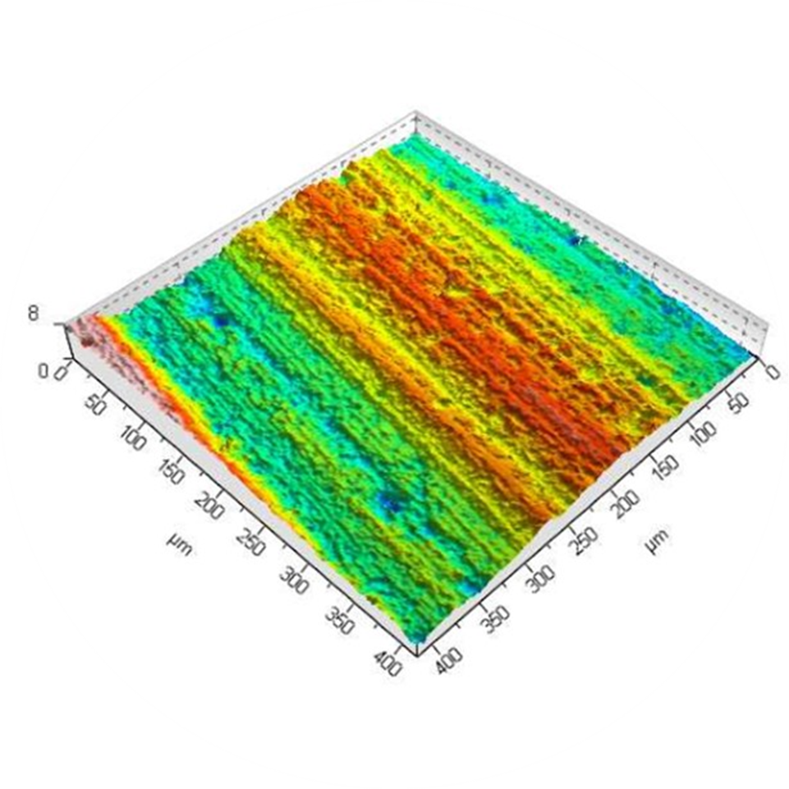
Energy Consumption
Relationship between energy consumption and material removal rate
Relationship between energy consumption and surface roughness
Trade-off relationship
Relationship between material removal rate and surface roughness
Material Removal Rate
Surface Roughness

