Slide 1
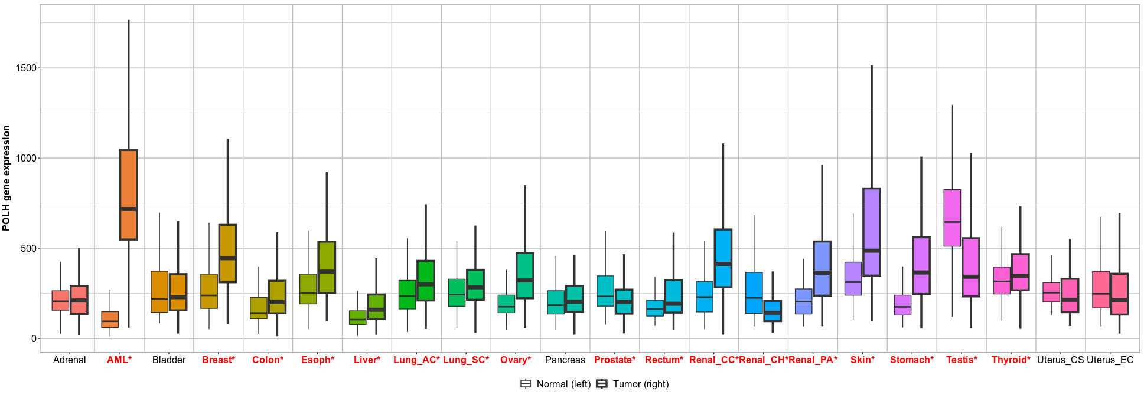
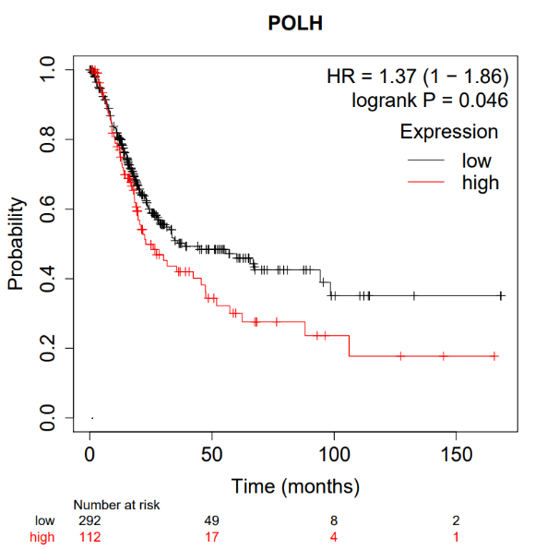
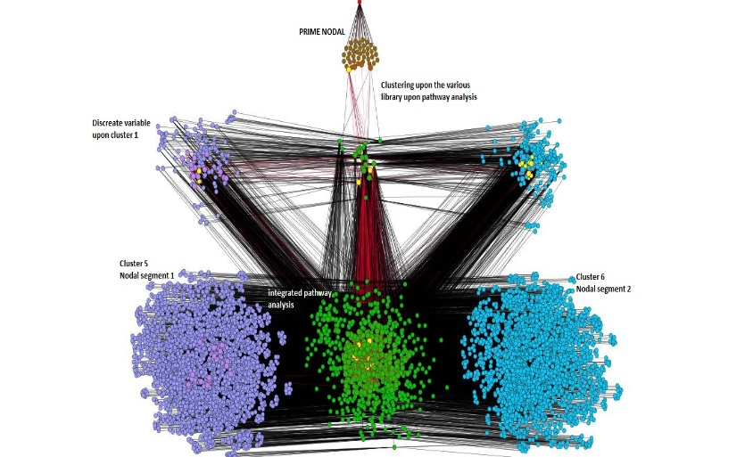
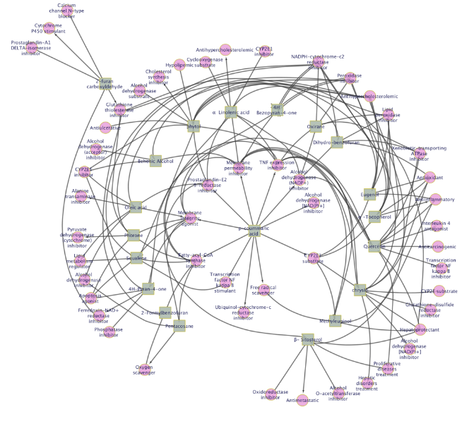
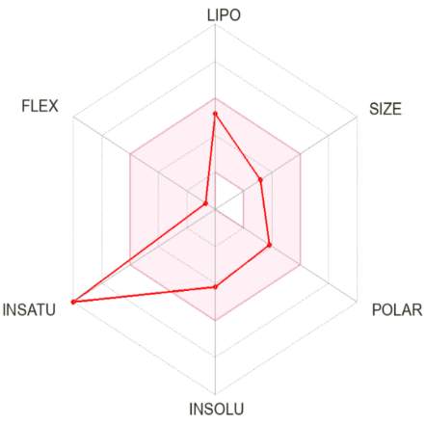
Figure S1
A
B
C
D
E
F
Molecular weight | 254.24 g/mol
Molar refractivity | 71.97
Log P_{o/w} (iLOGP) | 2.27
Log P_{o/w} (XLOGP3) | 3.52
Log P_{o/w} (WLOGP) | 2.87
Log P_{o/w} (MLOGP) | 1.08
Log P_{o/w} (SILICOS-IT) | 3.02
Consensus Log P_{o/w} | 2.55
GI absorption | High
Lipinski | yes
Figure S1: (A) The pan cancer analysis of POLH gene (normal vs cancer tissue) showing differential expression in ovary tissue, plot is based on available RNA seq data. (B) Kaplan-Meier plot showing overall survival of pan cancer patients in correlation with POLH gene expression. (C) Node and internode networking studies for various activities in ovarian cancer. (D) Circoss network interaction between active molecules and enriched pathways in ovarian cancer (E) Bioavailability radar model of chrysin. (F) SwissADME properties of chrysin.

Slide 2
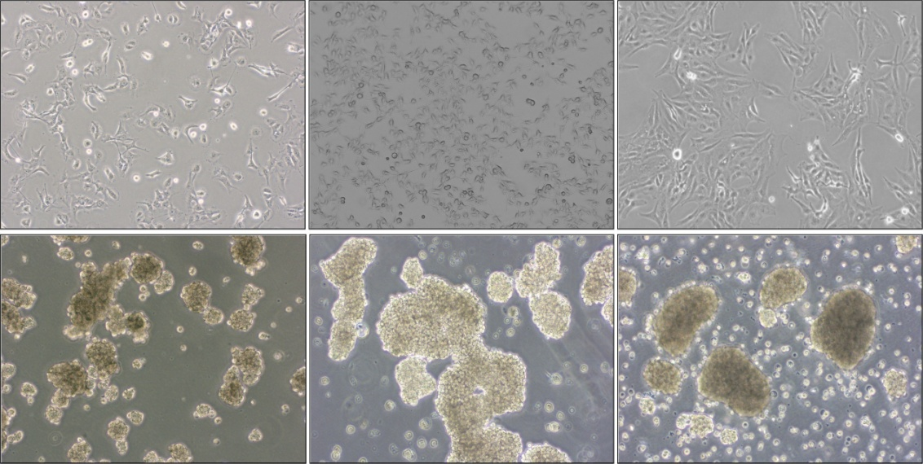
Figure S2
A
OVCAR3
OVCAR3 shPOLH
SKOV3
2008
C13
SKOV3 spheroids
OVCAR3 spheroids
OVCAR3 shPOLH spheroids
2008 spheroids
B
ShControl
C
Cell | Number of cells | Tumor formation
OVCAR3 spheroids | 1000 | 4/4
 | 1,0000 | 4/4
 | 10,0000 | 4/4
OVCAR3 | 1000 | 0/4
 | 1,0000 | 0/4
 | 10,0000 | 0/4
shPOLH
Pol ƞ
78 KDa
GAPDH
36 KDa
OVCAR3
Figure S2: (A) Representative bright field images of bulk and CSC spheroids. Images were taken with 10x objective. (B) Western blot result showing decreased expression of Pol ƞ protein in OVCAR3 cells transfected with shPOLH plasmid. Full length blot is presented in Figure S8 (C) Tumorigenicity of OVCAR3 spheroids compared to bulk OVCAR3 cells.

Slide 3
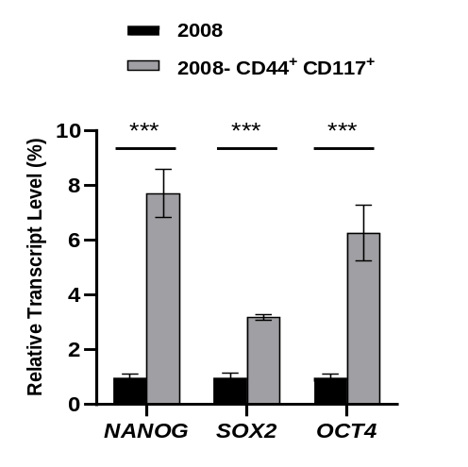
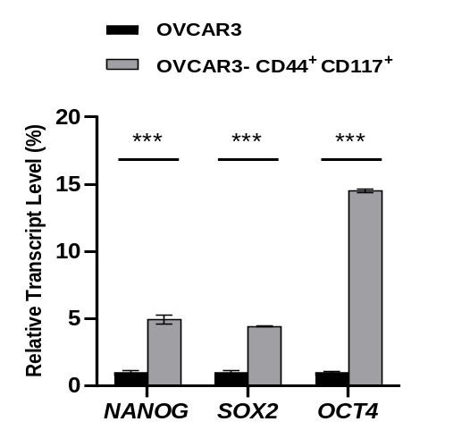
Figure S3
Primers for real-time RT-PCR analysis.
NANOG- forward, 5’- GTCCCAAAGGCAAACAACCC -3’, reverse, 5’- TTGACCGGGACCTTGTCTTC -3’; OCT4- forward, 5’-TCG CAA GCC CTC ATT TCA CC -3’, reverse, 5’- CGA GAA GGC GAA ATC CGA AG -3’; SOX2- forward, 5’- TCA GGA GTT GTC AAG GCA GAG -3’, reverse, 5’- GGC AGC AAA CTA CTT TCC CC -3’; GAPDH- forward, 5’- GAAGGTGAAGGTCGGAGT -3’, reverse, 5’- GAAGATGGTGATGGGATTTC -3’.
Figure S3: CD44⁺CD117⁺ cells were isolated form 2008 and OVCAR3. Expression levels of stem cell specific markers NANOG, OCT4 and SOX2 were determined with the help of RT-PCR. n = 3; Bar, SD; *, P < 0.05; **, P < 0.01.

Slide 4

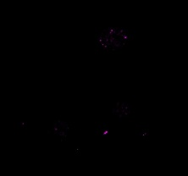
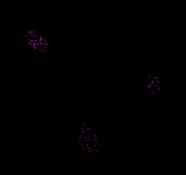
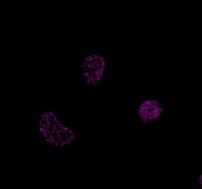
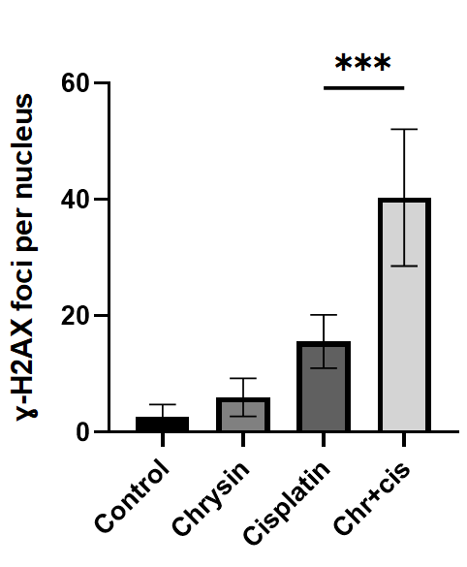
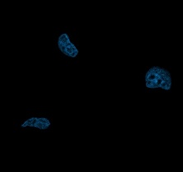
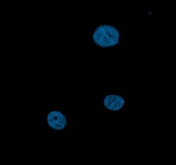
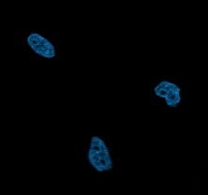
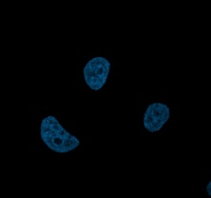

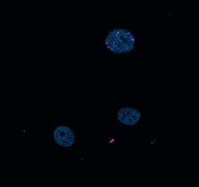
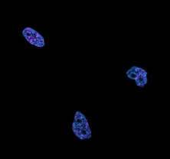
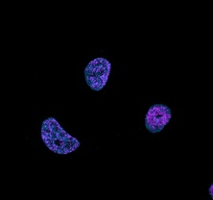
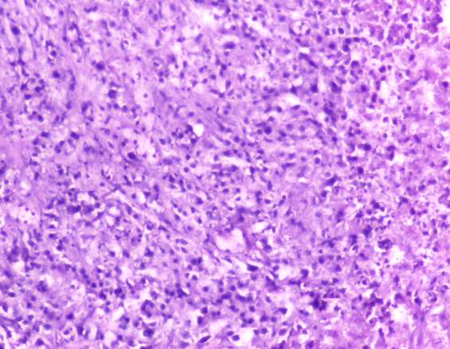
Figure S4
A
Control
Chrysin
Cisplatin
Chr+cis
ɣ-H2AX
HOECHST
MERGED
B
Cisplatin
Chr+Cis
Figure S4: (A) 2008 cells were treated with chrysin and cisplatin, washed with PBS and subjected to stain with gamma H2AX antibody. Gamma H2AX foci were counted per nucleus for each group. Atleast 50 nucleus were quantified per group. Images were taken with 100x objective. n = 3; Bar, SD; *, P < 0.05; **, P < 0.01 (B) Representative H & E images of xenograft tumors. Images were taken with 20x objective.

Slide 5
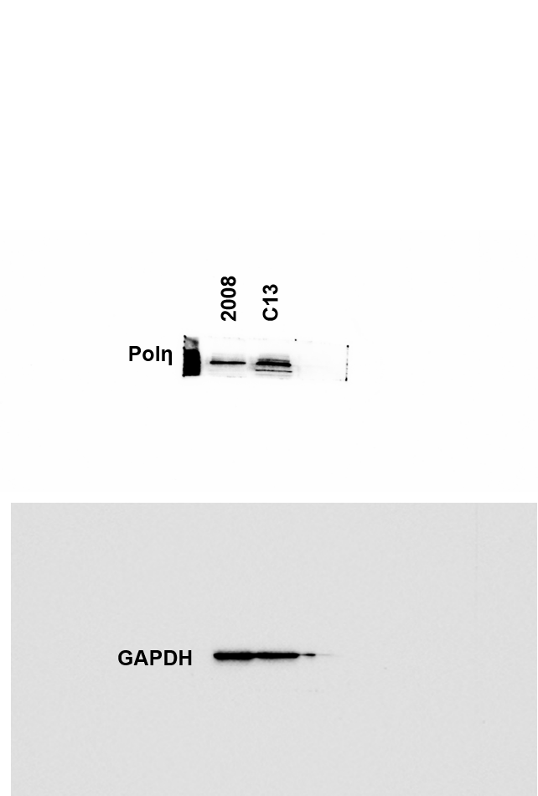
Figure S5
78 KDa
36 KDa

Slide 6
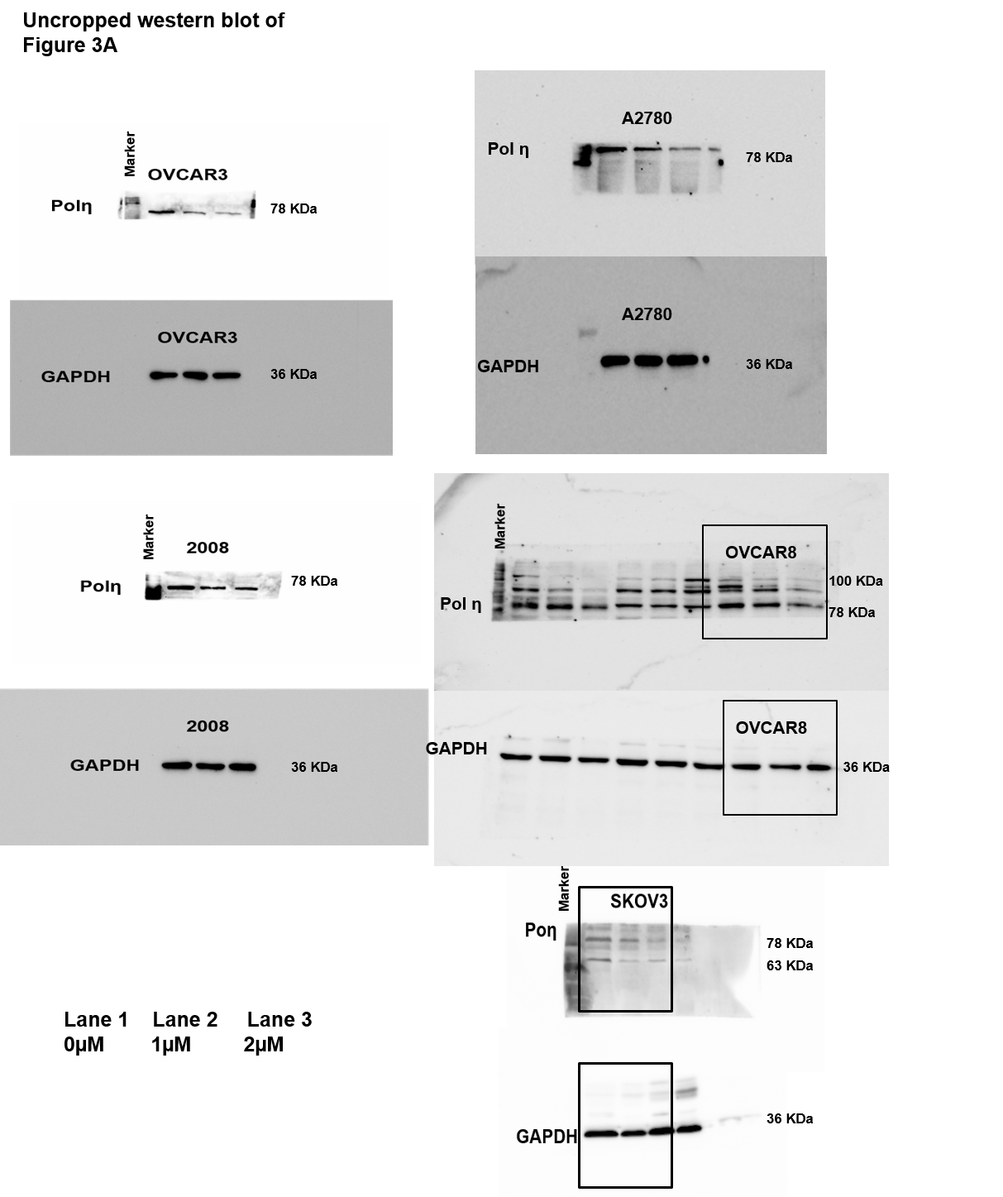
Figure S6
A
C
B
D
E

Slide 7
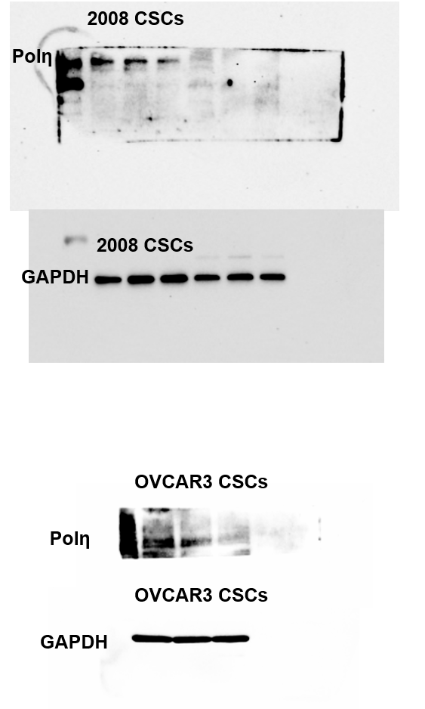
Figure S7
A
Marker
78 KDa
63 KDa
Marker
48 KDa
36 KDa
Marker
B
78 KDa
36 KDa
Lane 1 Lane 2 Lane 3
0µM 5µM 10µM

Slide 8
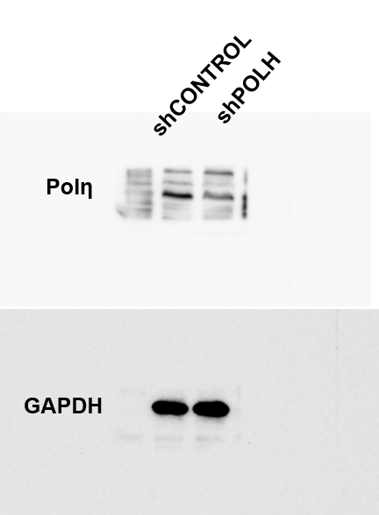
Figure S8
Marker
100 KDa
78 KDa
36 KDa

