Slide 1
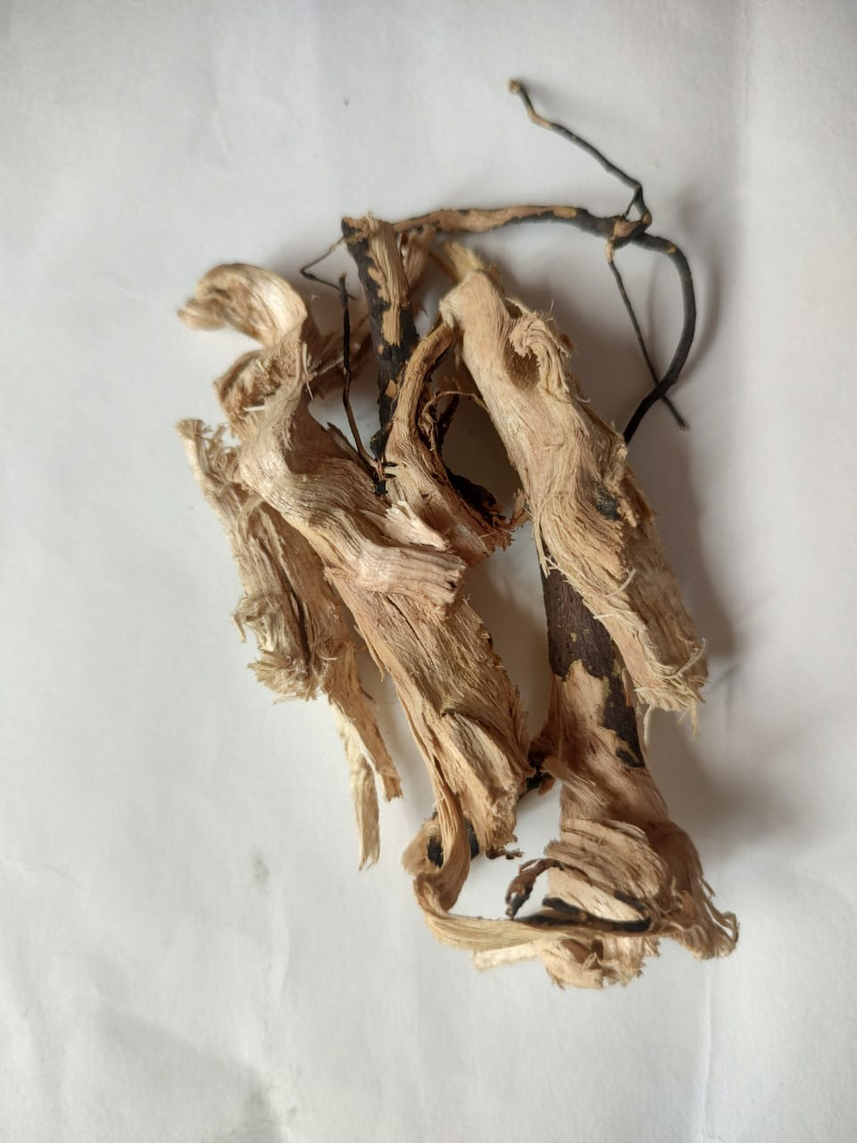
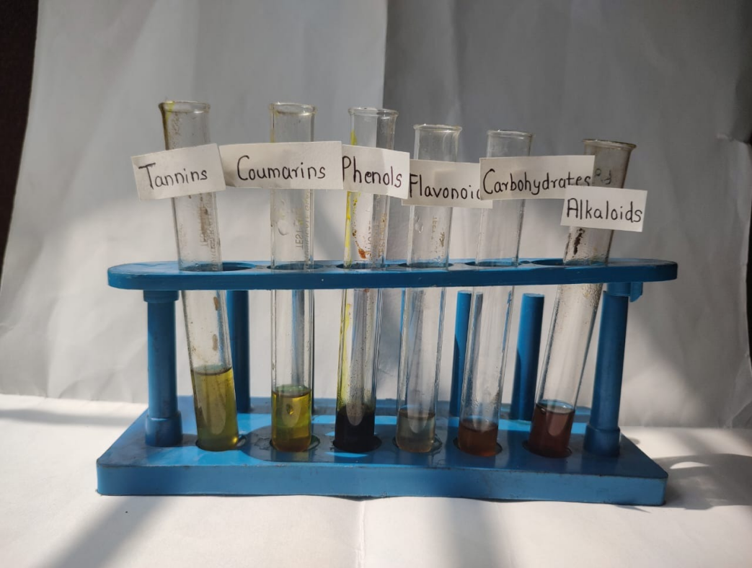
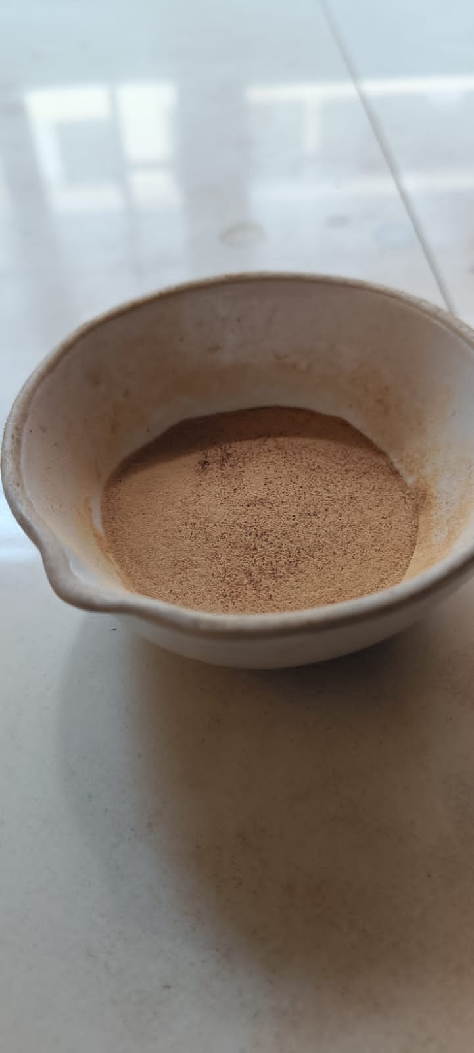
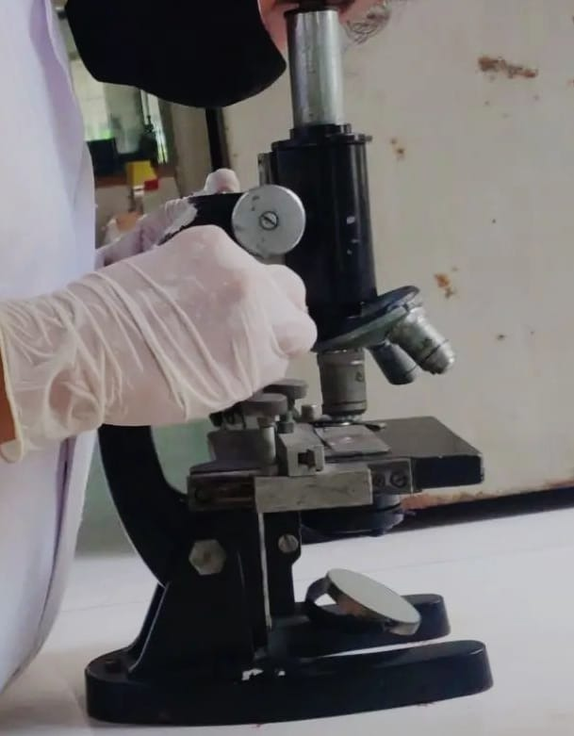
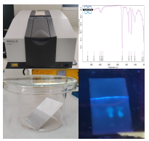
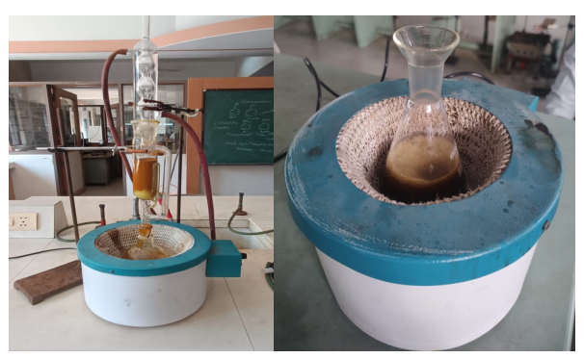
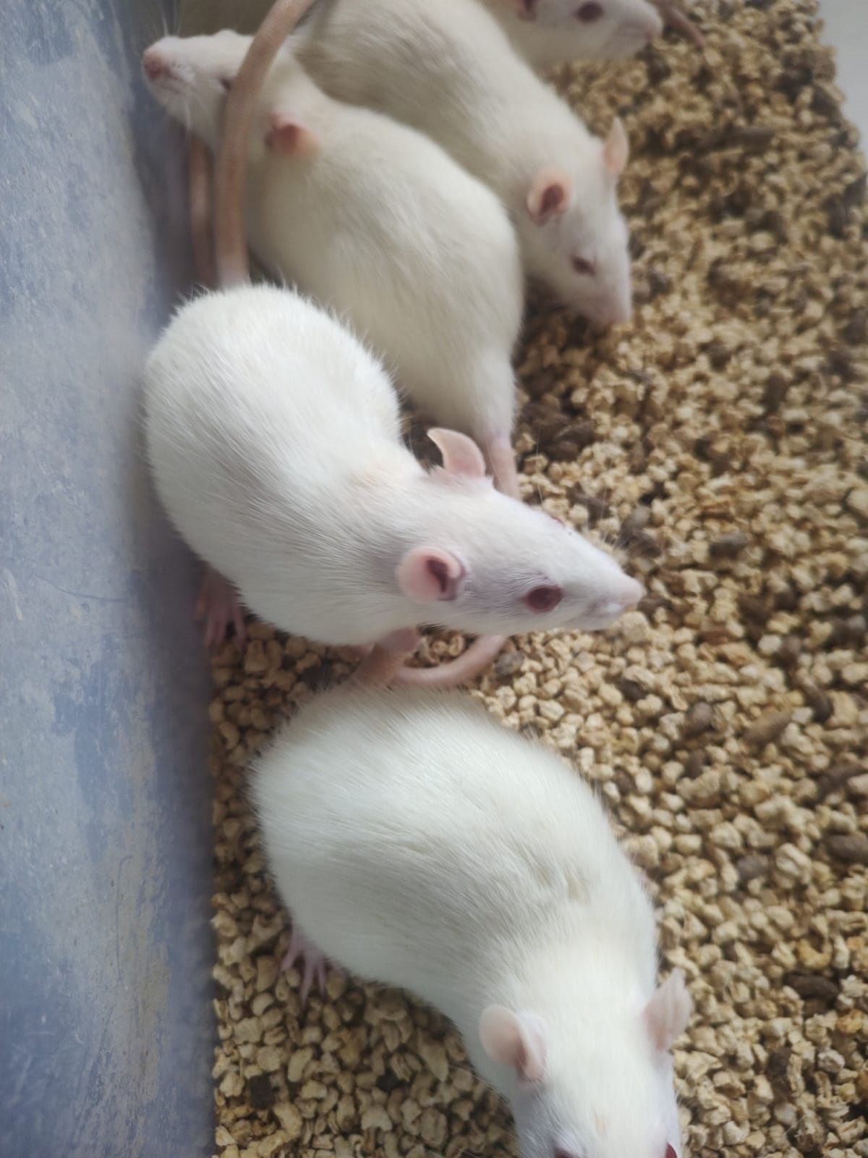
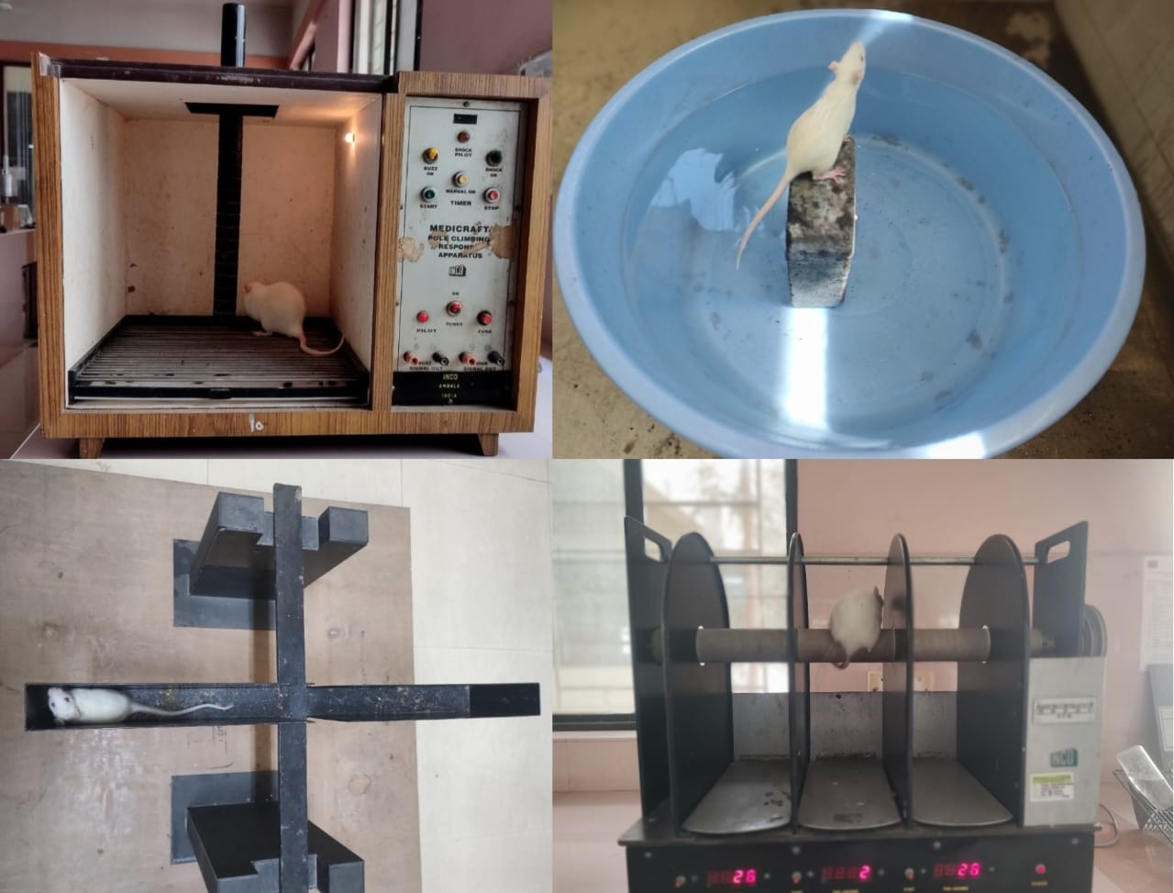
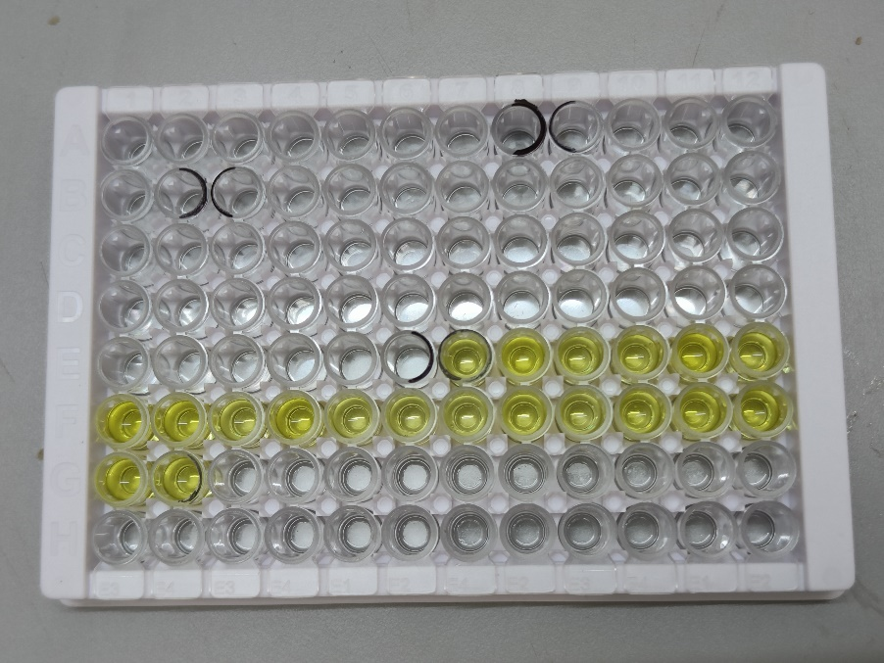
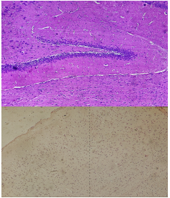
.
ROOT’S OF CASSIA OCCIDENTALIS L.
PHYTOCHEMICAL TESTS
POWDER OF CASSIA OCCIDENTALIS L.
PHARMACOGNOSTIC
EVALUATION
SPECTROSCOPIC ANALYSIS
SOXHLET EXTRACTION
ACUTE ORAL TOXICITY STUDY
(OECD GUIDELINES 423)
COLCHICINE INDUCED NEUROTOXICITY MODEL
BEHAVIORAL TESTS
BIOCHEMICAL ESTIMATION
HISTOPATHOLOGICAL STUDY

