Slide 1
Supplemental Table 1. Primers used in this study
Gene name | Accession numberr | Primer name | Primer sequence
ZmCesA1 | Zm00001d009795 | (1)qPCR-CesA1-F | GGAAAGACGCGCAATGAAGAGG
 |  | (1)qPCR-CesA1-R | GGCAACAAGGGCATTGATTCTTAC
ZmCesA2 | Zm00001d037636 | (2)qPCR-CesA2-F | ACCATCGGATTCCACGCCTTAC
 |  | (2)qPCR-CesA2-R | ACAATCCTCACAGGAACTGGAACG
ZmCesA3 | Zm00001d039660 | (3)qPCR-CesA3-F | AAAGAAAGGCGGGCTATGAAGAGG
 |  | (3)qPCR-CesA3-R | TTGCAACAAGGGCATTGATCCG
ZmCesA4 | Zm00001d019149 | (4)qPCR-CesA4-F | AACTGGGAACATTGGCAAGCG
 |  | (4)qPCR-CesA4-R | AGAACTCCCTTGACGGATTTGGC
ZmCesA5 | Zm00001d034553 | (5)qPCR-CesA5-F | ACTAAGTACAAGCGCCACAAAGGG
 |  | (5)qPCR-CesA5-R | TCACATCGTCAGCATCCACATCC
ZmCesA6 | Zm00001d034770 | (6)qPCR-CesA6-F | TGACCGGCTGAGTTTAAGGTTTG
 |  | (6)qPCR-CesA6-R | TAGCAGTGACCAATGGAGGTTCC
ZmCesA7 | Zm00001d019507 | (7)qPCR-CesA7-F | ATCCCAGCTTACCTGTGCAACC
 |  | (7)qPCR-CesA7-R | GCTTCCAATTCTCCATCCGTTCC
ZmCesA8 | Zm00001d019317 | (8)qPCR-CesA8-F | TCTCCTGGCTTACTGTACCTTGC
 |  | (8)qPCR-CesA8-R | GCGACATTGGTAAGCTCTGGTG
ZmCesA9 | Zm00001d005250 | (9)qPCR-CesA9-F | GTGGTTTCCAATCAACCGCGAGAC
 |  | (9)qPCR-CesA9-R | CCTTCCCGGTCATACCTTAATGCG
ZmCesA10 | Zm00001d032776 | (10)qPCR-CesA10-F | AAGTTCATCATTCCCACGCTGA
 |  | (10)qPCR-CesA10-R | CCACCAGTCCTCGATGCTCA
ZmCesA11 | Zm00001d043477 | (11)qPCR-CesA11-F | TTTCCTGGGTGAGACTGGTG
 |  | (11)qPCR-CesA11-R | AGACACTCGGACCAGAGCAT
ZmCesA12 | Zm00001d020531 | (12)qPCR-CesA12-F | CACCGCTGATATGGGAGTAGA
 |  | (12)qPCR-CesA12-R | CGAACCGCTTCTCGAAGTTCA
ZmCesA10 |  | ZmCesA10-1305-F | GGACTAGTATGGACGCCGGCTCGGTCA
 |  | ZmCesA10-1305-R | GCTCTAGAGCACTCGACTCCGCATGGCTTGA
ZmCesA11 |  | ZmCesA11-1305-F | GGACTAGTATGATGGAGTCGGCGGCG
 |  | ZmCesA11-1305-R | GCTCTAGAGCAGATGATCGTGTTGCAGTTGTTGGTG
ZmCesA12 |  | ZmCesA12-1305-F | GGACTAGTATGGAGGCCAGCGCC
 |  | ZmCesA12-1305-R | GCTCTAGAGCAATTGATGCCACACTGCCT
ZmCesA10 |  | ZmCesA10-AD/BD-F | GGAATTCCATATGATGGACGCCGGCTCGGTCA
 |  | ZmCesA10-AD/BD-R | CGGAATTCTCAGCACTCGACTCCGCATGGCTT
ZmCesA11 |  | ZmCesA11-AD/BD-F | GGAATTCCATATGATGATGGAGTCGGCGGCG
 |  | ZmCesA11-AD/BD-R | GGAATTCCATATGTCAGCAGATGATCGTGTTGCAGTTGTT
ZmCesA12 |  | ZmCesA12-AD/BD-F | GGAATTCCATATGATGGAGGCCAGCGCCG
 |  | ZmCesA12-AD/BD-R | CGGAATTCTCAGCAATTGATGCCACACTGCCT
ZmCesA10 |  | ZmCesA10-BiFC-C/N-F | GCTCTAGAATGGAGGGCGACGCG
 |  | ZmCesA10-BiFC-C/N-R | GGGGTACCGCACTCGACTCCGCATGG
ZmCesA11 |  | ZmCesA11-BiFC-C/N-F | GCTCTAGAATGATGGAGTCGGCGGC
 |  | ZmCesA11-BiFC-C/N-R | GGGGTACCGGCAGGCAACCCACGTTT
ZmCesA12 |  | ZmCesA12-BiFC-C/N-F | GCTCTAGAATGGAGGCCAGCGCC
 |  | ZmCesA12-BiFC-C/N-R | CCGCTCGAGGCAATTGATGCCACACTGCCT

Slide 2
Supplemental Table 2. Ear traits of cesa10-1, cesa11-1 and cesa12-1. *p<0.05; **p<0.01; ***p<0.001.
 | B73 | cesa10-1 | cesa11-1 | cesa12-1
Ear length (mm) | 143.07±9.74 | 126.42±9.64* | 130.57±13.08 | 124.62±10.22*
Ear width (mm) | 46.54±1.40 | 46.44±0.65 | 47.53±1.91 | 47.01±1.35
Number of kernel rows | 15.37±0.85 | 16.80±1.32 | 17.57±1.29* | 17.33±1.59
Grain sickness (mm) | 4.6±0.11 | 3.87±0.09**** | 4.49±0.19 | 3.95±0.05****

Slide 3
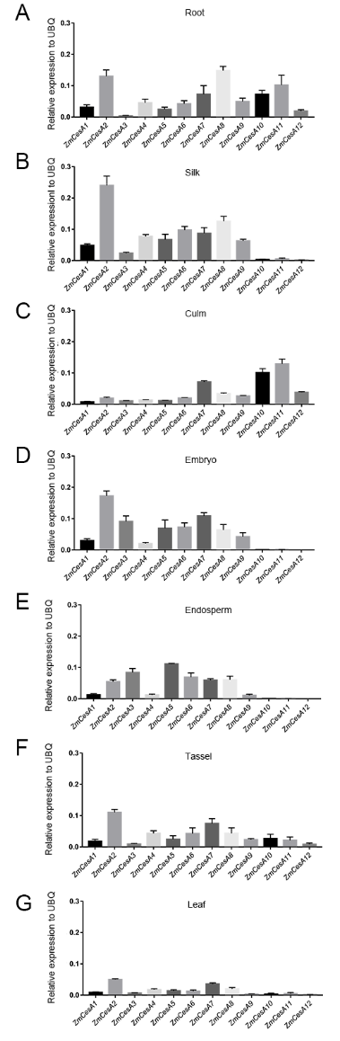
Supplemental Figure 1. Expression profiles of ZmCesA1-12 in maize root (A), tassels (B), culm(C), the embryo(D), endosperm(E), tassel (F), and leaf (G).

Slide 4
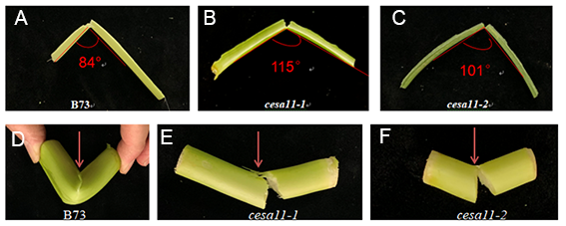
Supplemental Figure 2. Comparison of the broken culms and veins of B73, cesa11-1 and cesa11-2.
(A-C) Comparison of the broken veins of B73 (A), cesa11-1 (B) and cesa11-2 (C). (D-F) Comparison of the broken culms of B73 (D), cesa11-1 (E) and cesa11-2 (F).

