Slide 1
Human Western Blot Images

Slide 2
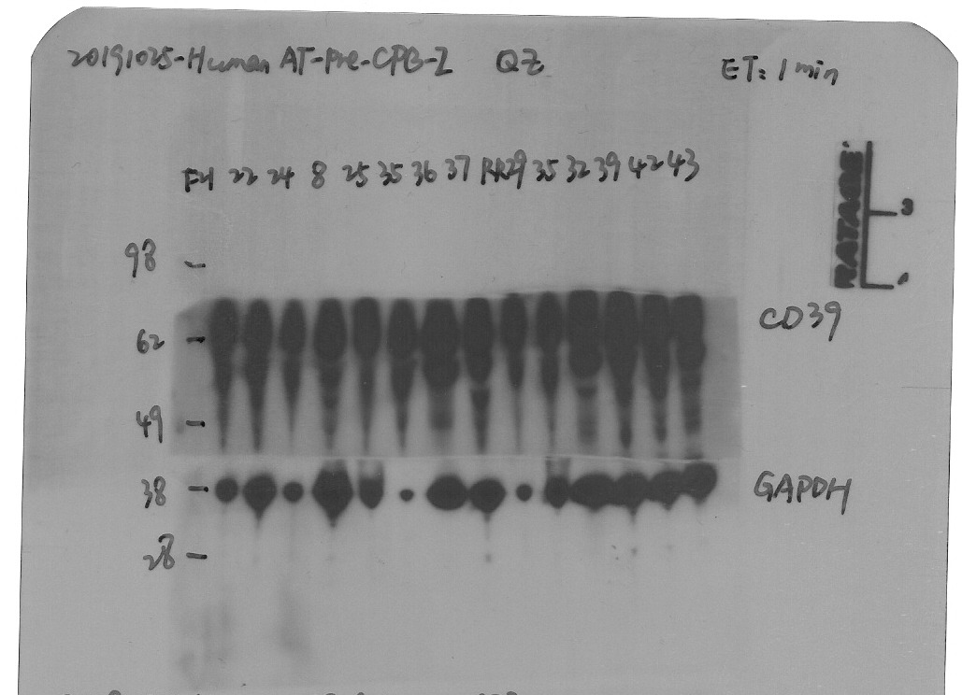
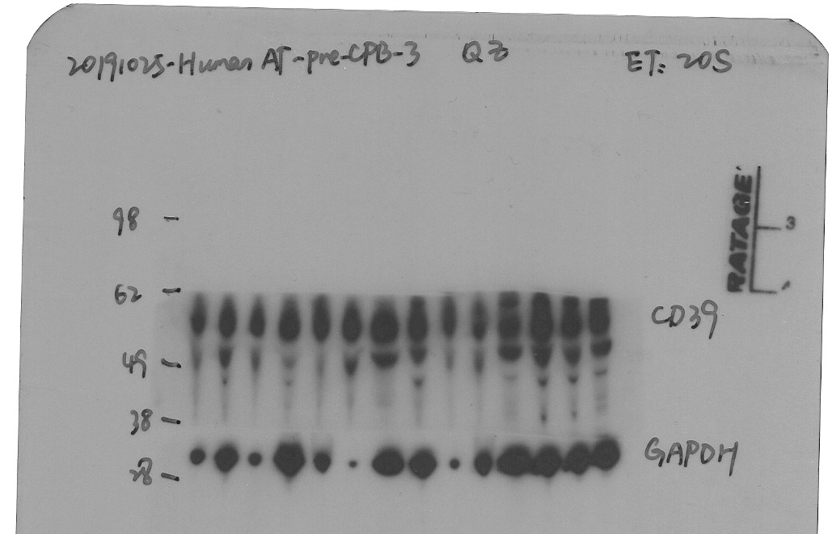
CD39
Female: 22, 24, Male: 8, 25, 35, 36, 37, RR29, 35, 32, 39, 42, 43
Figure 1. Pre and post atrial CD39 and GAPDH expression in female and male patients

Slide 3
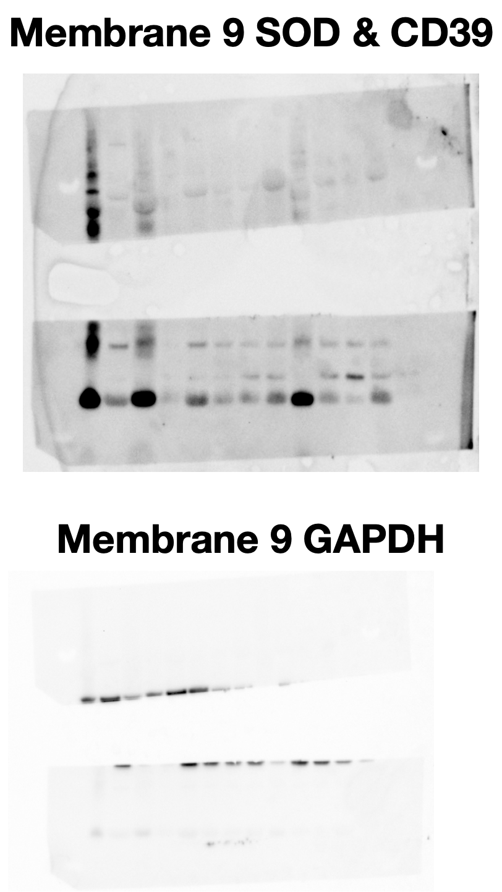
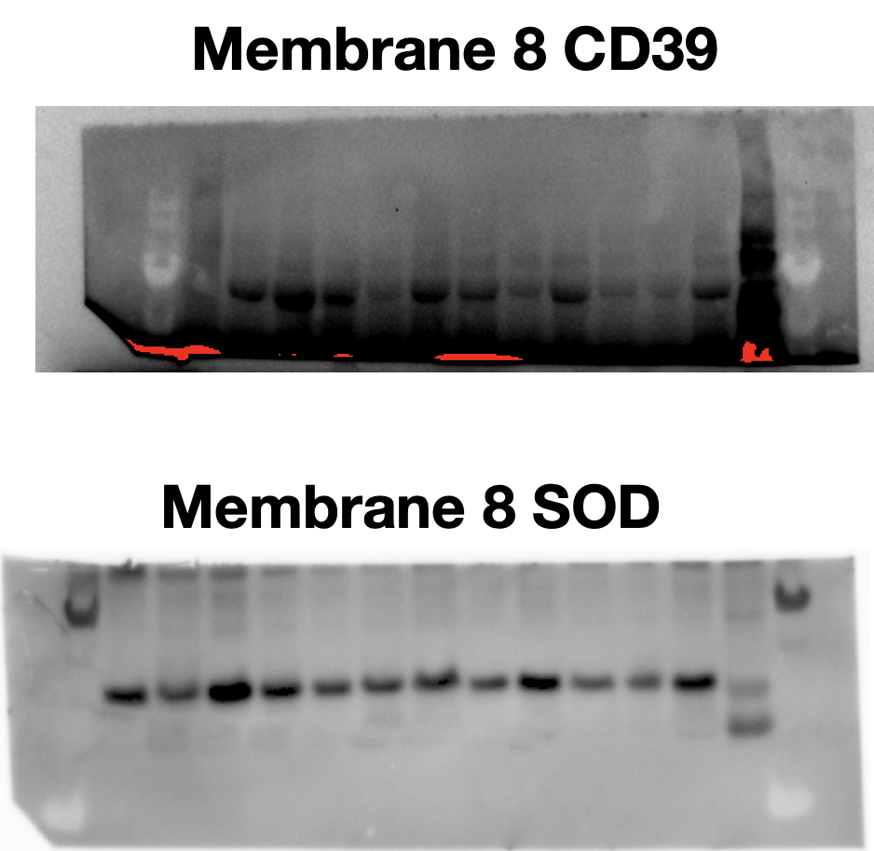
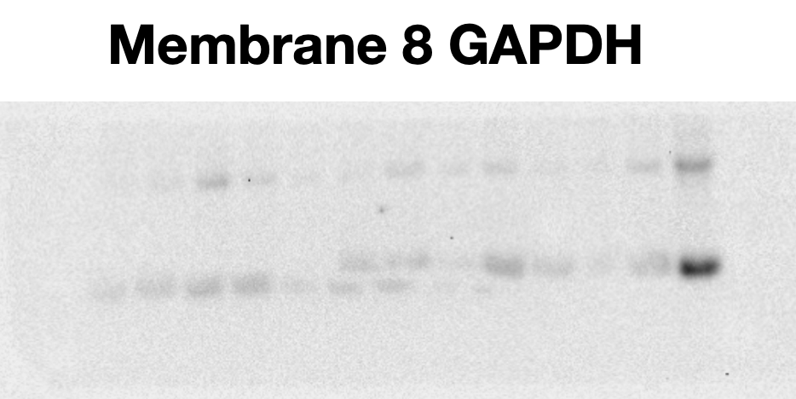
(In order) Male: 38, 40, 42, 46, 74, 67,
Female: 64, 66, 70, 73, 71, 76, 72
Pre-Atrial Tissue
Post-Atrial Tissue

Slide 4
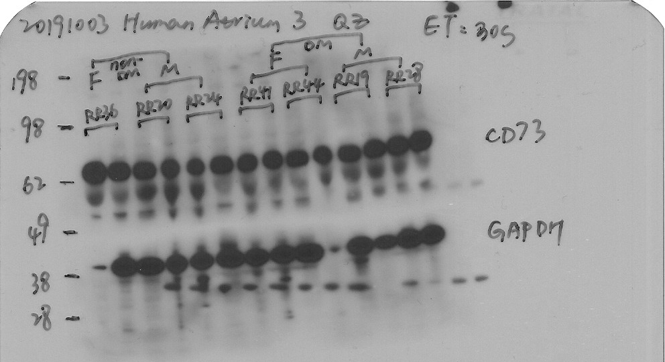
CD73
Figure 1. Pre and post atrial CD73 and GAPDH expression in female and male patients. M = Male; F= Female

Slide 5
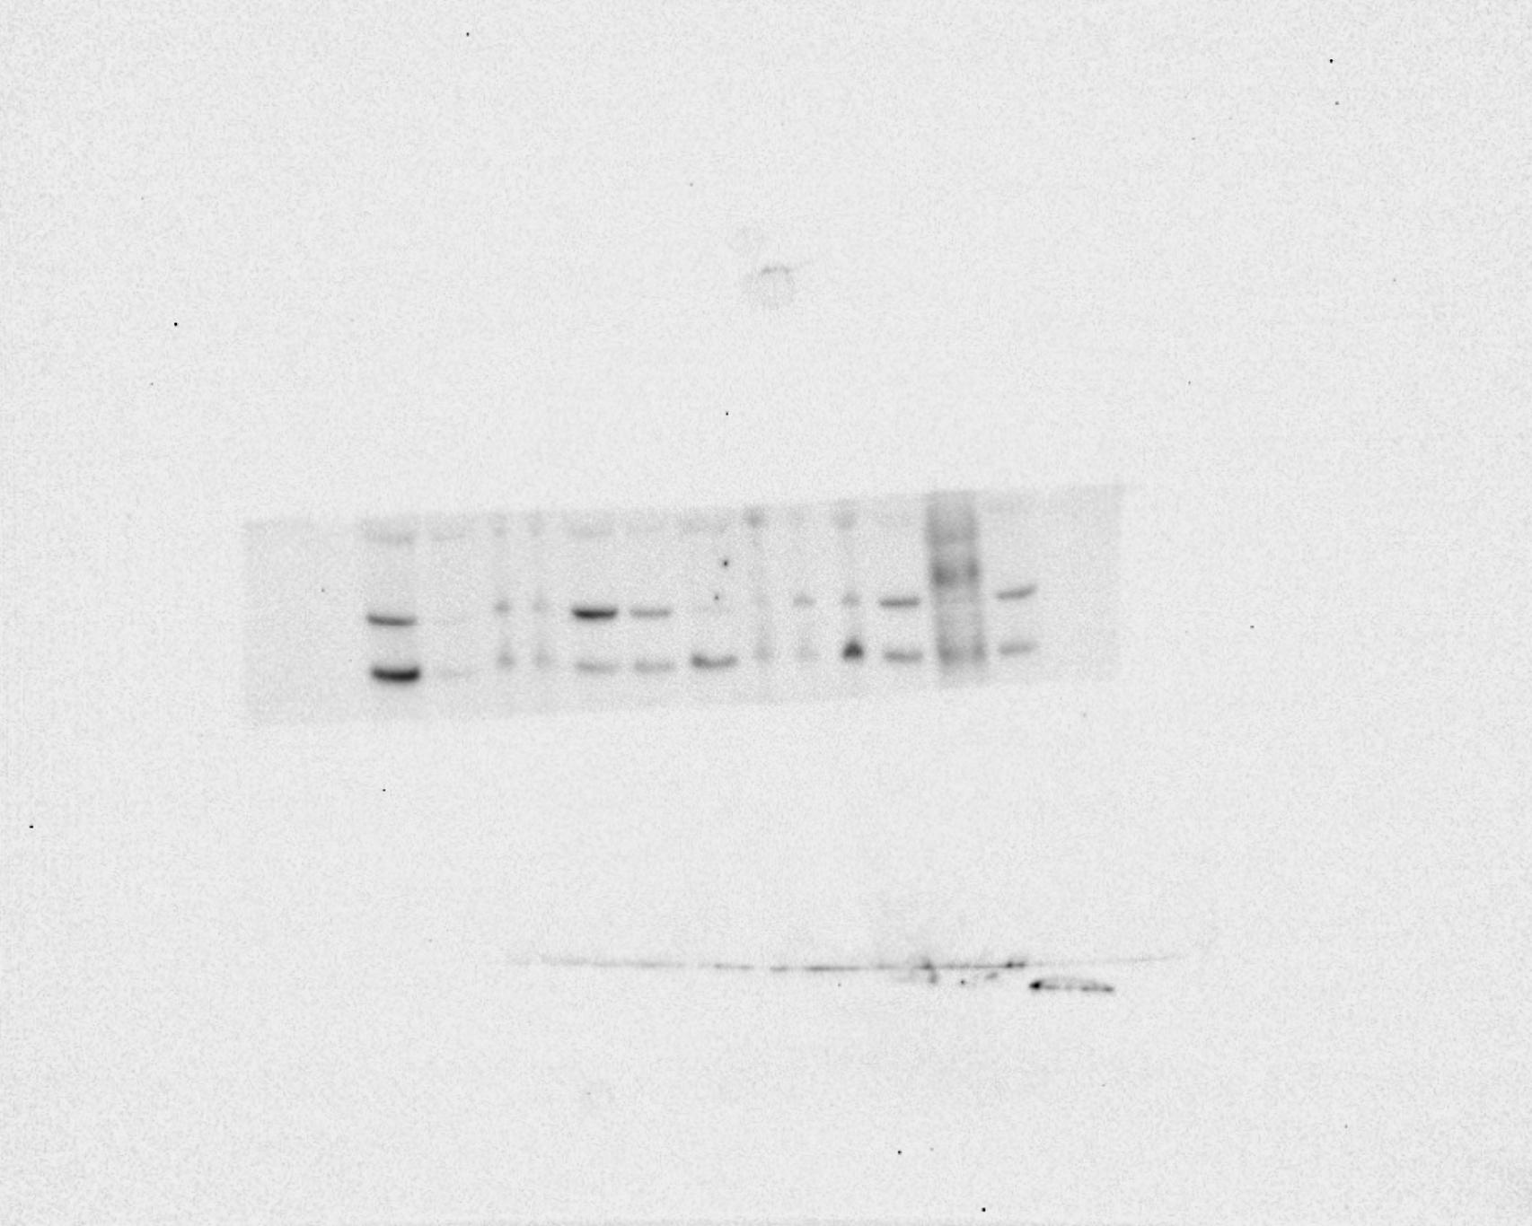
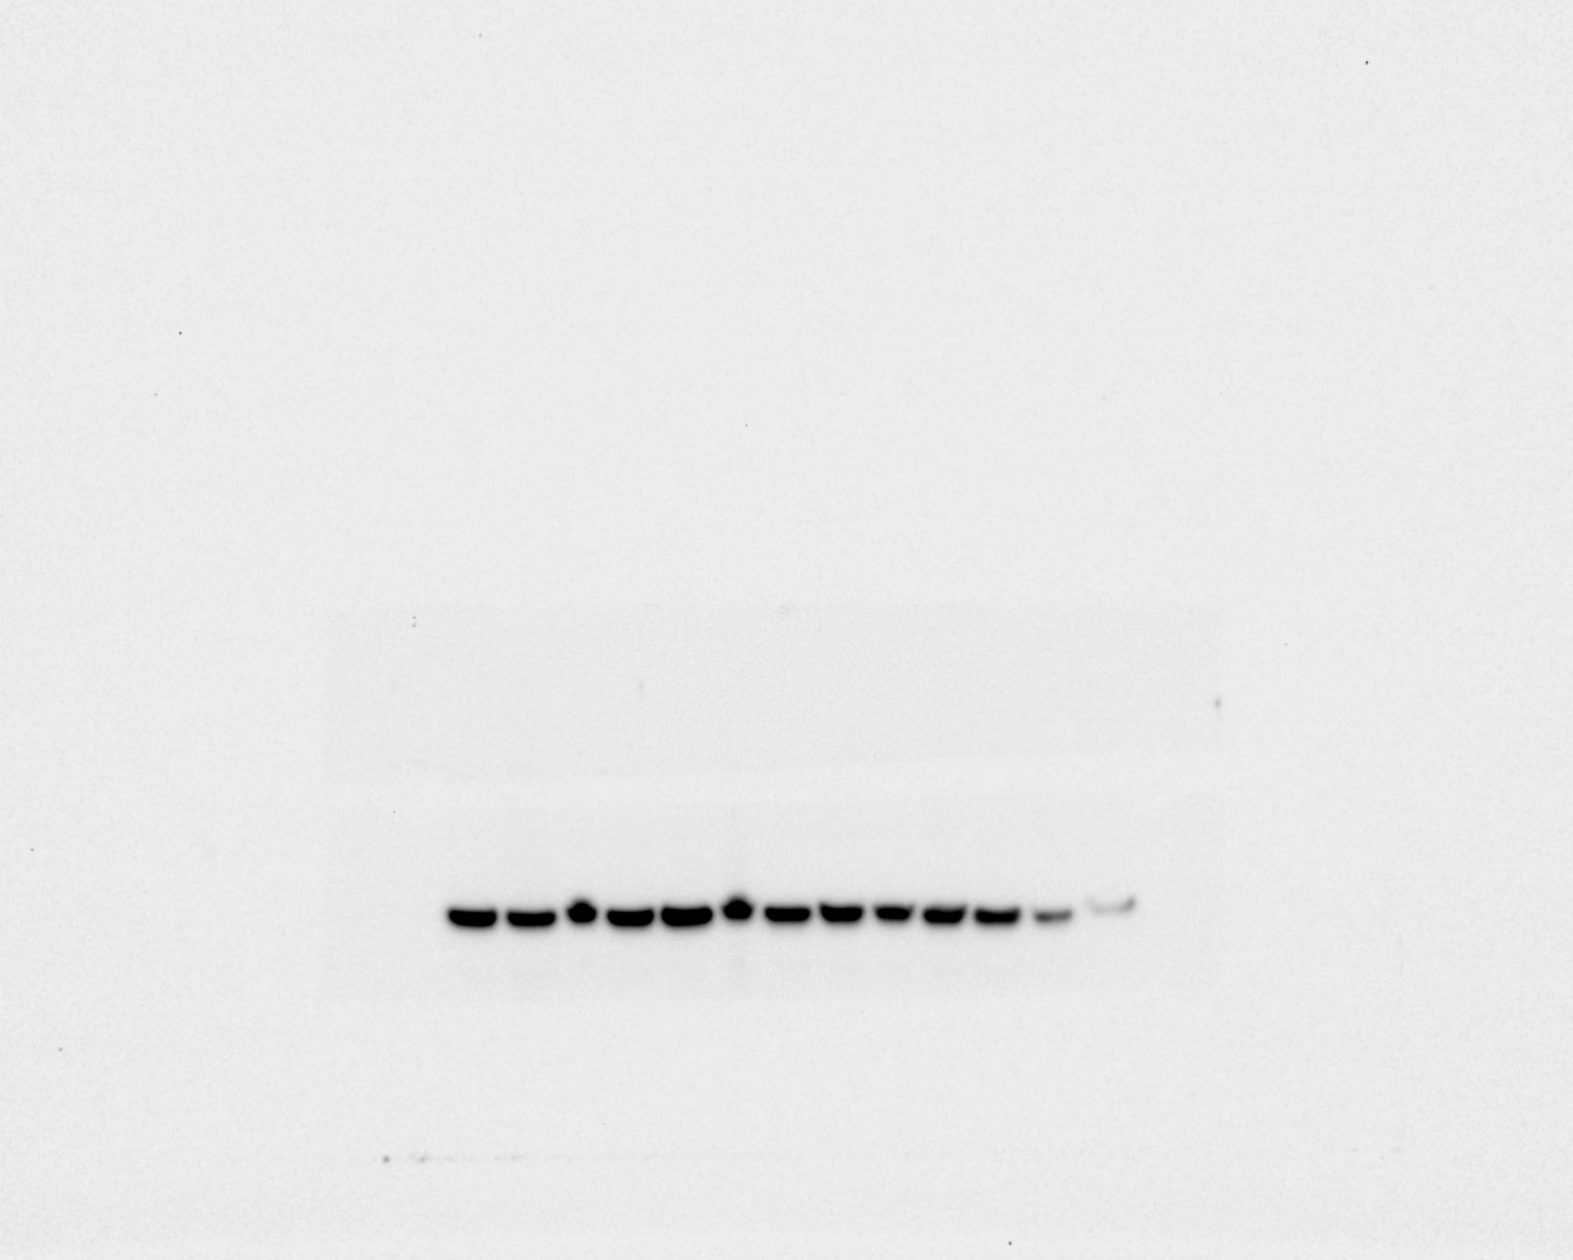
(In order) Male: 38, 40, 42, 46, 74, 67,
Female: 64, 66, 70, 73, 71, 76, 72
Cytochrome C
Cytochrome C
Cytochrome C
GAPDH
GAPDH
Pre Atrial Tissue
Post-atrial tissue
GAPDH

Slide 6
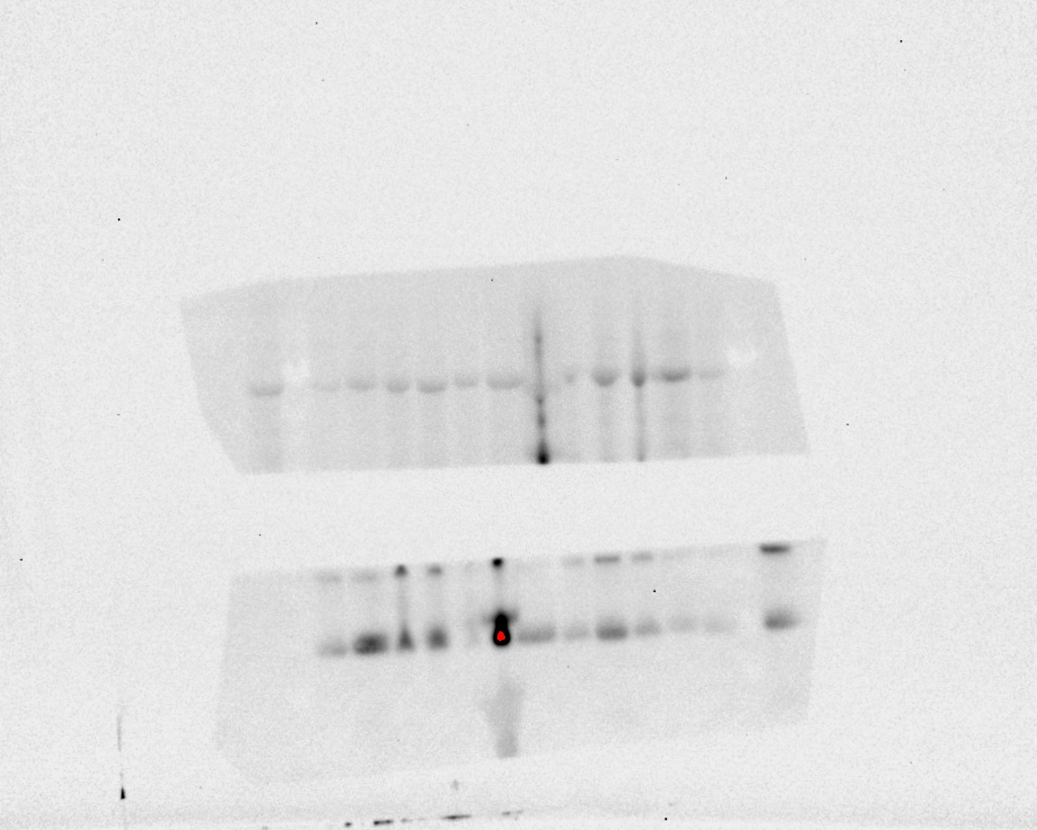
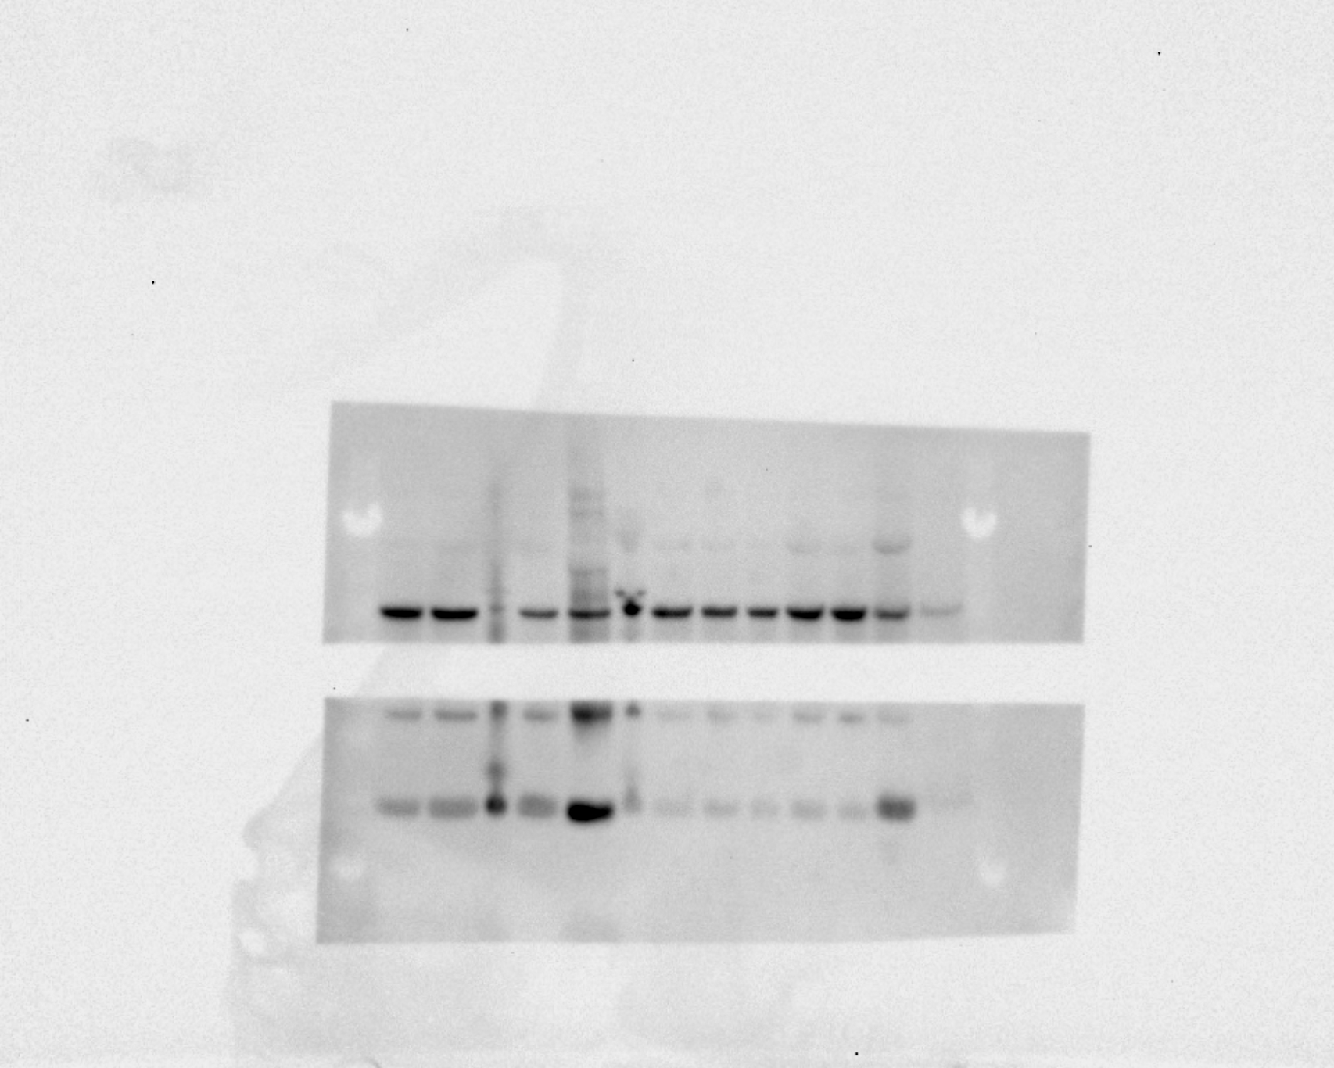
COXIV
(In order) Male: 38, 40, 42, 46, 74, 67,
Female: 64, 66, 70, 73, 71, 76, 72
Pre Atrial Tissue
Post Atrial Tissue
GAPDH

Slide 7
ADORA2A
Actinin
Pre-CPB atrial tissue
ADORA2A
Actinin
Post-CPB Atrial Tissue
ADORA2A

Slide 8
ADORA2B

Slide 9
Mice Western Blot Images

Slide 10
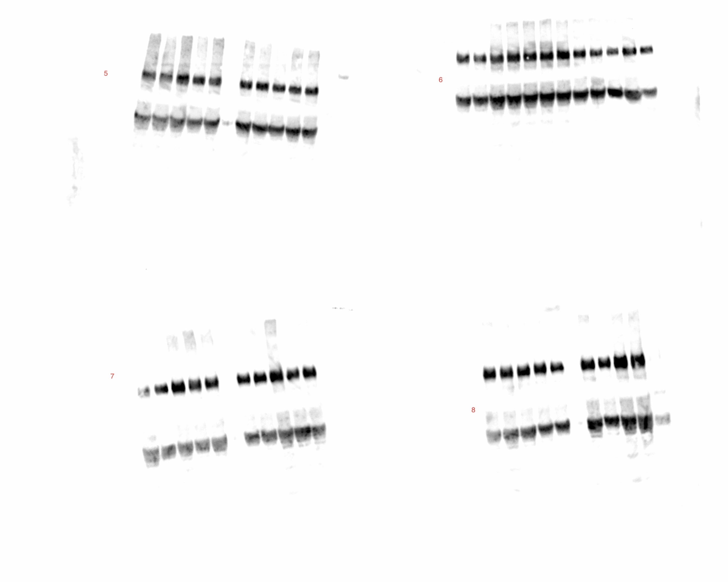
CD39
CD39
CD39
GAPDH
GAPDH
Control
OVX
Mice
CD39
GAPDH
CD39
CD39
GAPDH
GAPDH
HFD+OVX
HFD

Slide 11
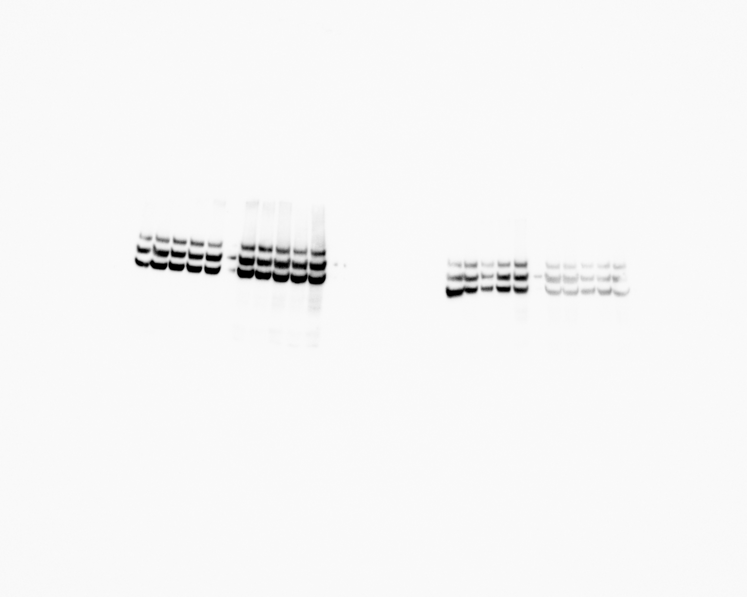
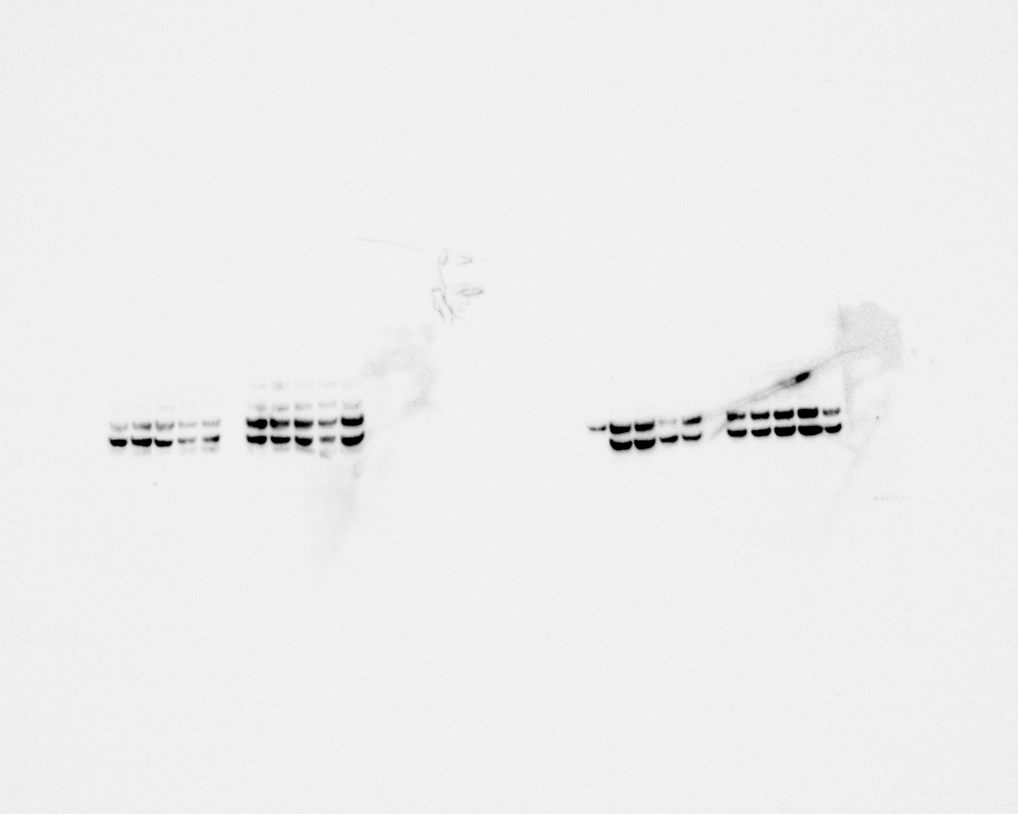
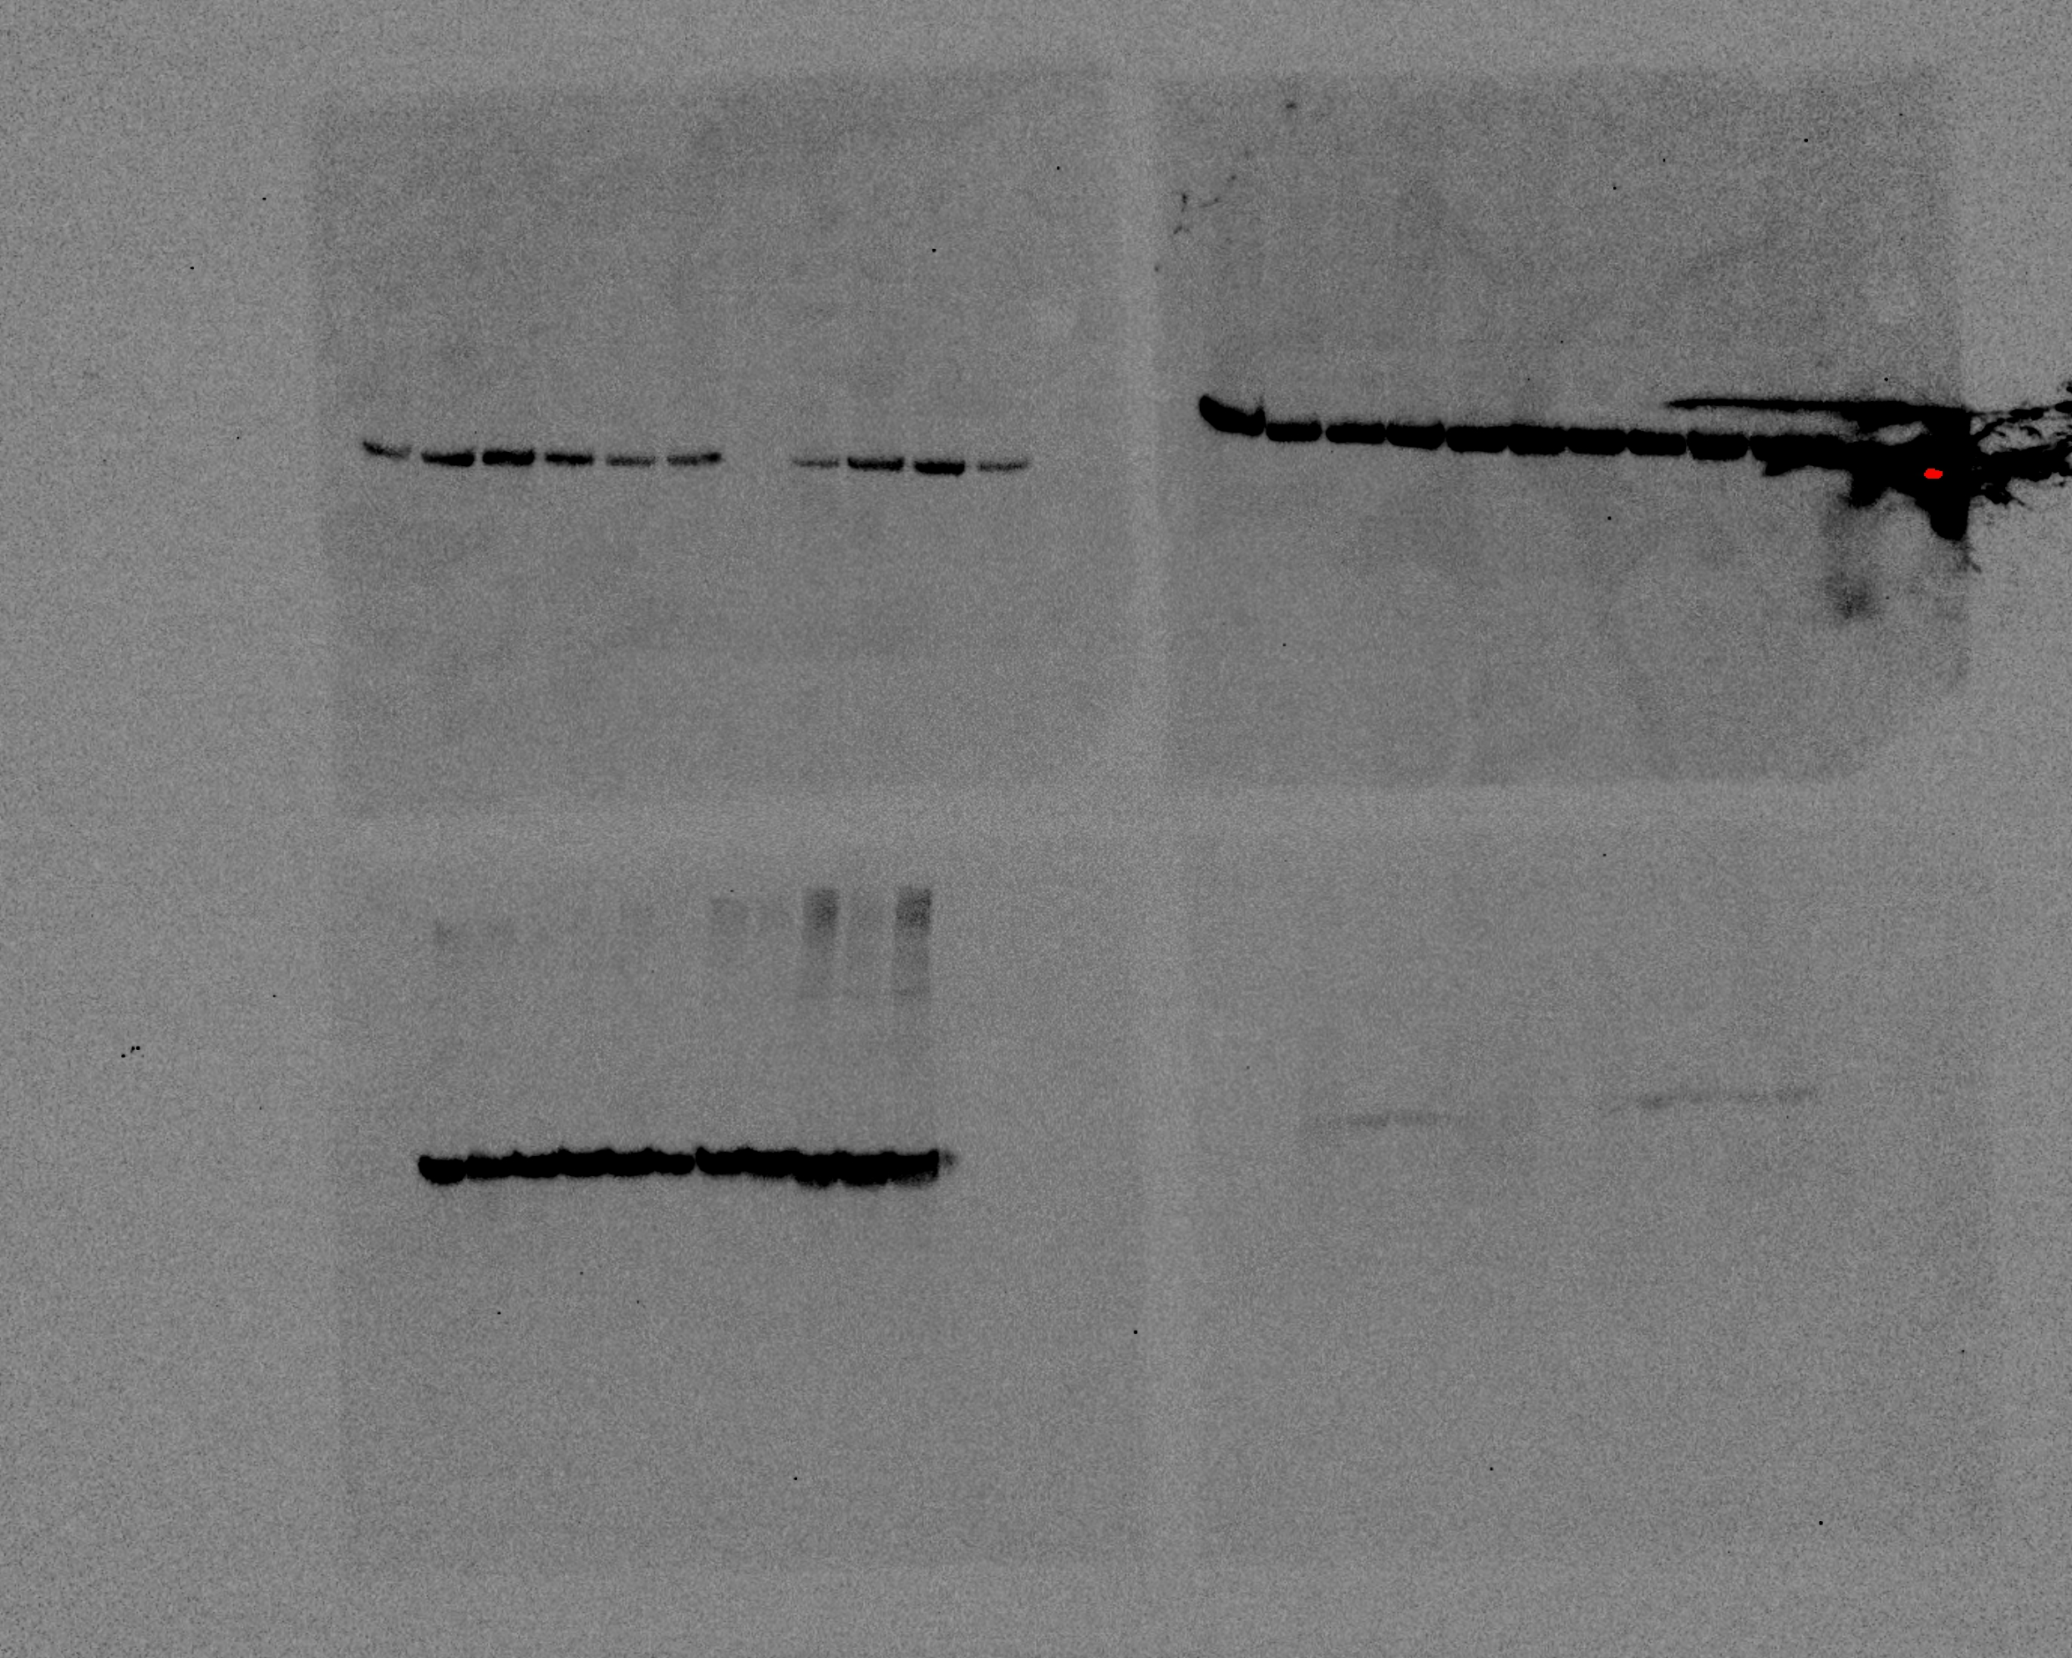
CD73
Control
OVX
HFD+OVX
HFD
Control
OVX
HFD+OVX
HFD

Slide 12
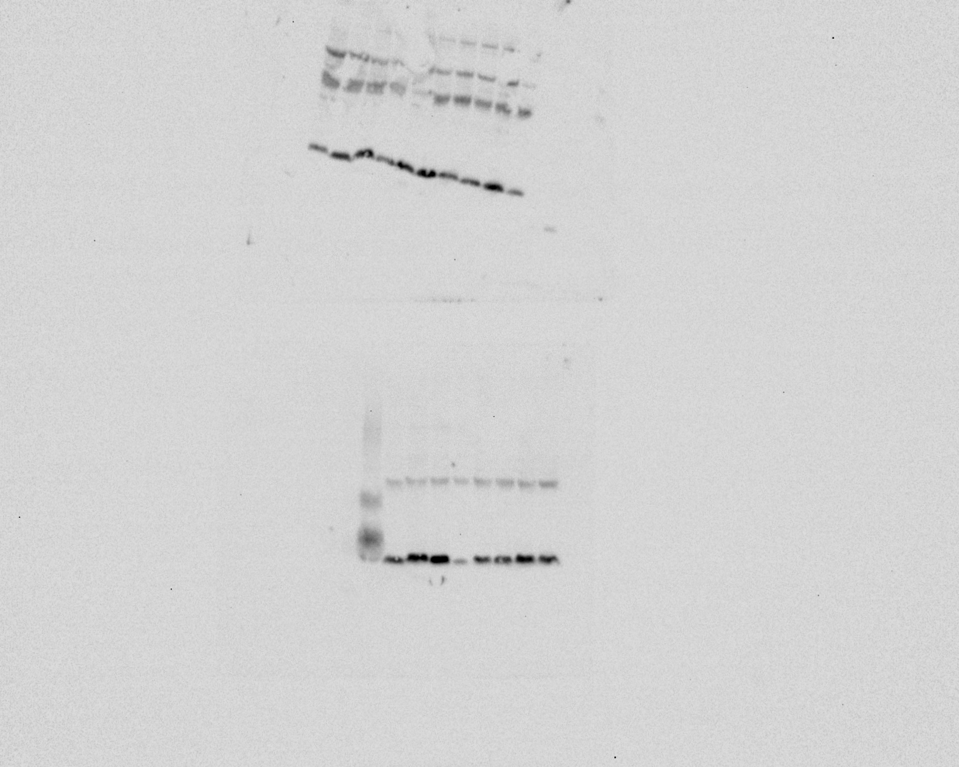
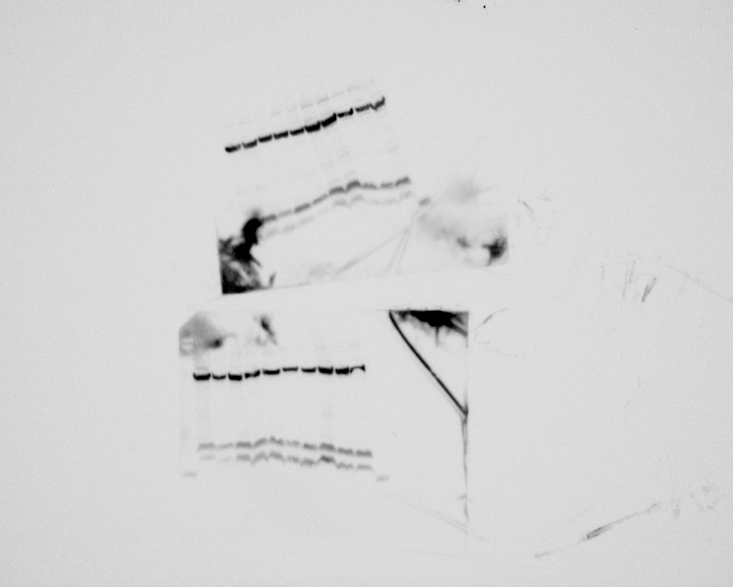
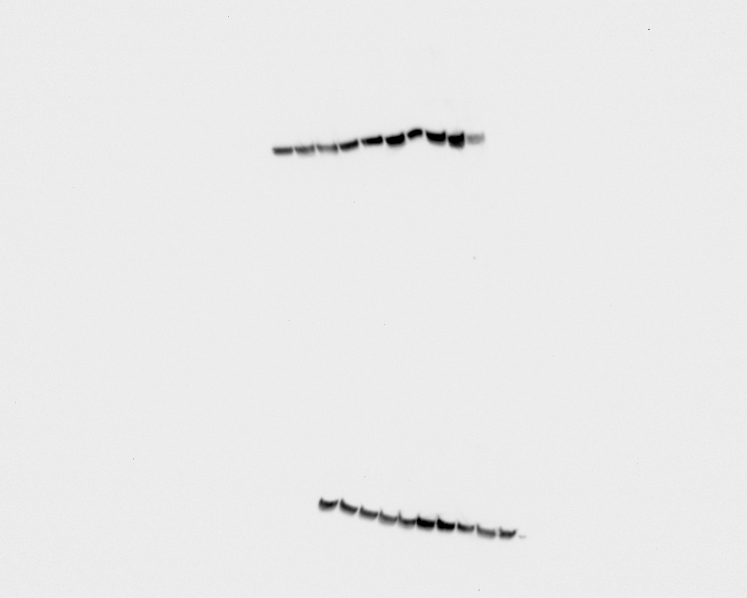
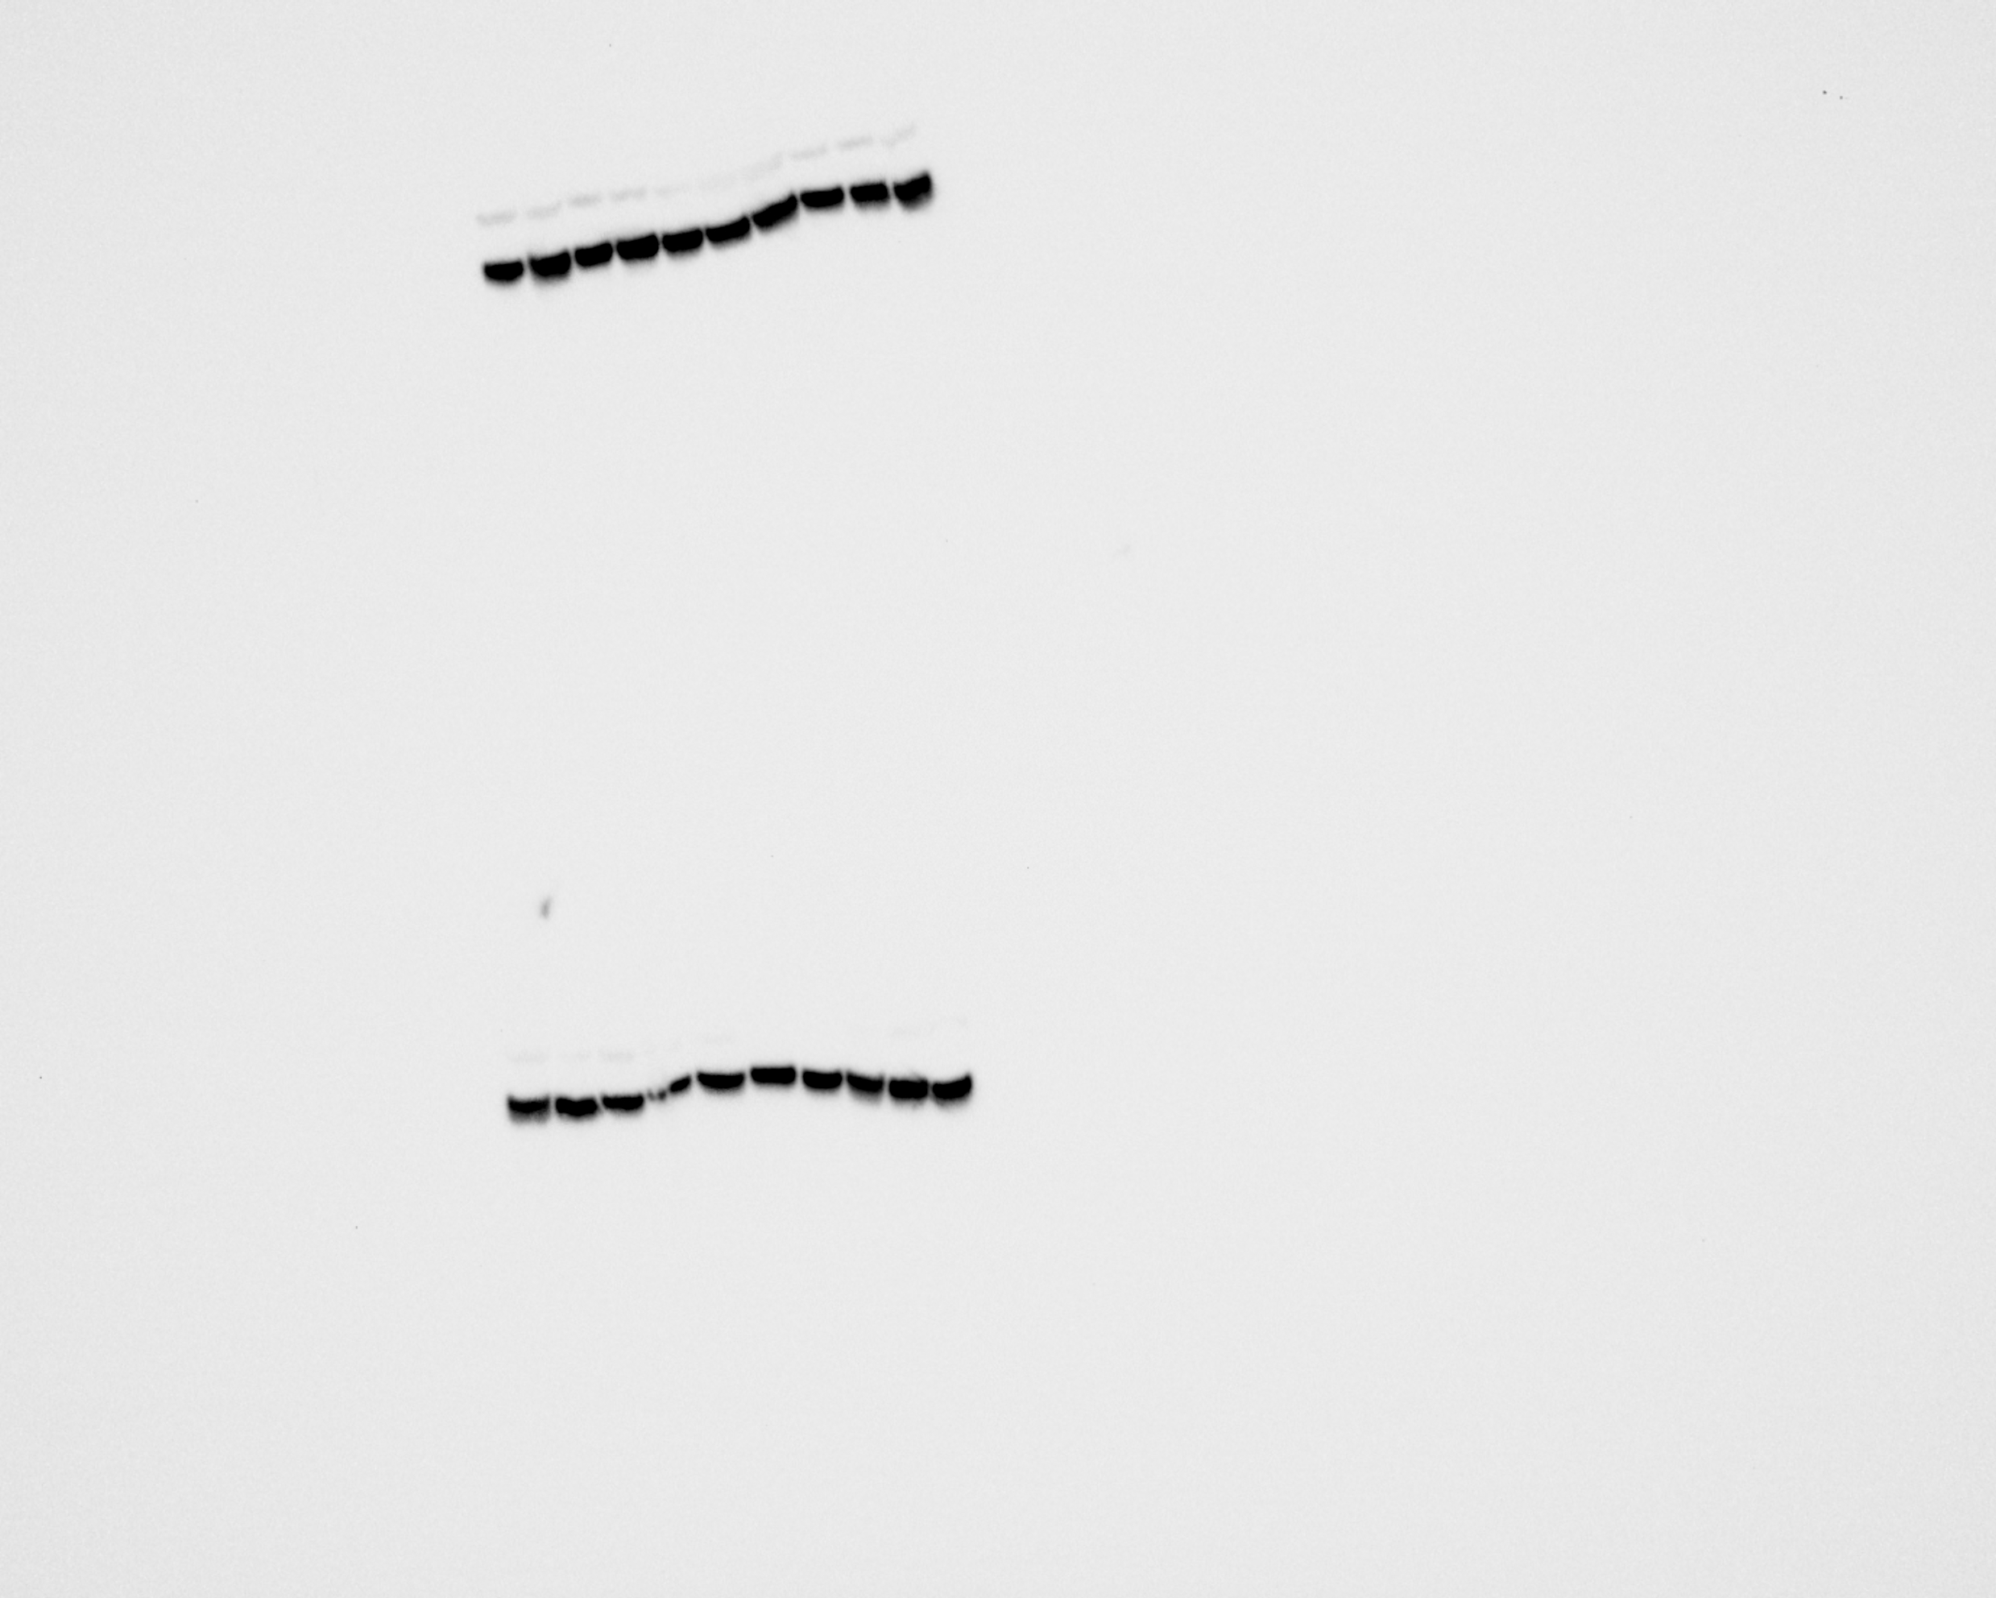
ENT 1
Control
OVX
HFD
HFD+OVX
GAPDH
OVX
Control
HFD+OVX
HFD

Slide 13
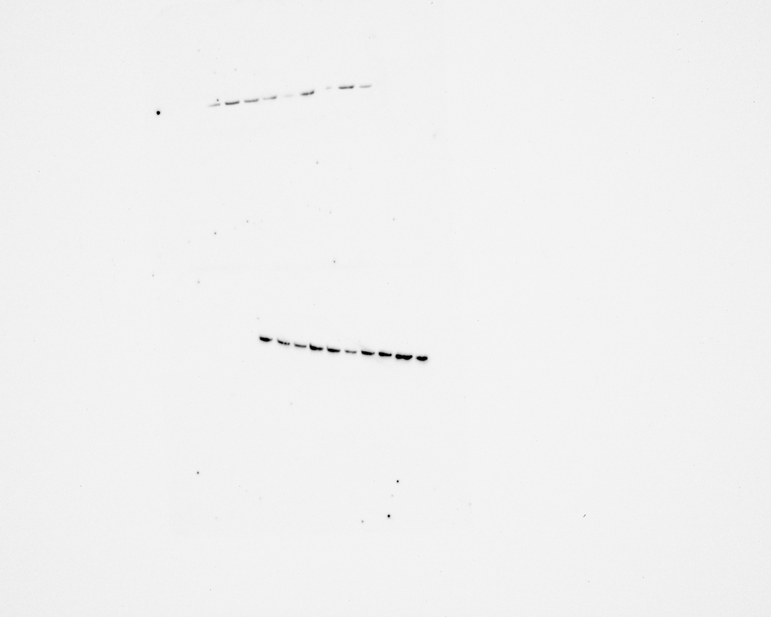
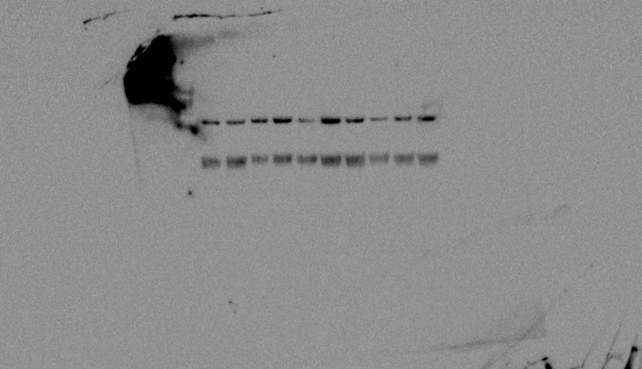
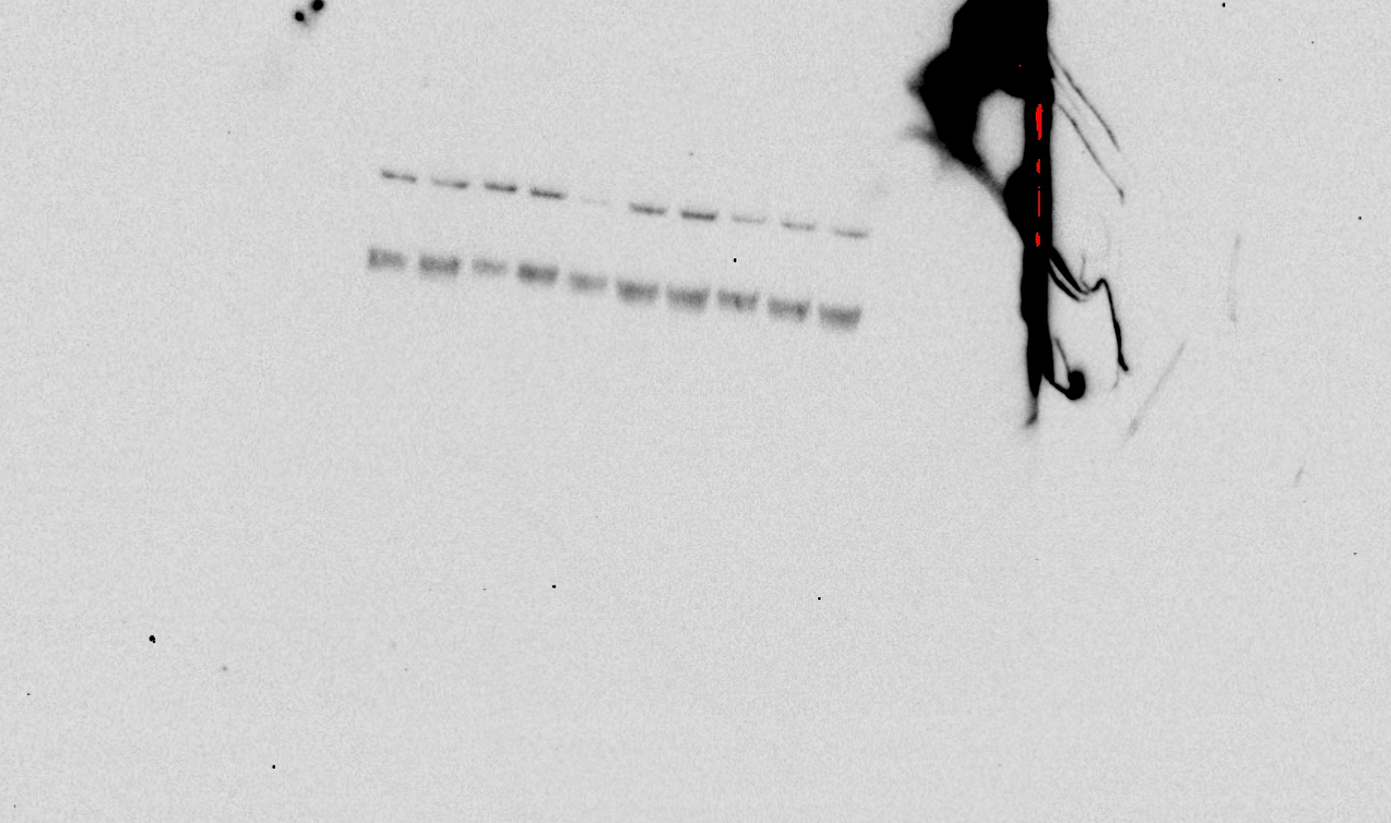
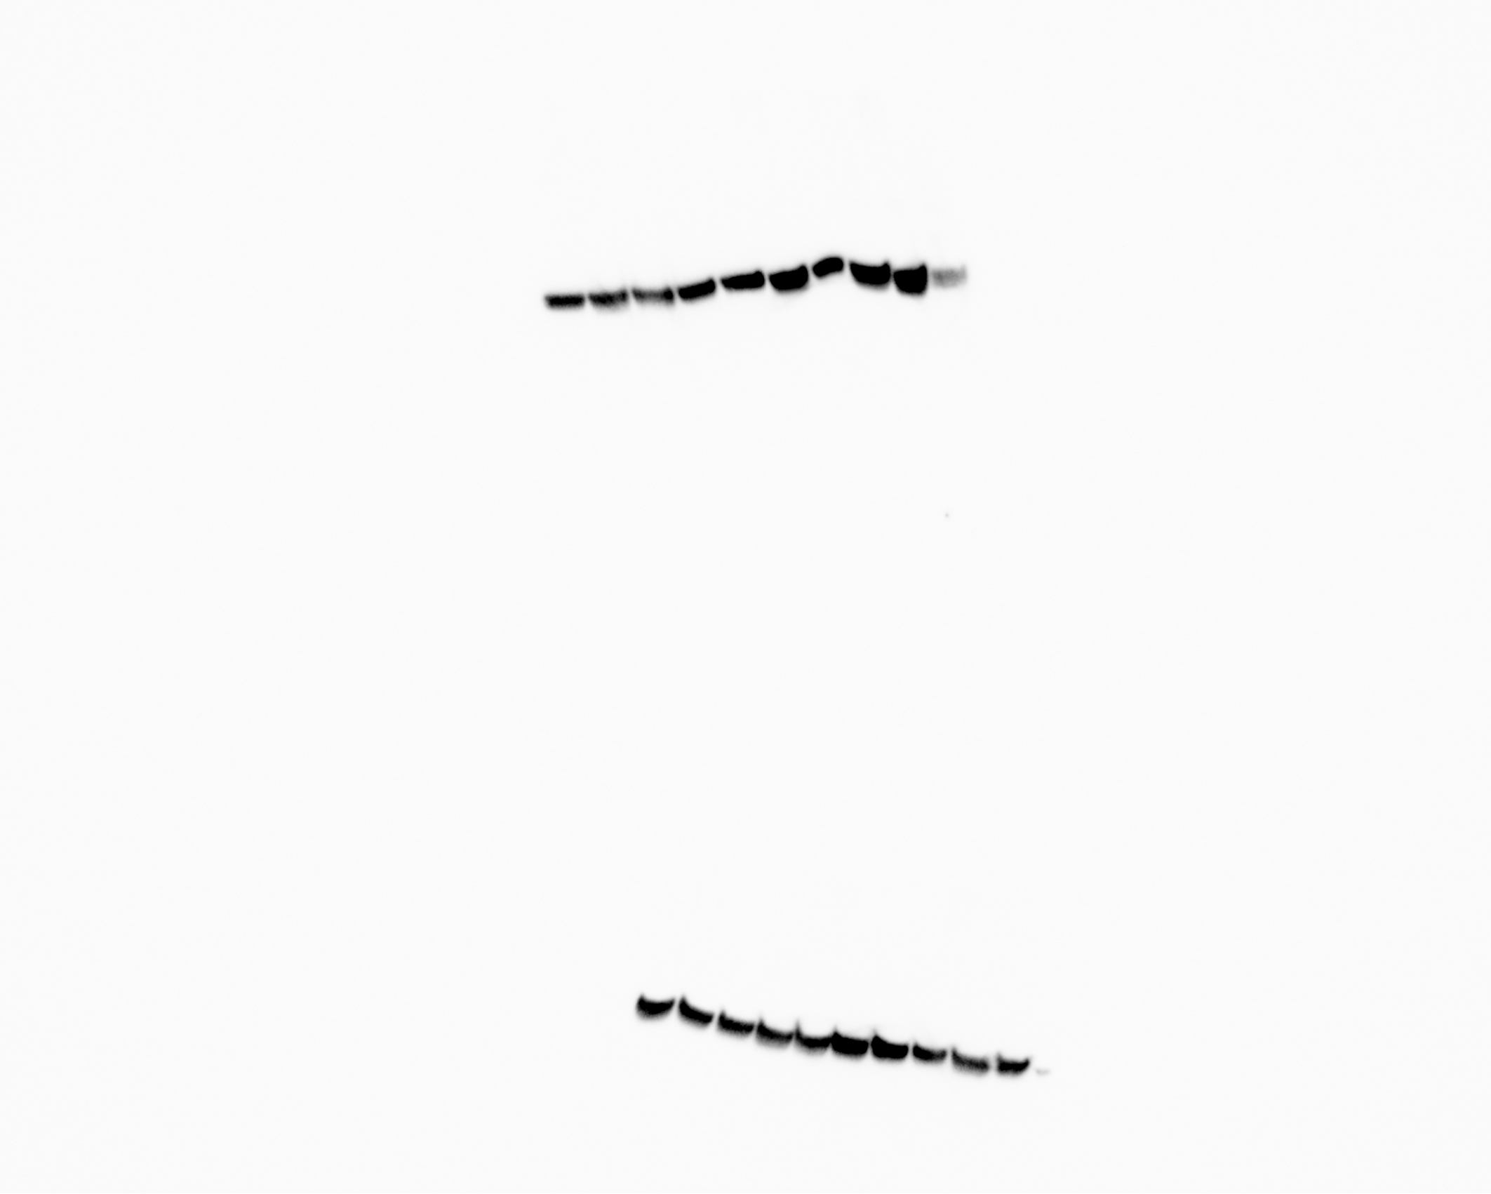
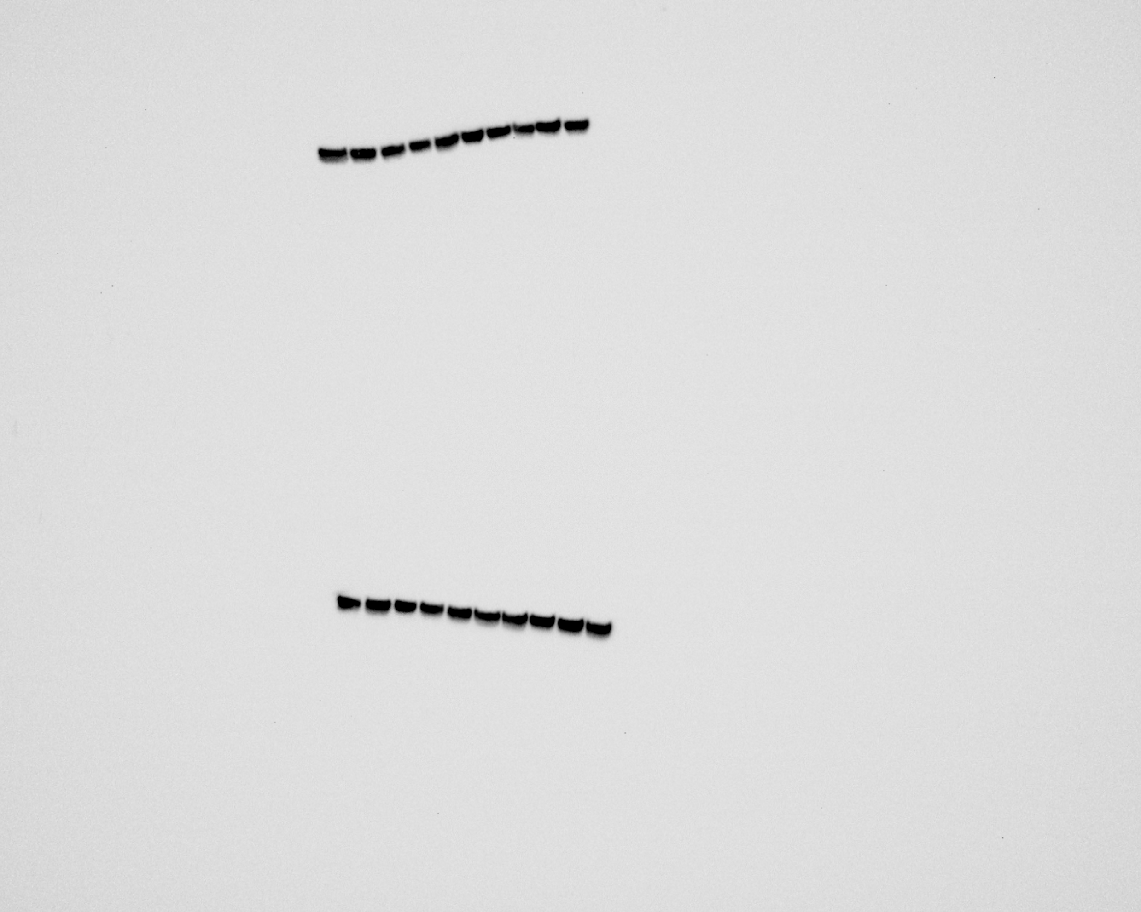
ADA
Control
HFD+OVX
HFD
OVX
GAPDH
Control
HFD+OVX
HFD
OVX

Slide 14
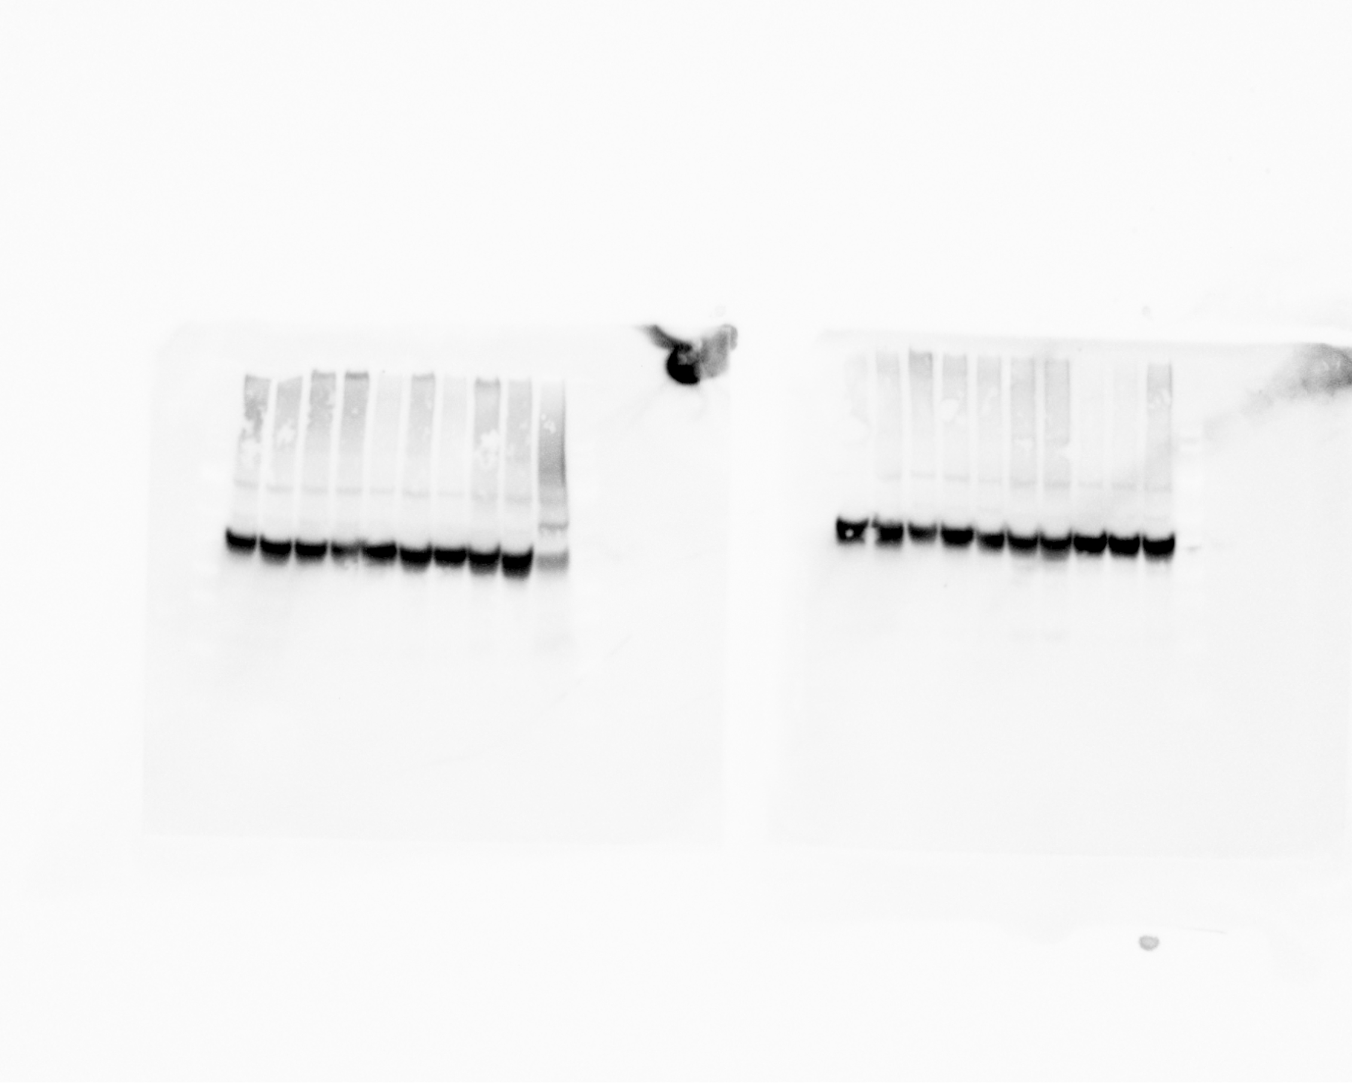
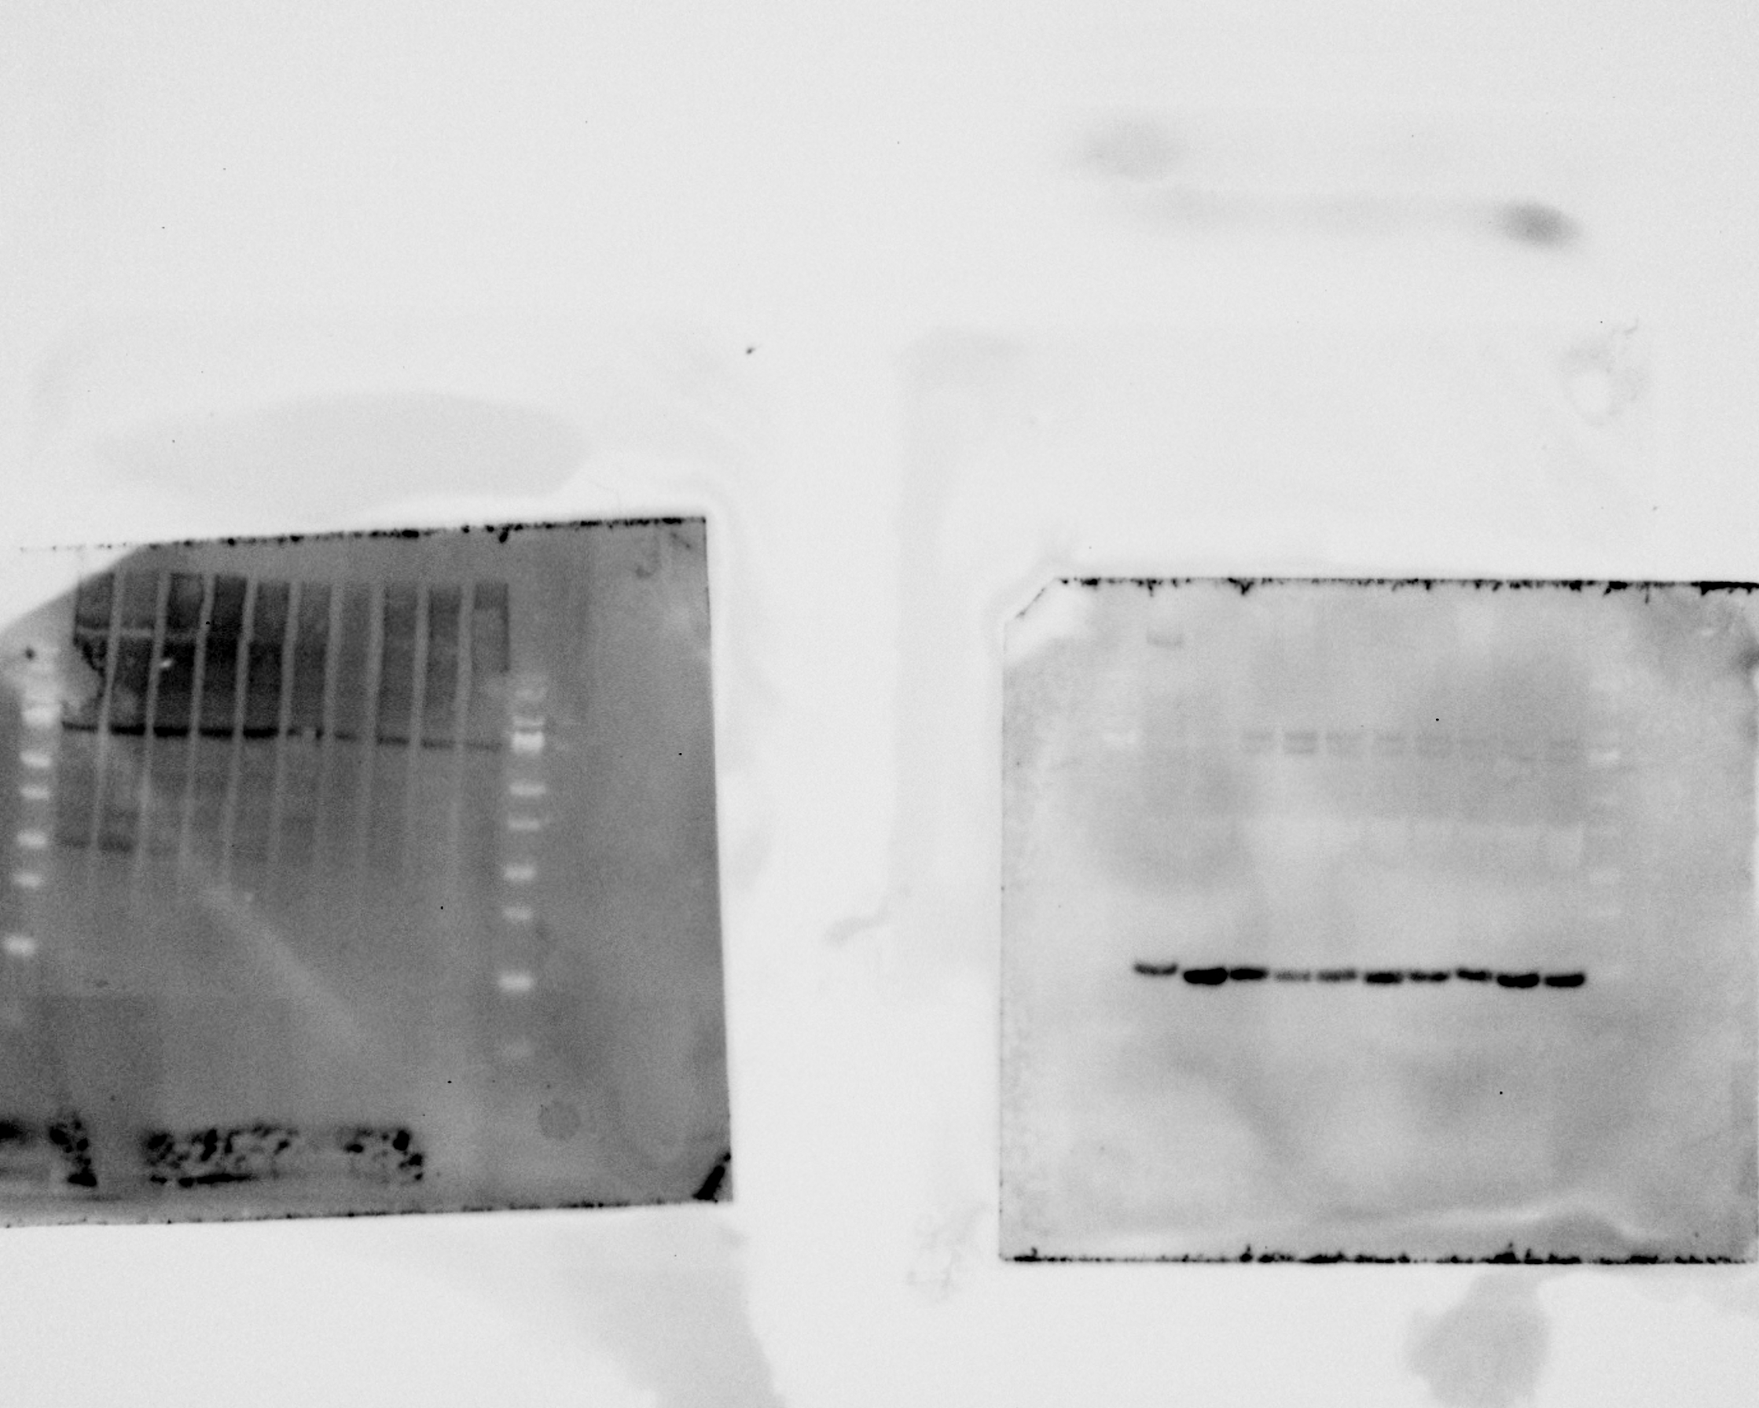
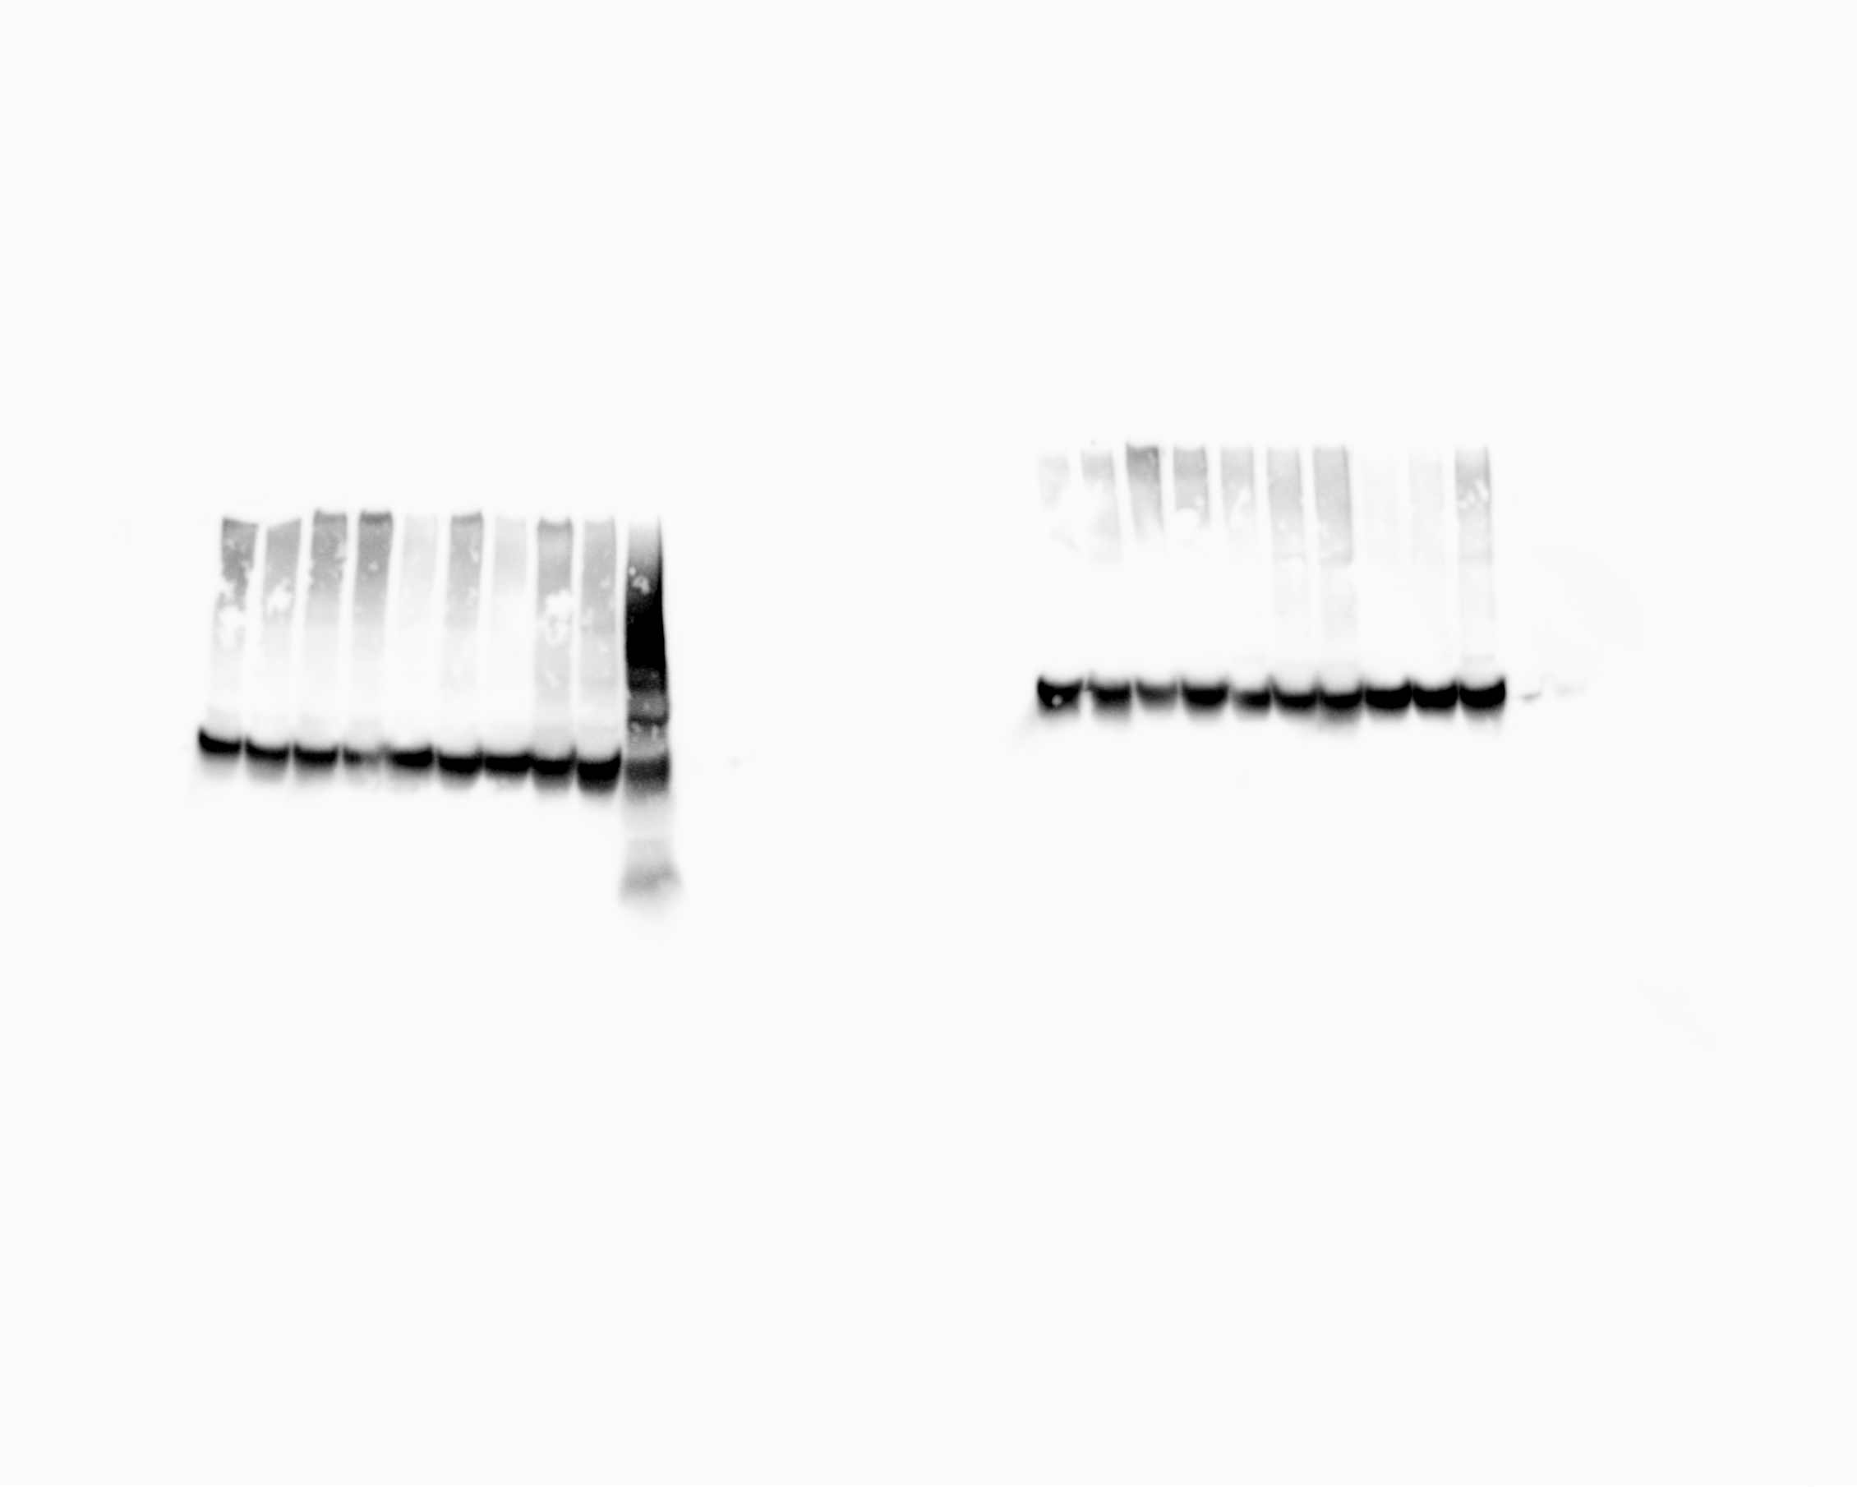
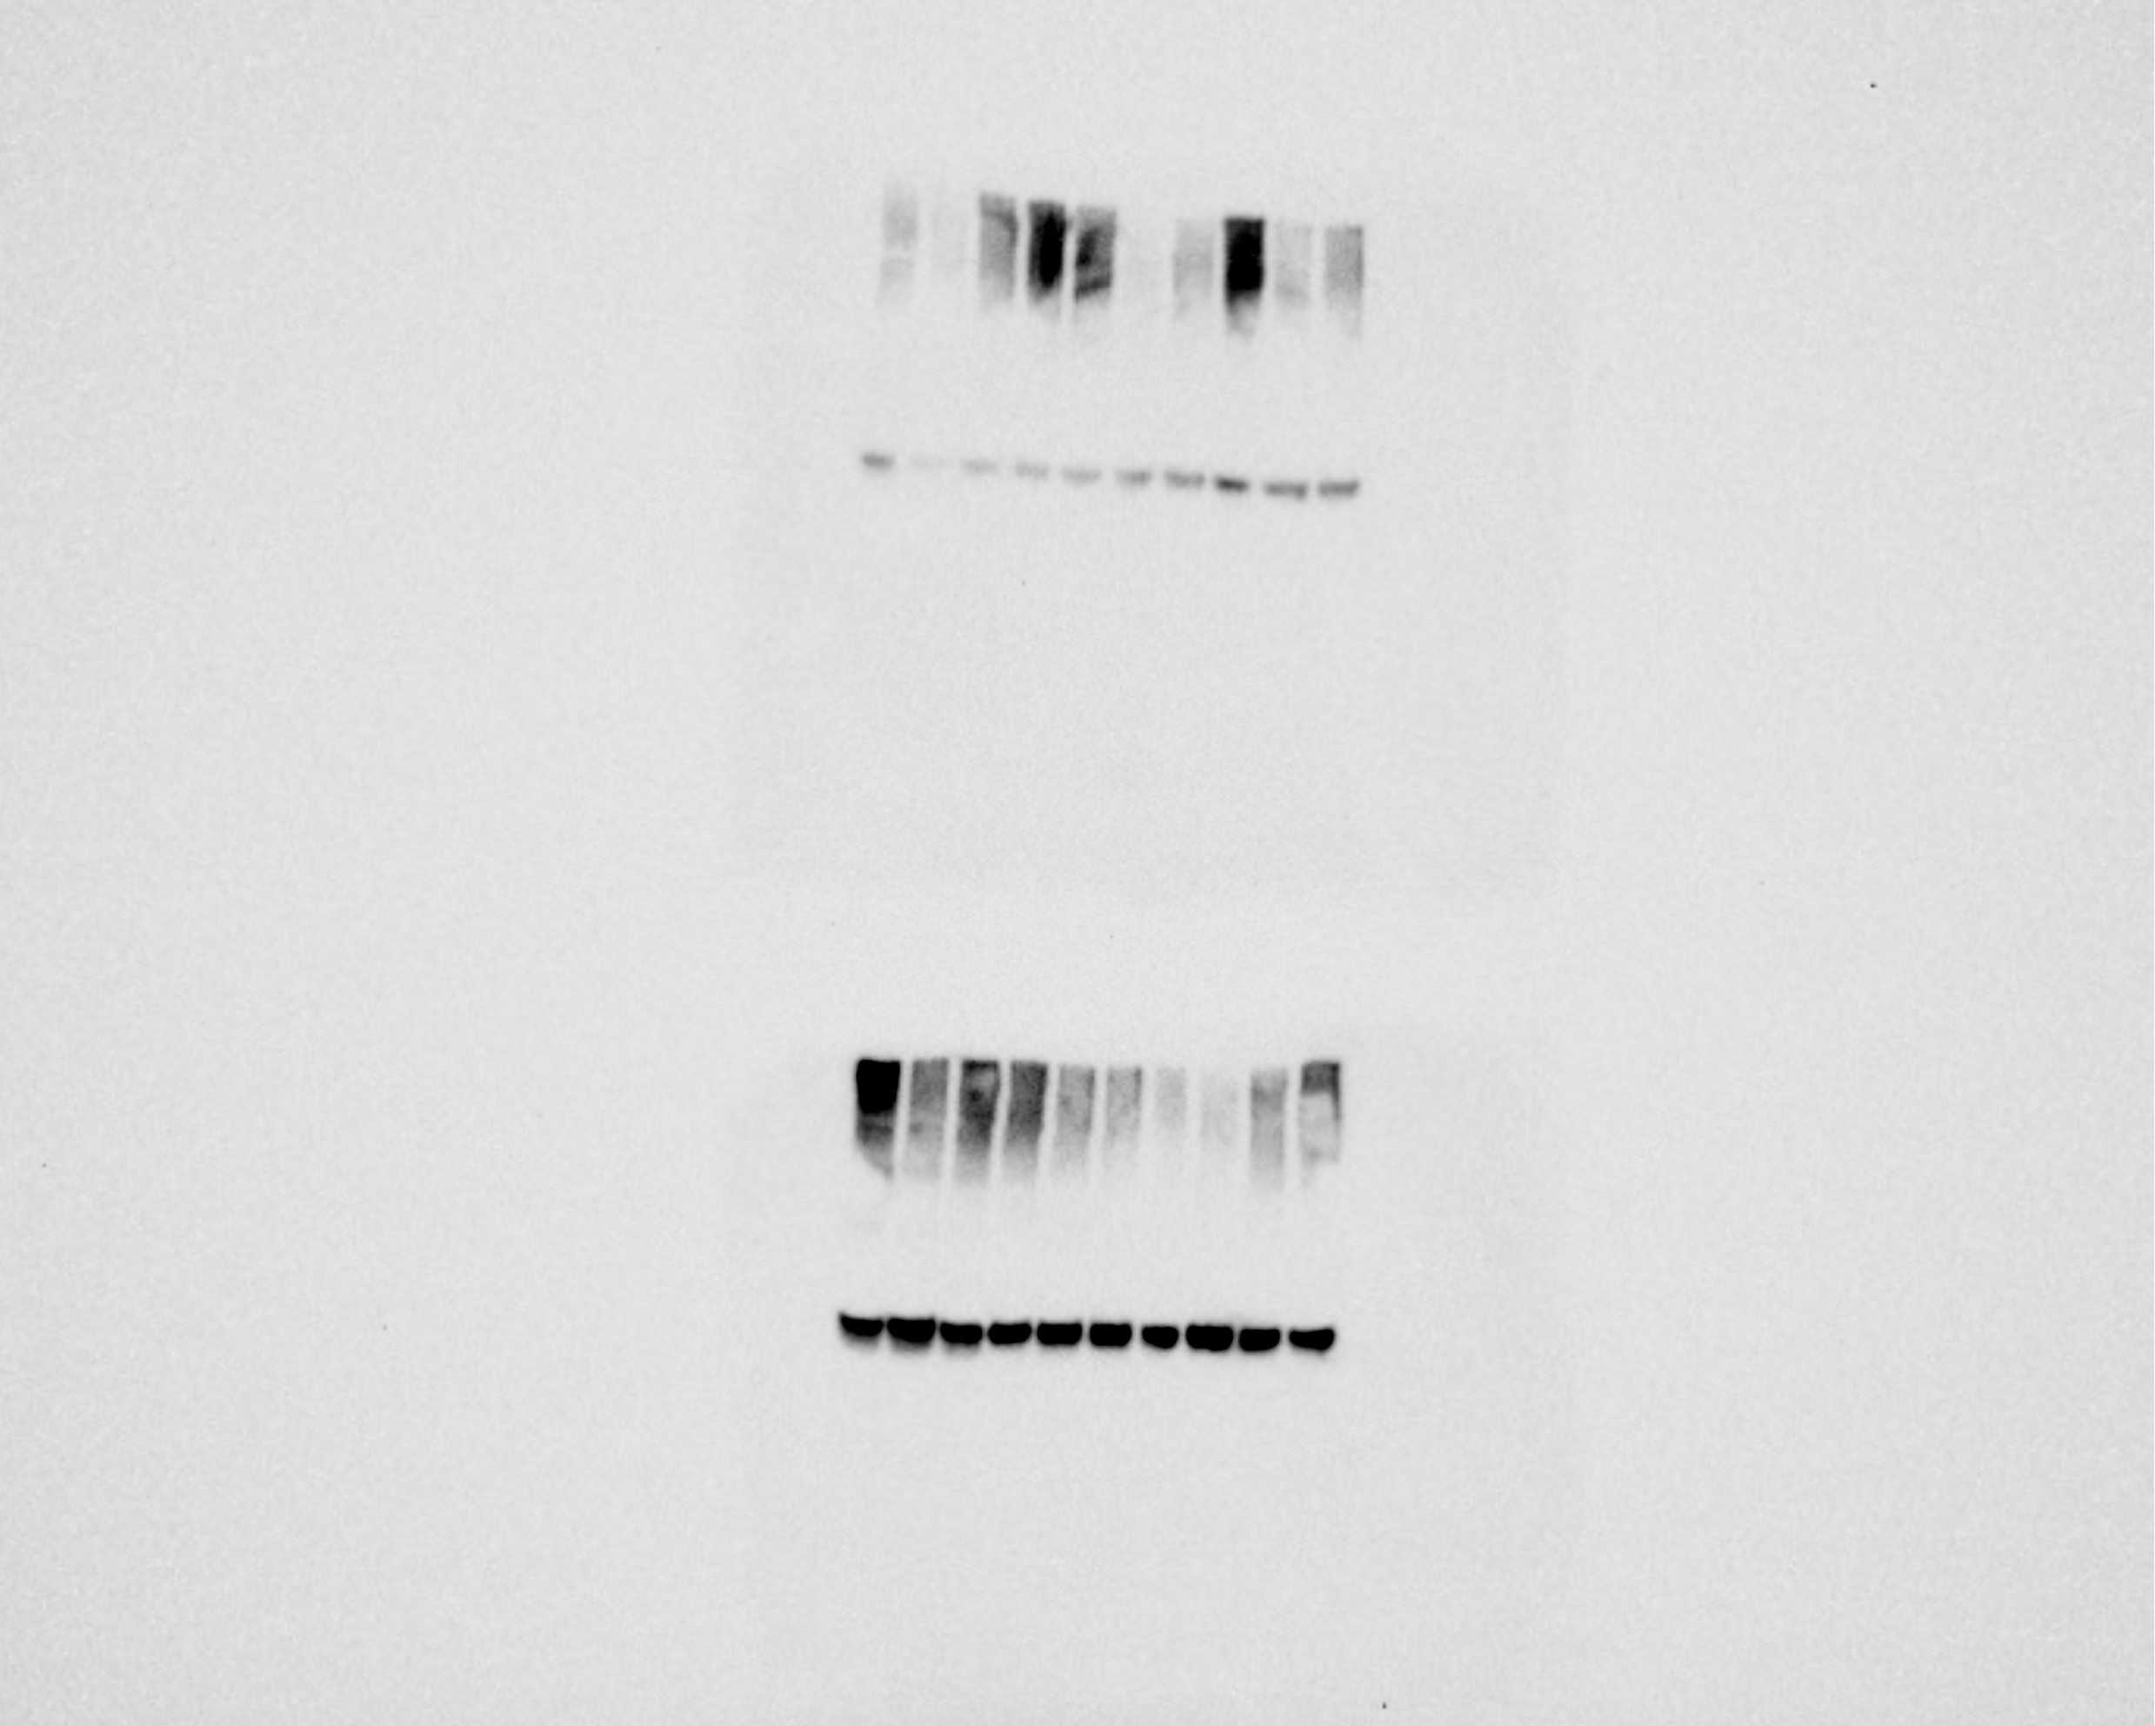
Leptin
Control
HFD
OVX
HFD+OVX
OVX
GAPDH
HFD
Control
HFD+OVX

Slide 15
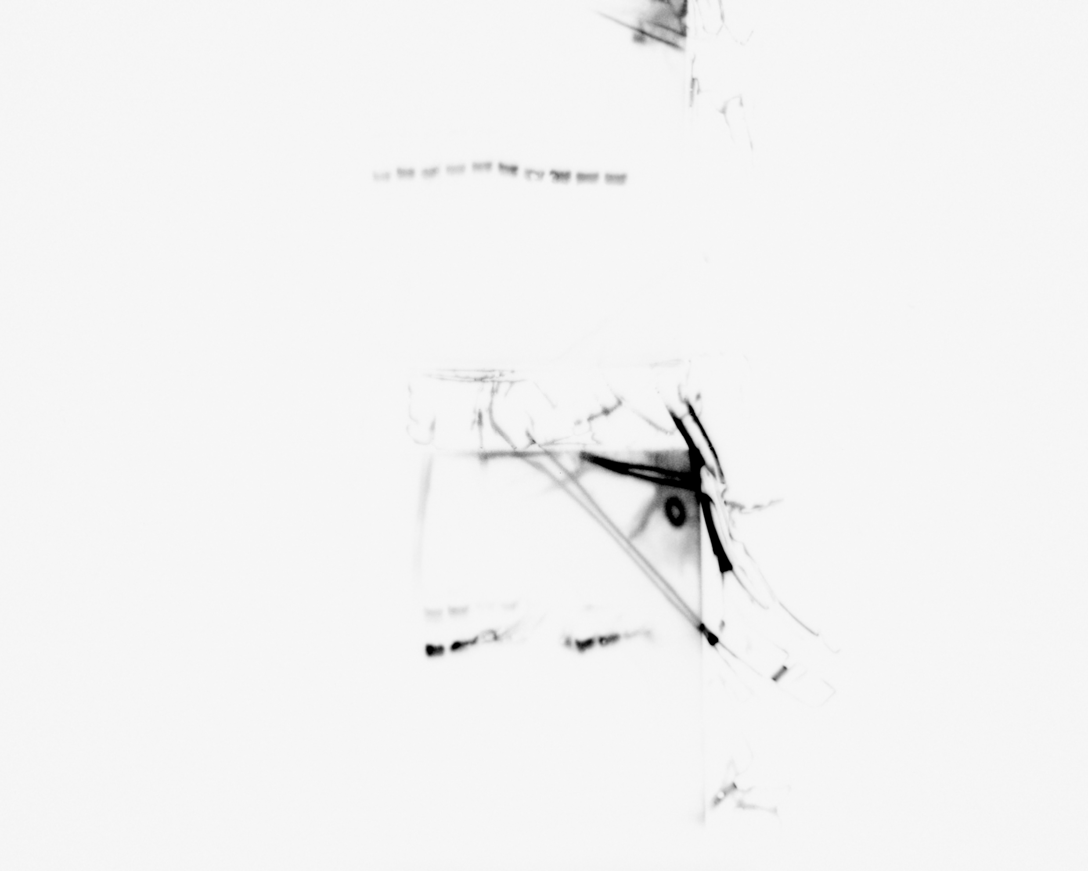
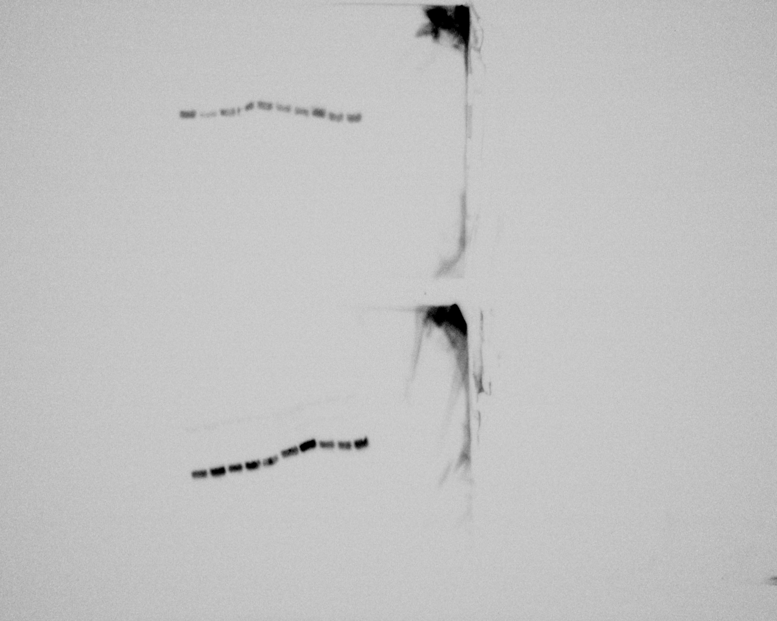
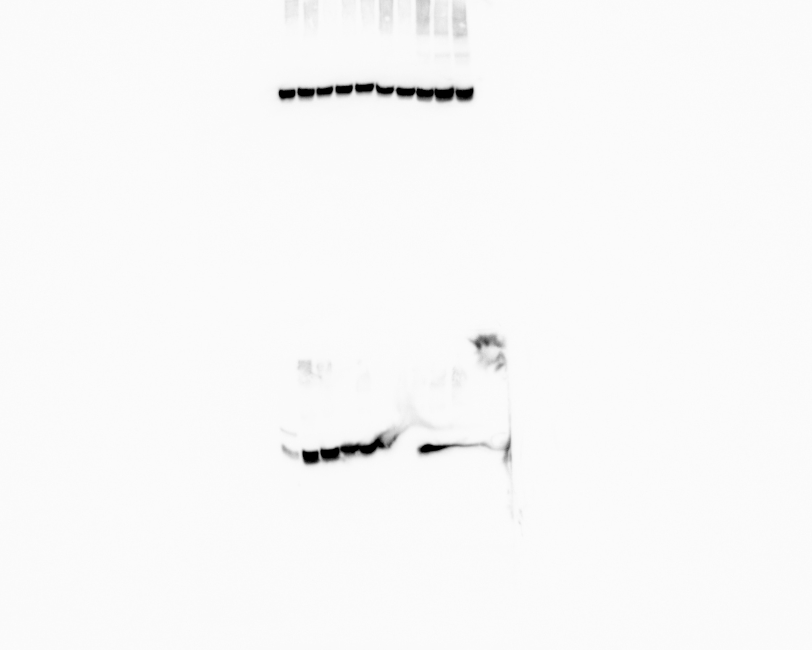
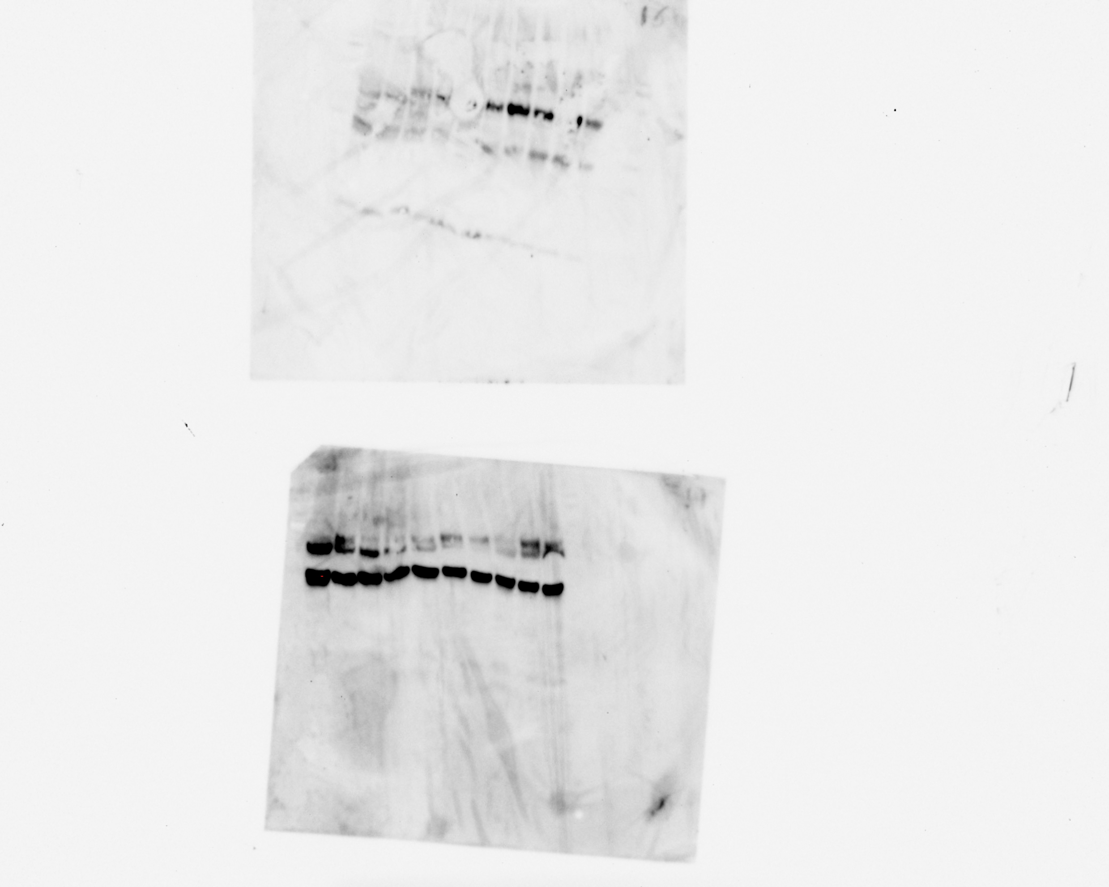
MnSOD
Control
HFD
HFD+OVX
OVX
Control
HFD
GAPDH
HFD+OVX
OVX

Slide 16
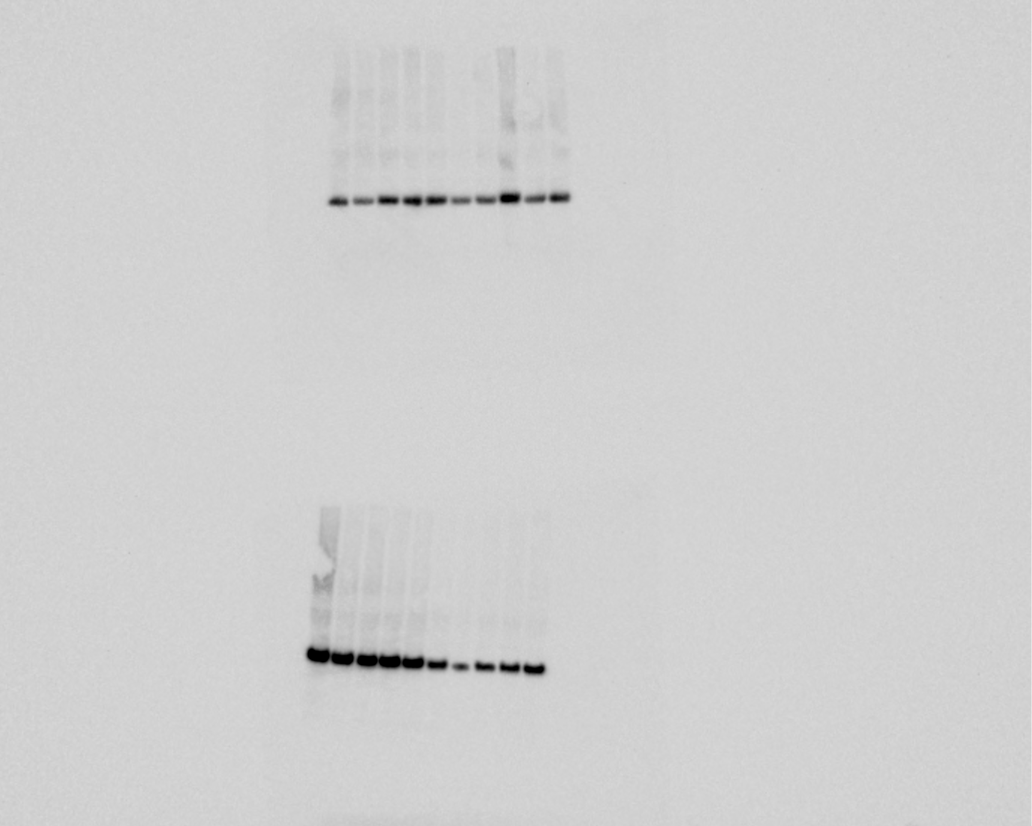
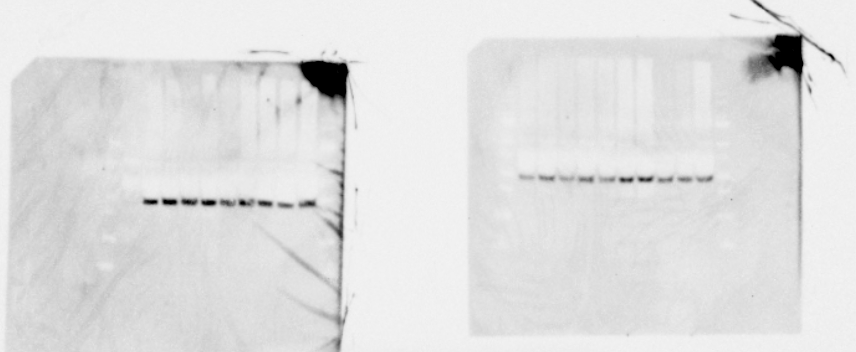
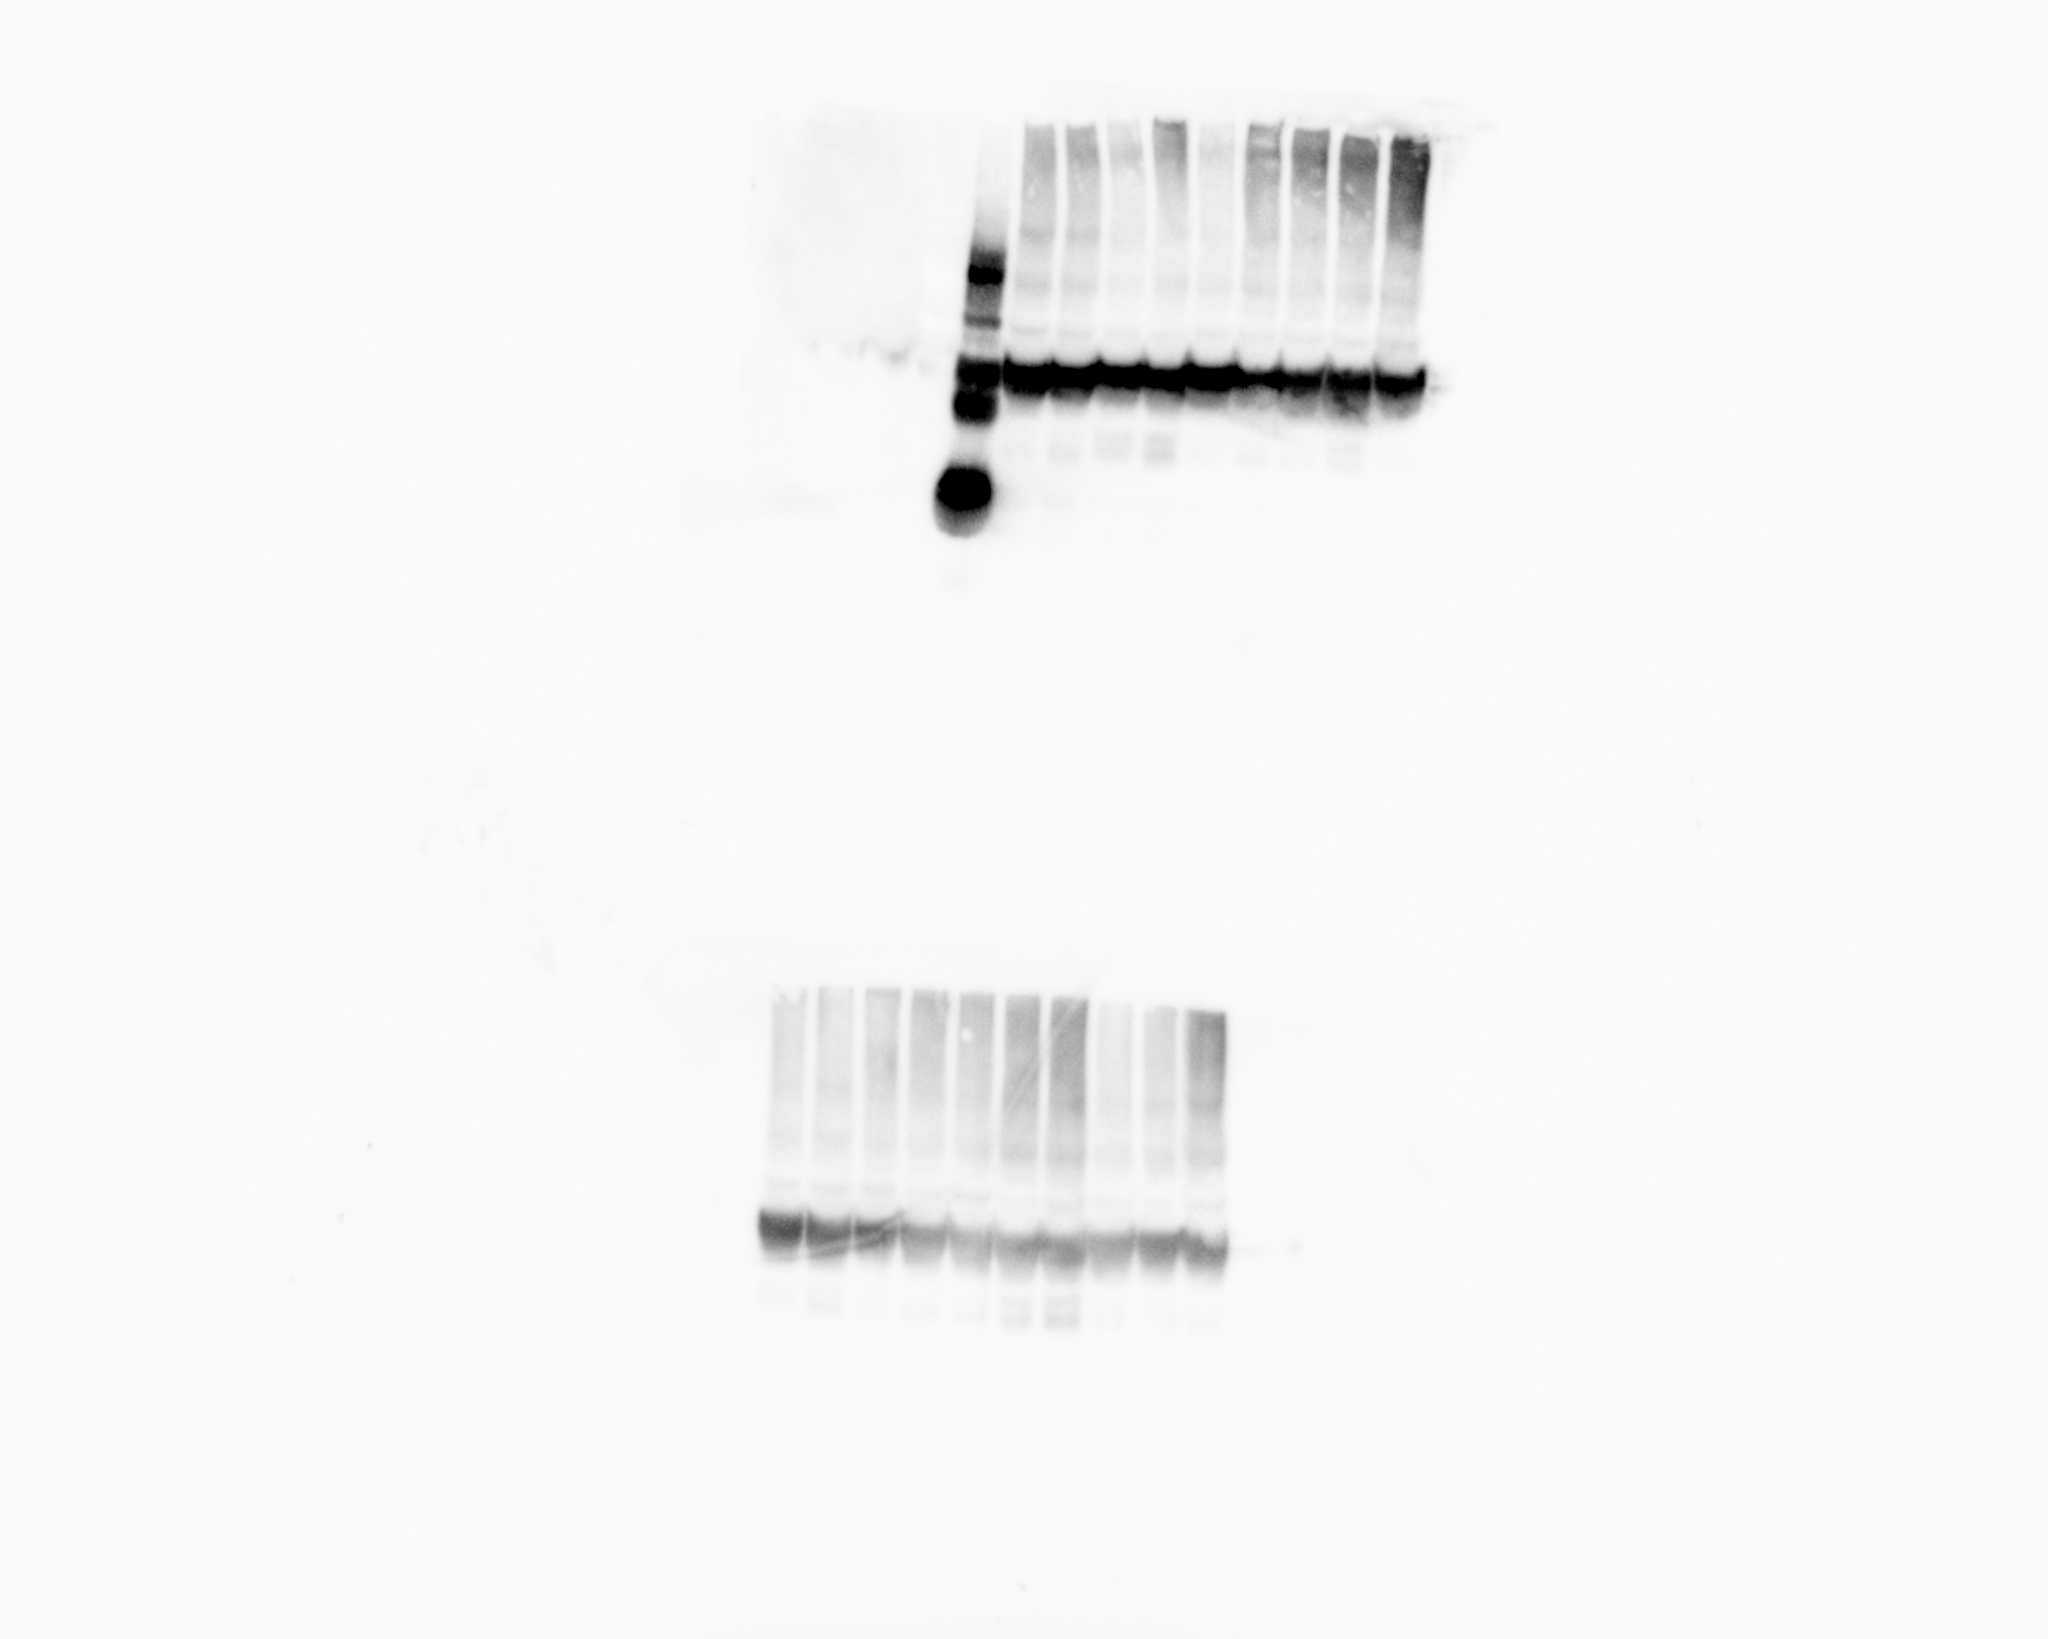
BCL-XL
HFD+OVX
HFD
OVX
Control
GAPDH
HFD
HFD+OVX
OVX
Control

Slide 17
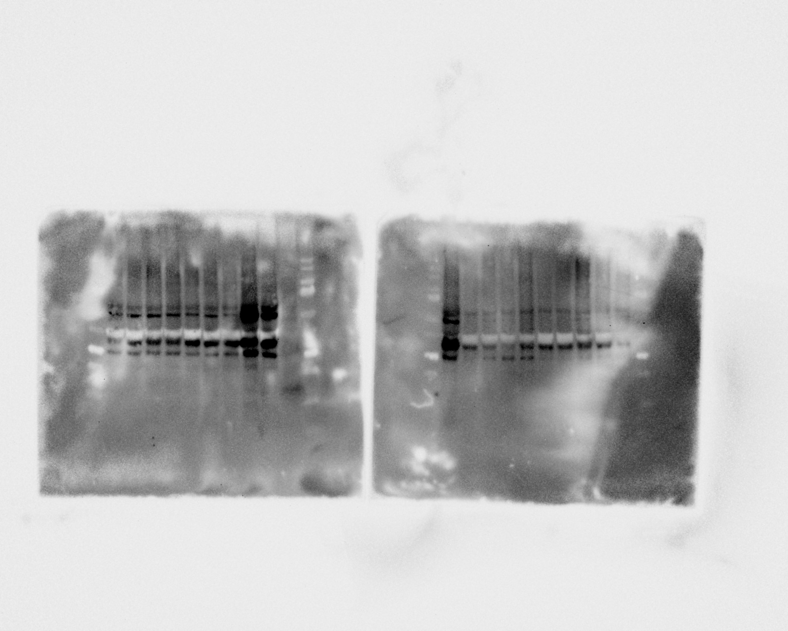
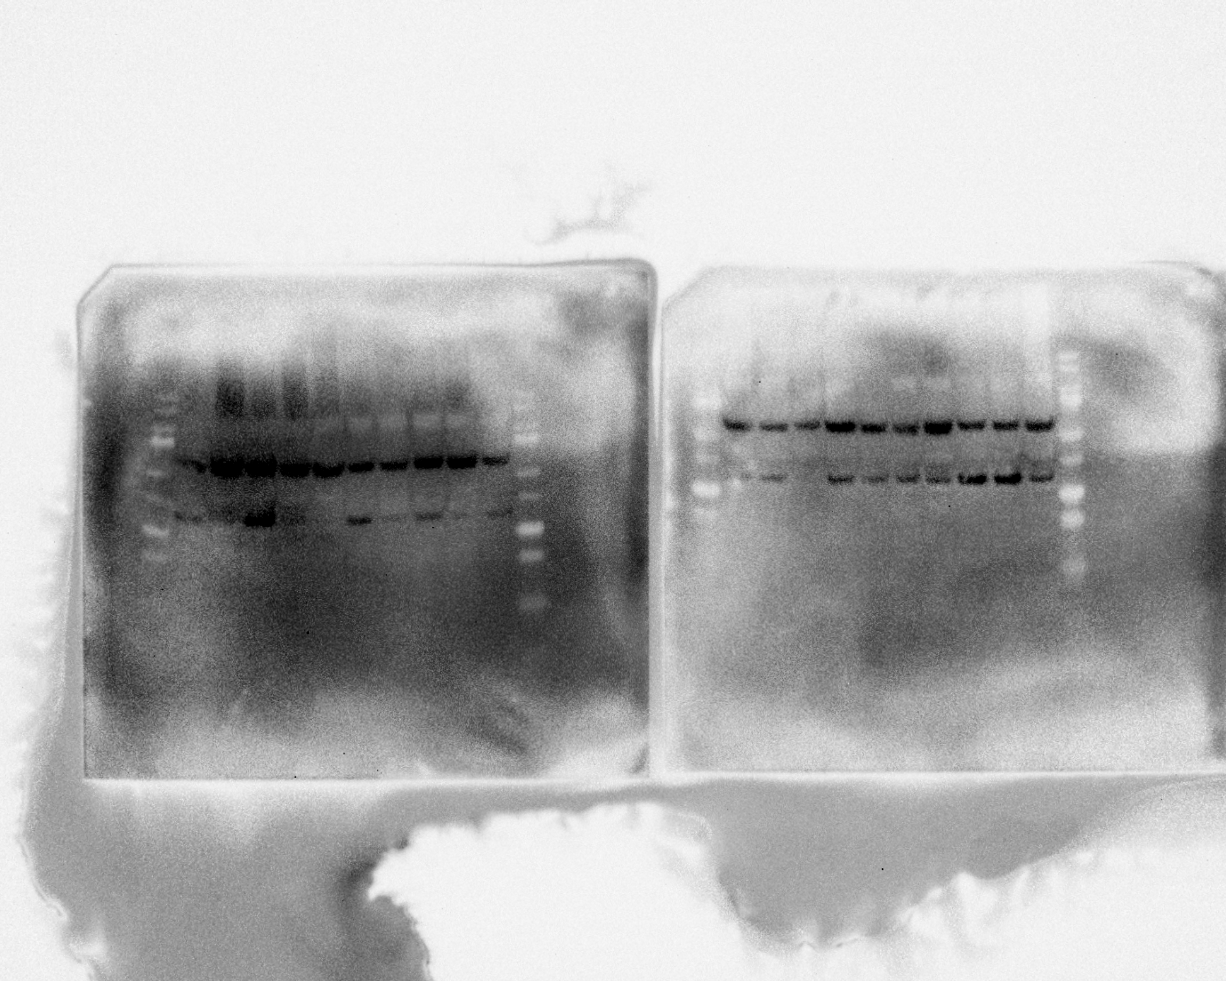
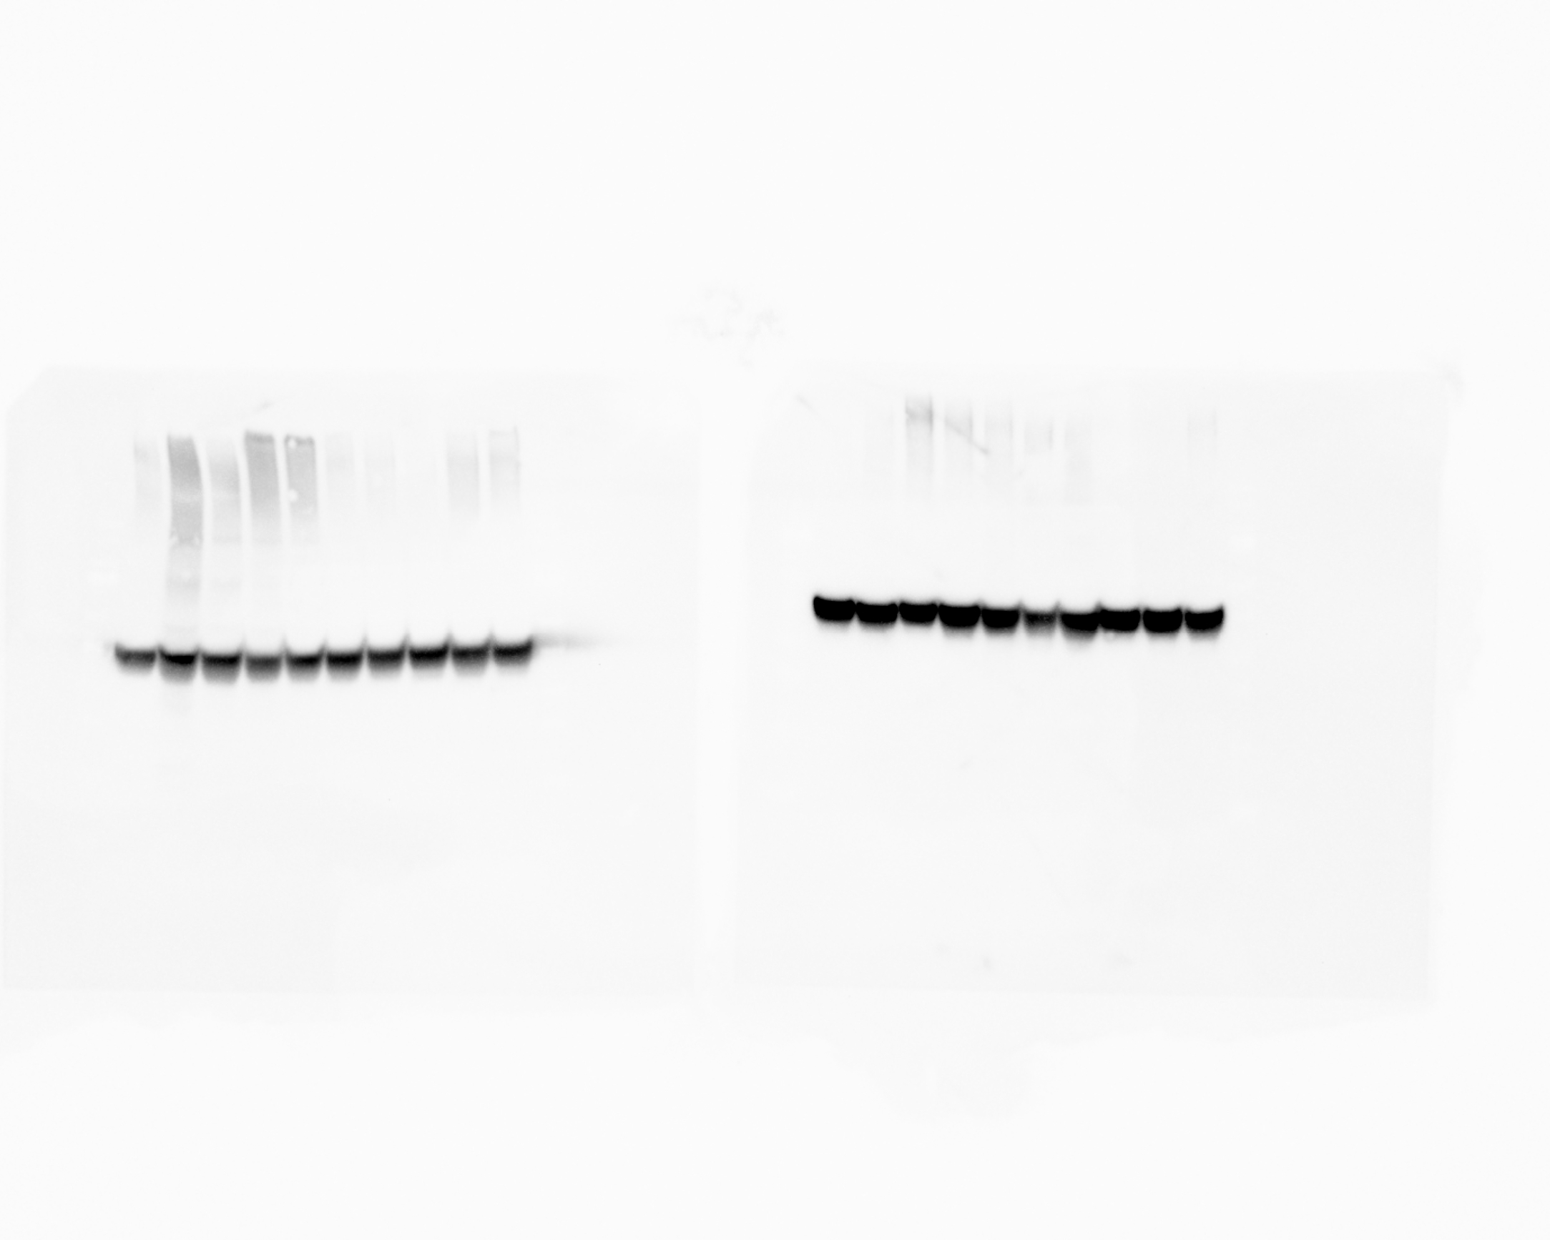
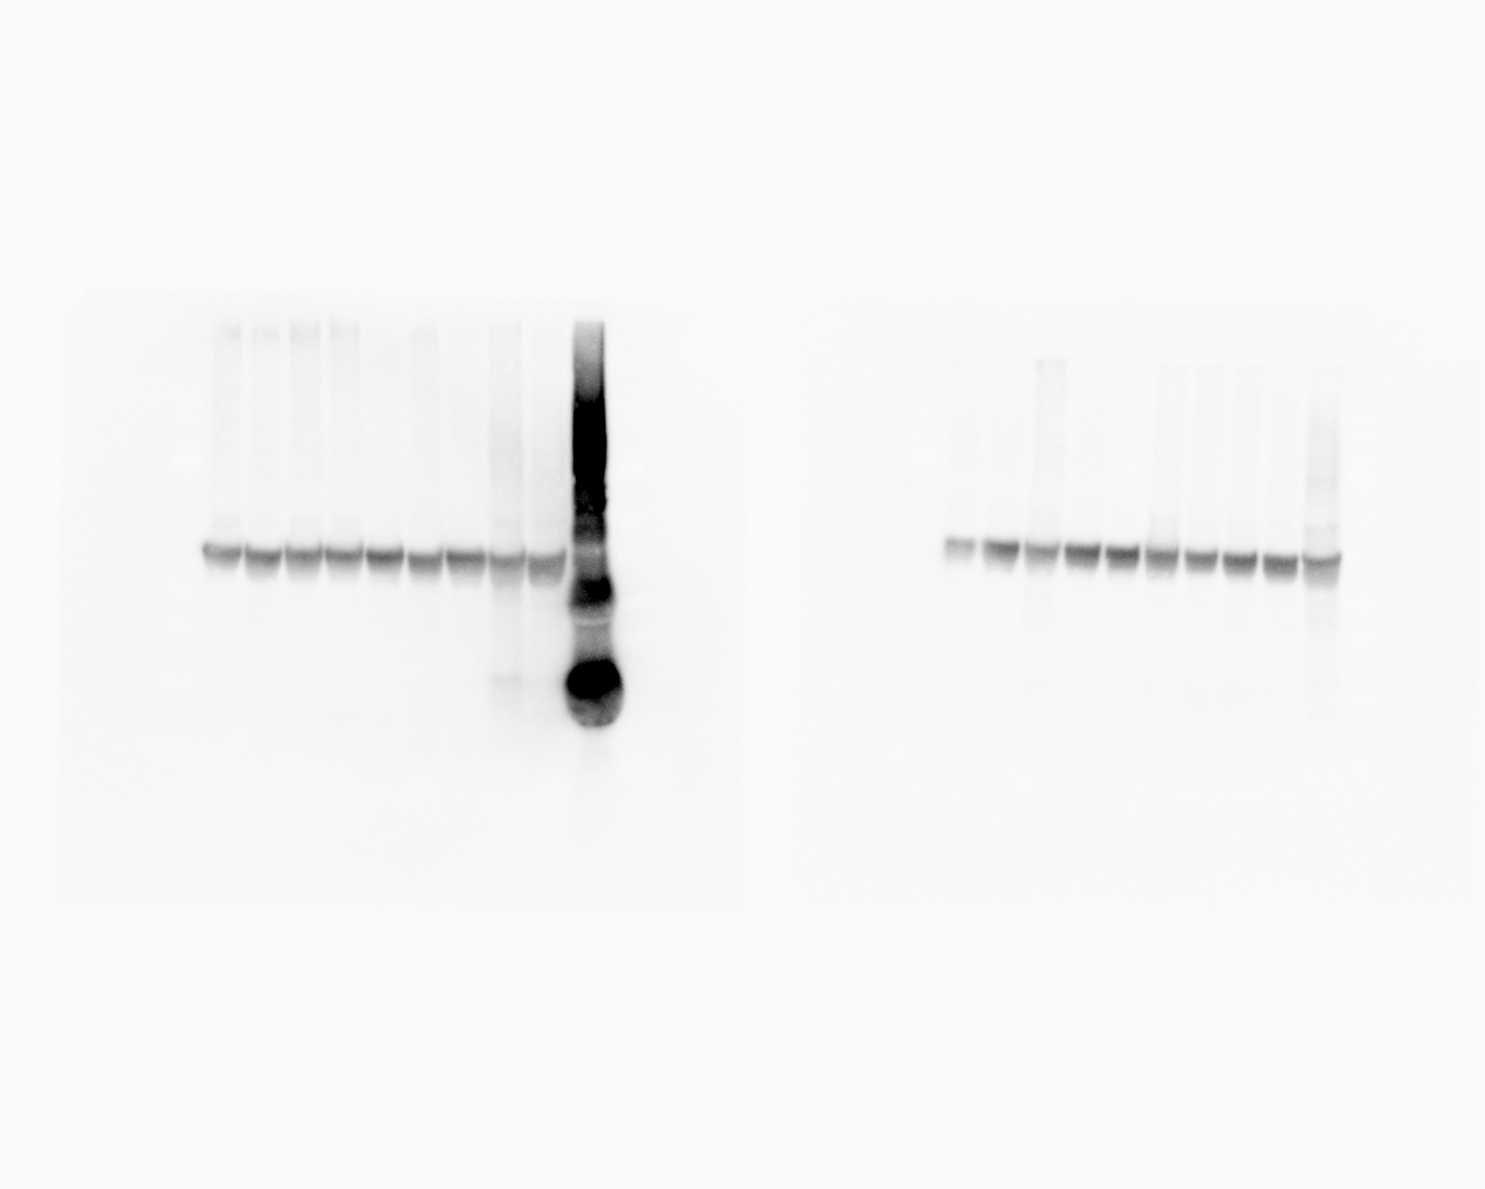
FOXO3a
Control
OVX
HFD
HFD+OVX
GAPDH
HFD
HFD+OVX
Control
OVX

