Slide 1
(i)
(ii)
(iii)
Soil Depth class
Particle Size
Texture
Extremely Shallow
Fine-loamy
Sandy
Moderately Shallow
Loamy-skeletal
Fine
Loamy
Deep
Clayey-skeletal
Fine-silty
Clayey
Very Deep
Sandy
Coarse-silty
Clay skeletal
No Data
Loamy
Marshy lands
Loamy skeletal
No Data
Coarse-lomay
Water bodies
Marshy lands
Water bodies
Fig S1: (i) Soil depth, (ii) Particle size, and (iii) Soil Texture map

Slide 2
(i)
(ii)
(iii)
Aspect
Elevation (m)
Slope (deg)
Flat (-1)
1971
77.5
North (0-22.5)
Northeast (22.5-67.5)
East (67.5-112.5)
Southeast (112.5-157.5)
South (157.5-202.5)
0
0
Southwest (202.5-247.5)
West (247.5-292.5)
Northwest (292.5-337.5)
North (337.5-360)
Fig S2: Shuttle Radar Topographic Mission (SRTM) digital elevation model (DEM) data derived (i) elevation, (ii) Slope and (iii) Aspect map

Slide 3
(i)
(ii)
TRI
TWI
34.75
20.9
0
2.12
Fig S3: SRTM DEM data derived (i) Terrain Ruggedness Index (TRI) and (ii) Topographic Wetness Index (TWI) map

Slide 4
(i)
(ii)
(iii)
Drainage Density (/sq.km)
Distance to Drainage (m)
1.05
29471
0
0
Fig S4: SRTM DEM data derived (i) Drainage network, (ii) Drainage Density and (iii) Distance to Dranage

Slide 5
Flow accumulation
2.85
0
Fig S5: Flow accumulation (at 1 km grid-scale) map

Slide 6
(i)
(ii)
Precipitation [in mm]
1606
645
Fig S6: Mean Annual Precipitation (July – September) (i) 2016 – 2018 and (ii) 2019 – 2021 (at sub-basin scale)

Slide 7
(i)
(ii)
Class
Tree Canopy Cover (TCC) in %
Bare land
Built-up
0
Cropland
> 0 – 10
Flooded Vegetation
Grass
10.01 – 40
Scrub
40.01 – 100
Snow & Ice
Trees
Water
Fig S7: (i) Land use land cover (LULC) and (ii) Tree Canopy Cover (TCC) percentage map of 2020

Slide 8
Sentinel-2 image April 2017
Sentinel-2 image July 2017
Sentinel-1 derived water inundation
Sentinel-2 derived Normalized Difference Water Index (NDWI) > 0.4
Figure S8: Validation of Sentinel-1 SAR data-derived water inundation map of 2017 using the Sentnel-2 optical data derived water index map

Slide 9
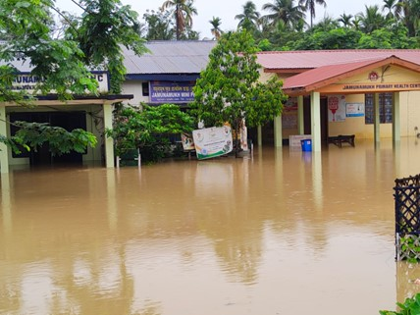
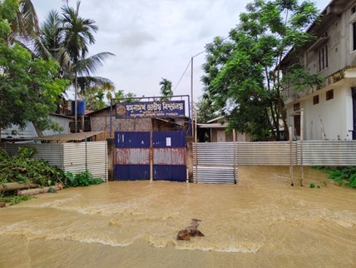
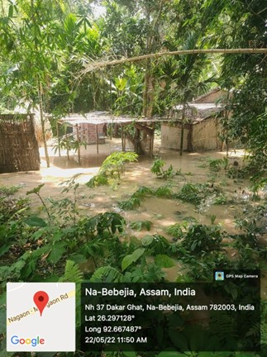
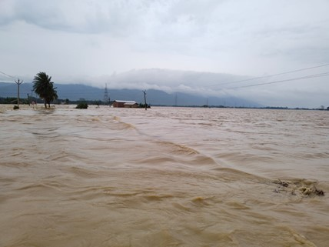
Na-Bebejia, Assam
Jamunamukh, Assam
Jamunamukh, Assam
Jamunamukh, Assam
Figure S9: Water Inundation map of May 2022 with a few field photographs (Photo Credit: Lakhyajit Baruah and Souvik Maity)

Slide 10
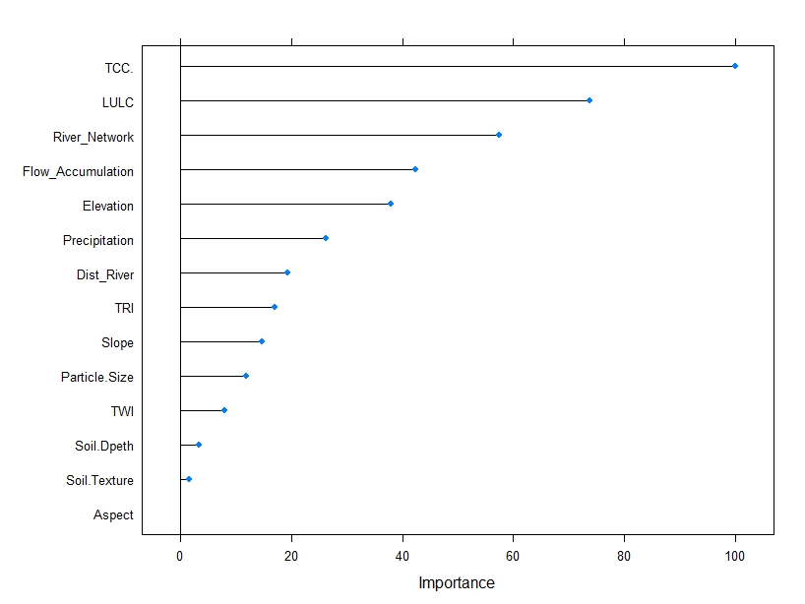
Figure S10: Variable importance plot derived using the RF algorithm

Slide 11
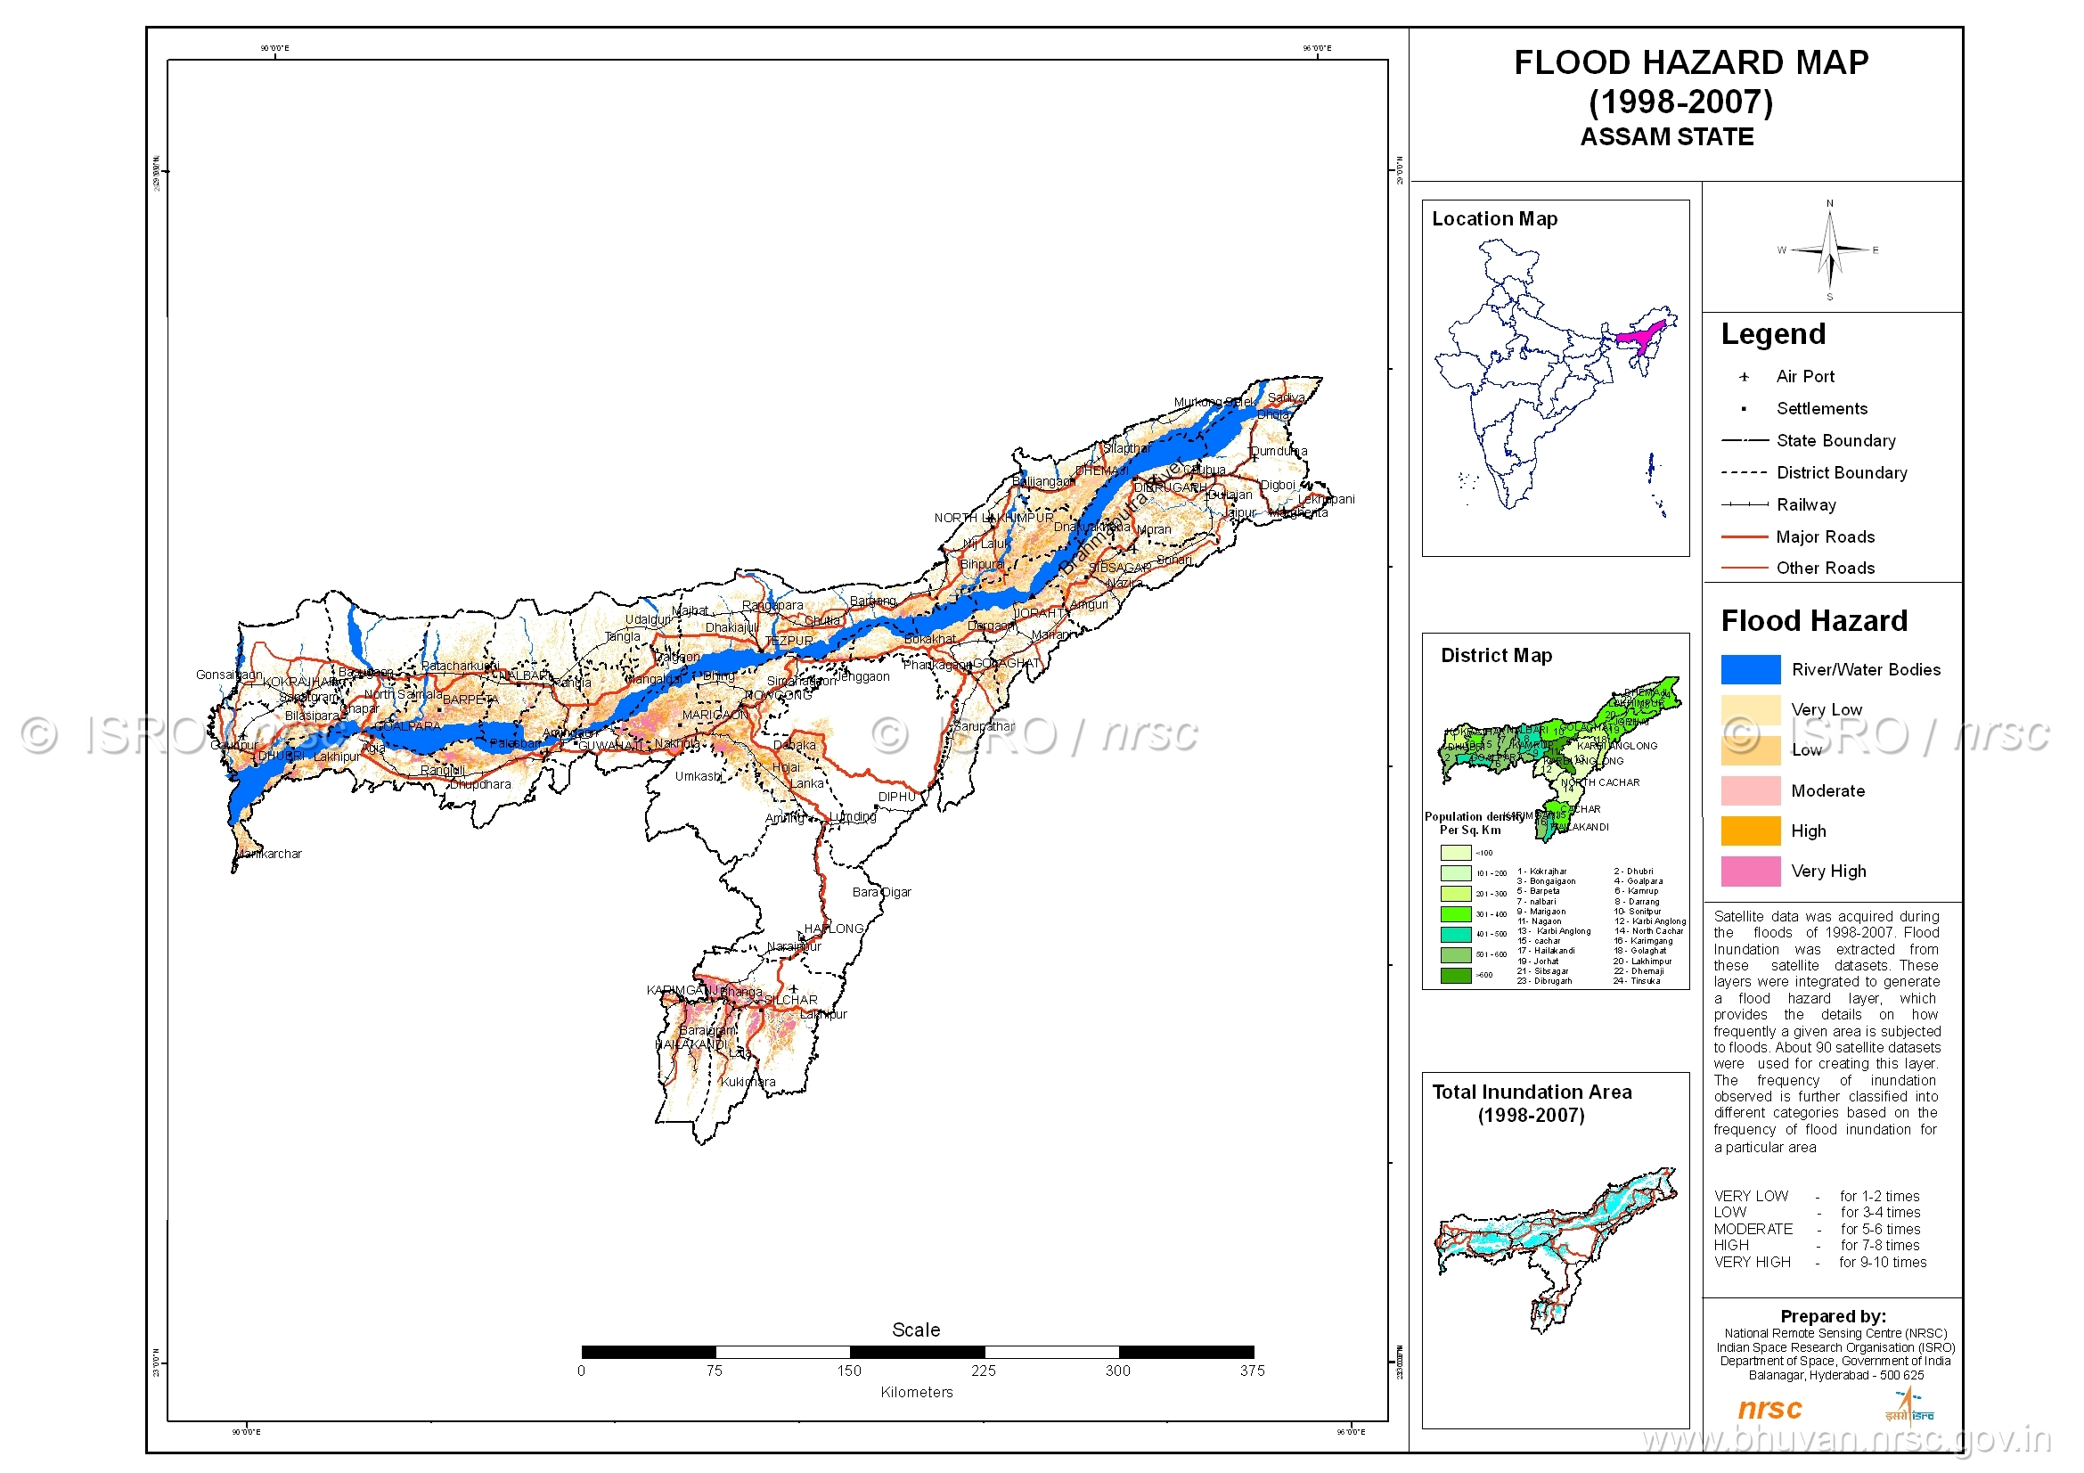
Figure S10: Flood hazard map of Assam (Source: https://bhuvan-app1.nrsc.gov.in/thematic/thematic/index.php#)

Slide 12
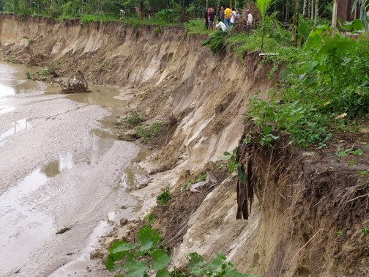
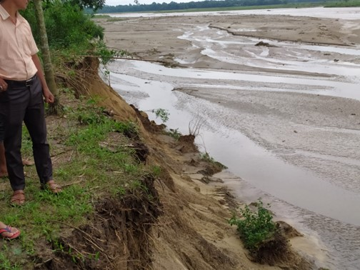
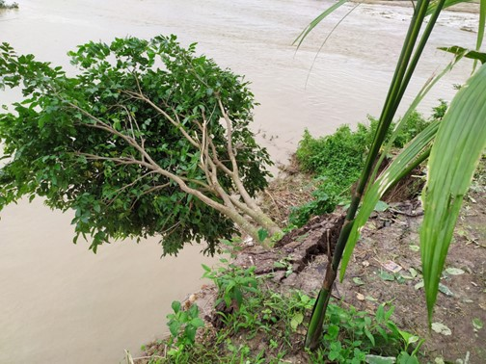
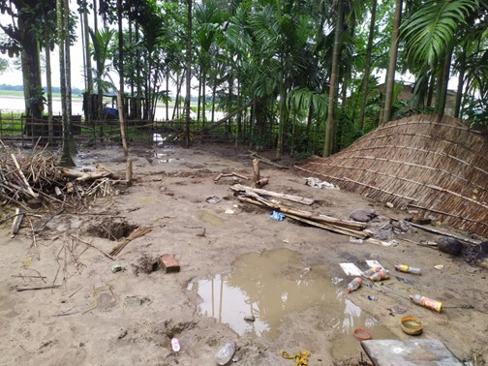
Figure S11: Field photos showing the soil river bank erosion in Brahmaputra River (Photo Credit: Suman Chetri)

