Slide 1
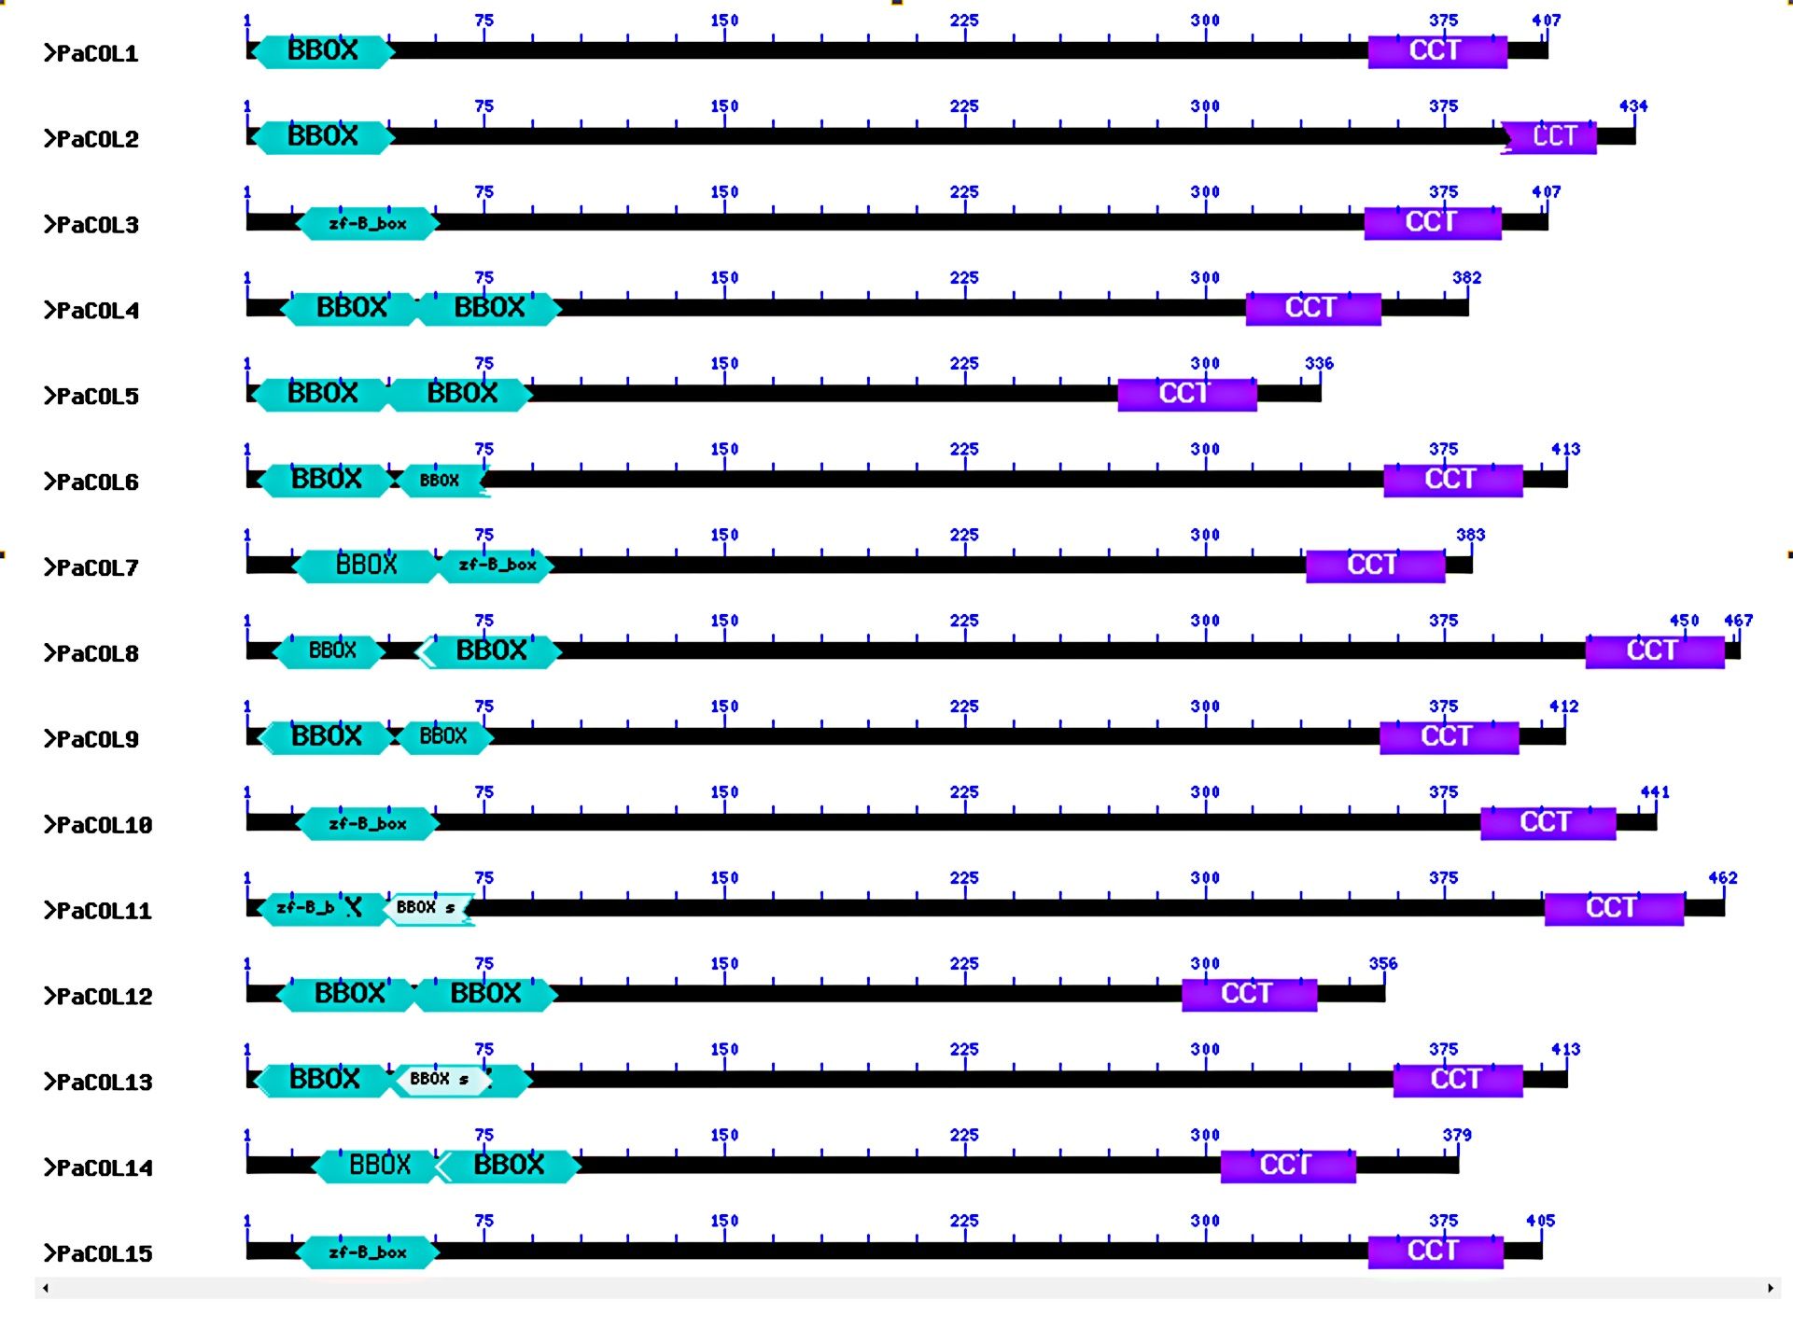
Figure S1 Domain architecture of PaCOL proteins. BBOX and CCT domains are indicated by mint and purple colour respectively. The black middle region represents the diverge region of COL proteins.

Slide 2
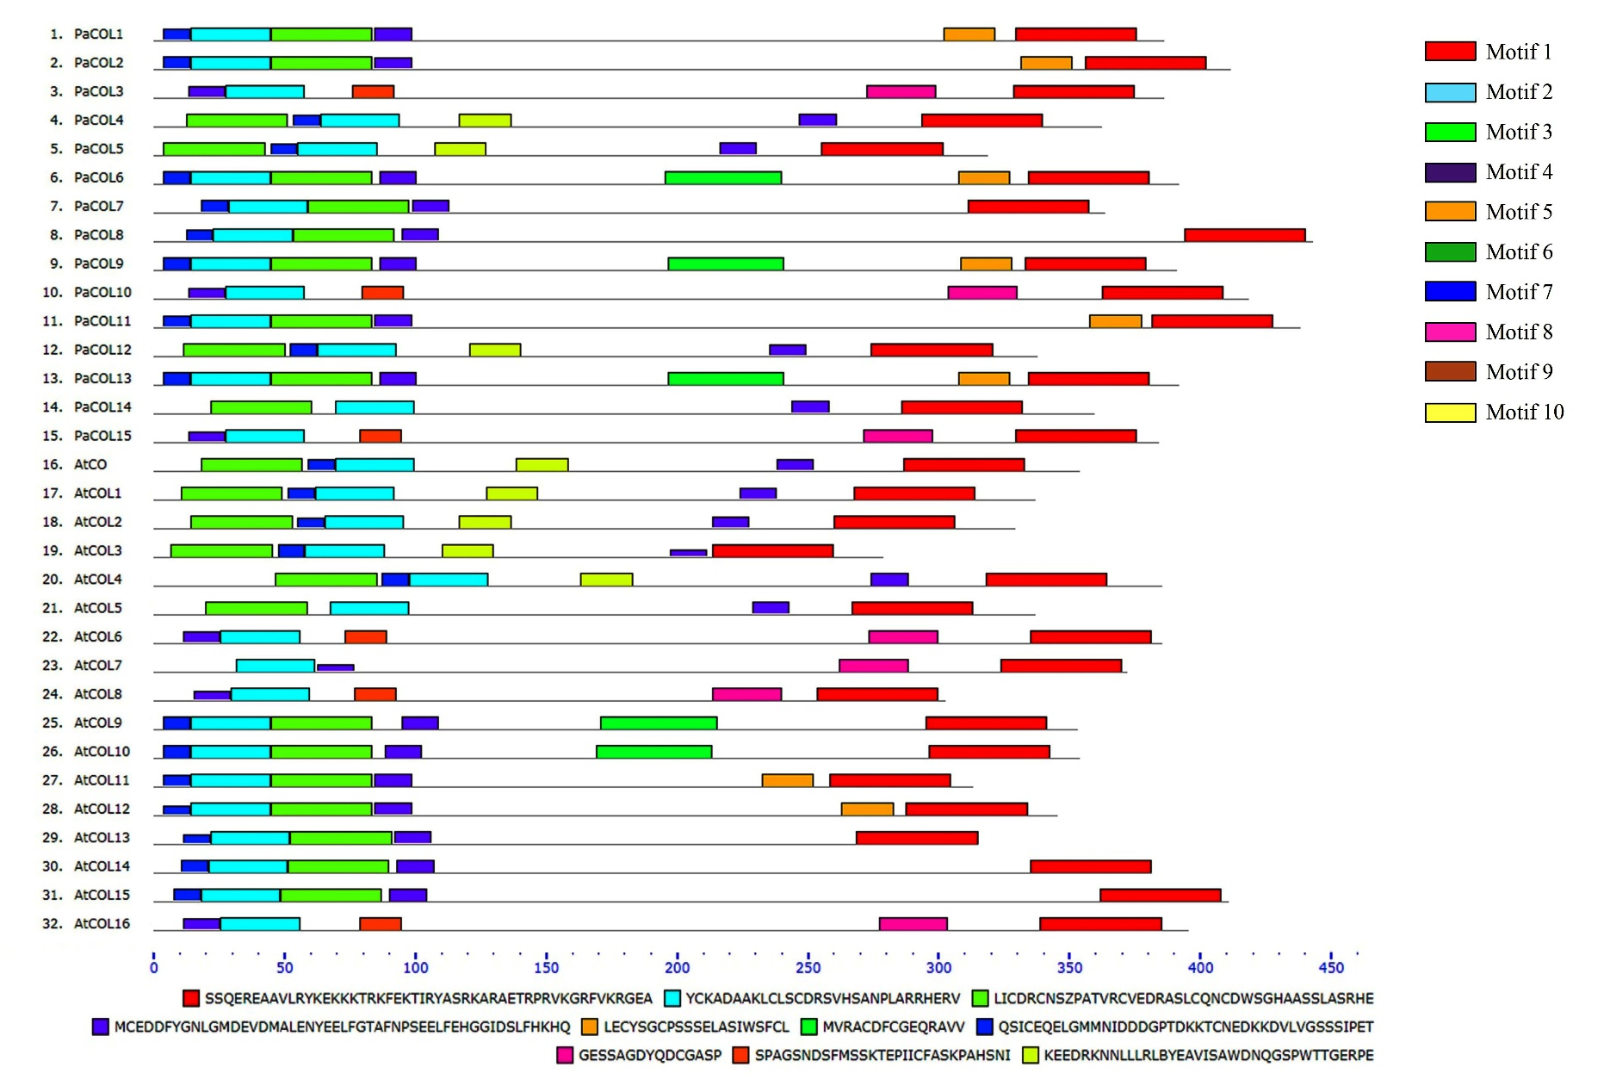
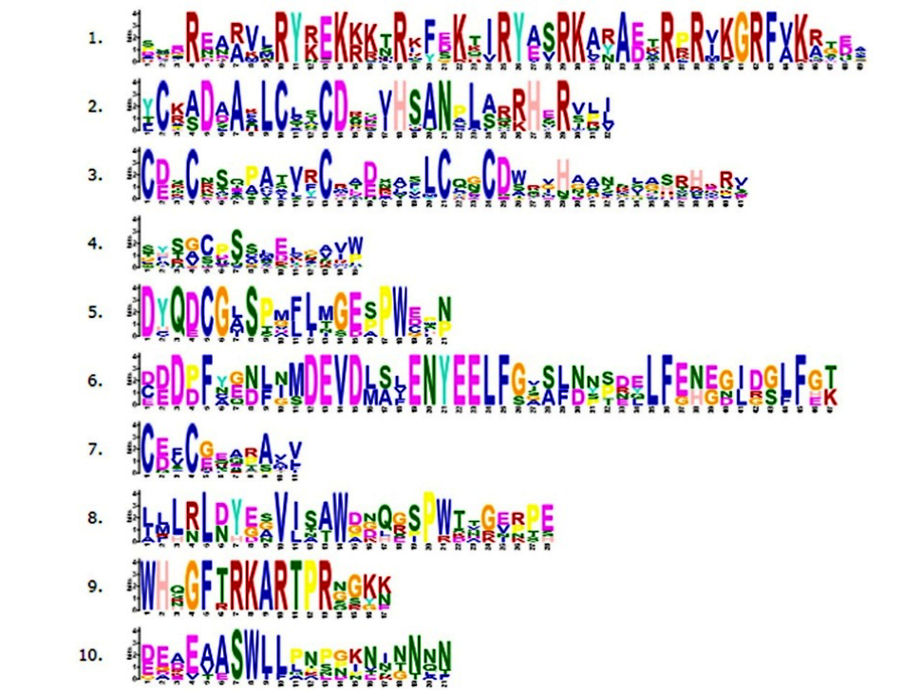
Figure S2 Analysis of motif composition in PaCOL proteins. Different motifs were represented by different color boxes. MEME database was used for motif analysis with the complete amino acid sequences of PaCOL proteins.

