Slide 1
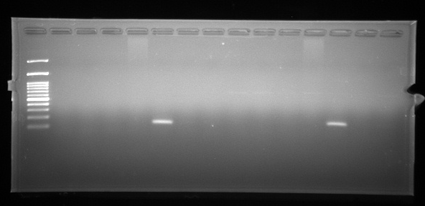
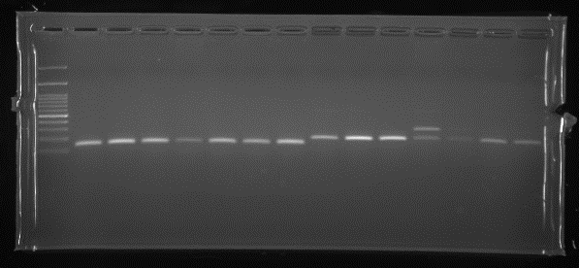
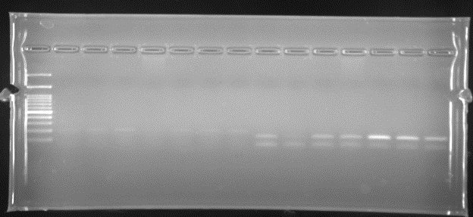
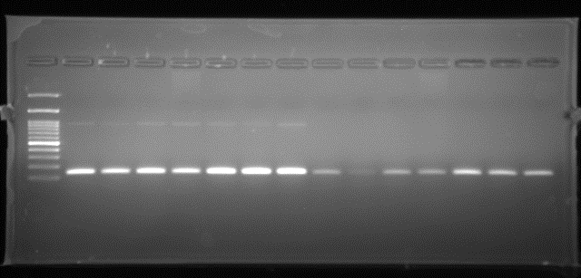
PaCOL 1
PaCOL 2
PaCOL 3
PaCOL 4
S
L
SB
R
FB
BF
SF
S
L
SB
R
FB
BF
SF
S
L
SB
R
FB
BF
SF
S
L
SB
R
FB
BF
SF
PaCOL 5
PaCOL 6
PaCOL 7
PaCOL 8
S
L
SB
R
FB
BF
SF
S
L
SB
R
FB
BF
SF
L
SB
R
FB
BF
S
L
SB
R
FB
BF
SF
S
SF

Slide 2
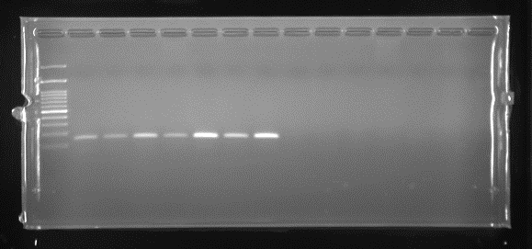
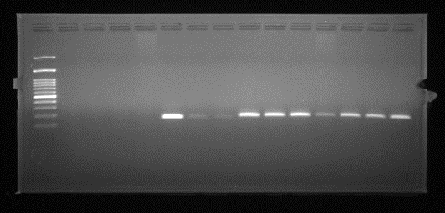
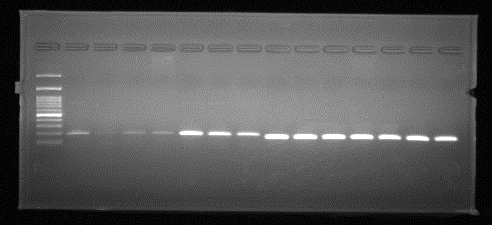
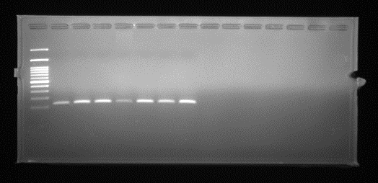
PaCOL9
PaCOL10
PaCOL 11
PaCOL 12
S
L
SB
R
FB
BF
SF
S
L
SB
R
FB
BF
SF
S
L
SB
R
FB
BF
SF
S
L
SB
R
FB
BF
SF
PaCOL 13
PaCOL 14
PaCOL 15
S
L
SB
R
FB
BF
SF
S
L
SB
R
FB
BF
SF
S
L
SB
R
FB
BF
SF

Slide 3
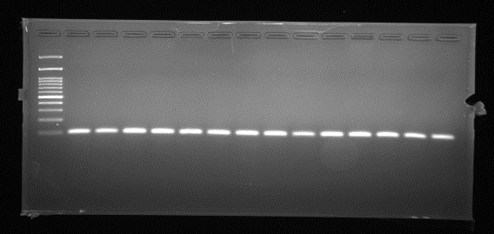
S
L
SB
R
FB
BF
SF
PaCOL EF 1
PaCOL EF 1
S
L
SB
R
FB
BF
SF

