Slide 1
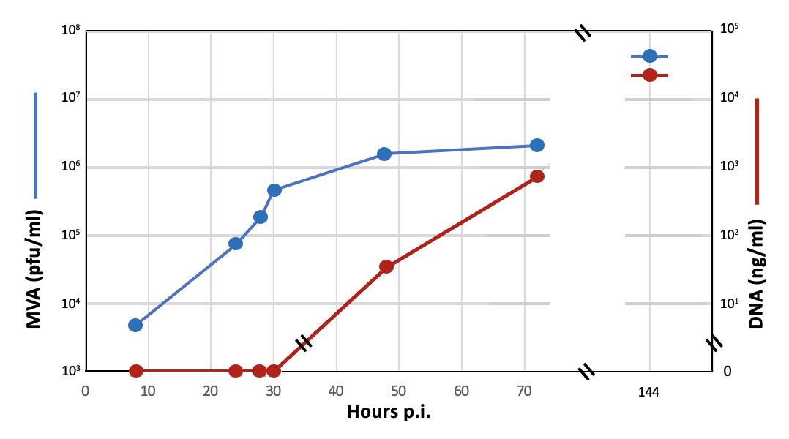
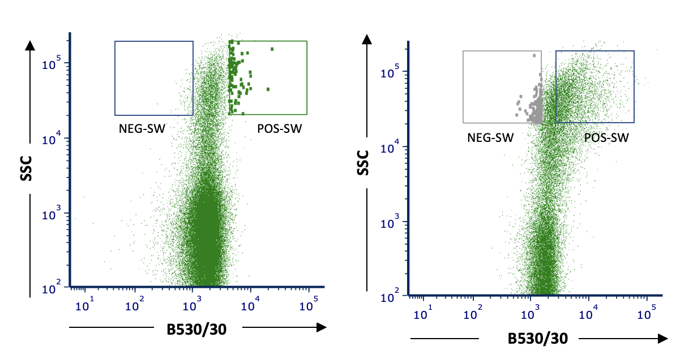


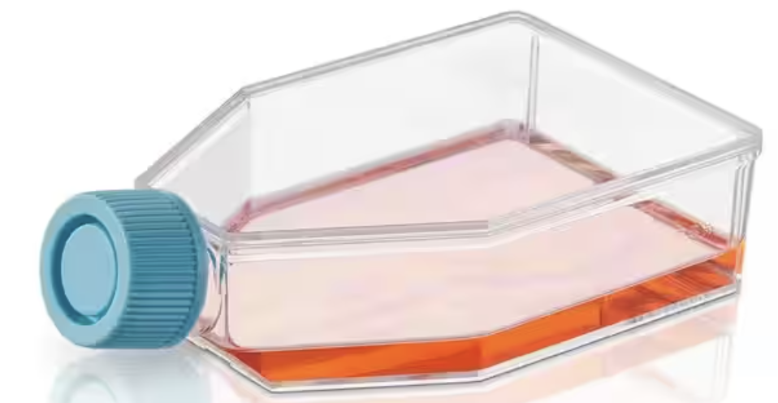
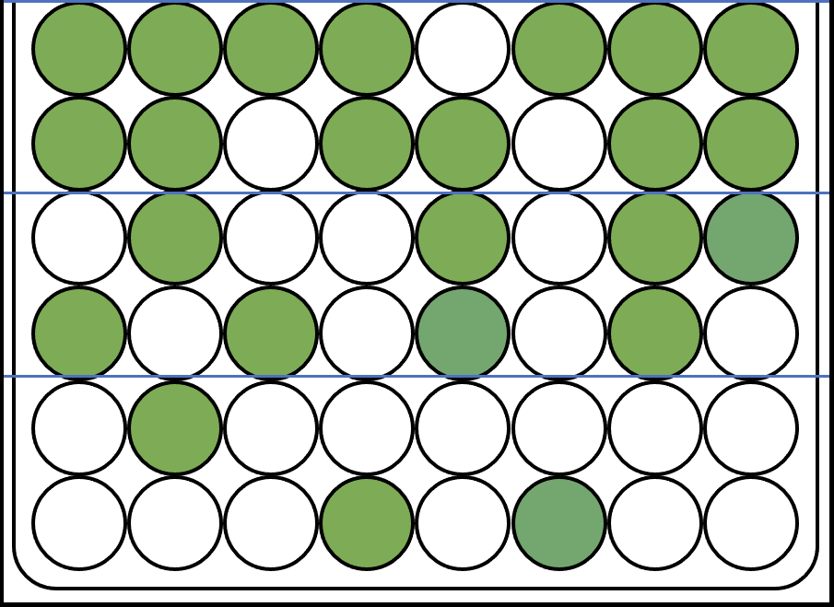
Construction of
TP-HAG-TG
TP
HAG
Flank-1
Z
P1
Z
TG
P2
Flank-2
EGFP HA
Infection/Transfection
MVA-77-RED
x TP-HAG-TG
EEVs
Virus-Sorting
IMVs
MVA-HAG-TG
-infected CEF
Supernatant
Sorting
“Green” EEVs
TD-Clones
“Green”
EEVs
Identify & Amplify
“Green” Clones
Virus-Sorting
Sorting
“Tag-less” EEVs
Terminal Dilution
Amplify
“Green” Clones
“Tag-less”
EEVs
TD-Clones
Identify & Amplify
“Tag-less” Clones
PCR & WB analysis
Z/Z Recombination
Flank-1
Z
TG
P2
Flank-2
MVA
“Green” Clones

Slide 2
Construction of
TP-HAG-TG
TP
HAG
Flank-1
Z
P1
Z
TG
P2
Flank-2
EGFP HA
Infection/Transfection
MVA-77-RED
x TP-HAG-TG
EEVs
Virus-Sorting
IMVs
Sorting
“Green” EEVs
MVA-HAG-TG
-infected CEF
Supernatant
TD-Clones
“Green”
EEVs
Identify & Amplify
“Green” Clones
Virus-Sorting
Sorting
“Tag-less” EEVs
Terminal Dilution
Amplify
“Green” Clones
“Tag-less”
EEVs
TD-Clones
Identify & Amplify
“Tag-less” Clones
PCR & WB analysis
Z/Z Recombination
Flank-1
Z
TG
P2
Flank-2
MVA
“Green” Clones

