Slide 1
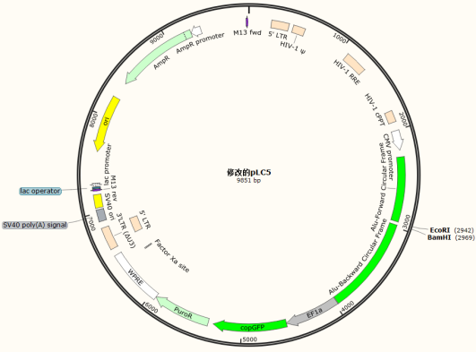
Additional file 4: Figure S1
A
B
C
pLC5
D
hsa_circ_0002371 siRNA-3
hsa_circ_0002371 siRNA-2
hsa_circ_0002371 siRNA-1
hsa_circ_0002371 siRNA-1： 3' UUCCGAGUCUAUCCCUACUCCUU 5'
hsa_circ_0002371
（Exon 20-Exon 21）
Back-splicing site： 5' TCGGGCTCAGATAGGGATGAGGAAGAA 3'
hsa_circ_0002371 siRNA-2： 3' UUGAGUCGAUCCCUACUCCUU CU 5'
hsa_circ_0002371 siRNA-3： 3' UUAAGAGCCCGAGUCUAUCCCUA 5'
Exon 21
Exon 20
E
F
G

Slide 2
Additional file 5: Figure S2
A

Slide 3
Additional file 6: Figure S3
A
B

Slide 4
Additional file 7: Figure S4
A

Slide 5
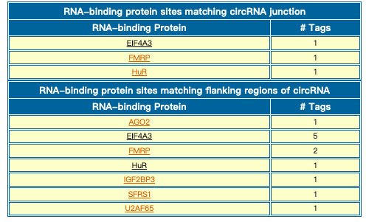
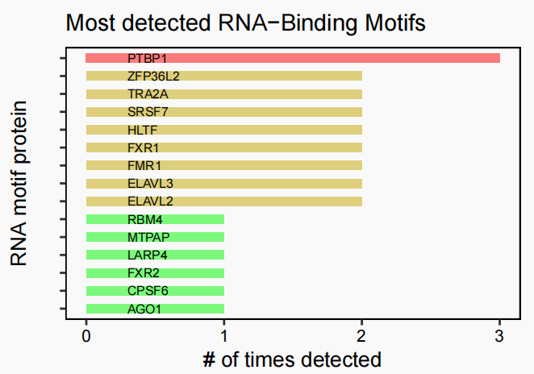
Additional file 8: Figure S5
A
B
C

