Slide 1
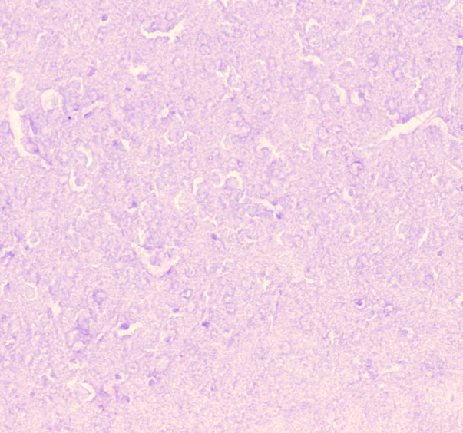
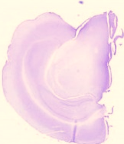
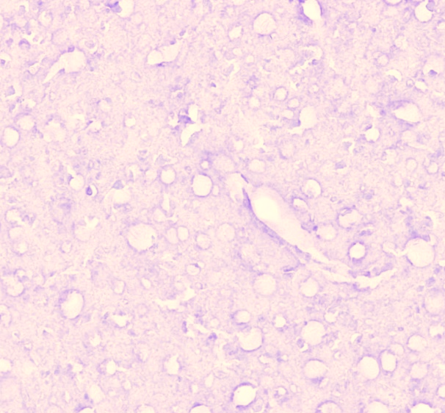
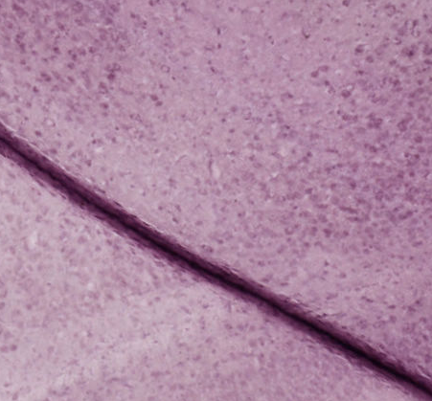
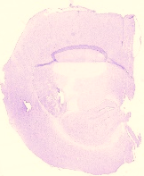
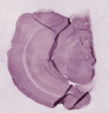
eFigure 1 in Supplement
A.
3M
12M
22M
B.
3M
12M
22M

Slide 2
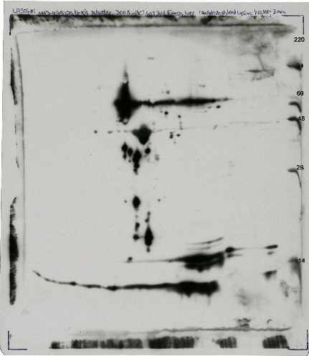
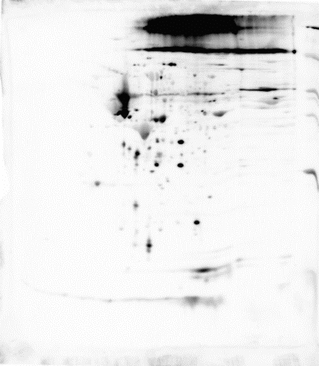
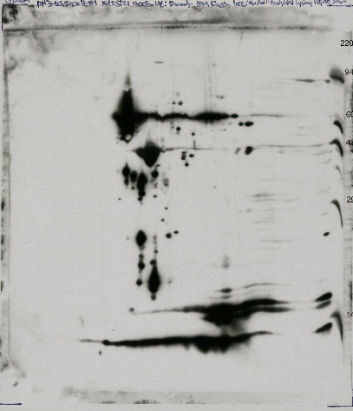
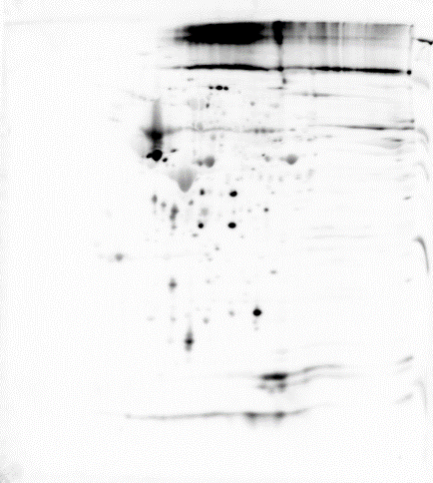
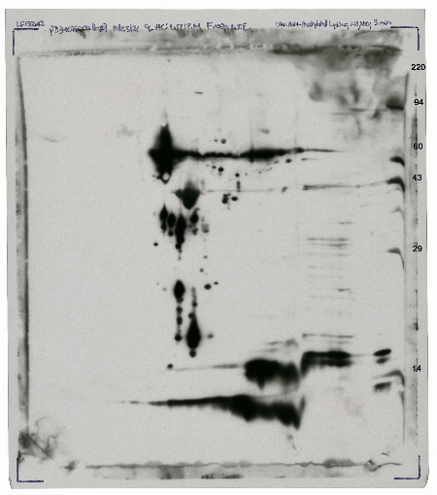
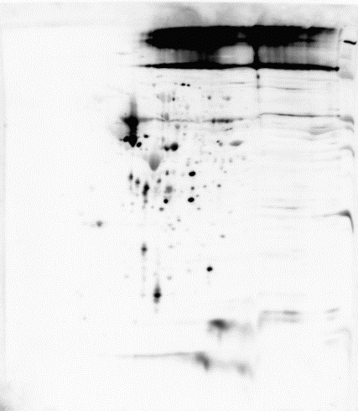
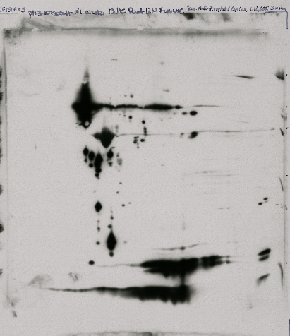
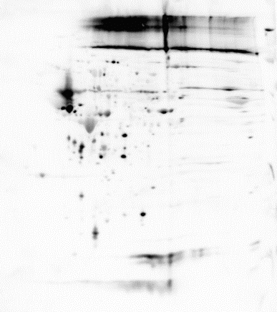
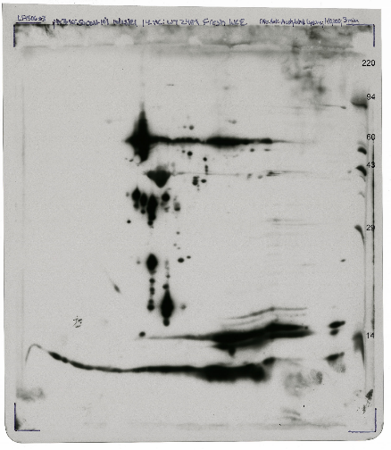
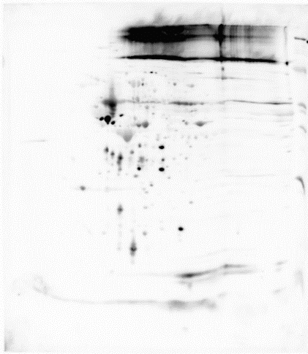
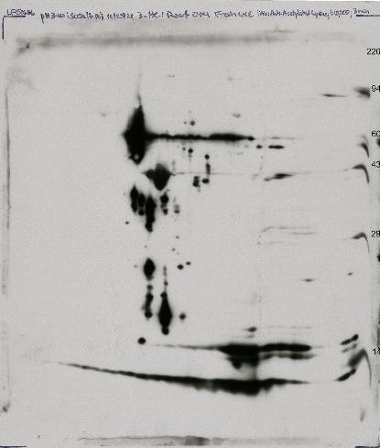
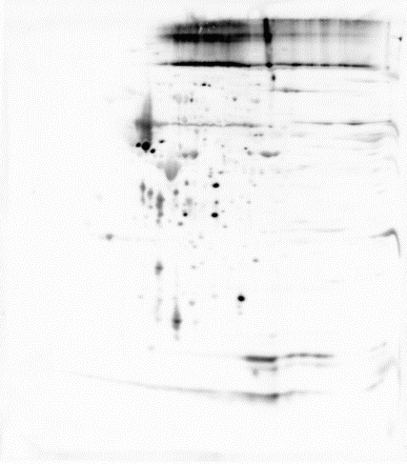
eFigure 2 in Supplement
A.
B.
Acetylation
HSF1 reprobe
Acetylation
HSF1 reprobe
21
37
32
51
31
109
93
3M
106,119, 124
91,95,96, 100
3M
110,118, 126
114,122,132, 137
168
159
171,173, 178,
181,183,188
193
175,184,192
197
195
202
12M
12M
24M
24M

Slide 3
eTable 1 in Supplement

Slide 4
eFigure 1 In Supplement. Immunohistochemical Staining of HSF1 in Ames wild type and Dwarf Mice Hippocampus. Immunohistochemistry in the 3M, 12M and 22M old Ames wild type and Dwarf brain tissue. The hippocampus region shows age-dependent increase in HSF1 level in Ames wild type mice (eFigure 1A) and increase in Dwarf mice hippocampus (eFigure 1B).
eFigure 2 In Supplement. Western blot of HSF1 Acetylation in Ames wild type and Dwarf Mice Brain Tissue. eFigure 2A and 2B shows a representative western blot analysis of two-dimensional (2D) gel electrophoresis showing separated acetylated proteins and HSF1 from 3M, 12M and 22M old hippocampus for Ames wild type and Dwarf mice. eFigure 2A shows HSF1 acetylated spots and their corresponding number which is common in all three age groups in both Ames wild type and Dwarf mice hippocampus.
eTable 1 In Supplement. Spot volume comparisons of Acetylated HSF1 proteins detected by 2D acetyl lysine and HSF1 western blots of WT and Dwarf Fresh WCE samples. Reference spot numbering, pI, MW, and spot volumes are given for the acetylated HSF1 protein spots. A total of 39 spots out of 208 spots detected by the acetyl-lysine antibody matched spots in the corresponding HSF1 western blot.

