Slide 1
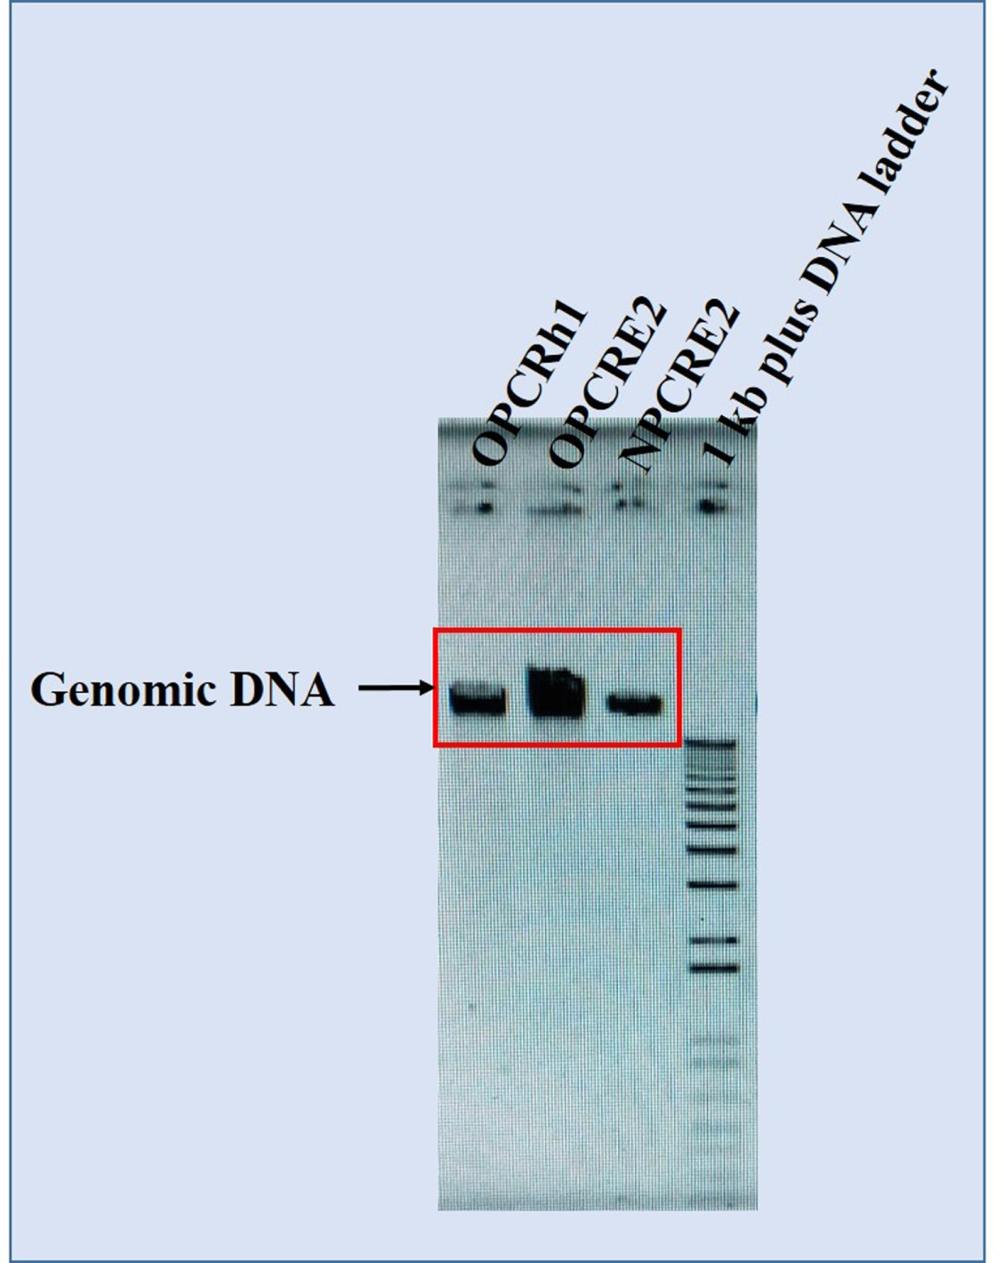
Fig. S1. Gel electrophoresis of genomic DNA extracted from OPCRh1, OPCRE2, and NPCRE2.

Slide 2
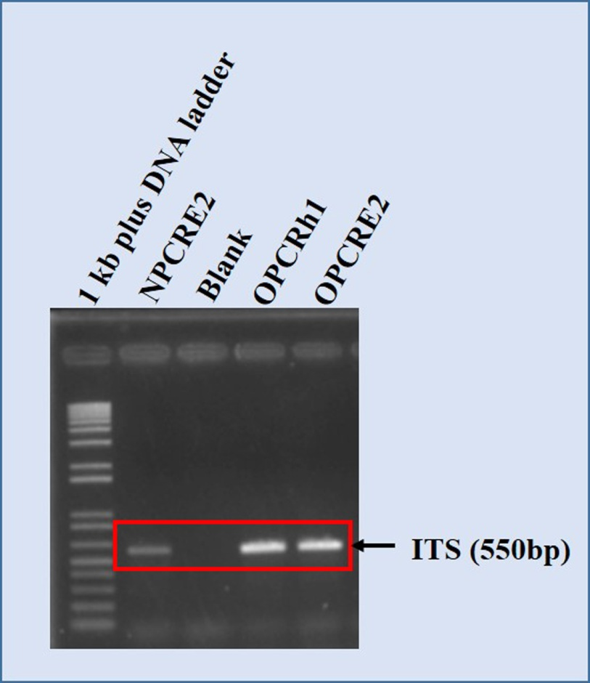
Fig. S2. Gel electrophoresis of amplified PCR product of NPCRE2, OPCRh1, and OPCRE2 using 1kb plus DNA ladder.

Slide 3
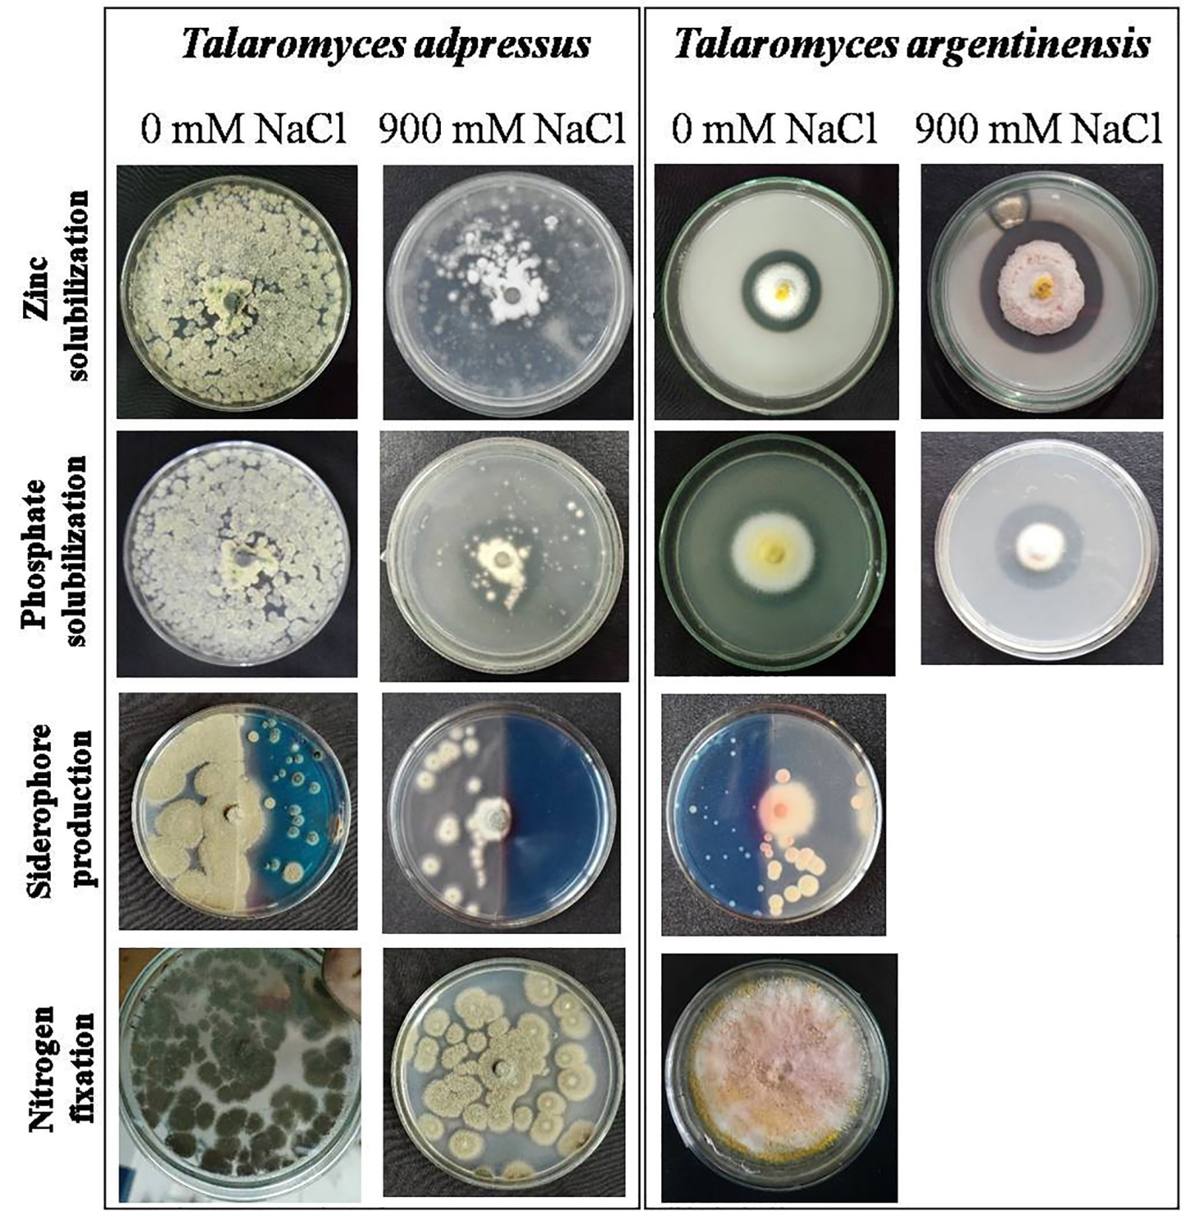
Fig. S3. Plant growth prompting activities of endophytic fungus Talaromyces adpressus (OPCRE2) (left) and Talaromyces argentinensis (OPCRh1) (right) at 0 mM and 900 mM NaCl stress.

Slide 4
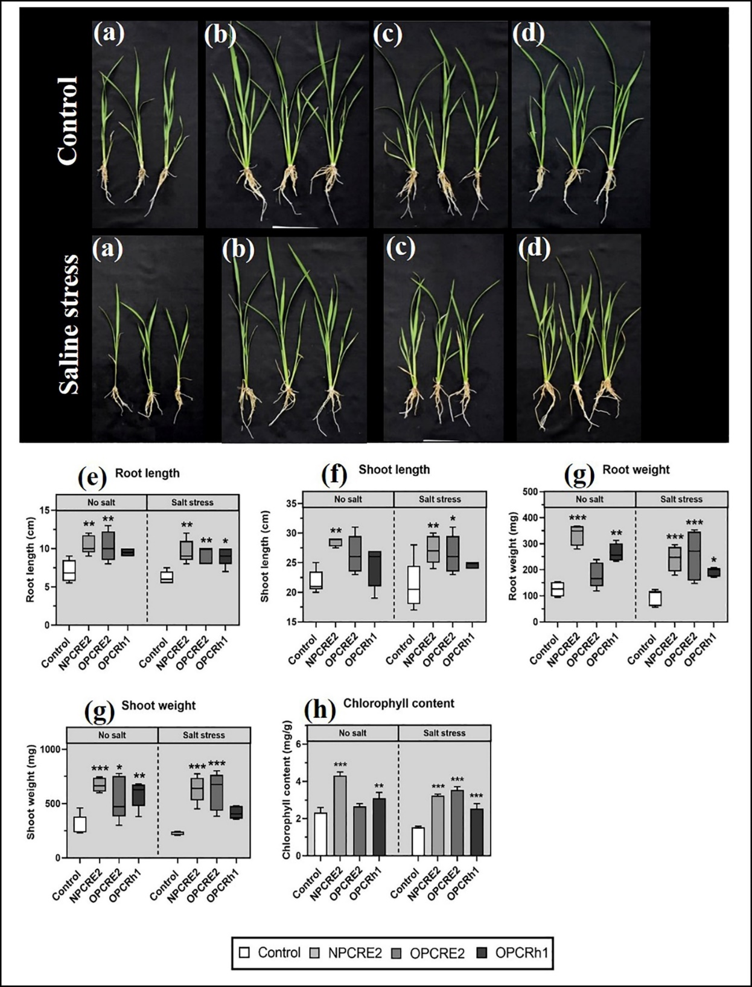
Fig. S4. Representation of the growth of a rice seedling under normal and salt-stressed conditions upon treatment with (b) NPCRE2 (AwOcstreb1) , (c) OCPRE2 (Talaromyces argentinensis) , (d) OPCRh1(Talaromyces adpressus) comparing with (a) Control (un-inoculated plants). Root length (e), Shoot length (f), Root weight (g), and Shoot weight (h) are depicted in the box plots. The boxes on all box plots represent the first and third quartiles, while the lower and upper lines, respectively, denote the minimum and maximum values. The middle black line in each box plot denotes the median. The coloum bar graphs represent total chlorophyll content (i). Bars represent mean ± SD. One-way ANOVA was done for all parameters separately. Significant differences between control and treated plants were indicated by asterisks (*, **, ***) at p ≤ 0.05.

Slide 5
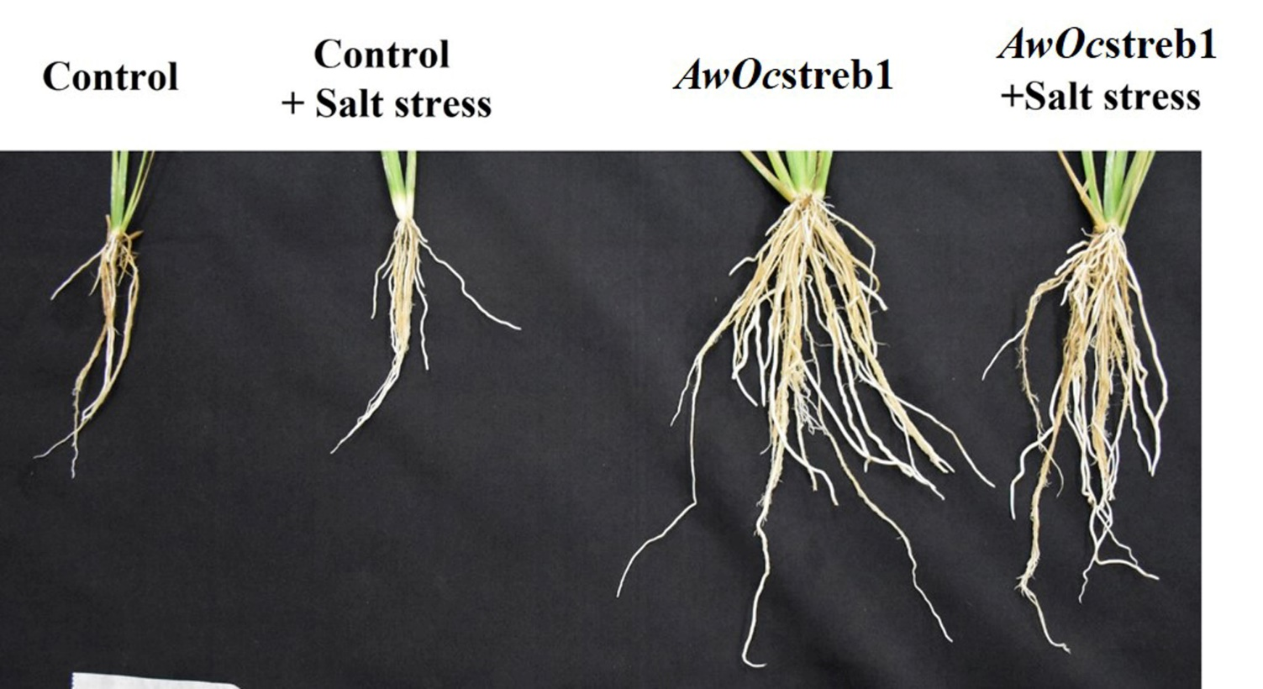
Fig. S5. Comparison of root of 28 days old AwOcstreb1 treated rice plants with uninoculated control plants.

Slide 6
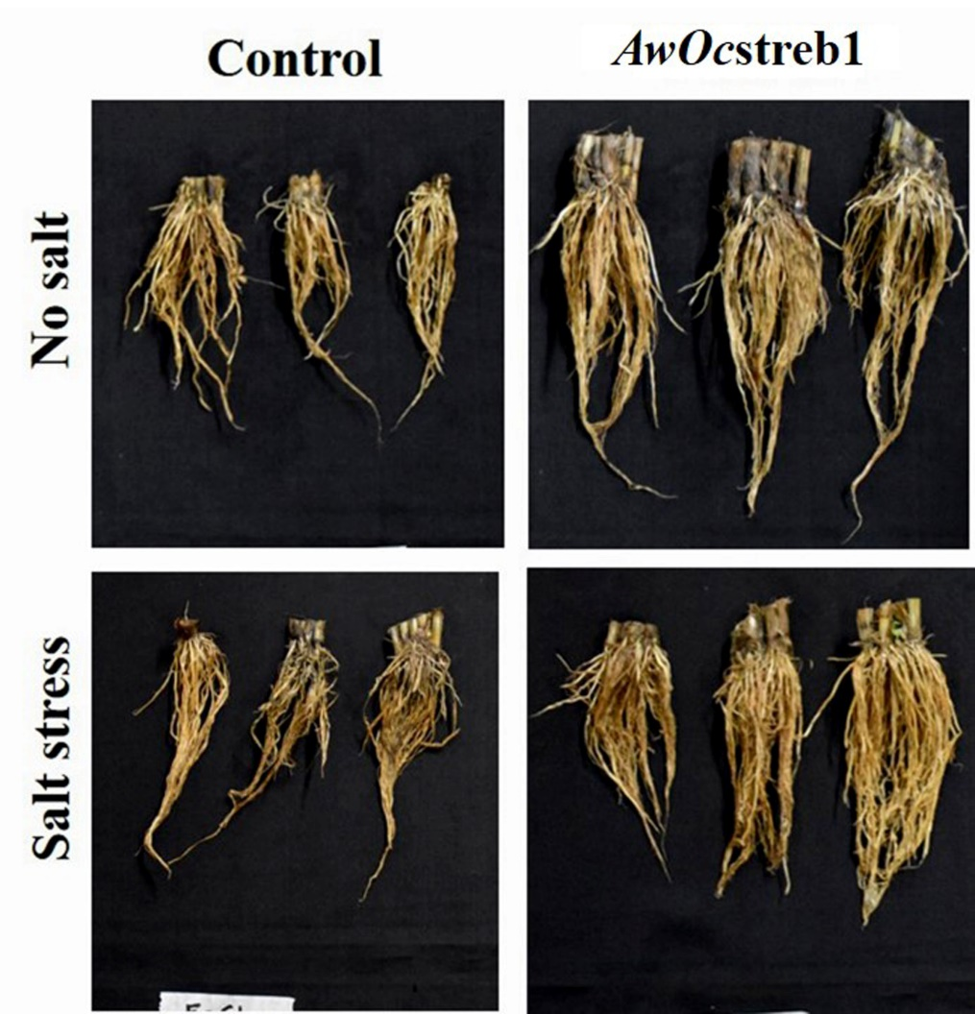
Fig. S6. Comparison of root of 140 days old AwOcstreb1 treated rice plants with uninoculated control plants.

Slide 7
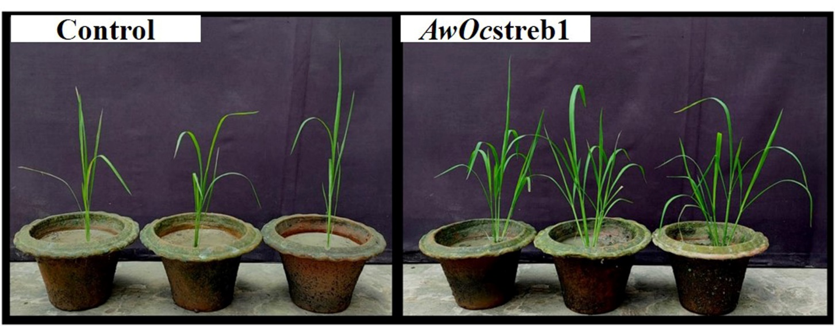
Fig. S7. Comparison of 35 days old AwOcstreb1 treated rice plants with uninoculated control plants at normal condition.

Slide 8
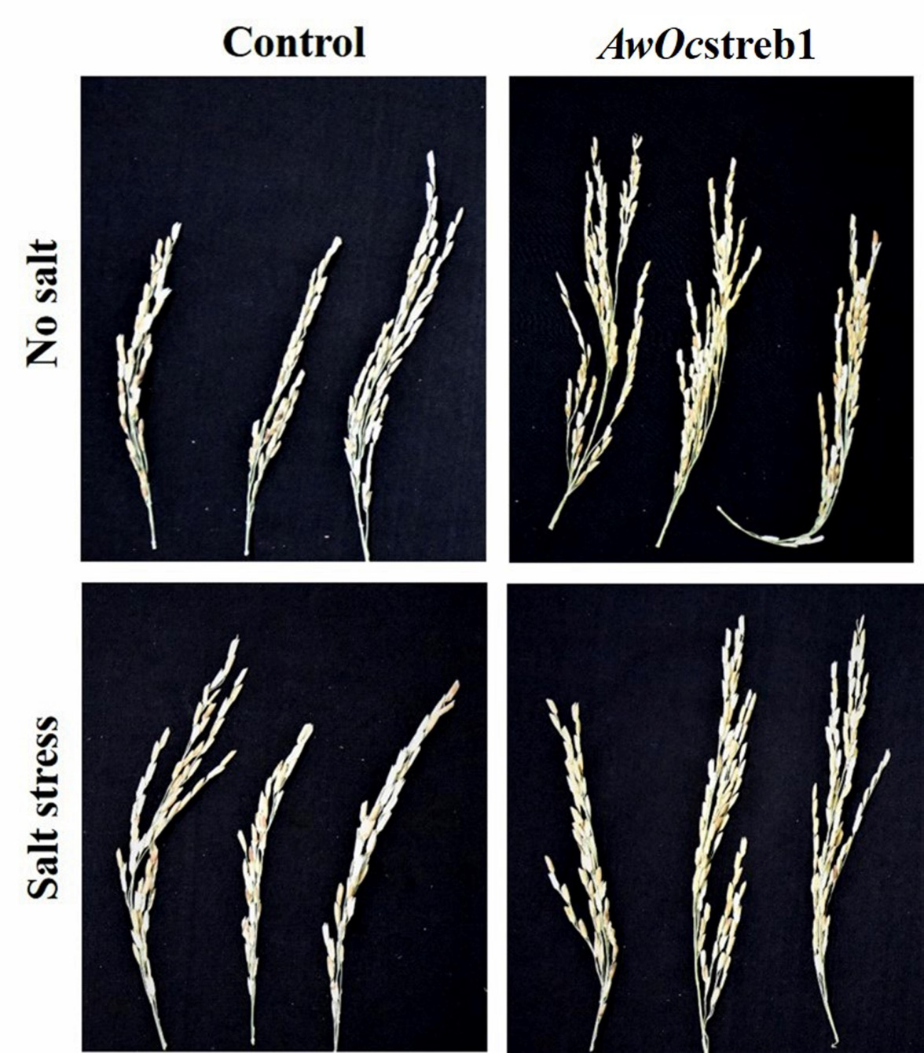
Fig. S8. Comparison of the panicles of AwOcstreb1 treated rice plants with uninoculated control plants at normal and saline stress condition.

Slide 9
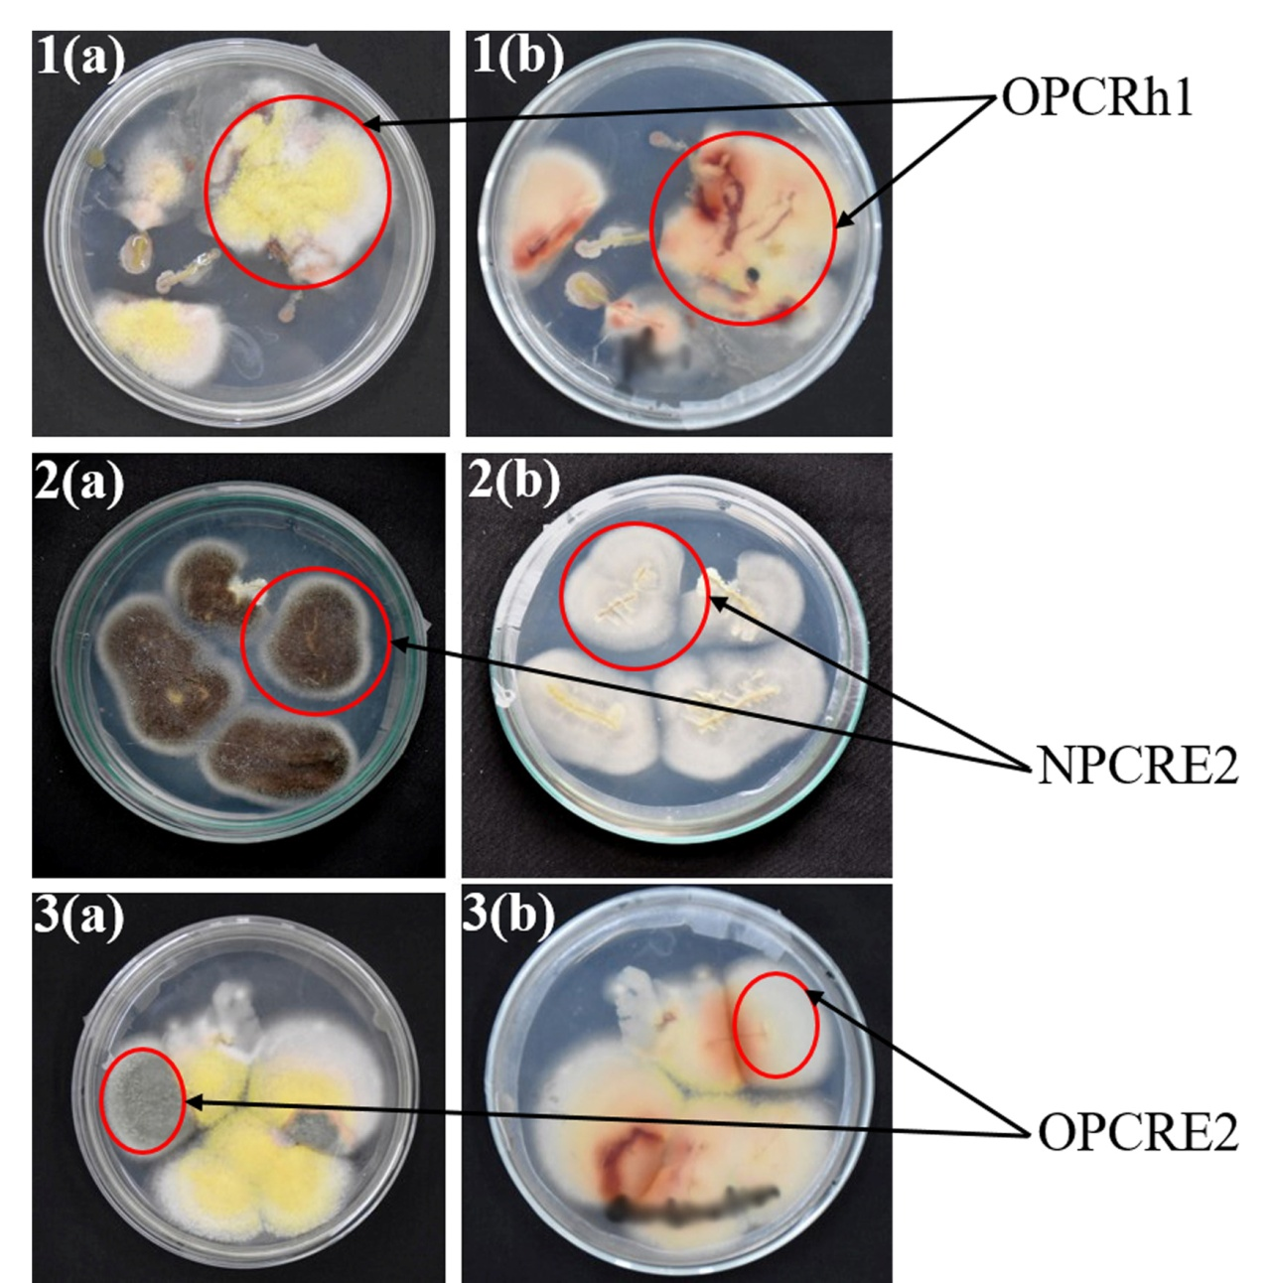
Fig. S9. Confirmation of colonization of Talaromyces adpressus (up), AwOcstreb1 (middle) , and Talaromyces argentinensis (down) in the roots of BR-28 rice by root colonization assay.

