Slide 1
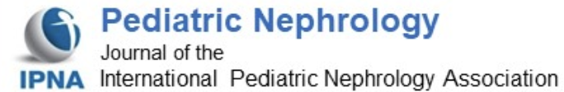
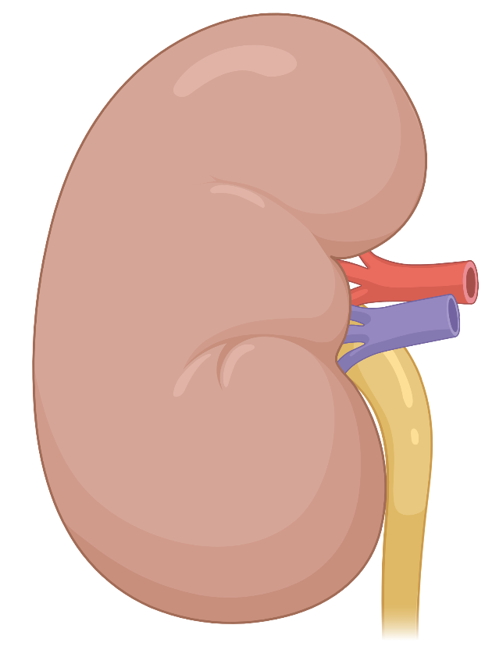



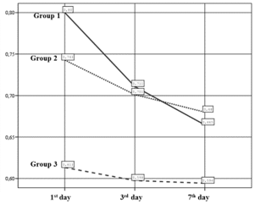
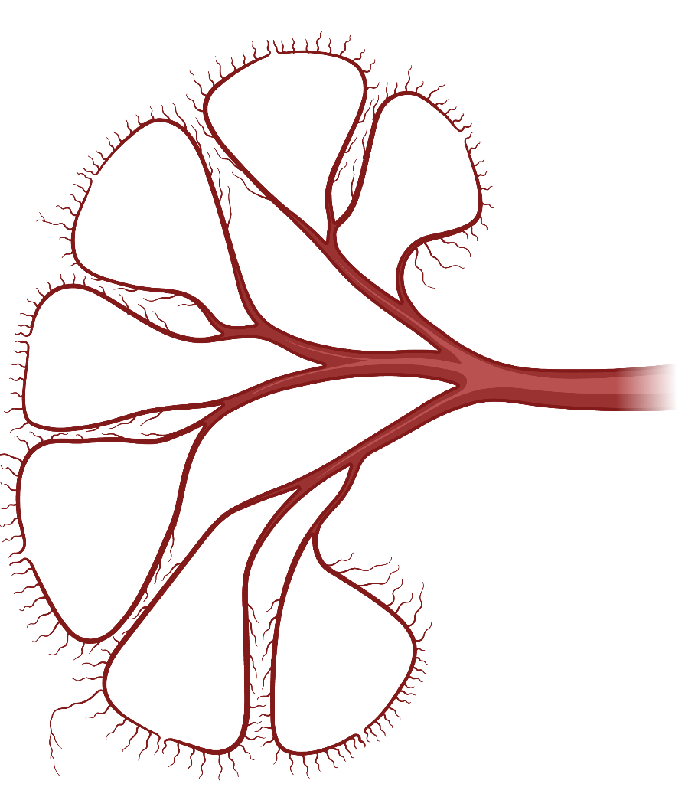
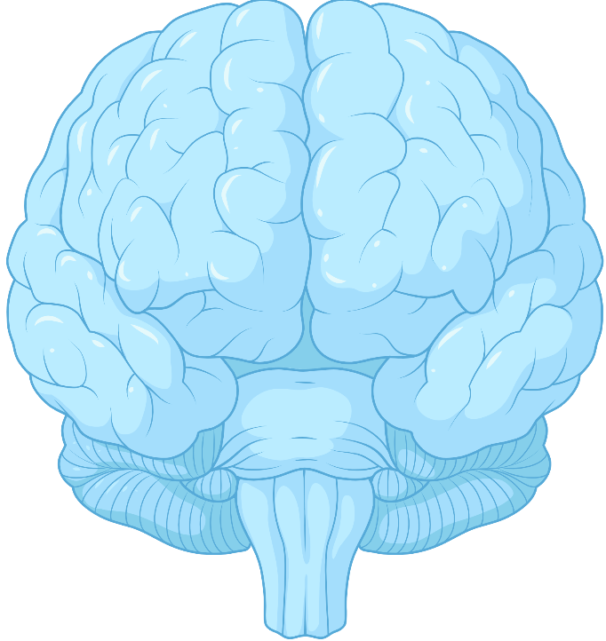
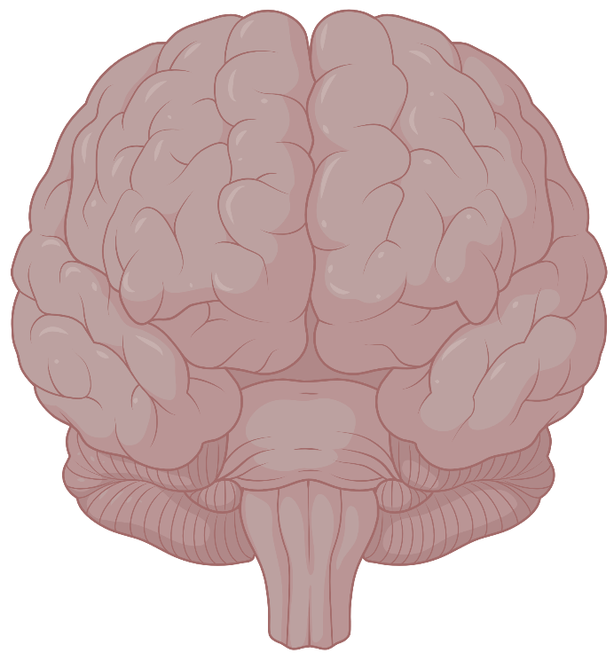
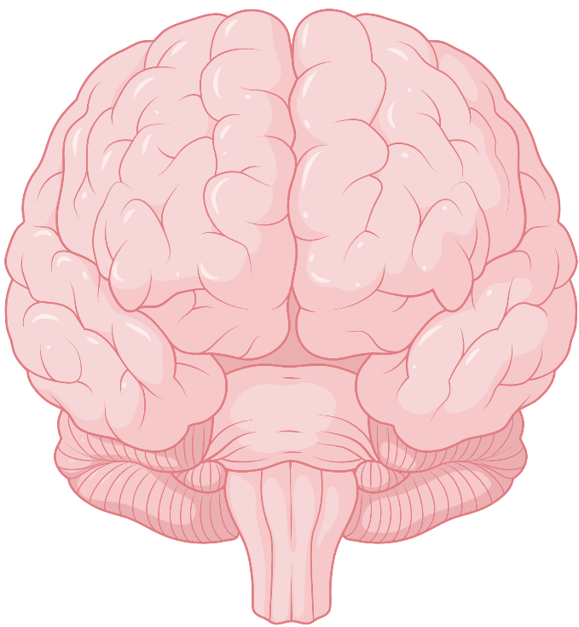
Renoprotective effects of therapeutic hypothermia
in neonates with perinatal asphyxia
Aydın et al. 2023
AIM: To compare renal artery (RA) blood flow and renal function tests in infants with perinatal asphyxia (HIE) and the effects of therapeutic hypothermia (TH) during the first seven days of life.
DESIGN & RESULTS:
Serum blood urea nitrogen (BUN), creatinine, uric acid, cystatin C levels decreased &
glomerular filtration rate (GFR) increased during TH
Single center prospective cohort study
Systolic and end-diastolic blood flow in RA increased and RA resistive index (RI) decreased with time in Group1
119 neonate
< 6 hours of postnatal age
≥36 weeks gestational age
RA RESISTIVE INDEX
On the 7th day, all the three groups had similar values
Group 1
(n=36)
Group 2
(n=23)
Group 3
(n=60)
CONCLUSION:
    Therapeutic hypothermia seems to help to restore the renal blood flow and renal functions during the neonatal adaptive period along with its neuroprotective properties.
Stage
2-3 HIE
+ TH
Stage 1 HIE
Healthy newborns

