Slide 1
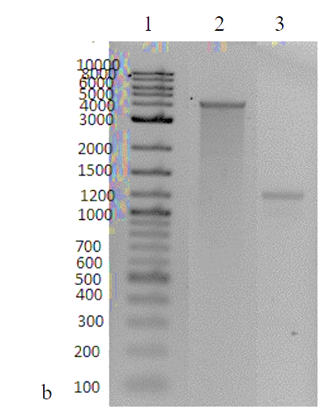
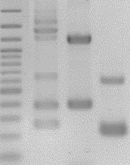
Supplement
Fig. S1
1 2 3 M 4
bp
2000
1500
1200
1000
500
400
300
200
100

Slide 2
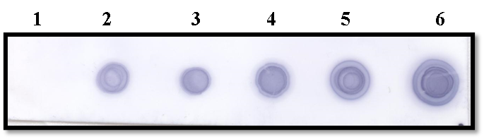
Fig. S2

