Slide 1
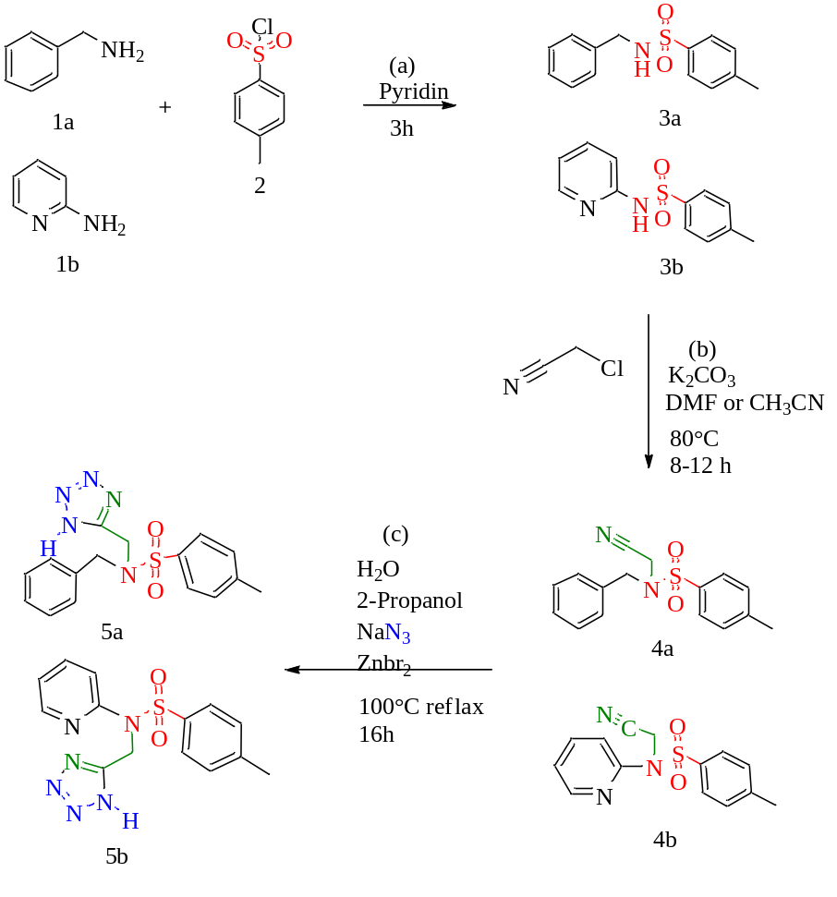

Slide 2

Scheme 1. Efficient synthesis of 5a-b tetrazole compound

