Slide 1
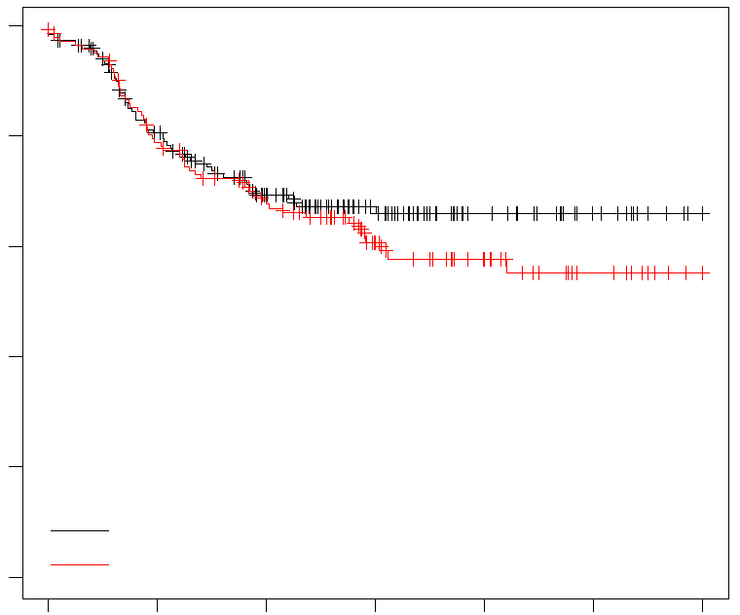
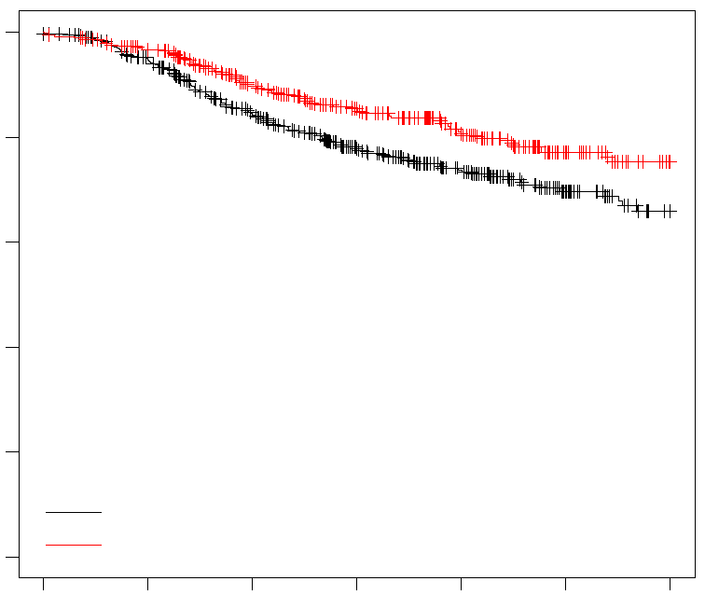
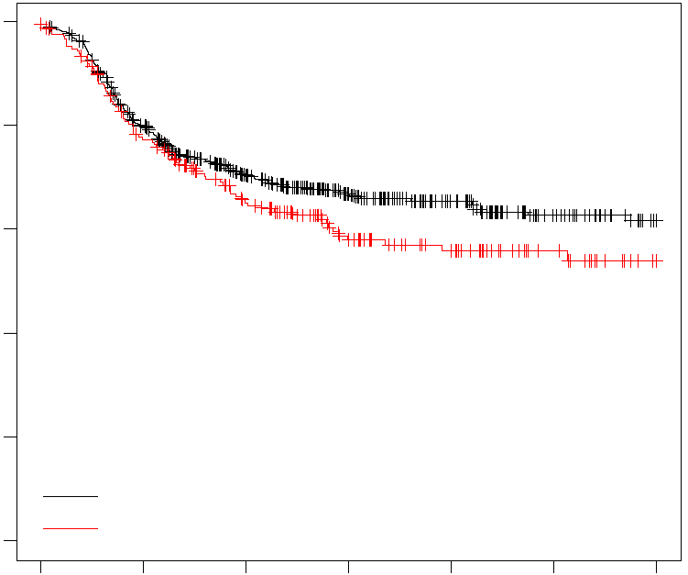
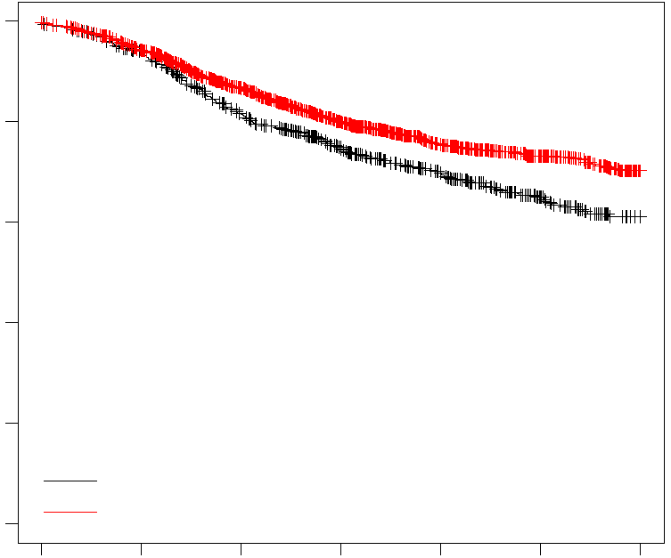
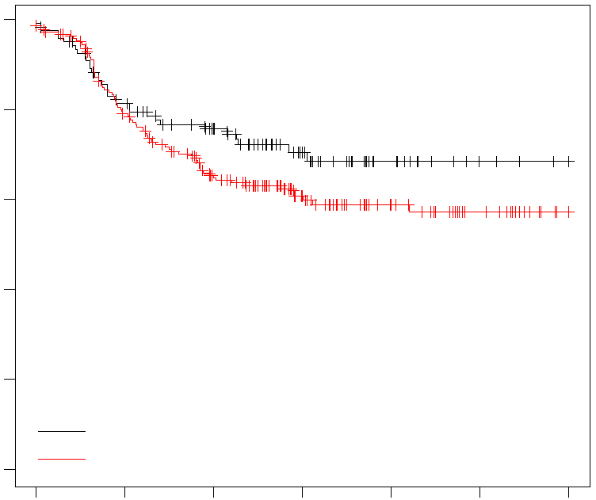
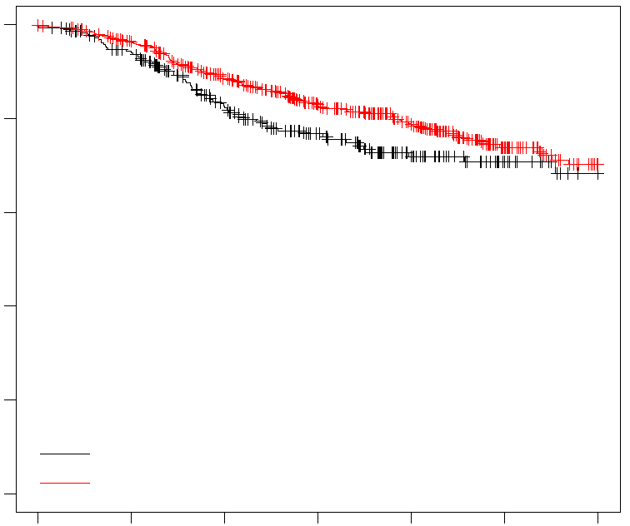
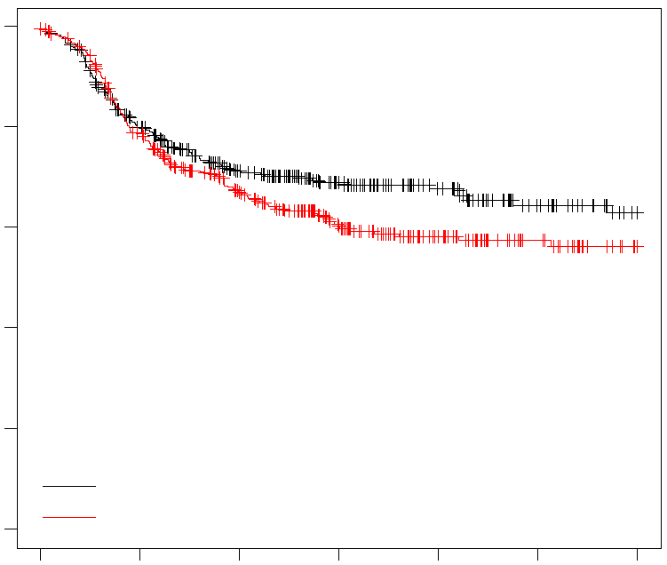
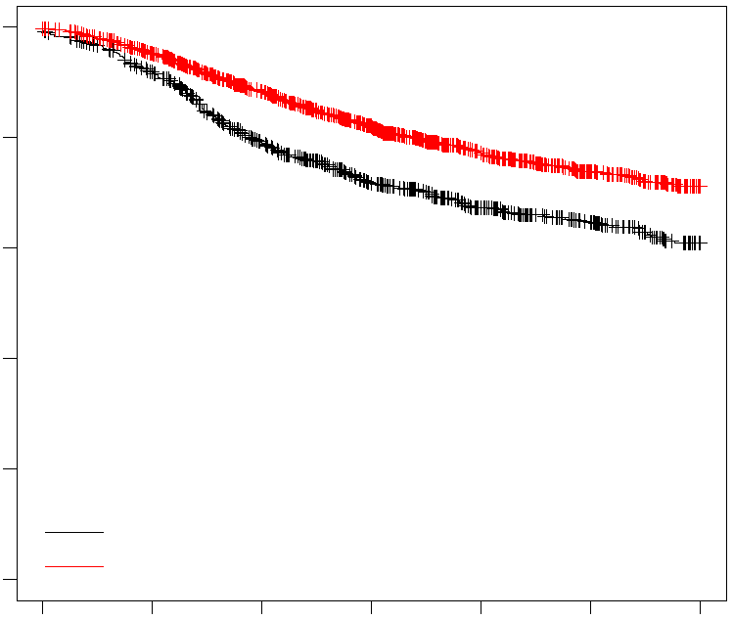
Supplementary figure 1
A
B
1.0
ERα -
1.0
ERα +
0.8
p = 0.35
0.8
p = 0.012
0.6
0.6
RFS Probability
RFS Probability
0.4
0.4
0.2
Low AZIN2
0.2
Low AZIN2
0.0
High AZIN2
0.0
High AZIN2
0
20
40
60
80
100
120
0
20
40
60
80
100
120
C
Time (months)
D
Time (months)
1.0
ERα -
1.0
ERα +
0.8
p = 0.10
0.8
p = 0.00032
0.6
0.6
RFS Probability
RFS Probability
0.4
0.4
0.2
Low GAD1
0.2
Low GAD1
0.0
High GAD1
0.0
High GAD1
0
20
40
60
80
100
120
0
20
40
60
80
100
120
E
Time (months)
F
Time (months)
1.0
ERα -
1.0
ERα +
0.8
p = 0.13
0.8
p = 0.074
0.6
0.6
RFS Probability
RFS Probability
0.4
0.4
0.2
Low SLC27A4
0.2
Low SLC27A4
0.0
High SLC27A4
0.0
High SLC27A4
0
20
40
60
80
100
120
0
20
40
60
80
100
120
G
Time (months)
H
Time (months)
1.0
ERα -
1.0
ERα +
0.8
p = 0.085
0.8
p = 4.4e-08
0.6
0.6
RFS Probability
RFS Probability
0.4
0.4
0.2
Low CA4
0.2
Low CA4
0.0
High CA4
0.0
High CA4
0
20
40
60
80
100
120
0
20
40
60
80
100
120
Time (months)
Time (months)

Slide 2

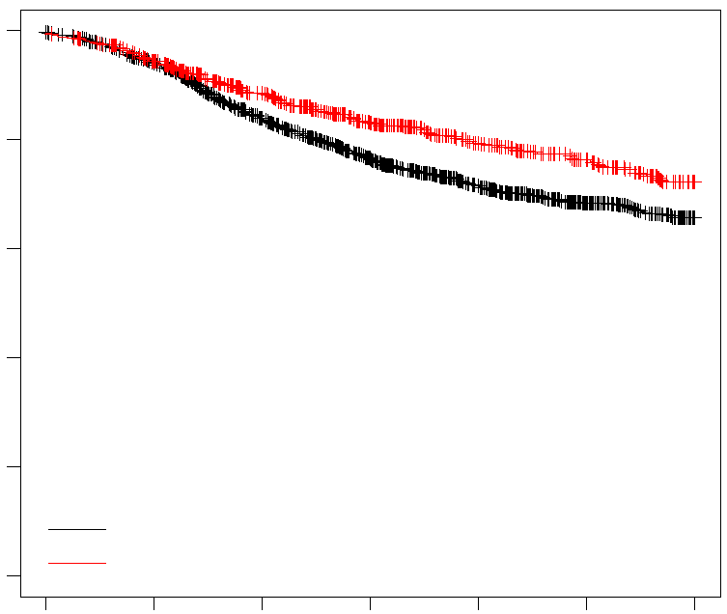
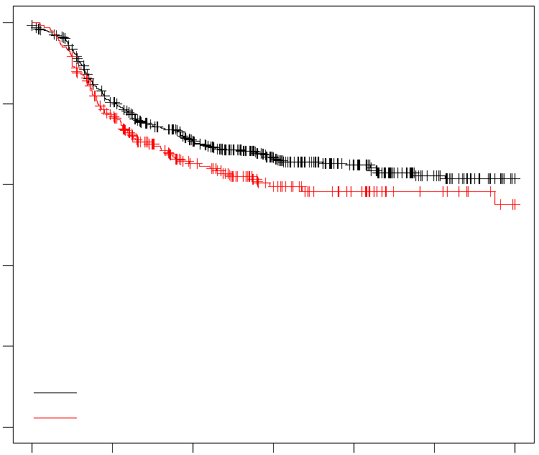
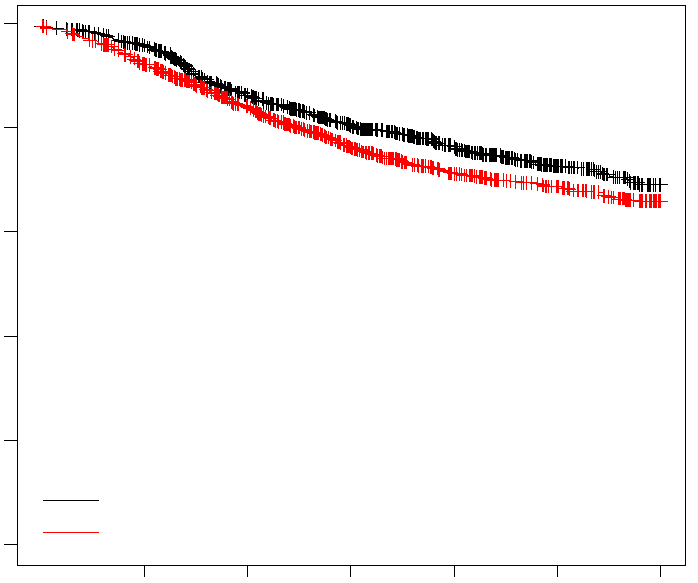
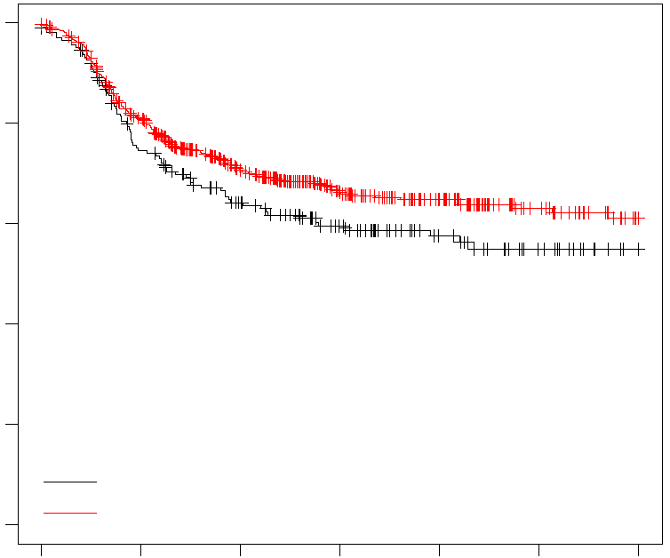
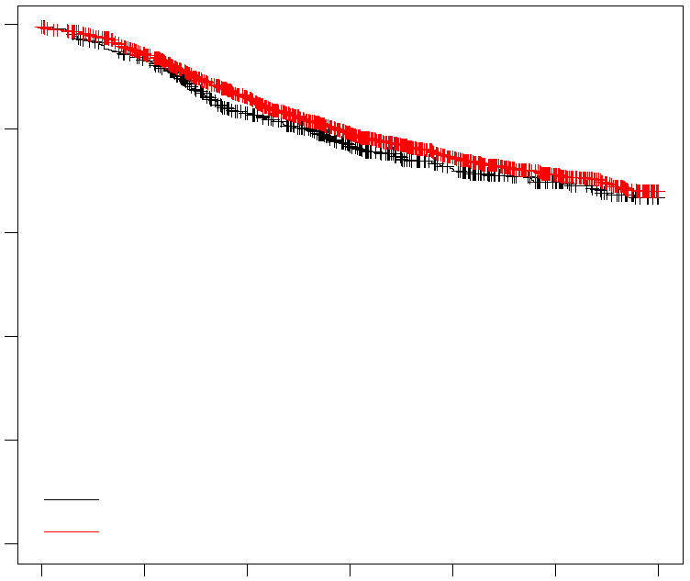
Supplementary figure 2
A
B
1.0
ERα -
1.0
ERα +
0.8
p = 0.21
0.8
p = 0.00083
0.6
0.6
RFS Probability
RFS Probability
0.4
0.4
0.2
Low CA14
0.2
Low CA14
0.0
High CA14
0.0
High CA14
0
20
40
60
80
100
120
0
20
40
60
80
100
120
Time (months)
Time (months)
C
D
1.0
ERα -
1.0
ERα +
0.8
p = 0.1
0.8
p = 0.02
0.6
0.6
RFS Probability
RFS Probability
0.4
0.4
0.2
Low FKBP6
0.2
Low FKBP6
0.0
High FKBP6
0.0
High FKBP6
0
20
40
60
80
100
120
0
20
40
60
80
100
120
Time (months)
Time (months)
E
F
1.0
ERα -
1.0
ERα +
0.8
p = 0.08
0.8
p = 0.29
0.6
0.6
RFS Probability
RFS Probability
0.4
0.4
0.2
Low PGAM2
0.2
Low PGAM2
0.0
High PGAM2
0.0
High PGAM2
0
20
40
60
80
100
120
0
20
40
60
80
100
120
Time (months)
Time (months)

