Slide 1

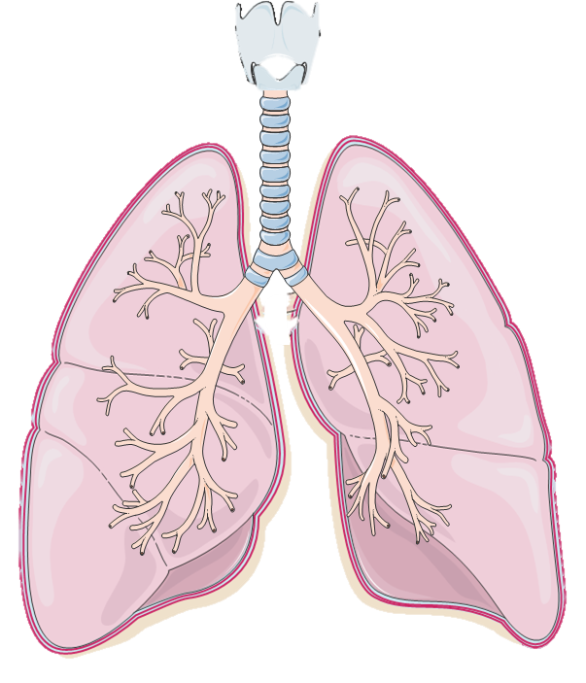
Non asthma
n = 10
Severe asthma (SA)
n = 20
SA signature in broncho-alveolar lavages
SA signature in broncho-alveolar lavages
Single-omics
Microbiota
Increase of alpha-diversity
Increase of Streptococcus, Prevotella, Corynebacterium, Dolosigranulum pigrum, Tropheryma whipplei, Moraxella nonliquefaciens
Decrease of Haemophilus
Metabolome
Increase of spermine and spermidine
Multi-omics
Metabolome
Glycyl-L-leucine, N-acetyl-ornithine, N6-acetyl-L-lysine, L-alanyl-L-proline, lysine, xanthosine, adenosine, guanosine, hypoxanthine...
Immune system
APRIL, IL-8, MMP2, CCL-20

