Slide 1
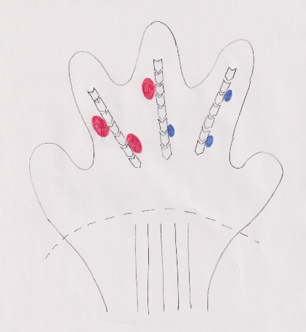

(a)
(b)
+ neurotrophins
: ribosomal protein S6 (small subunit)
: ribosomal protein P0/1/2 (large subunit)
: actin
: phospho-ribosomal protein S6

