Slide 1
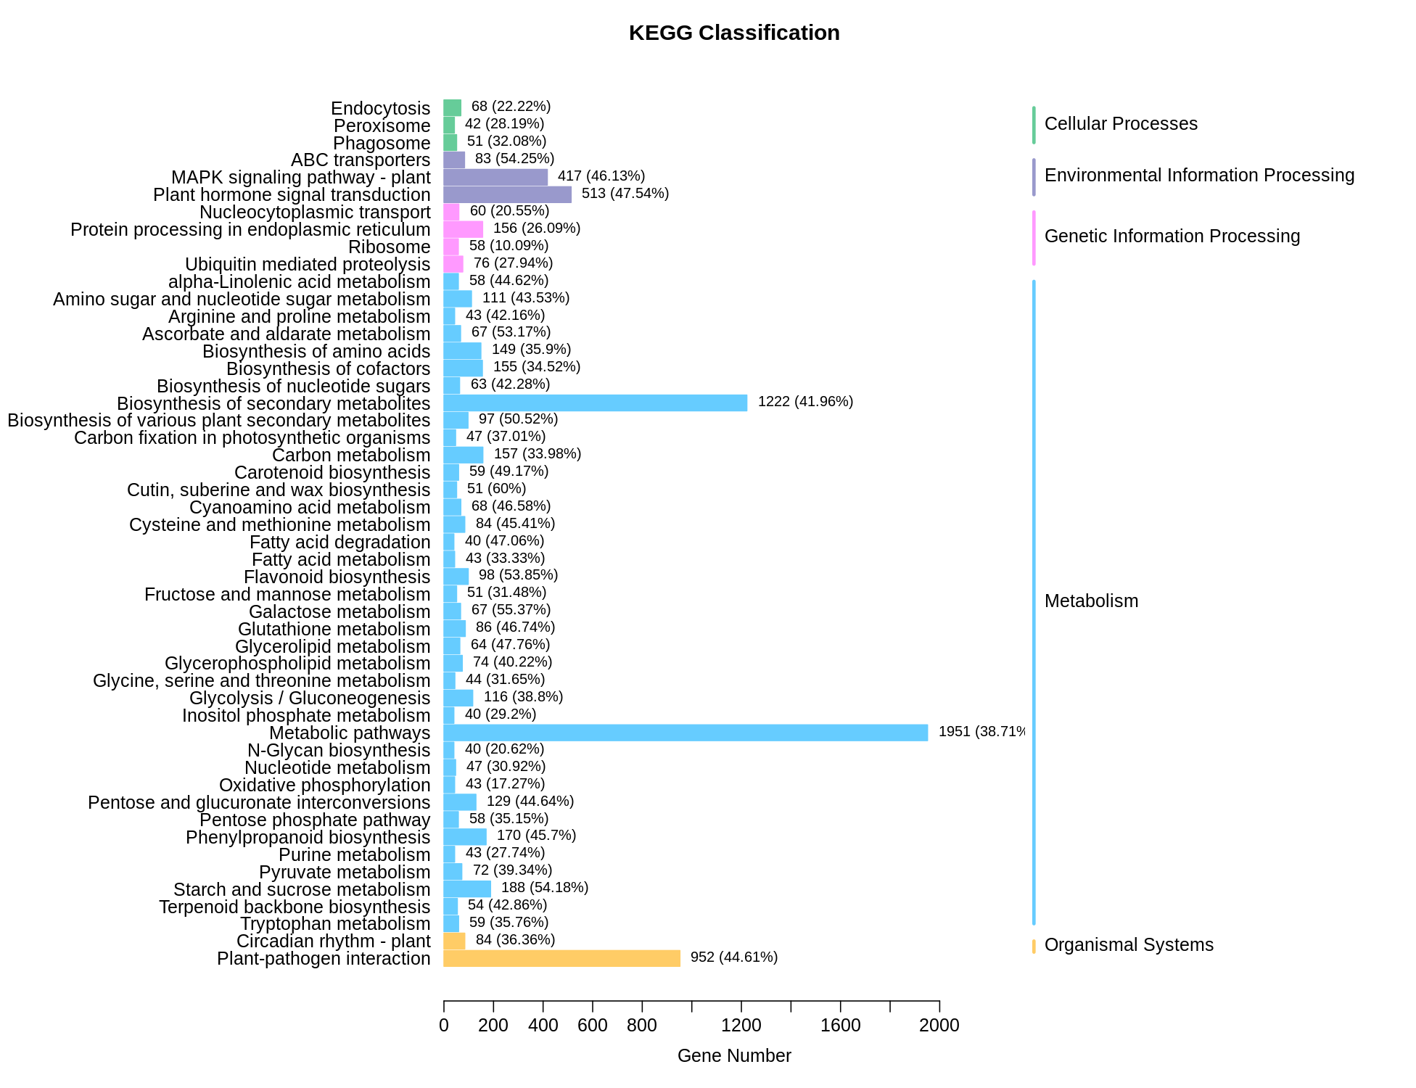
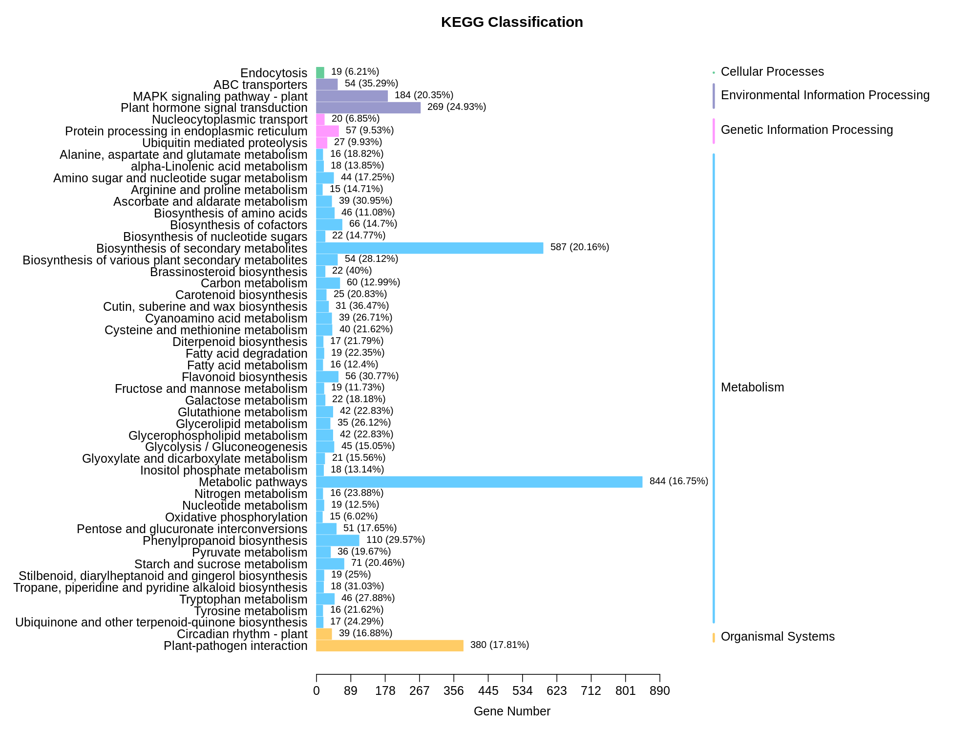
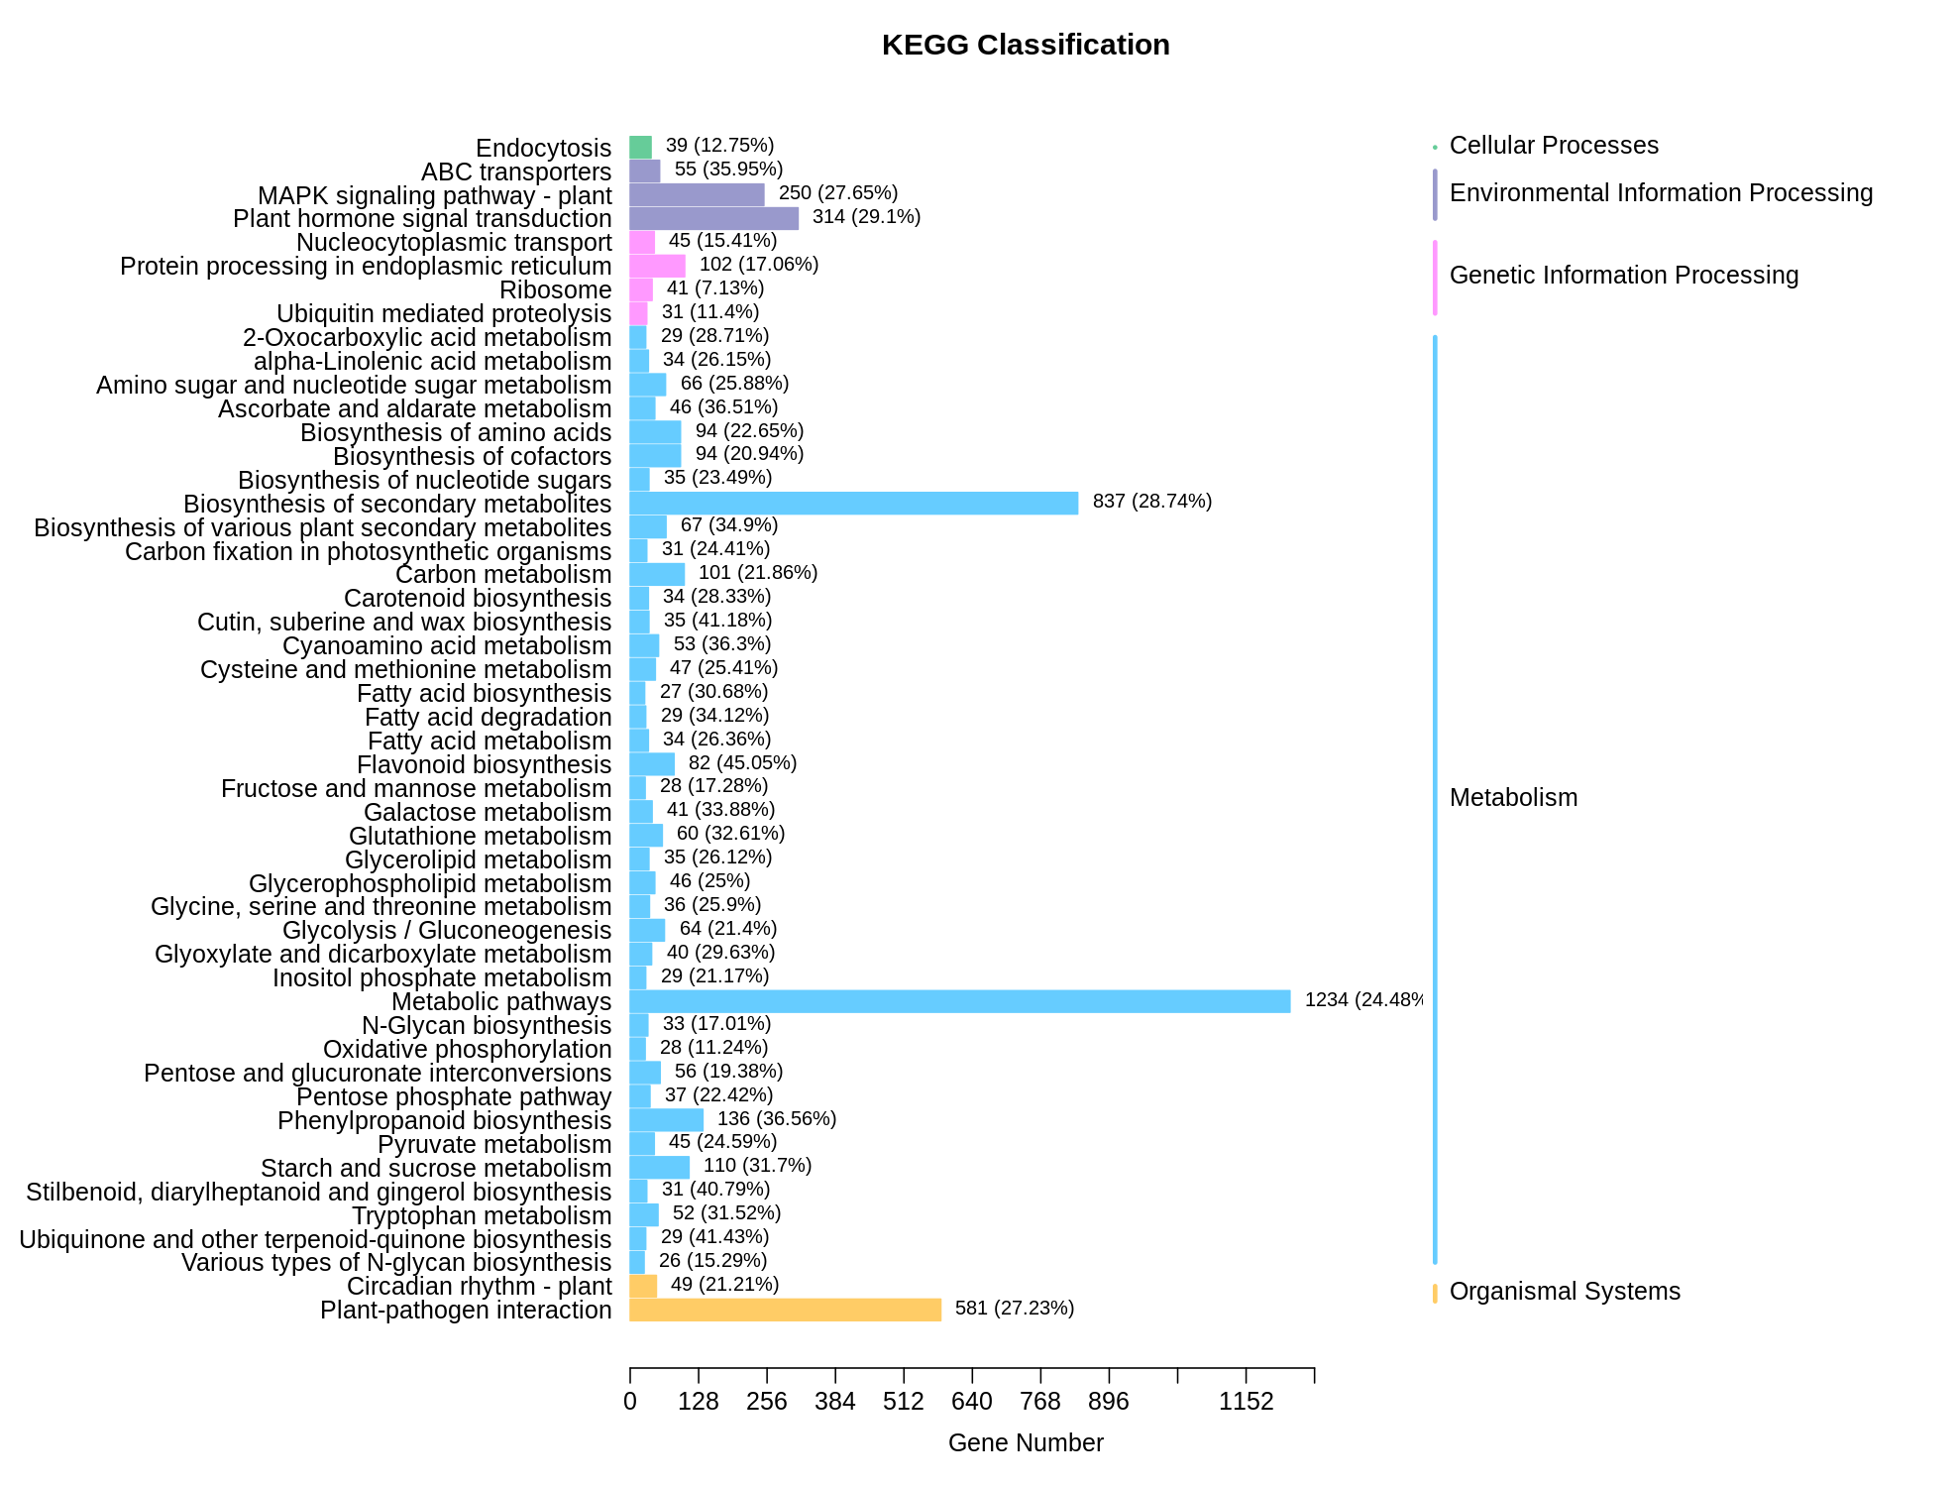
YT-h vs YT-y
YT-y vs YT-f
YT-f vs YT-p
Supplementary Figure 4. Classification of KEGG pathways to which the DEGs in YT-h vs YT-y, RT-y vs RT-f, and YT-f vs YT-p were enriched.

