Slide 1
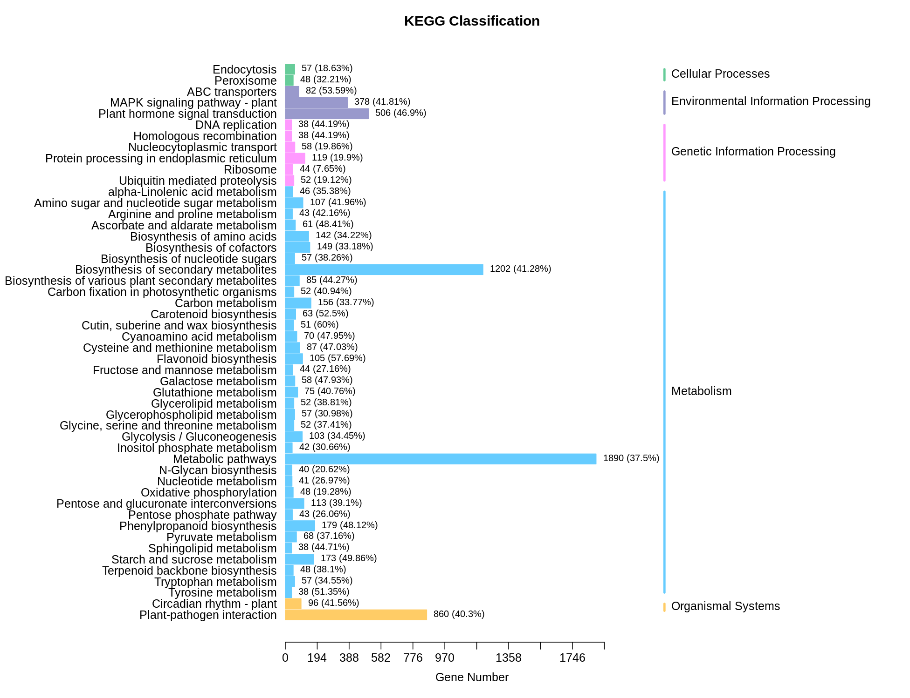
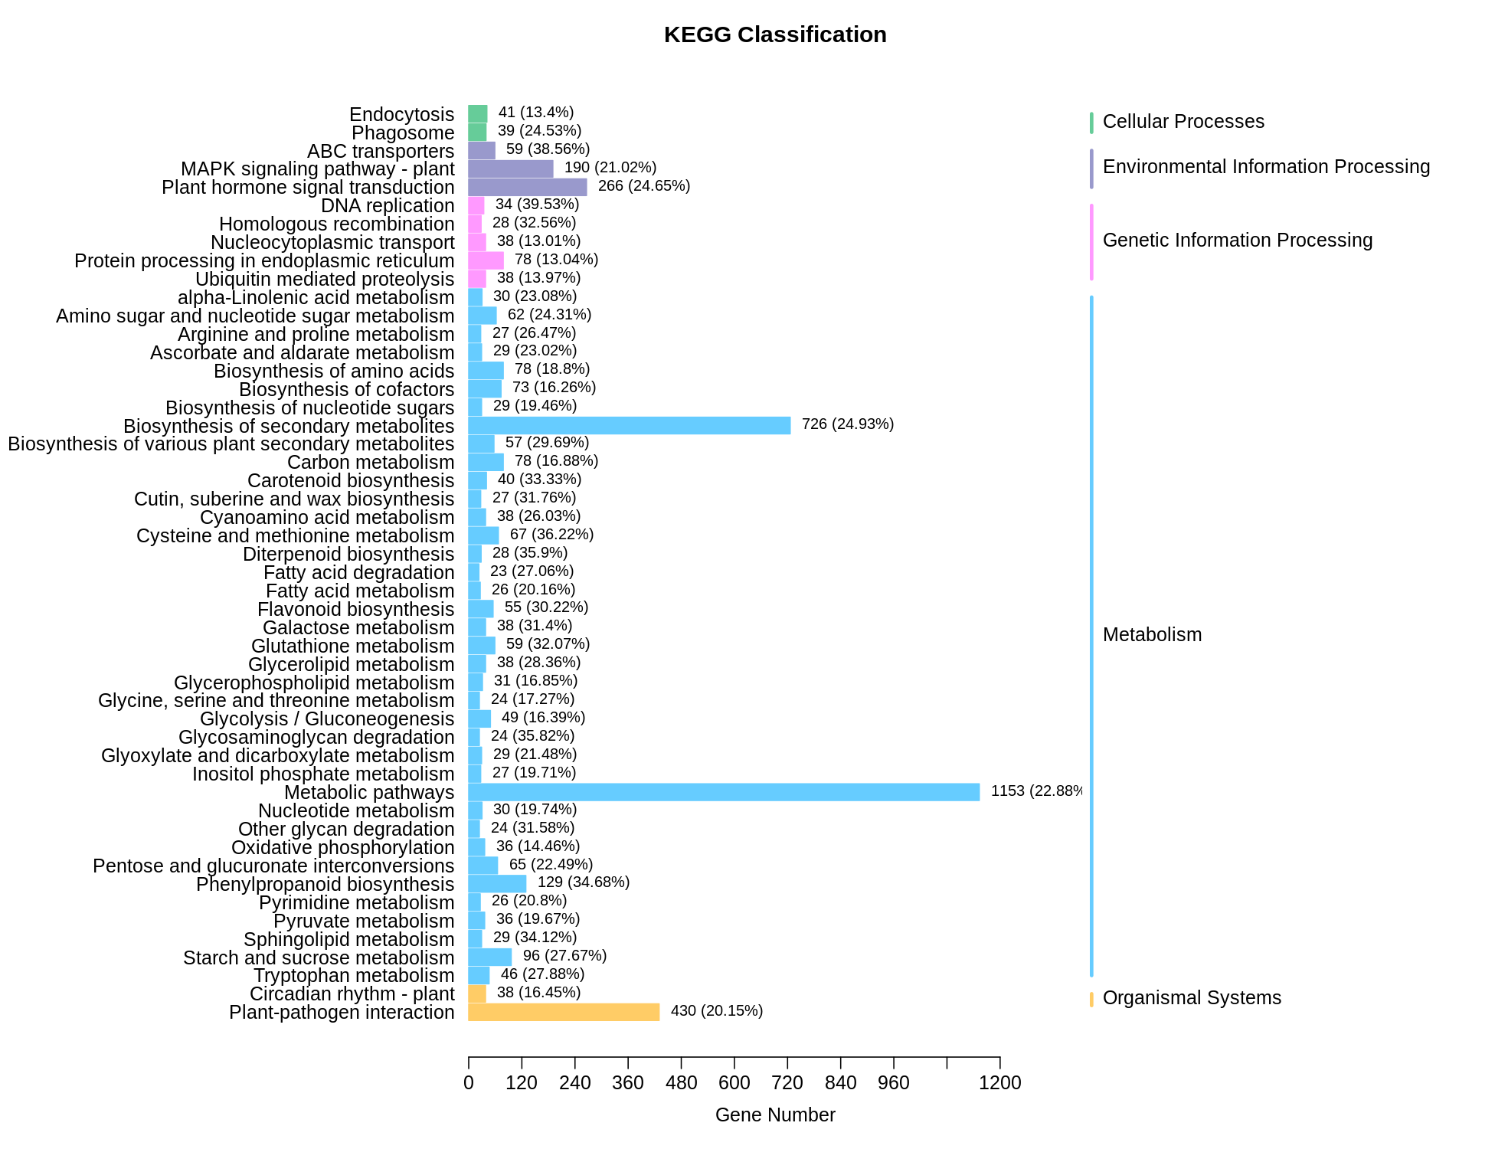
RT-y vs RT-f
RT-h vs RT-y
Supplementary Figure 3. Classification of KEGG pathways to which the DEGs in RT-h vs RT-y and RT-y vs RT-f were enriched.

