Slide 1
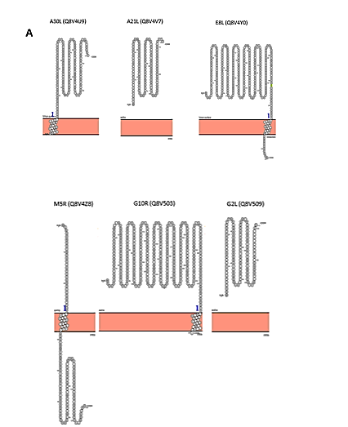
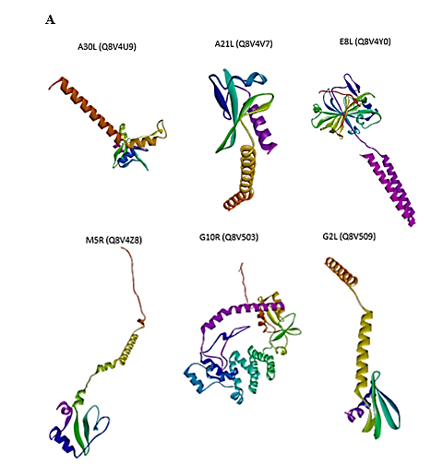
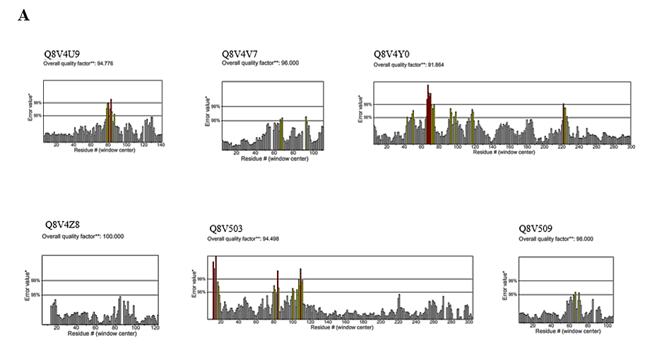
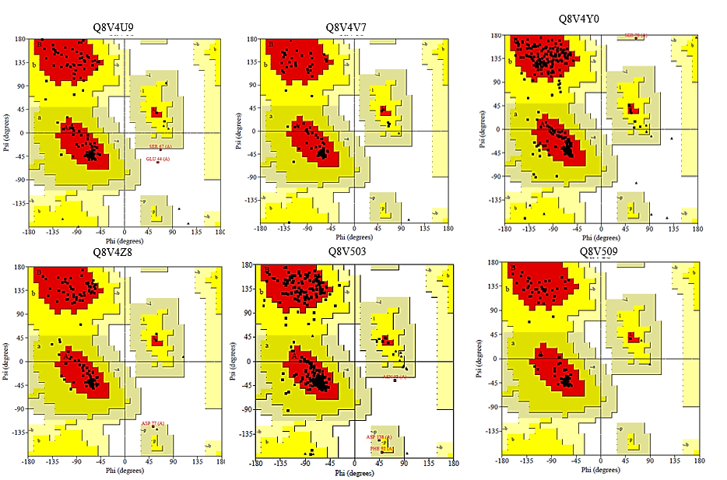
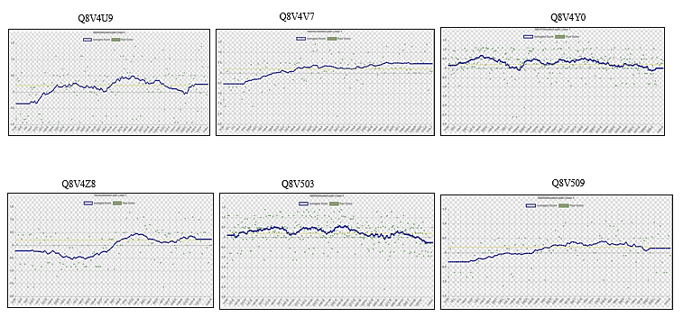
a
b
c
d
e
Supplementary Fig 1. Ab initio protein structure prediction and modelling of MPXV surface proteins (C-QUARK/trRosetta /Swiss-model ), Predicted localization, ERRAT value, Verify3D plot, and Ramachandran Plot (Procheck) of MPXV surface proteins -Q8V4U9 (A30L), Q8V4V7 (A21L), Q8V4Y0 (E8L), Q8V4Z8 (M5R), Q8V503 (G10R) and Q8V509 (G2L). a Modelled Protein structures of six Monkeypox virus (MPXV) surface proteins. b The membrane topology of MPXV proteins are shown. c ERRAT value of quality factor for MPXV proteins are given. d Verify3D plots for MPXV surface proteins are demonstrated. e Ramachandran plot for the models of MPXV surface proteins are given.

Slide 2
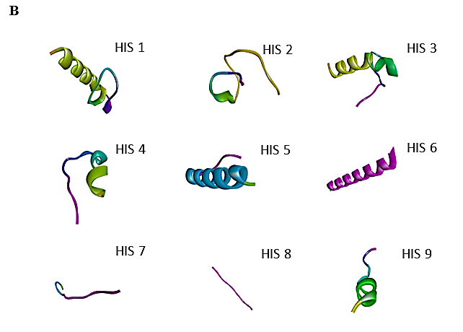
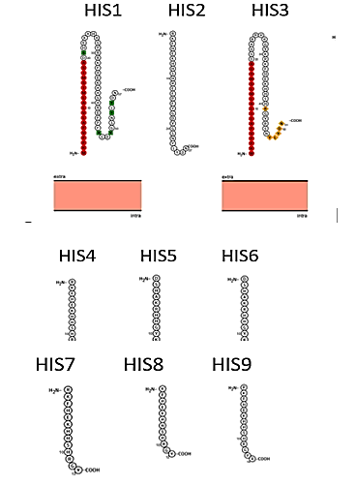
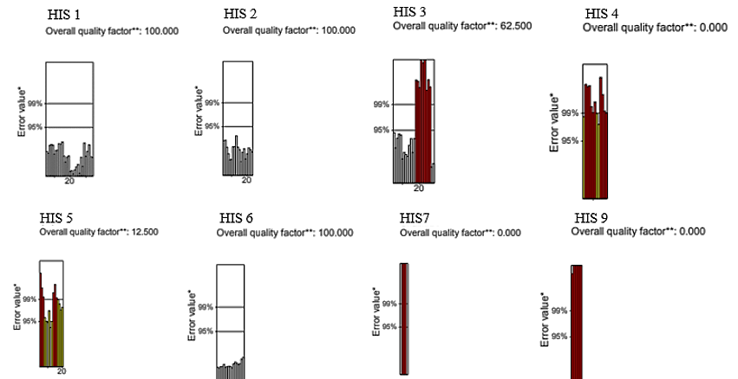
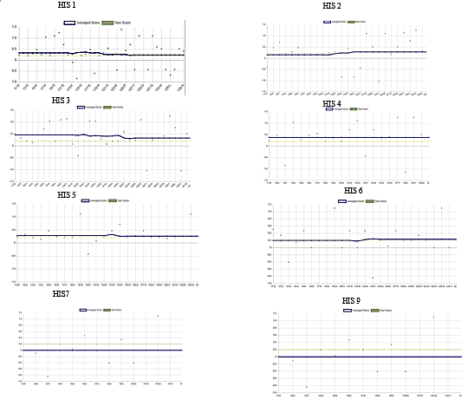
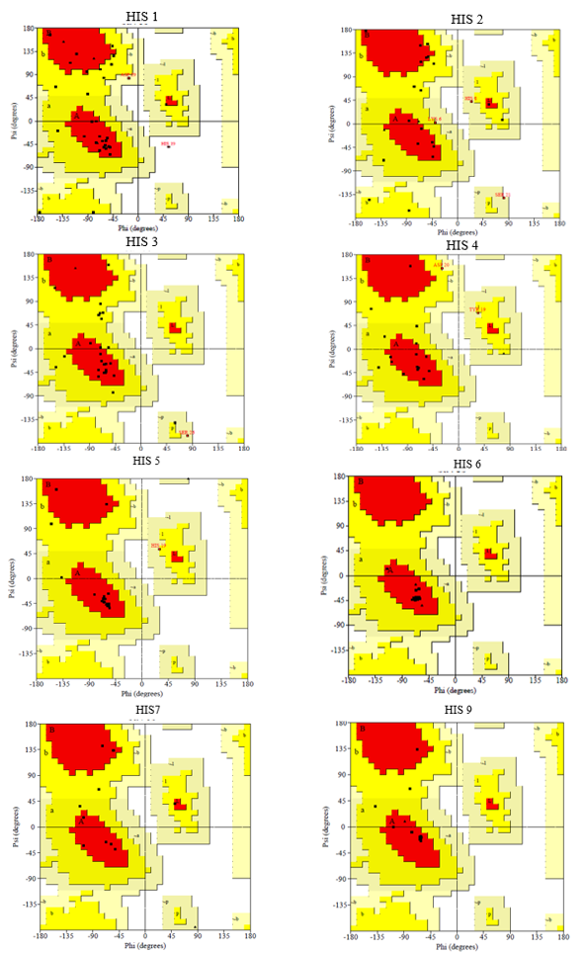
a
b
c
d
e
Supplementary Fig 2. Ab initio protein structure prediction and modelling (C-QUARK/trRosetta/Swiss-model ), Predicted localization, ERRAT value, Verify3D plot, and Ramachandran Plot (Procheck) of human antimicrobial peptides (hAMPs)Histatin 1-9. a Modelled Protein structures of Histatins. b The membrane topology of Histatins are shown. c ERRAT value of quality factor for Histatins are given. d Verify3D plots for Histatins are demonstrated. e Ramachandran plot for the models of Histatins are given.

Slide 3
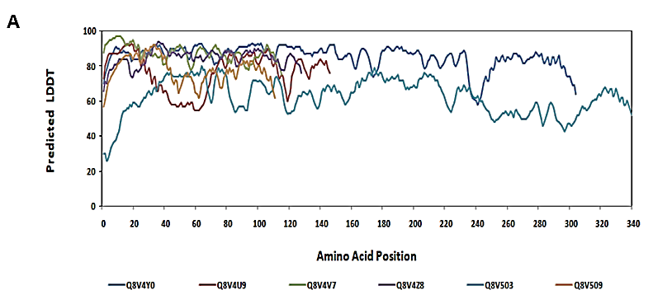
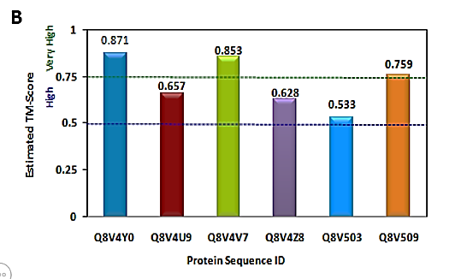
a
b
Supplementary Fig 3. MPXV surface proteins Local Distance Difference Test (LDDT). Template Modeling score (TM-score) of respective proteins. a Local Distance Difference Test (LDDT) for MPXV surface proteins are performed according to the amino acid position. b TM-score for MPXV proteins are displayed. TM scores above 0.5 may be considered high.

