Slide 1



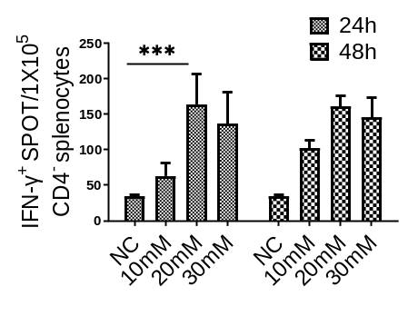









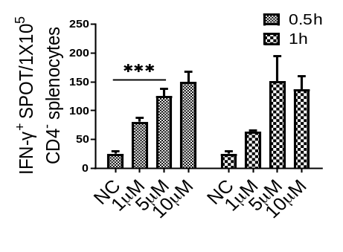






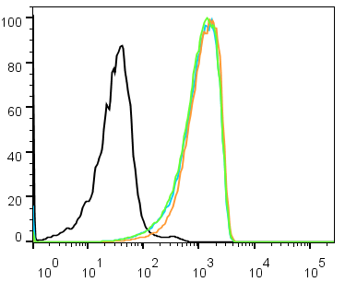
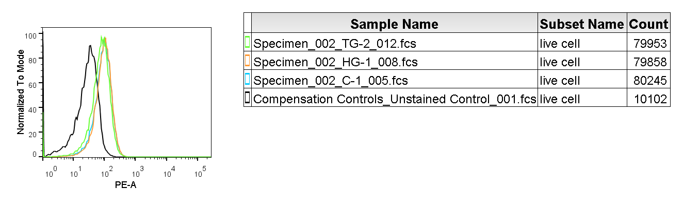
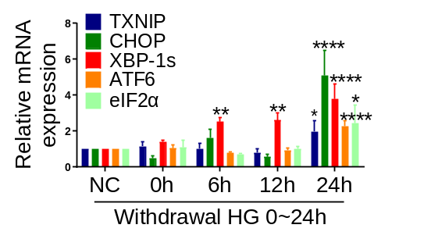
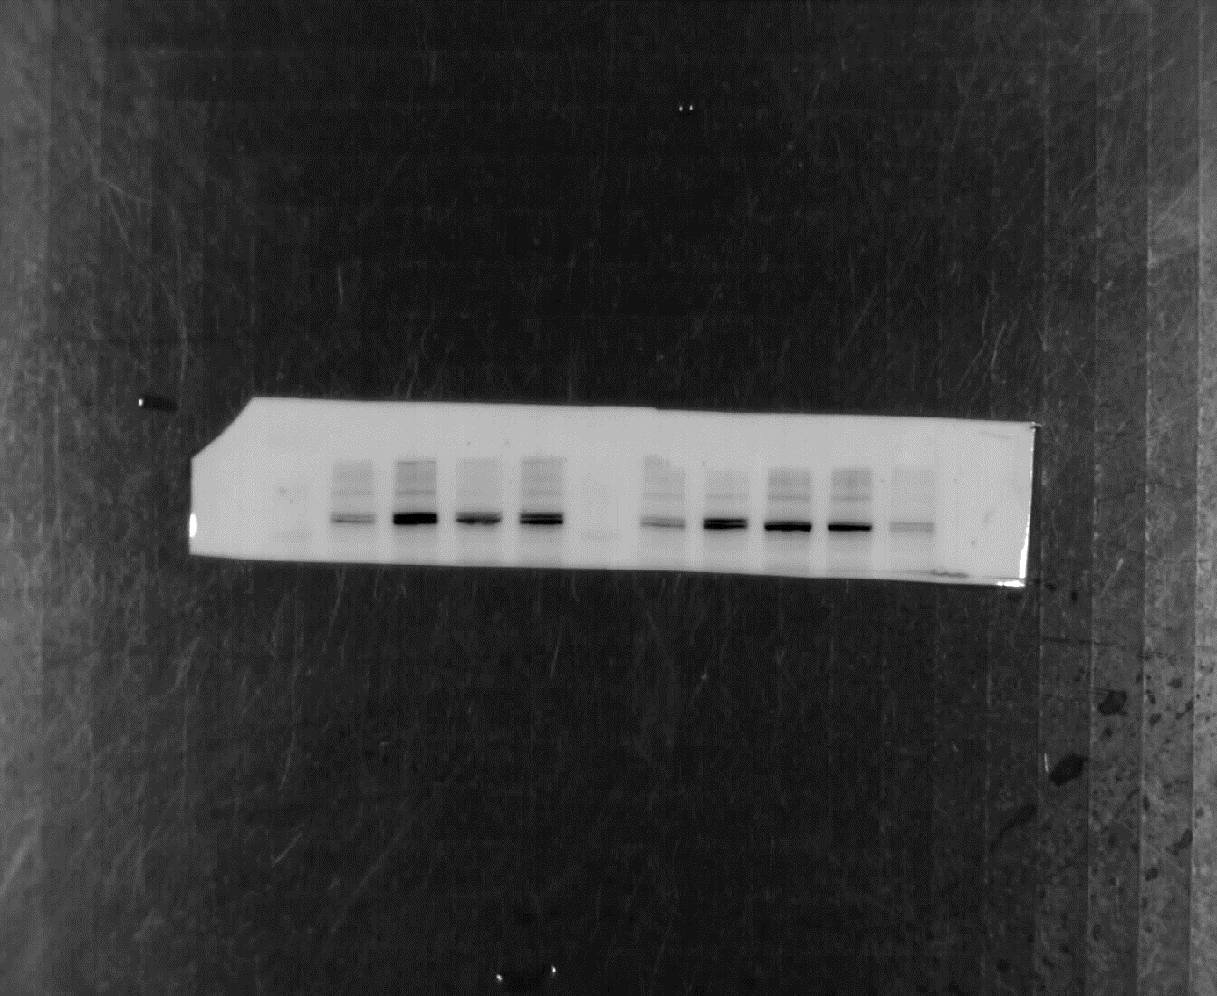

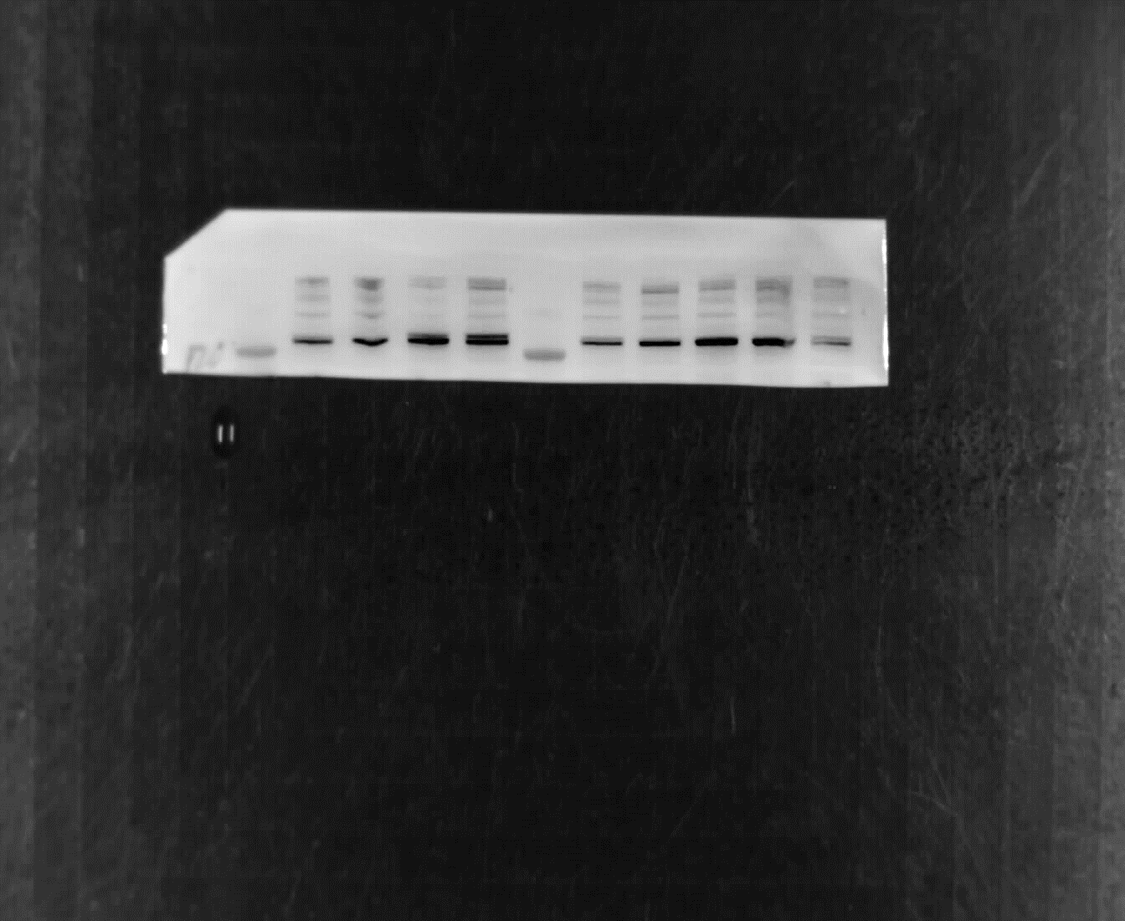
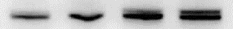
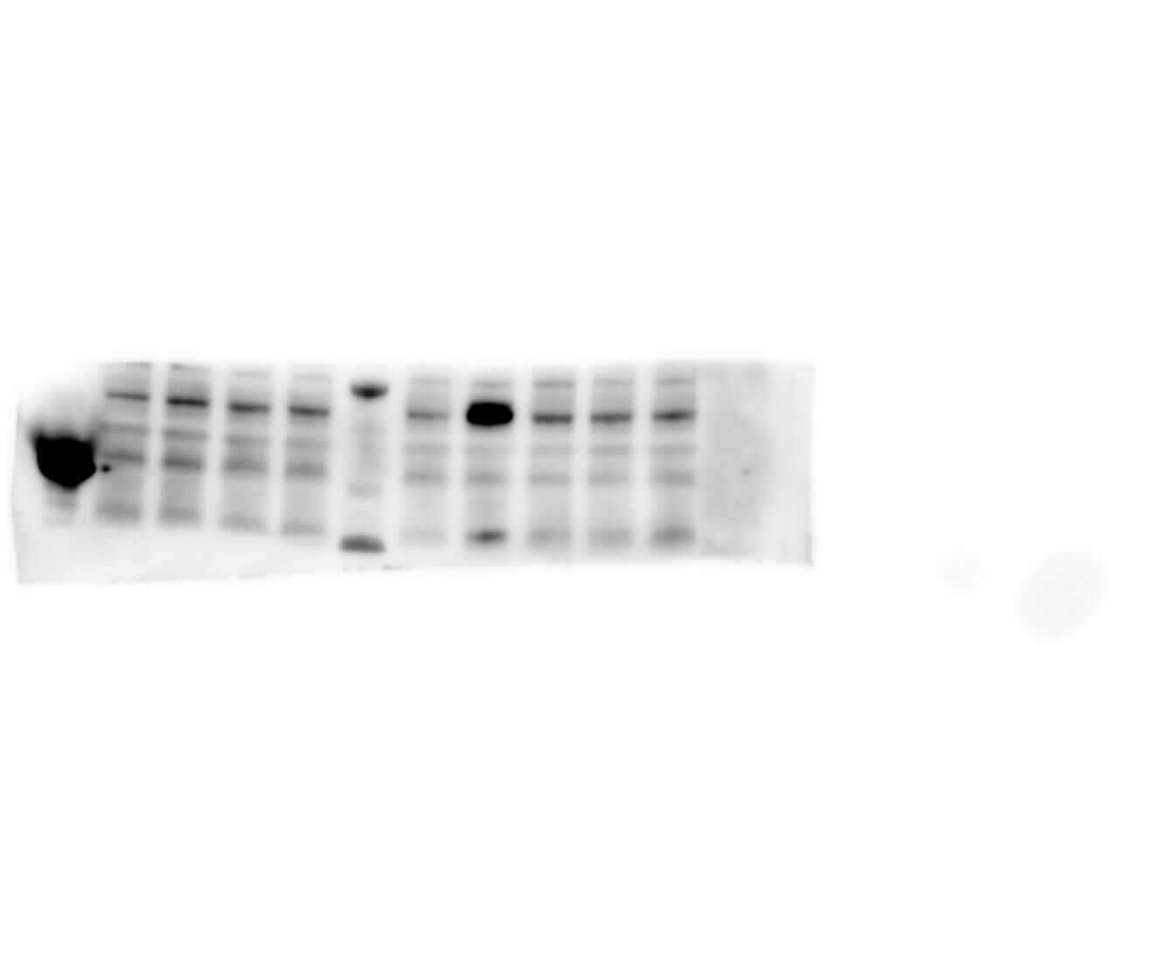
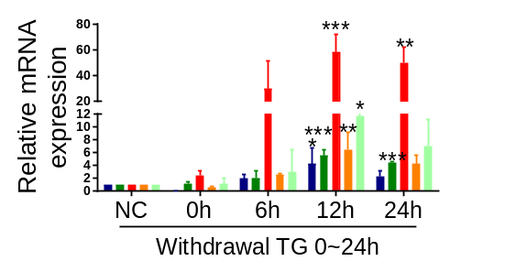
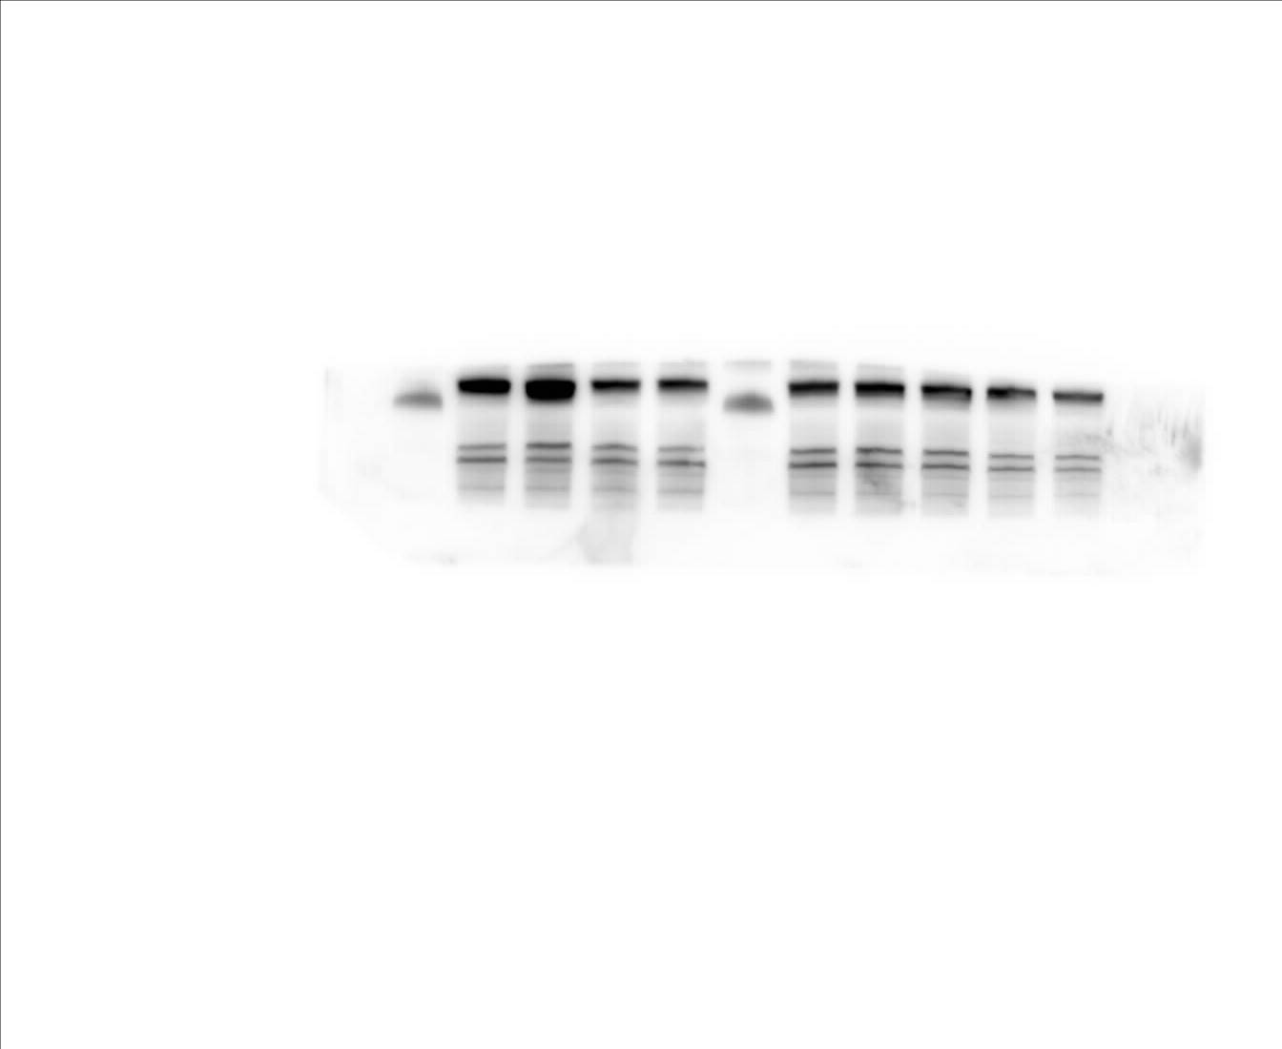
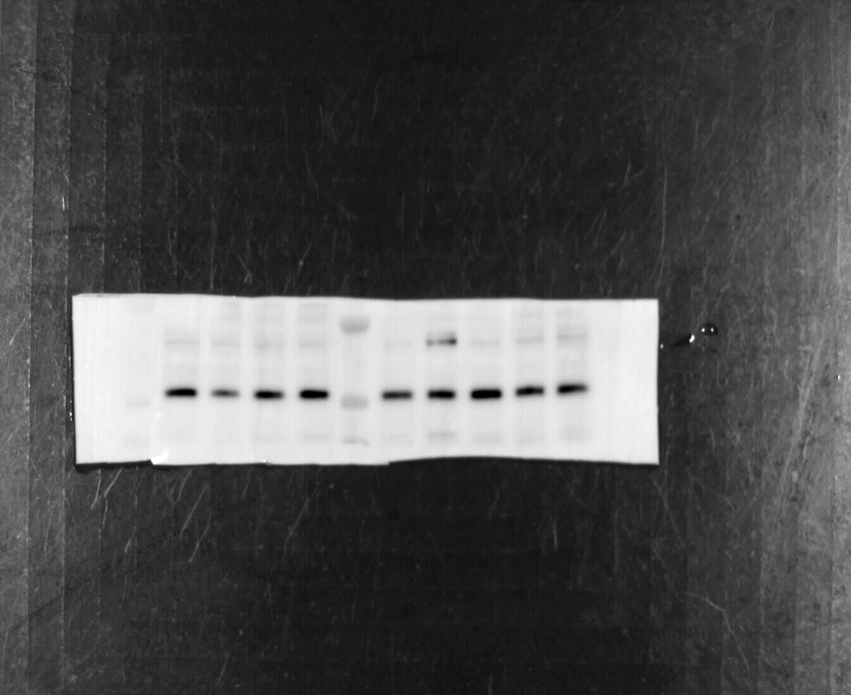

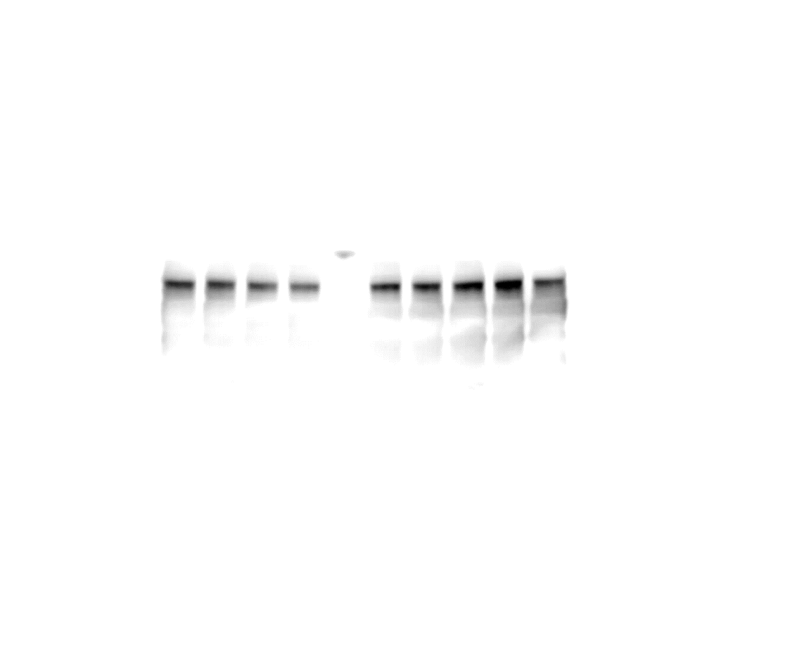
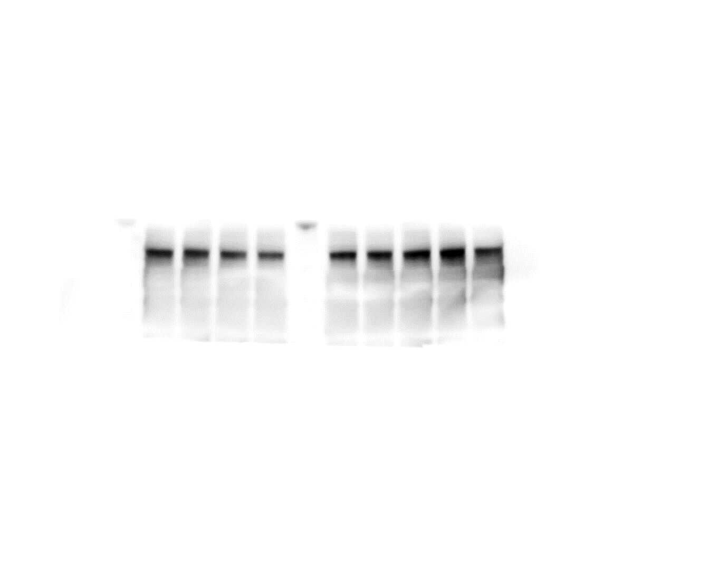
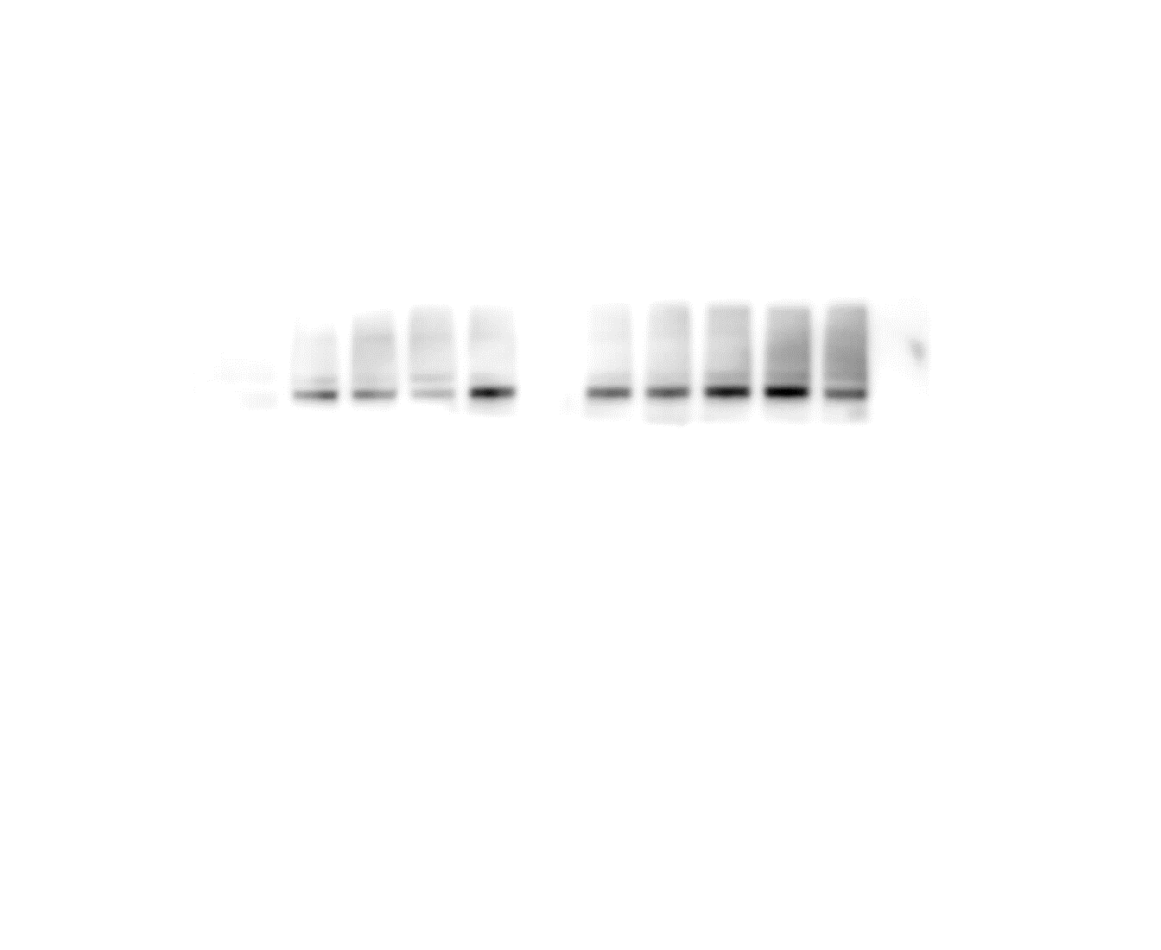
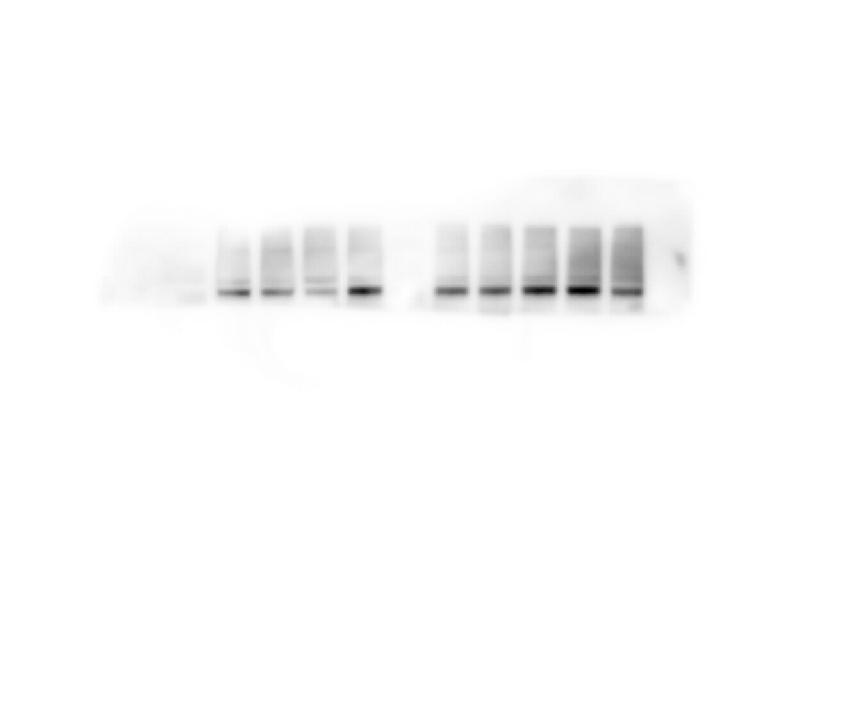
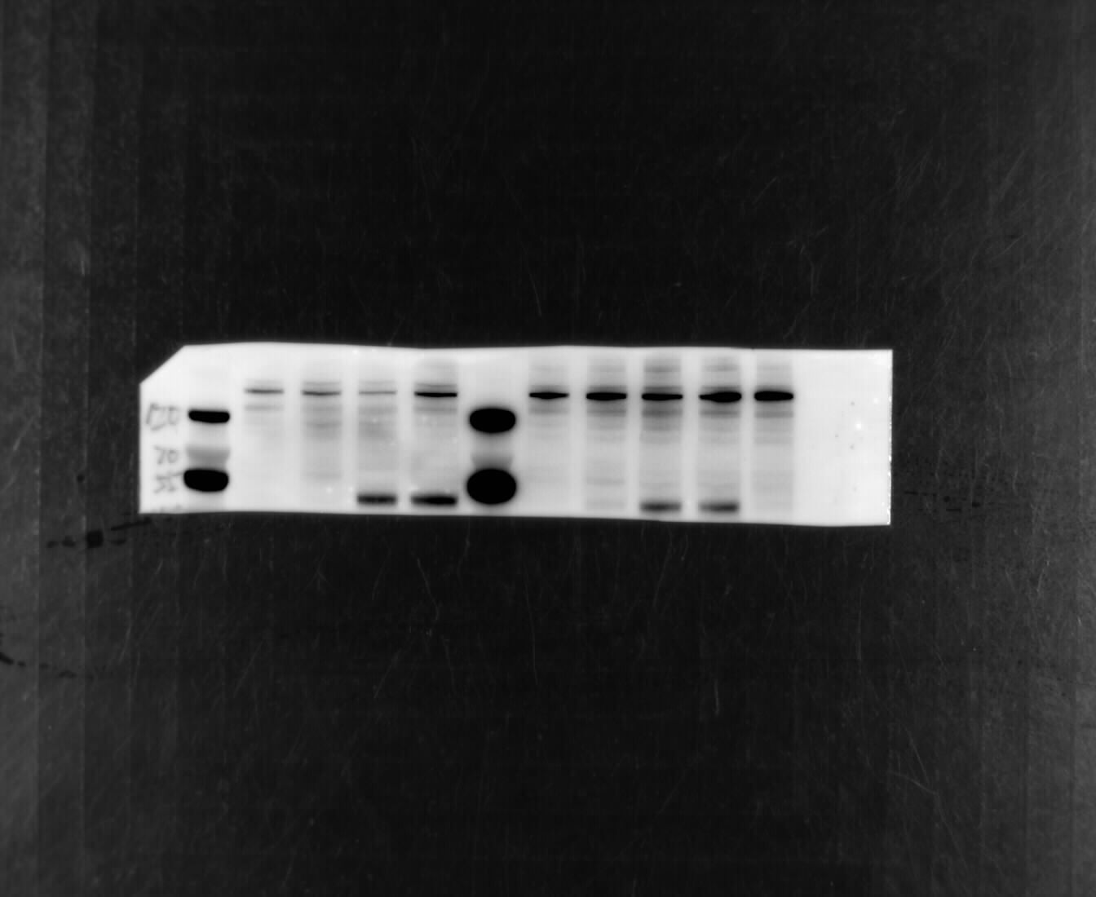
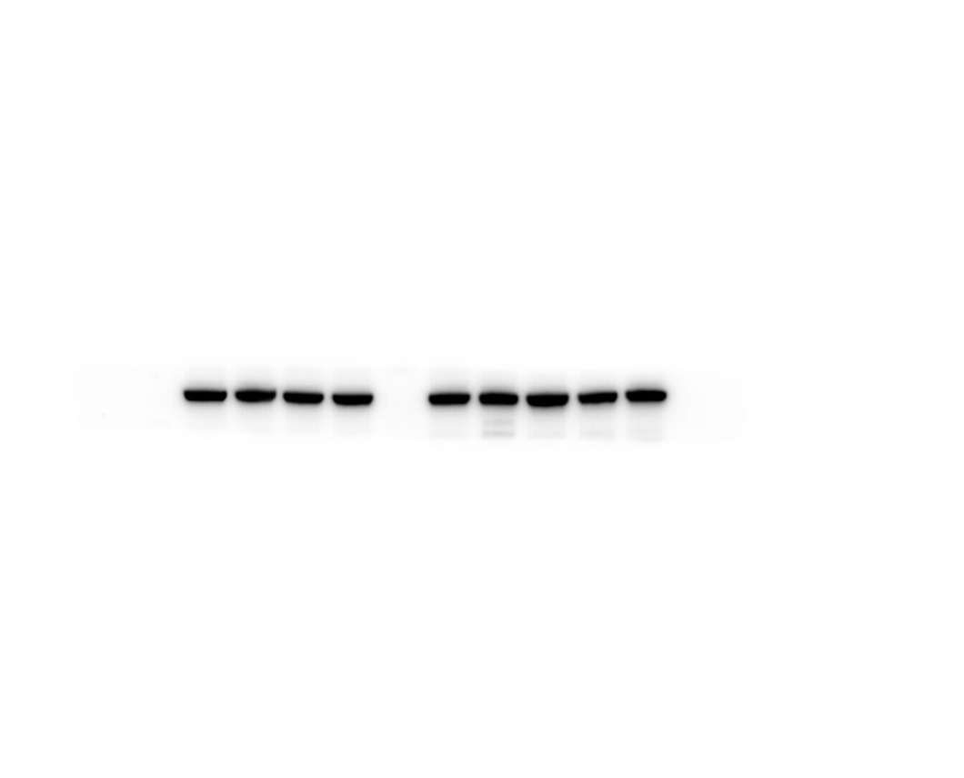

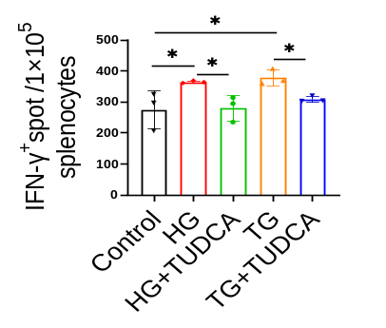
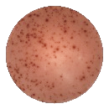

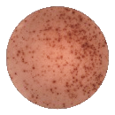
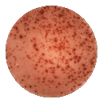
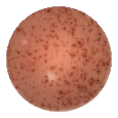
A
B
C
Pos
Neg
NC
Isotype Ab
Anti H-2Kd Ab
24h
IFN-γ⁺ SPOT/1X10⁵
CD4⁻ splenocytes
48h
10mM
20mM
30mM
HG
20mM HG-24h
D
Pos
Neg
NC
E
F
Isotype Ab
Anti H-2Kd Ab
0.5h
IFN-γ⁺ SPOT/1X10⁵
CD4⁻ splenocytes
1h
1μM
5μM
10μM
TG
5μM TG-0.5h
G
Blank
Normalized to mode
Normalized to mode
NIT-1
NIT-1-HG
NIT-1-TG
APC-H-2Kd
PE-H-2Db
H
I
Withdrawal HG (h)
Withdrawal TG (h)
NC
0
6
12
24
NC
0
6
12
IRE1α-P
IRE1α
XBP-1
XBP-1s
eIF2α-P
eIF2α
ATF6
TXNIP
α-tubulin
J
Control
HG
TG
HG+TUDCA
TG+TUDCA

