Slide 1
Supplementary Movie

Slide 2
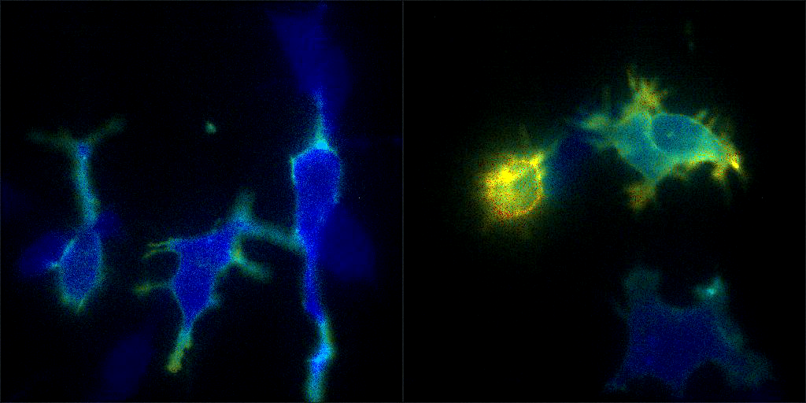
Supplementary Movie 1 : Time lapse recording of BRET signal for the recruitment of RlucII-SH2(Grb2) at the plasma membrane and inhibition with Gefitinib.
EGF
EGF -> Gefitinib
1.0
Exposure 50 sec/channel/frame, video rate 6 FPS (1sec ->300sec)
BRET level
0.1

