Slide 1
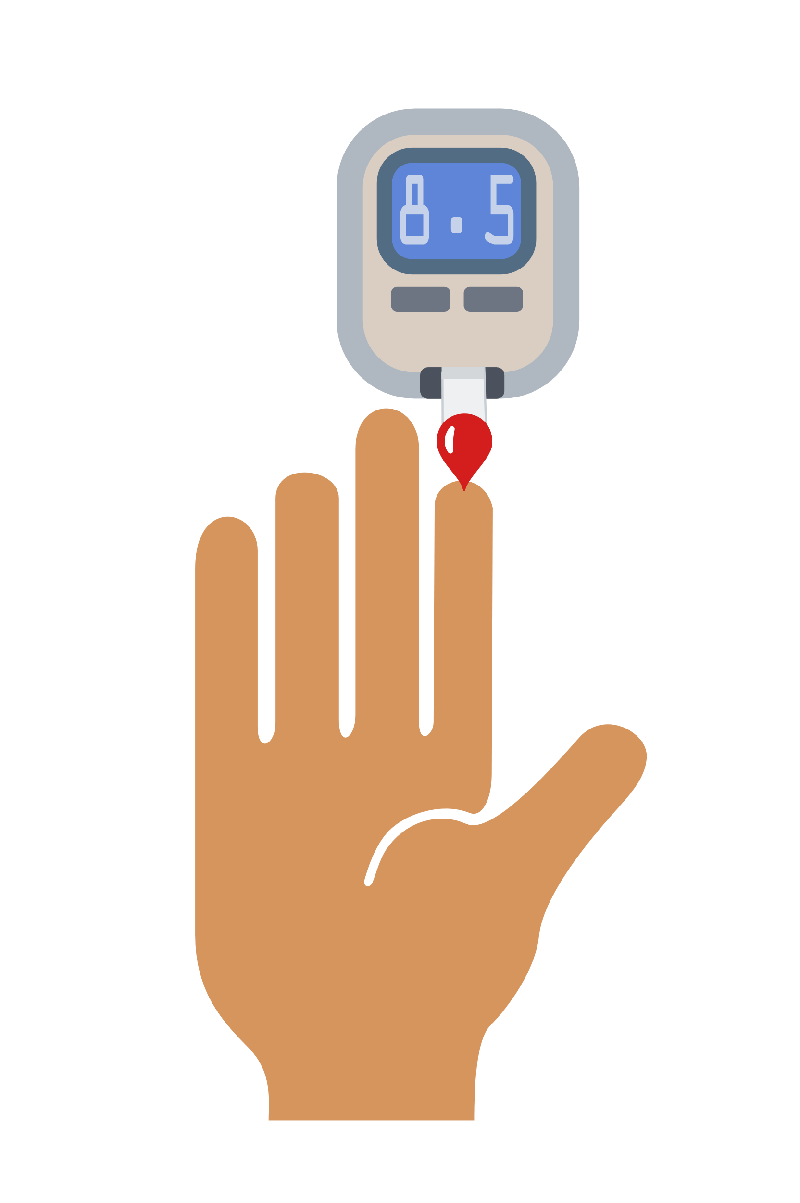
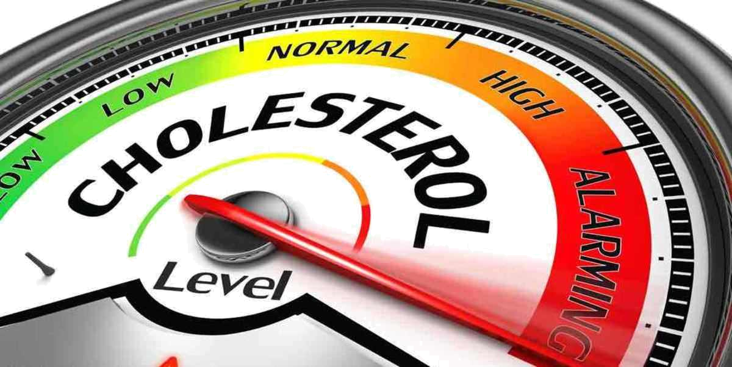
Dyslipidemia among persons with type 2 diabetes in a rural Malian community
Type 2 Diabetes
n = 104
Dyslipidemia
Summary
Type 2 diabetes (T2D) is an emerging crisis in Africa.
T2D is a risk factor for dyslipidemia.
There are limited studies reporting on dyslipidemia in rural African settings.
Dyslipidemia prevalence was 87.5% among 104 type 2 diabetic participants in the rural community of Ganadougou, Mali.
Mechanisms are needed to raise awareness about type 2 diabetes and dyslipidemia in rural African settings.
87.5% (n = 91) participants with dyslipidemia

