Slide 1
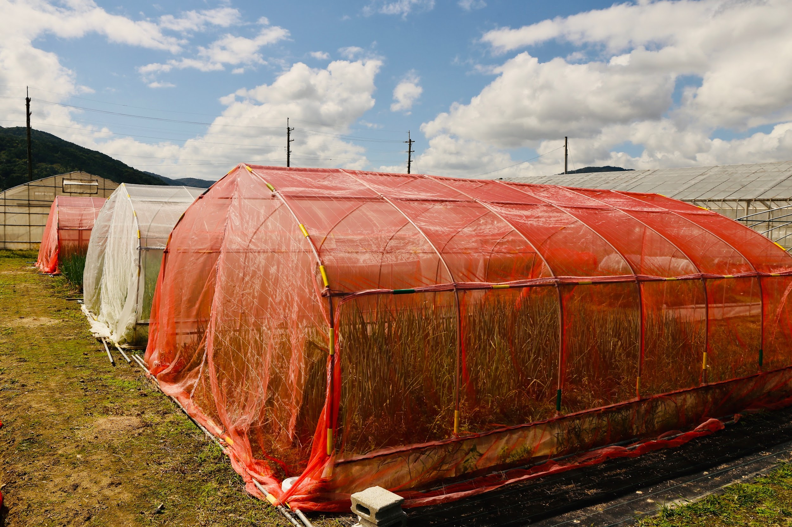
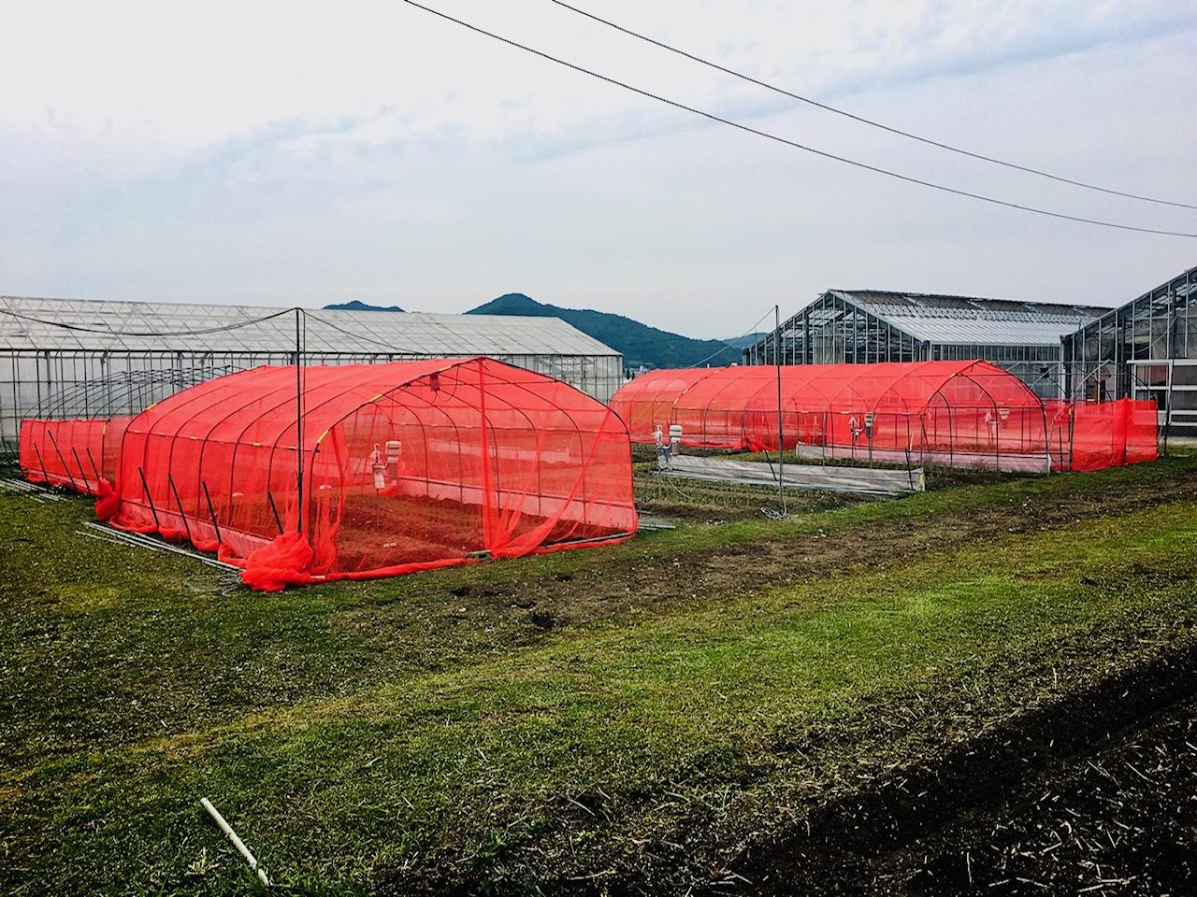
Fig. S1
Trial 1 Field
Trial 2 Field
Figure S1. Welsh onion field in Trial 1 and 2.

Slide 2
Fig. S2
RR
(2, 0)
RW
(1, 0)
WW
(0, 0)
RB
(1, 1)
BW
(0, 1)
BB
(0, 2)
(·,·) = (amount of red, amount of black)
Figure S2. Relationships between the nets based on the color of the yarn used to make them.
The white-white (WW) nets were considered as the baseline, and the nets were systematized
based on the amount of red (R) and black (B) fibers used, as indicated in parentheses.

Slide 3
Fig. S3
c
c
c
b
b
a
a
b
Leaf damage rate (%)
a
b
a
a
Jul. 20
Aug. 2
Aug. 15
: RR
: RW
: WW
: No net
Figure S3. The effect of red insect nets on the rate of leaf damage by Thrips tabaci in Trial 1.
Columns denoted by different letters are significantly different at the 5% level by Tukey-Kramer multiple
comparison test using arcsine transformed values from each survey date.

Slide 4
Fig. S4
a
bc
b
c
b
c
b
c
d
b
Leaf damage rate (%)
b
a
a
b
c
a
Jul. 3
Jul. 20
Aug. 1
Aug. 14
: Full
: Ceiling
: Sides
: No net
Figure S4. The effect of red insect nets on the rate of leaf damage by Thrips tabaci in Trial 2.
Columns denoted by different letters are significantly different at the 5% level by Tukey-Kramer multiple
comparison test using arcsine transformed values from each survey date.

