Slide 1
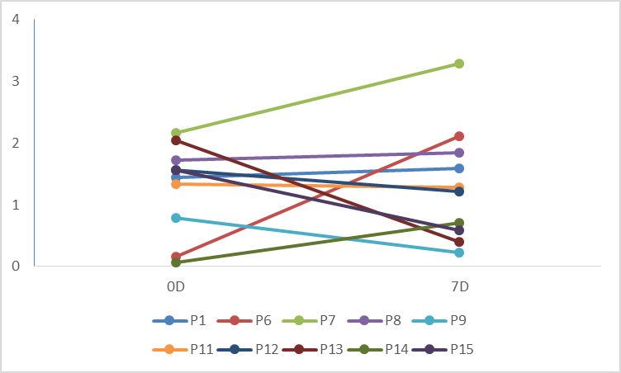
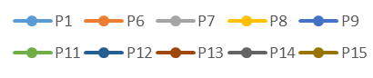
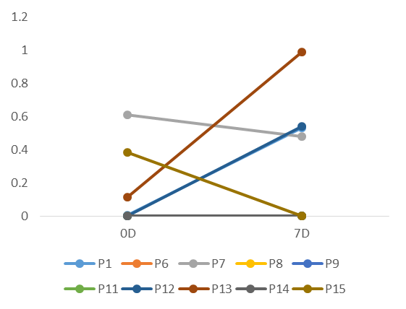
A
B
0.8
4
*p<0.05
Relative abundance
*p<0.05
*p<0.05
Shannon Diversity
2
0.4
0
0
0
7 days
Donor
0D
7D
Donor
0D
7D
proteobacteria
firmicutes
C
1.2
Relative abundance
0.6
0
0
7 days
bacteroidetes
Supplement Figure S1

Slide 2
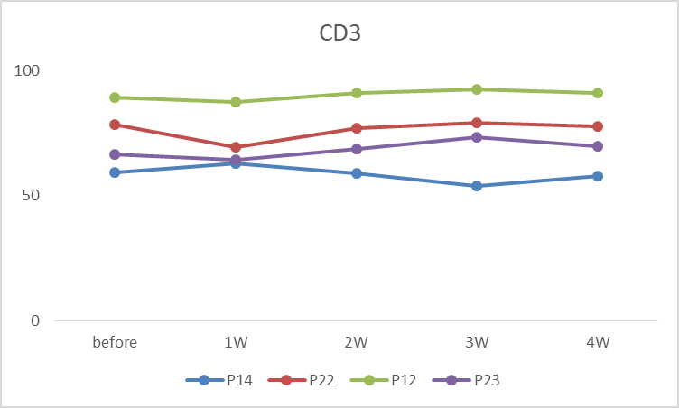
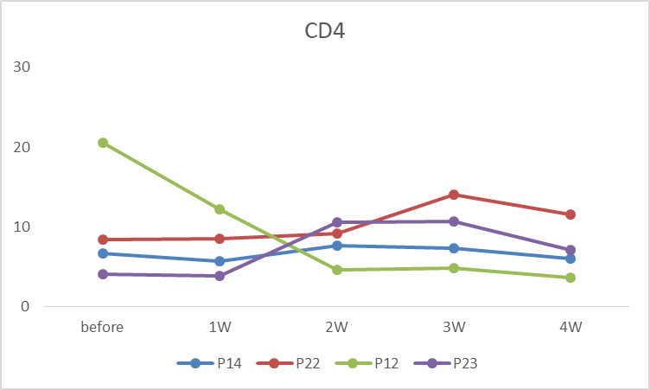
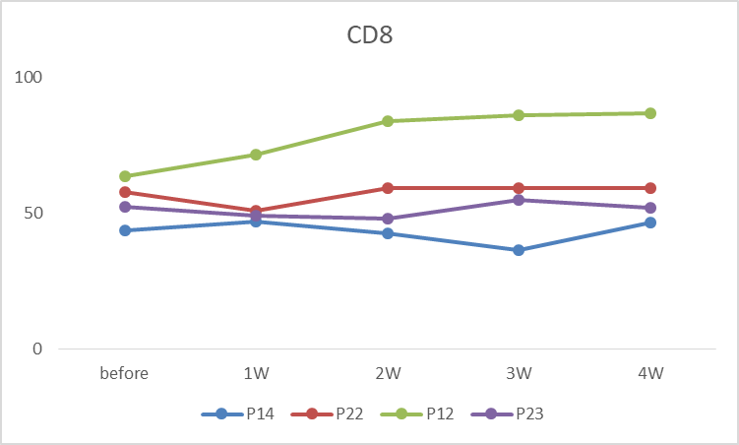
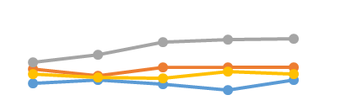
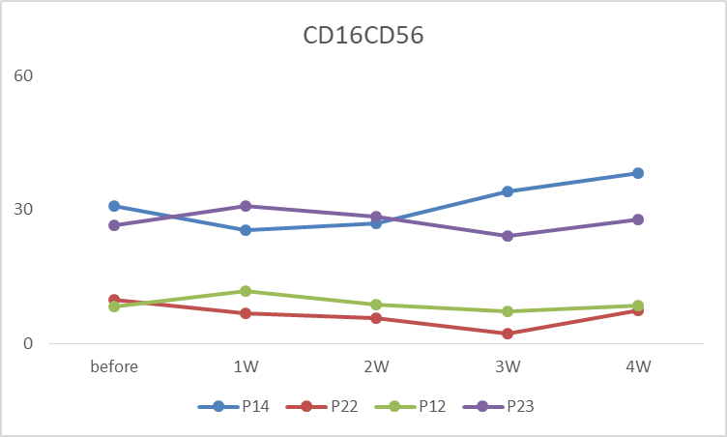
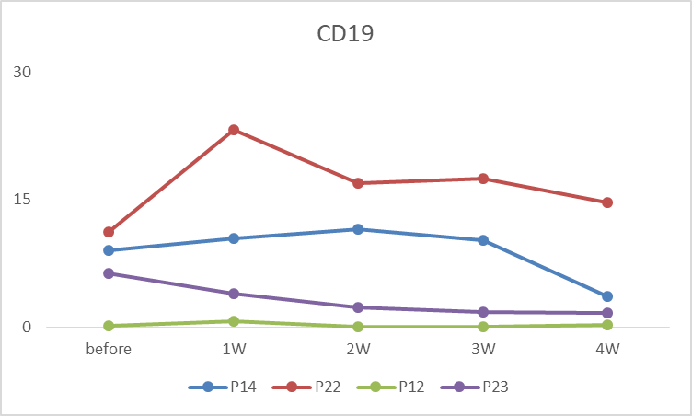
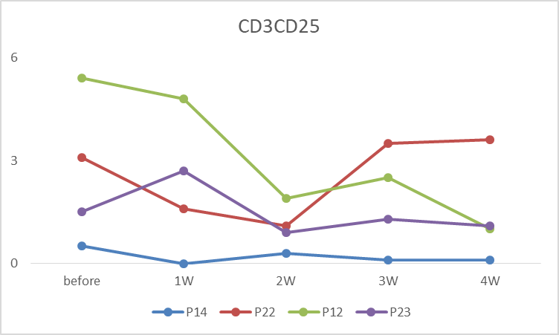
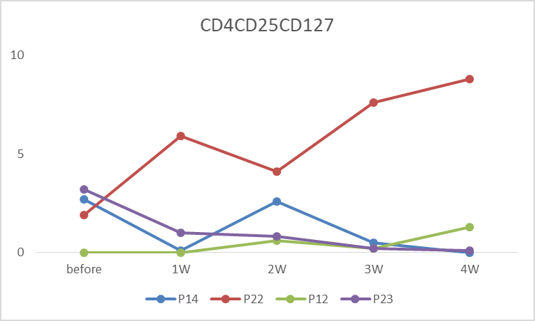
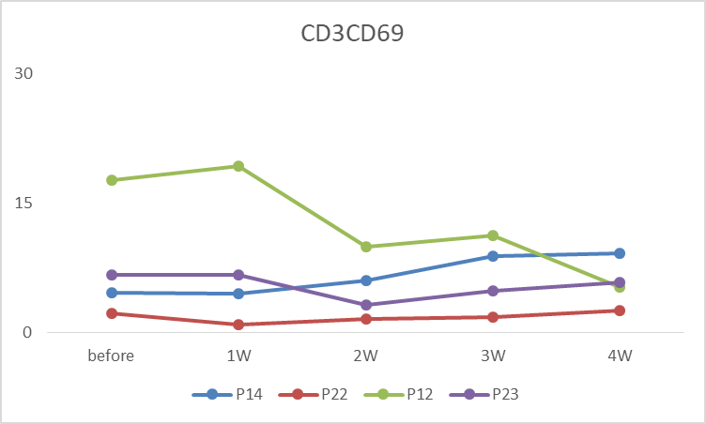
A
B
30
100
CD4⁺Cells(%)
CD8⁺Cells(%)
15
50
0
0
0
1
2
3
4
weeks
D
0
1
2
3
4
weeks
C
100
60
CD3⁺Cells(%)
CD16⁺CD56⁺Cells(%)
50
30
0
0
0
1
2
3
4
weeks
0
1
2
3
4
weeks
E
F
30
6
CD19⁺Cells(%)
CD3⁺CD25⁺Cells(%)
15
3
0
0
0
1
2
3
4
weeks
0
1
2
3
4
weeks
G
H
10
30
CD4⁺CD25⁺CD127⁻
Cells(%)
CD3⁺CD69⁺Cells(%)
5
15
0
0
0
1
2
3
4
weeks
0
1
2
3
4
weeks
Supplement Figure S2

