Slide 1
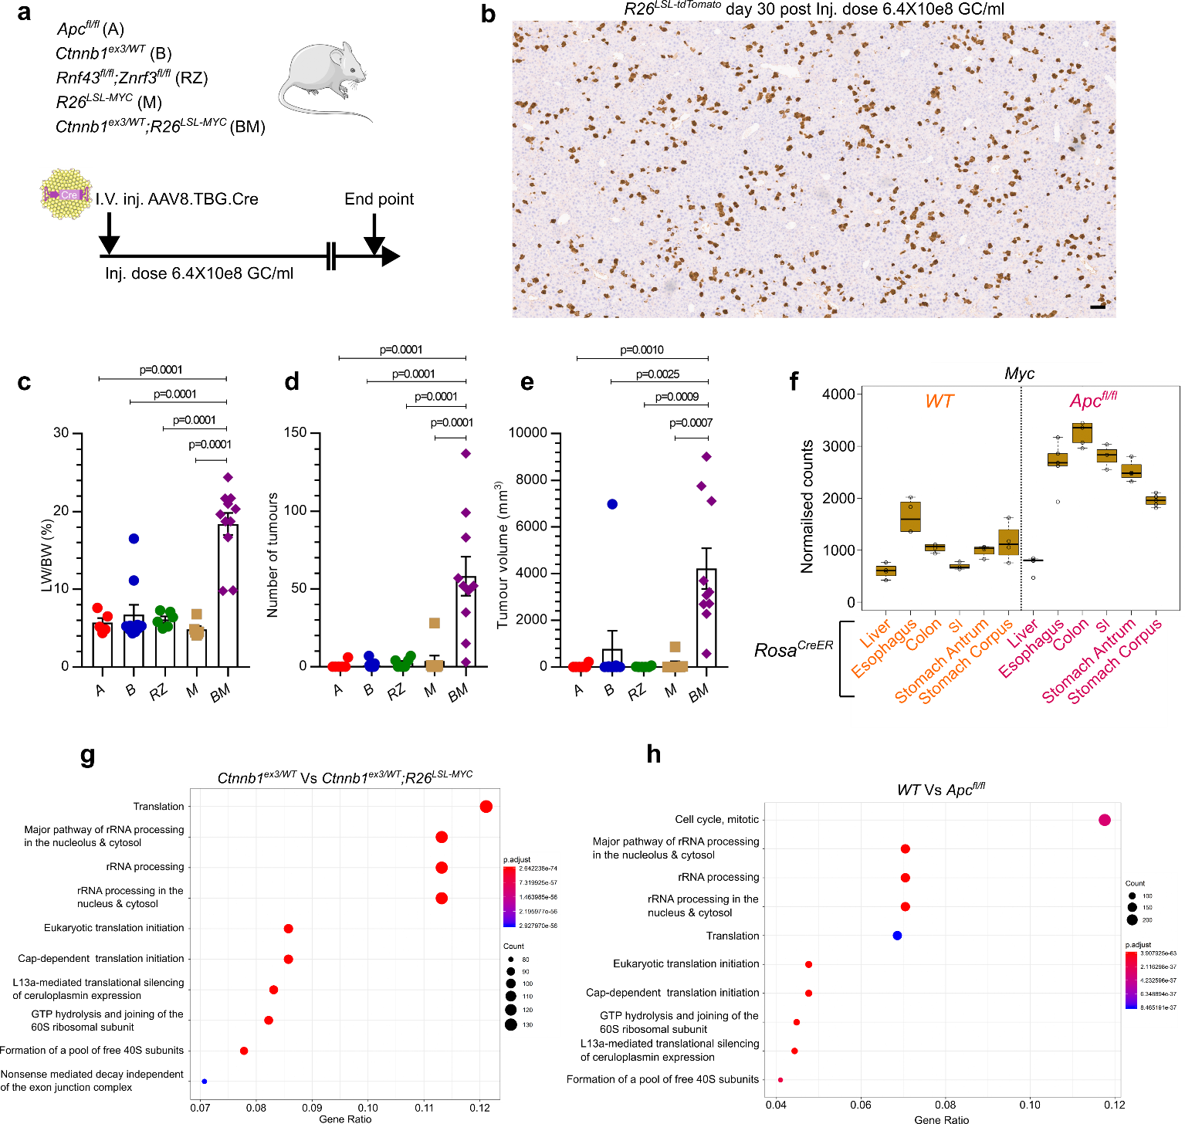
Extended Data Fig.1
Related to Fig.1
Extended Data Fig. 1: Elevated MYC expression is required for Wnt-driven cancer in the liver. a, Schematic representing murine models recombining Wnt-pathway activating mutations and/or MYC at a low clonal density in the hepatocyte epithelium. b, Representative image of RFP immunohistochemistry in an R26^{LSL-tdTomato} liver showing recombination 30 days post administration of AAV8.TBG.Cre (GC/ml = genome copy per ml). Scale bar, 100 μm. c–e, Liver-to-body weight ratio and tumour scoring in mice of the indicated genotypes from a. Data are mean ± s.e.m. One-way ANOVA with Tukey’s multiple comparisons test. Biological replicates for the following genotypes: Apc^{fl/fl} n=6, Ctnnb1^{ex3/WT} n=11, Rnf43^{fl/fl};Znrf3^{fl/fl} n=6, R26^{LSL-MYC} n=8, Ctnnb1^{ex3/WT};R26^{LSL-MYC} n=10. f, Whole-tissue normalised RNA-Seq read counts for Myc transcripts in indicated tissues from wild-type and Apc^{fl/fl} mice. Box plots represent median (centre line), upper (25th percentile) and lower quartiles (75th percentile) (box limits), and 1.5x interquartile range (whiskers) Biological replicates, moving left to right on the x-axis: n= 4,4,4,3,4,4,5,5,5,3,4,5. g, AAV8.TBG.Cre-treated livers at day 10 post induction (2×10¹¹ GC/ml). Top reactome pathways enriched in genes differentially upregulated in Ctnnb1^{ex3/WT};R26^{LSL-MYC} versus Ctnnb1^{ex3/WT}. h, Top reactome pathways enriched in genes differentially upregulated in Villin^{CreER}Apc^{fl/fl} versus Villin^{CreER} (WT) intestines at day 4 post induction. In g and h, dots are coloured according to their adjusted P-values (red, lower P-value; blue, higher P-value), with the size of the dots representing the number of differentially expressed genes from whole-liver (g) or whole-intestine (h) enriched in each term. Biological replicates: liver, n= 3; intestinal, n=16 WT and n=15 Apc^{fl/fl}.

Slide 2
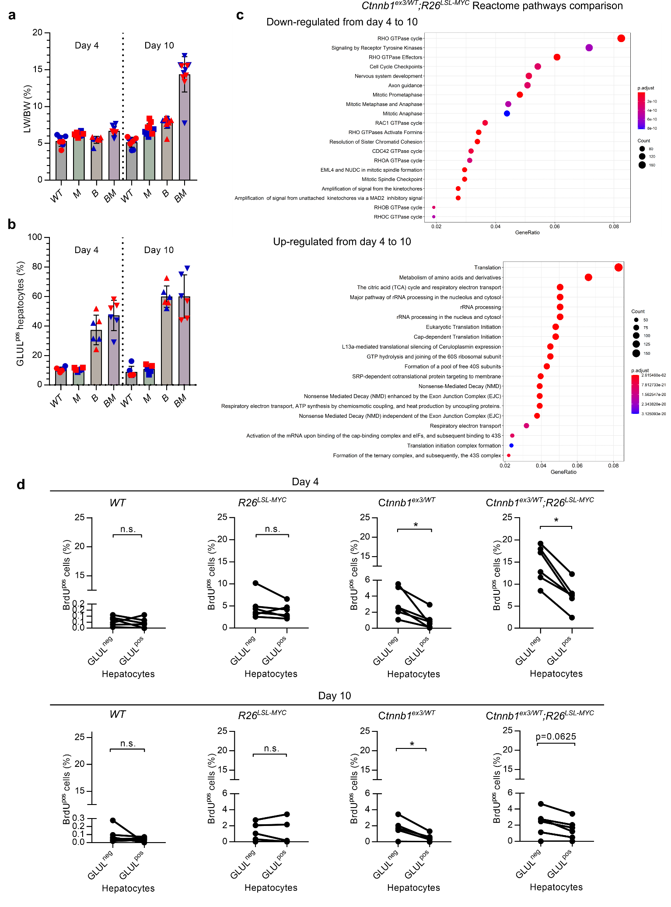
Extended Data Fig.2
Related to Fig.1
Extended Data Fig. 2: Transient proliferation of zone-1 and -2 GLUL^{neg} hepatocytes following β-catenin and MYC activation. a, Liver-to-body weight ratios for mice of the indicated genotypes. Biological replicates: Day 4—WT n=7, Ctnnb1^{ex3/WT} (B) n=8, R26^{LSL-MYC} (M) n=8, Ctnnb1^{ex3/WT};R26^{LSL-MYC} (BM) n=8; Day 10—WT n=9, B n=11, M n=10, BM n=11. Data are mean ± s.e.m. Males, blue points; Females, red points. b, Quantification of GLUL^{pos} hepatocytes in the livers of mice of the indicated genotypes. n=6 per genotype. Data are mean ± s.e.m. c, Top reactome pathways enriched in genes differentially upregulated (upper panel) and downregulated (lower panel) in AAV8.TBG.Cre-treated Ctnnb1^{ex3/WT};R26^{LSL-MYC} livers, on day 4 versus day 10 post induction (2×1011 GC/ml). Dots are coloured according to their adjusted P-values (red, higher P-value; blue, lower P-value), representing the number of differentially expressed genes from whole-liver RNA-Seq read counts. Biological replicates: Day 4, n=5; Day 10, n=3. d, Quantification of BrdU^{pos} hepatocytes, stratified into GLUL-positive and -negative subsets, from mice of the indicated genotypes. Data are mean ± s.e.m. Wilcoxon matched-pairs test, *P=0.0313. Biological replicates: n=6 per condition.

Slide 3
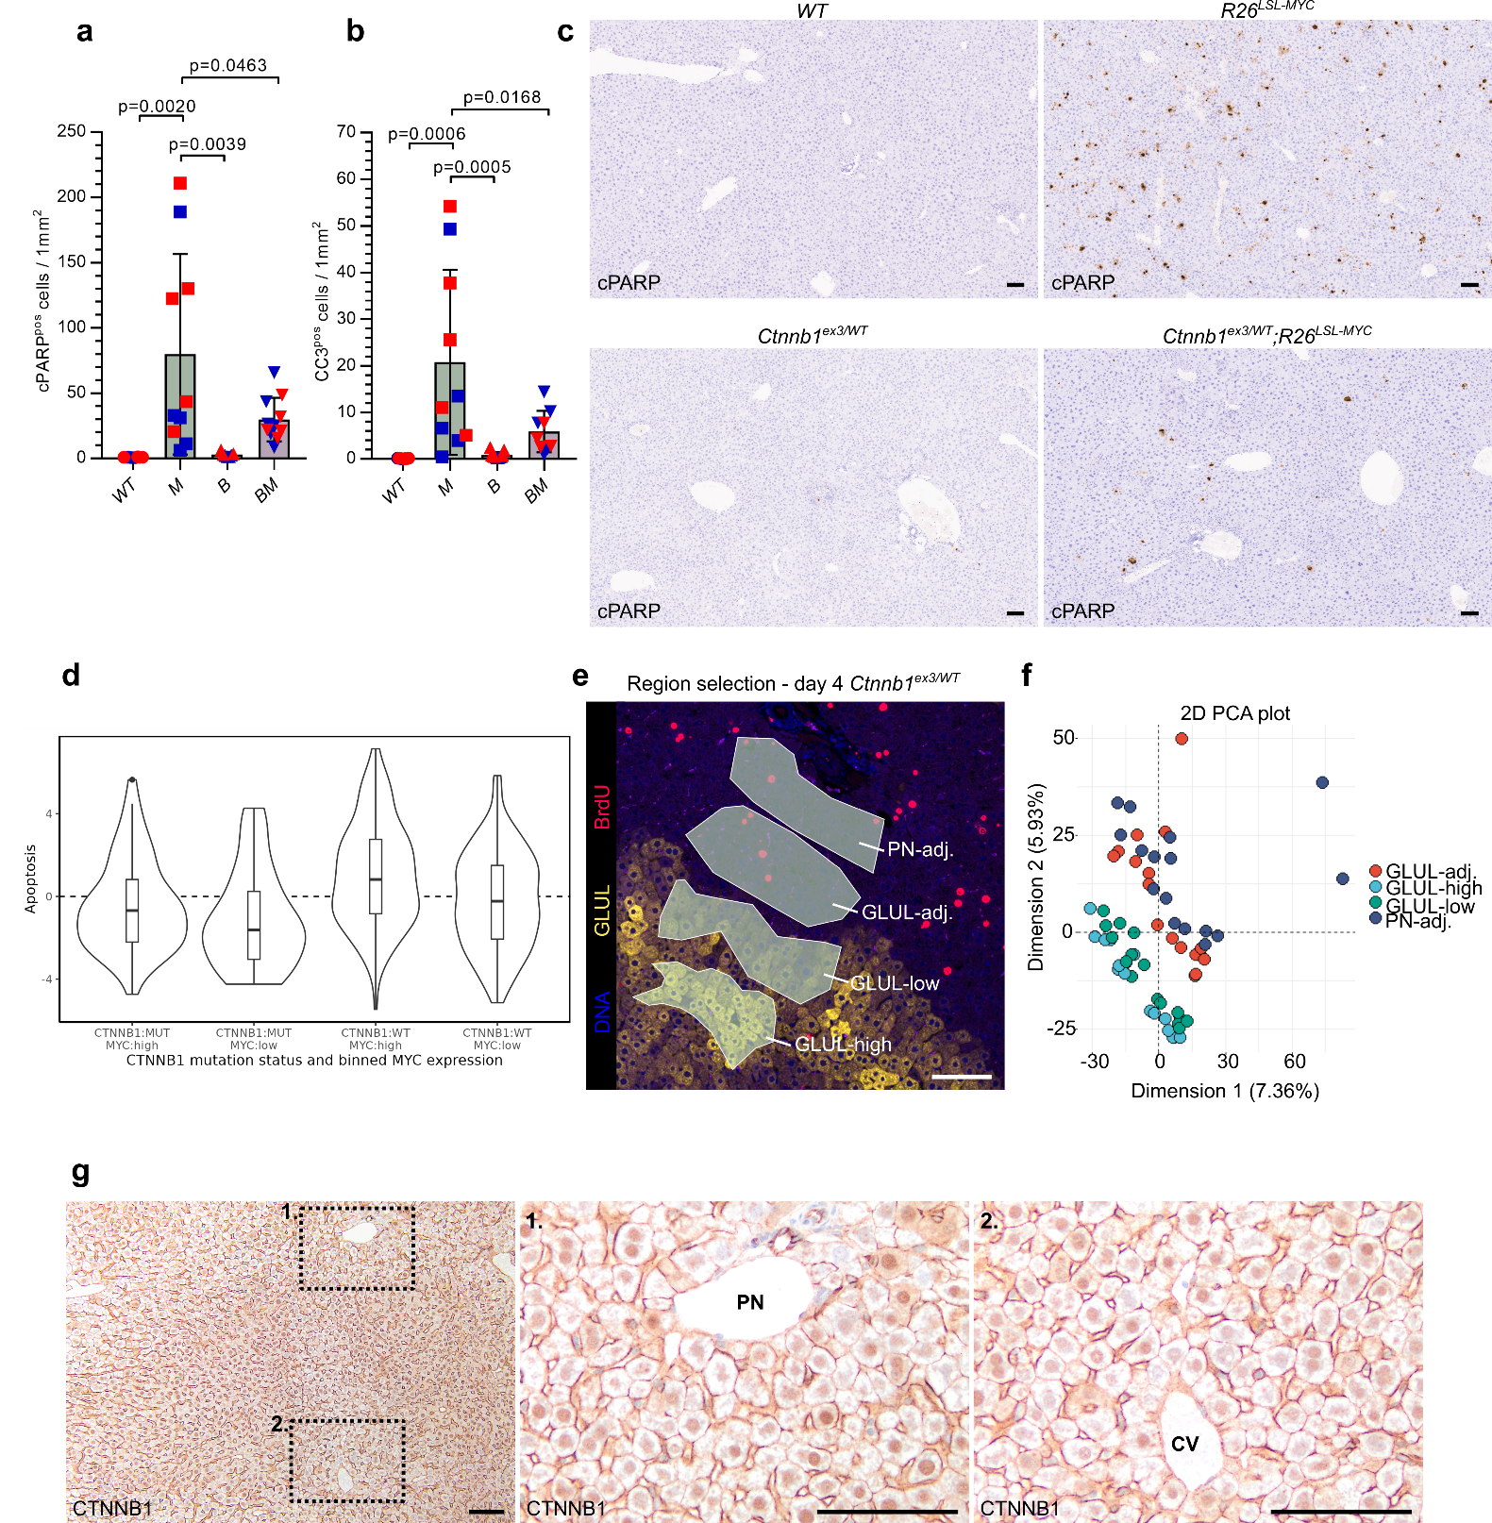
Extended Data Fig.3
Related to Fig.1
Extended Data Fig. 3: R26^{LSL-MYC} liver is apoptotic and Ctnnb1^{ex3/WT} mutation uniformly activates the Wnt pathway across the liver lobule. a, b, Quantification of apoptotic cells in livers of indicated genotypes by immunohistochemistry for cleaved PARP (cPARP) and cleaved caspase-3 (CC3) on day 10 post AAV8.TBG.Cre induction. a, Biological replicates: WT n=8, R26^{LSL-MYC} (M) n=10, Ctnnb1^{ex3/WT} (B) n=7, Ctnnb1^{ex3/WT};R26^{LSL-MYC} (BM) n=11. Data are mean ± s.e.m. One-way ANOVA with Tukey’s multiple comparisons test. b, Biological replicates: WT n=9, B n=11, M n=10, BM n=9. Data are mean ± s.e.m. One-way ANOVA with Tukey’s multiple comparisons test. Males, blue points; Females, red points. c, Representative images of cPARP immunohistochemistry. Scale bars, 100 μm. d, Apoptosis gene set enrichment in differentially expressed genes among TCGA-LIHC binned by CTNNB1 mutation status and MYC expression. e, Representative image of immunofluorescence masks used to define the regions of the liver segmented and selected for spatial transcriptomics. BrdU (red), GLUL (yellow), DNA (blue). PN, portal node, adj., adjacent. Scale bar, 100 μm. f, Principal component analysis (PCA) of spatial transcriptomics data. ROI per Biological replicate: n=8. g, Representative CTNNB1 immunohistochemistry in AAV8.TBG.Cre-treated Ctnnb1^{ex3/WT} liver at day 4 post induction. Panels 1 and 2 are higher magnification images of the dashed areas in the left panel, highlighting hepatocytes near the portal node (PN) and the central vein (CV). Scale bars, 100 μm.

Slide 4
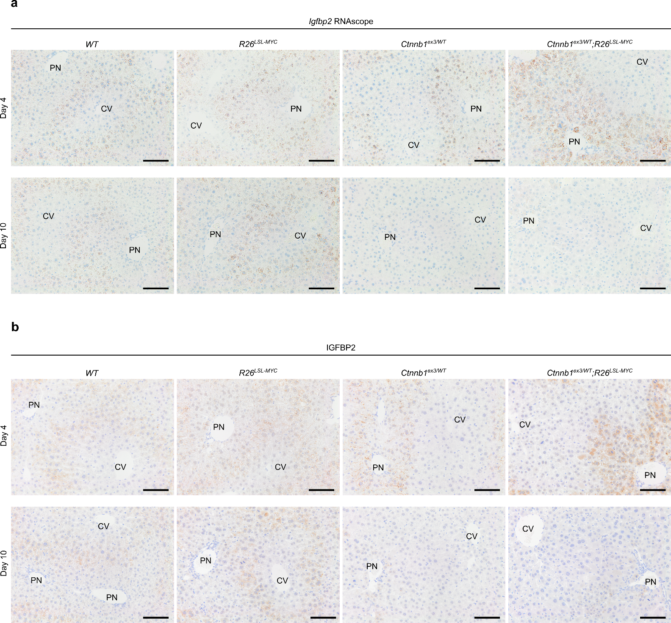
Extended Data Fig.4
Related to Fig.1
Extended Data Fig. 4: Igfbp2 expression is suppressed in day-10 Ctnnb1^{ex3/WT}-mutated liver. AAV8.TBG.Cre-treated wild-type, R26^{LSL-MYC}, Ctnnb1^{ex3/WT}, and Ctnnb1^{ex3/WT};R26^{LSL-MYC} livers at days 4 and 10 post induction. a, In situ hybridisation for Igfbp2. b, IGFBP2 immunohistochemistry. Representative images, n=4 per group. PN, Portal Node; CV, Central Vein. Scale bars, 100 μm.

Slide 5
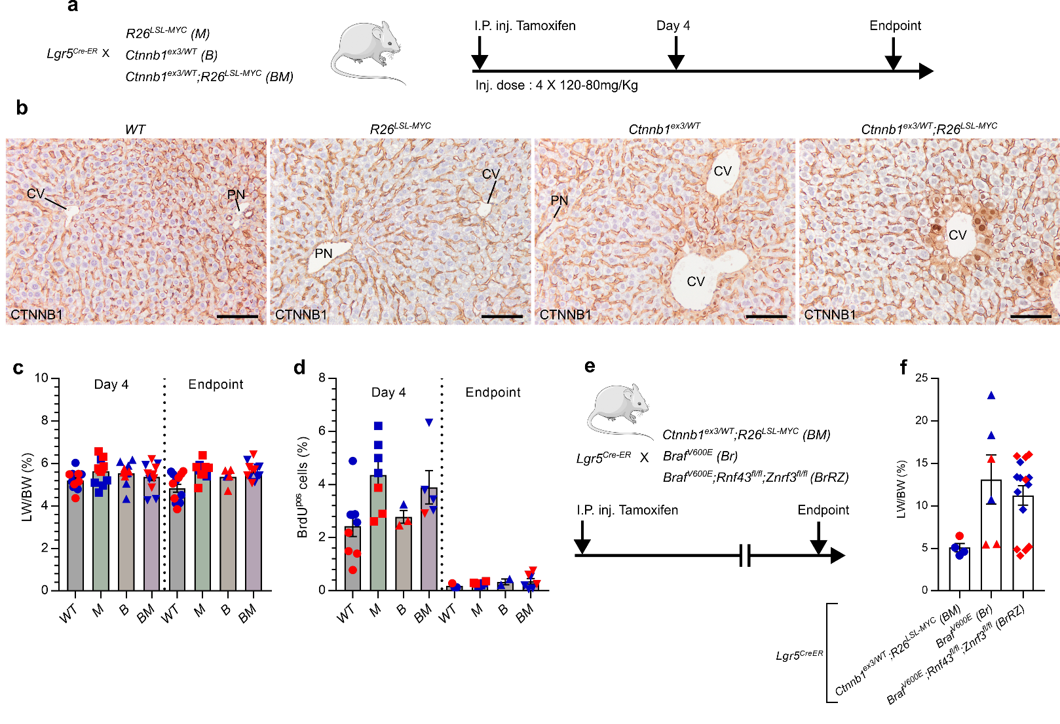
Extended Data Fig.5
Related to Fig.2
Extended Data Fig. 5: Lgr5^{pos} zone-3 hepatocytes are not permissive to aberrant growth driven by Ctnnb1^{ex3/WT}. a, CV Lgr5-specific model of acute Wnt and MYC activation. b, Representative images of CTNNB1 immunohistochemistry in indicated livers at endpoint. Biological replicates n=3. Scale bars, 100 μm. c, Liver-to-body weight ratios of indicated mice at day 4 and endpoint. Data are mean ± s.e.m. Biological replicates: WT n=12, B n=6, M n=11, BM n=12. d, Quantification of BrdU^{pos} cells in indicated livers at day 4 and endpoint. Data are mean ± s.e.m. Biological replicates: WT n=6, B n=3, M n=7, BM n=5. e, CV Lgr5-specific model of Wnt and BRAF^{V600E} activation. f. Liver-to-body weight ratios in end-stage Lgr5^{CreER}-driven Wnt or Braf^{V600E} tumour model induced with either 0.5 mg or 0.1 mg tamoxifen. Males, blue points; Females, red points. Data are mean ± s.e.m. Biological replicates: Lgr5^{CreER};BM n=4, Lgr5^{CreER};Br n=6, and Lgr5^{CreER};BrRZ n=15.

Slide 6
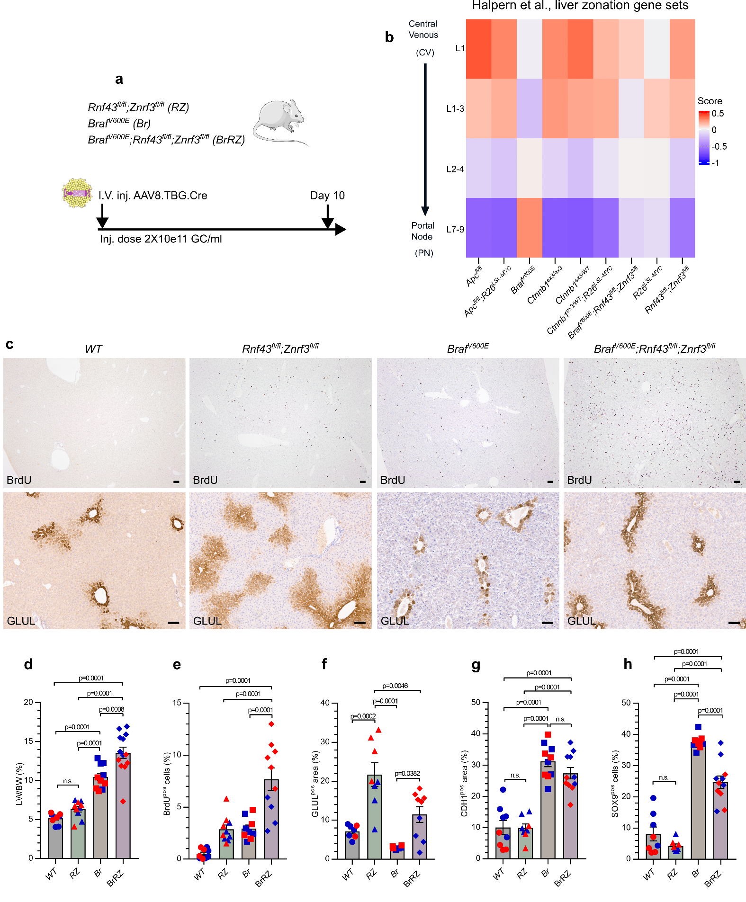
Extended Data Fig.6
Related to Fig.2
Extended Data Fig. 6: MAPK activity modulates liver zonation by promoting zone-1 transcripts and markers. a, Schematic representing liver-specific murine model of acute Wnt, MYC, and BRAF^{V600E} activation. b, Day-10 whole liver RNA-Seq and liver zonation gene set enrichment analysis. Biological replicates: Apc^{fl/fl} n=9, Apc^{fl/fl};R26^{LSL-MYC} n=8, Braf^{V600E} n=5, Ctnnb1^{ex3/ex3} n=3, Ctnnb1^{ex3/WT} n=3, Ctnnb1^{ex3/WT};R26^{LSL-MYC} n=5, Braf^{V600E};Rnf43^{fl/fl};Znrf3^{fl/fl} n=5, R26^{LSL-MYC} n=5, Rnf43^{fl/fl};Znrf3^{fl/fl} n=5. c, Representative images of BrdU and GLUL immunohistochemistry of day-10 livers from indicated mice. Scale bars, 100 μm. d, Liver-to-body weight ratios of indicated mice. e-h, BrdU, GLUL, CDH1, and SOX9 histo-scoring of day-10 livers from indicated mice. Males, blue points; Females, red points. Data are mean ± s.e.m. One-way ANOVA with Tukey’s multiple comparisons test. Biological replicates: WT n=7, RZ n=8, Br n=6, BrRZ n=9.

Slide 7
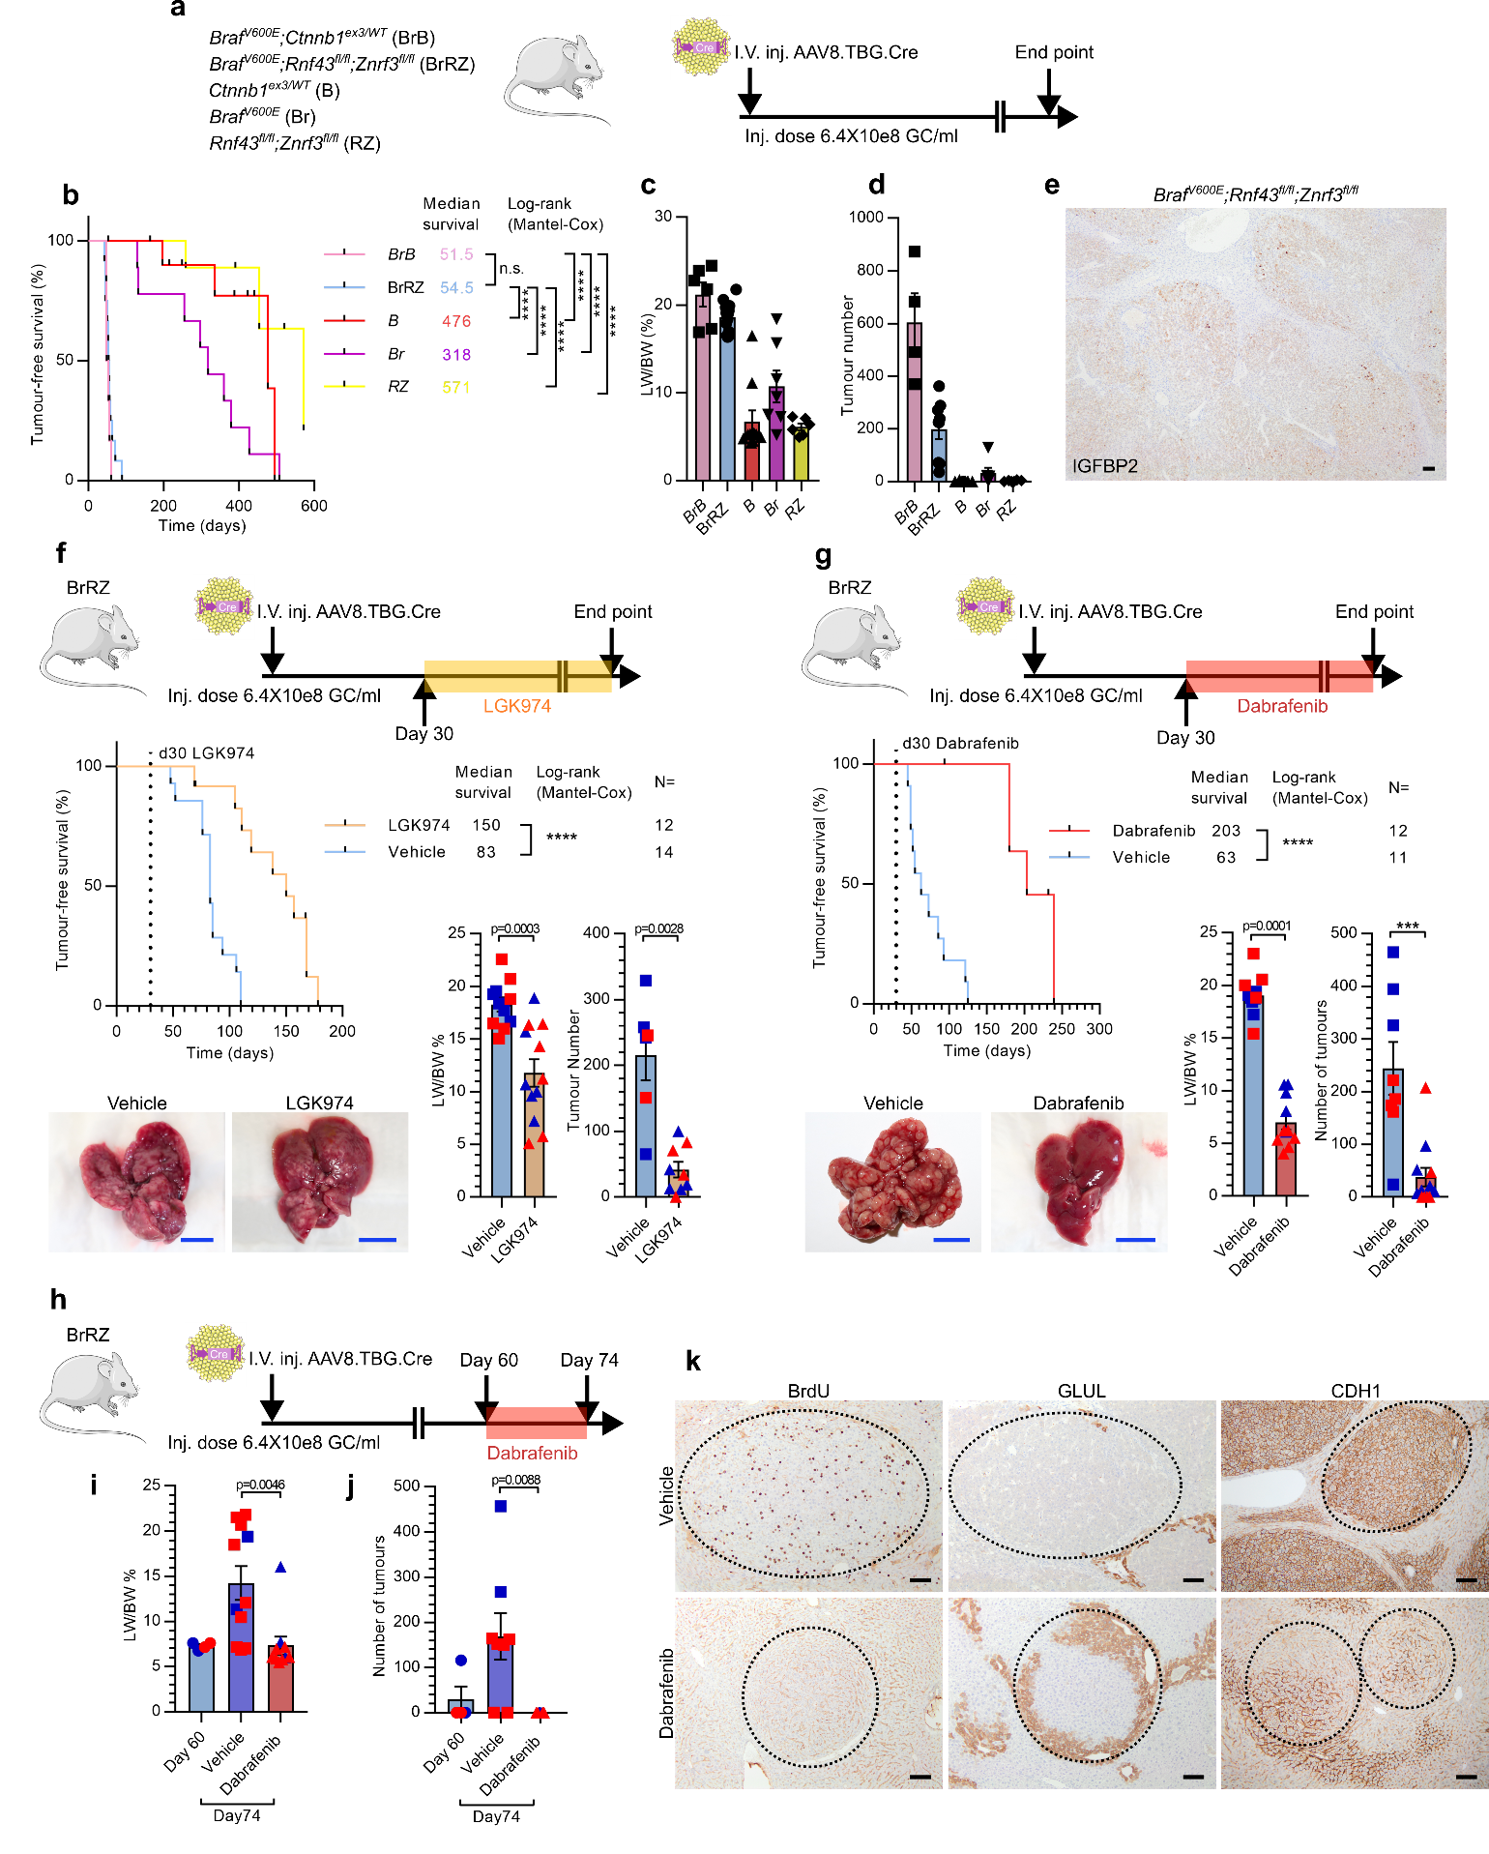
Extended Data Fig.7
Related to Fig.2
Extended Data Fig. 7: MAPK activity modulates liver zonation and accelerates tumorigenesis when combined with Wnt-pathway mutations. a, Schematic representing murine models recombining Wnt- and MYC-mutant alleles at a low clonal density in the hepatocyte epithelium. b–d, Tumour-free survival (biological replicates: BrB n=6, BrRZ n=12, B n=12, Br n=9, RZ n=9, Log-rank (Mantel–Cox) test, ****P=0.0001) and tumour scoring in male murine models of sporadic Wnt-driven tumorigenesis (biological replicates: BrB n=4, BrRZ n=9, B n=11, Br n=6, RZ n=6. e, Representative image of IGFBP2 immunohistochemistry in end-stage tumours. Scale bar, 100 μm. f–g, Tumour-free survival (Log-rank (Mantel–Cox) test), tumour scoring, liver-to-body weight (two-tailed t-test and Mann–Whitney test)and representative macroscopic images of livers from Braf^{V600E};Rnf43^{fl/fl};Znrf3^{fl/fl} mice treated with either LGK974 (PORCN-inhibitor) or dabrafenib (BRAF-inhibitor). Scale bars, 1cm. h–k, Model of short-term dabrafenib treatment in established Braf^{V600E};Rnf43^{fl/fl};Znrf3^{fl/fl} tumours, liver-to-body weight ratios, tumour scoring, and BrdU, GLUL and CDH1 immunohistochemistry. Scale bars, 100 μm. Dashed line, tumour boundary. Males, blue points; Females, red points. Data are mean ± s.e.m. One-way ANOVA and Dunn’s multiple comparisons test. Biological replicates: day 60 n=4; Vehicle, day 74 n=8; dabrafenib, day 74 n=7.

Slide 8
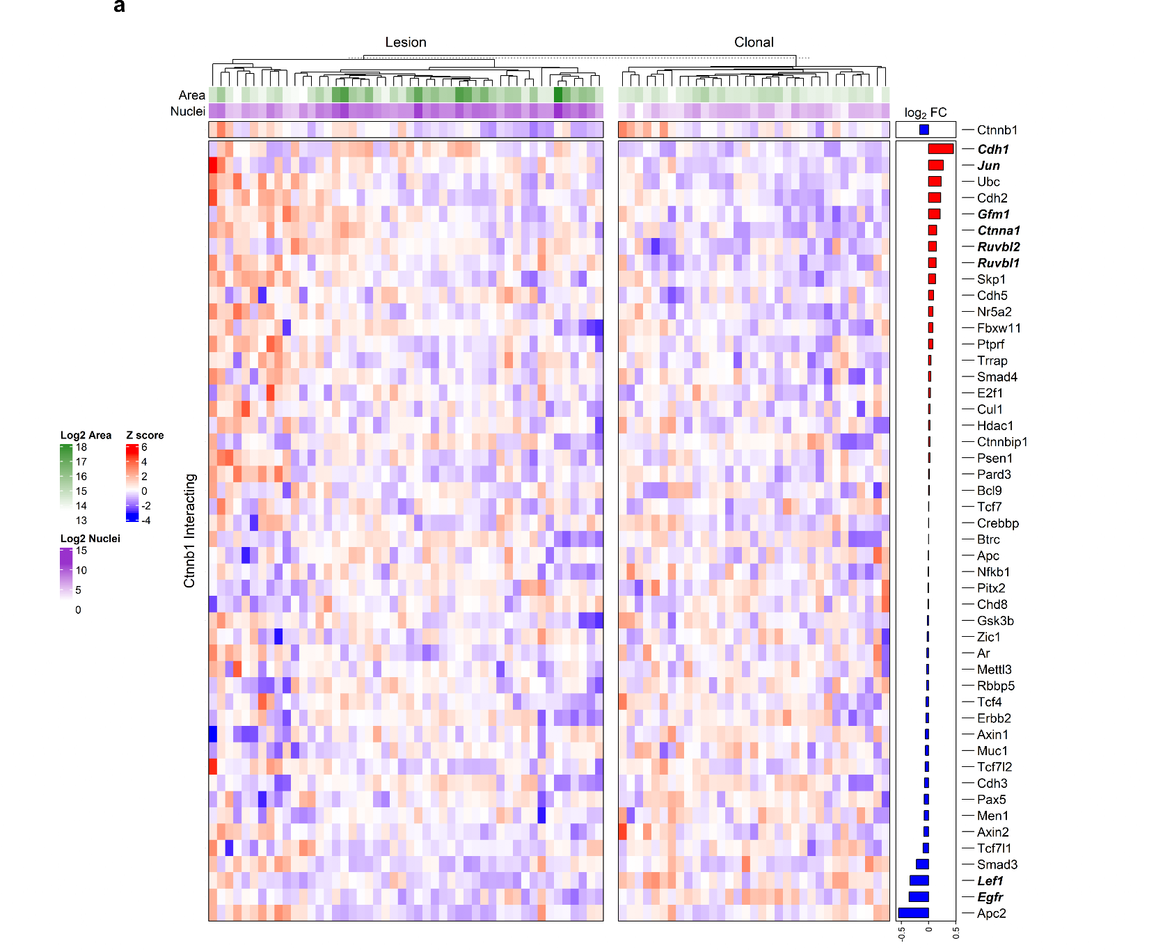
Extended Data Fig.8
Related to Fig.3
Extended Data Fig. 8: Ctnnb1^{ex/WT};R26^{LSL-MYC} lesions exhibit reduced Lef1 expression and increased Cdh1 expression. a, Spatial transcriptomics of 6.4×10⁸ GC/ml day-60 Ctnnb1^{ex/WT};R26^{LSL-MYC} liver. Heatmap showing differential gene expression of factors that regulate CTNNB1 activity at a protein and transcriptional level. Selected regions of interest: n=34 clonal; n= 49 lesions. Biological replicates: n=4.

Slide 9
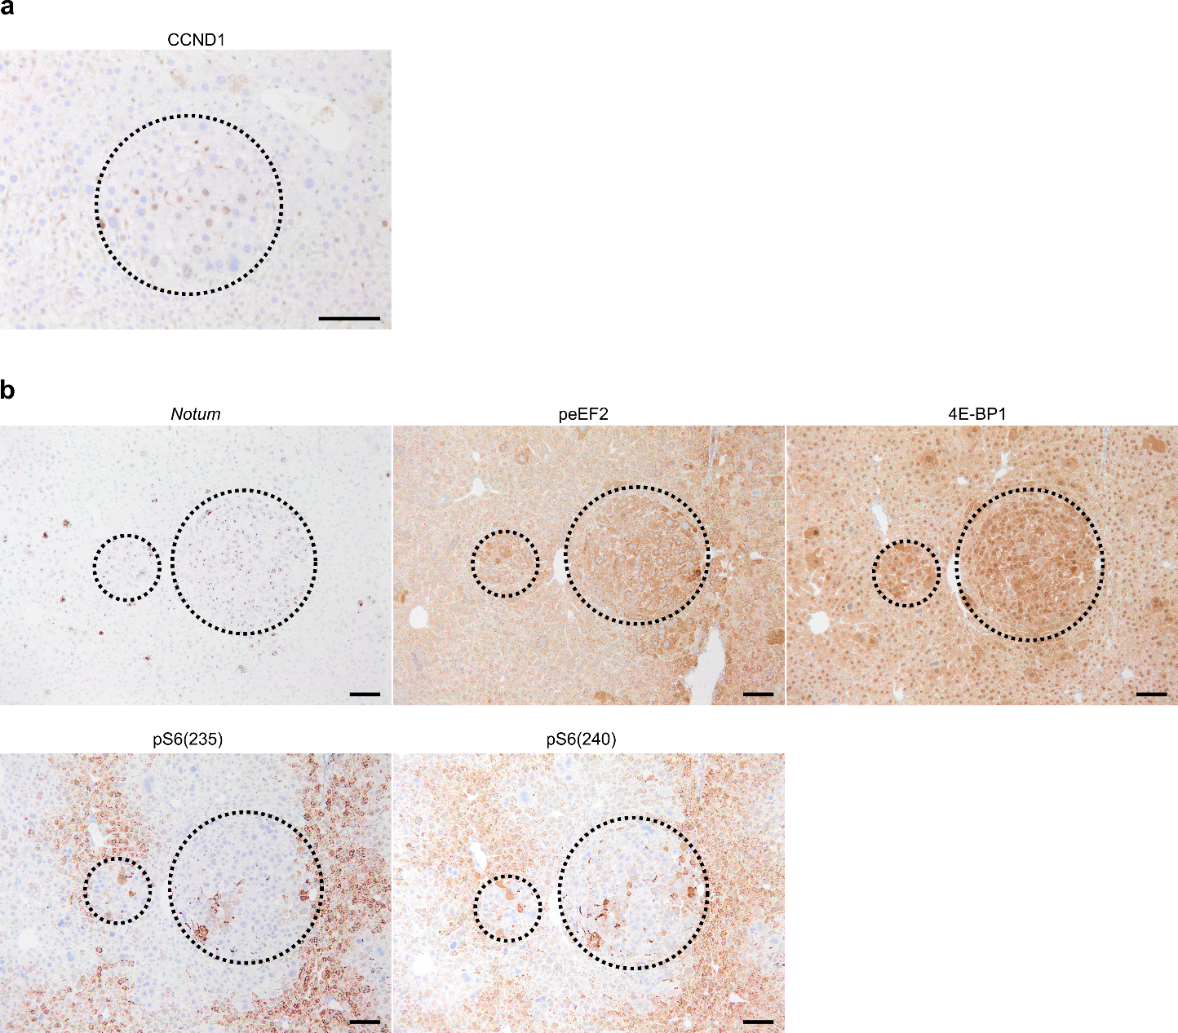
Extended Data Fig.9
Related to Fig.4
Extended Data Fig. 9: CCND1 and mTOR-pathway are active in Ctnnb1^{ex3/WT};R26^{LSL-MYC} mutant lesions. Ctnnb1^{ex/WT};R26^{LSL-MYC} liver on day 60 post AAV8.TBG.Cre (6.4×10⁸ GC/ml). a, CCND1 immunohistochemistry. b, In situ hybridisation for Notum and immunohistochemistry for peEF2, p4E-BP1 (Thr37/46), pS6(Ser235/236), and pS6(Ser240/244). Dashed outline highlights lesion. Representative images of n=4 per group. Scale bars, 100 μm.

Slide 10
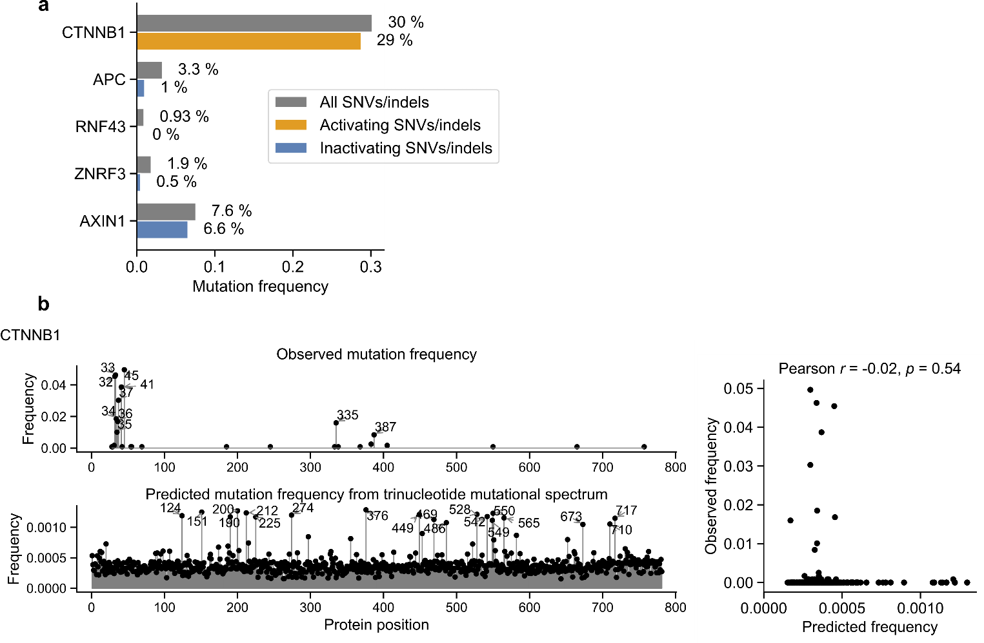
Extended Data Fig.10
Related to Fig.5
Extended Data Fig.10: CTNNB1 mutational modelling. Modelling CTNNB1 mutations using trinucleotide mutational spectrum. a, Mutation frequency of CTNNB1, APC, RNF43, ZNRF3, and AXIN1 in HCC. In total 1,189 HCC samples were analysed by combining multiple cohorts (Materials and Methods). For CTNNB1, activating mutations are defined as missense mutations or in-frame indels at hotspots. For tumour suppressor genes, inactivating mutations are defined as nonsense mutations, splice-site mutations, and frame-shift indels. b, Observed CTNNB1 mutation frequencies were compared to the predicted mutation frequencies at different protein positions. Prediction is based on the trinucleotide mutational spectrum in HCC (Materials and Methods). Only missense single-nucleotide variants (SNVs) were considered. The lack of correlation between observed and predicted mutation frequencies indicates that the hotspot CTNNB1 mutations are mainly driven by selection advantage, rather than the underlying mutagenic processes.

Slide 11
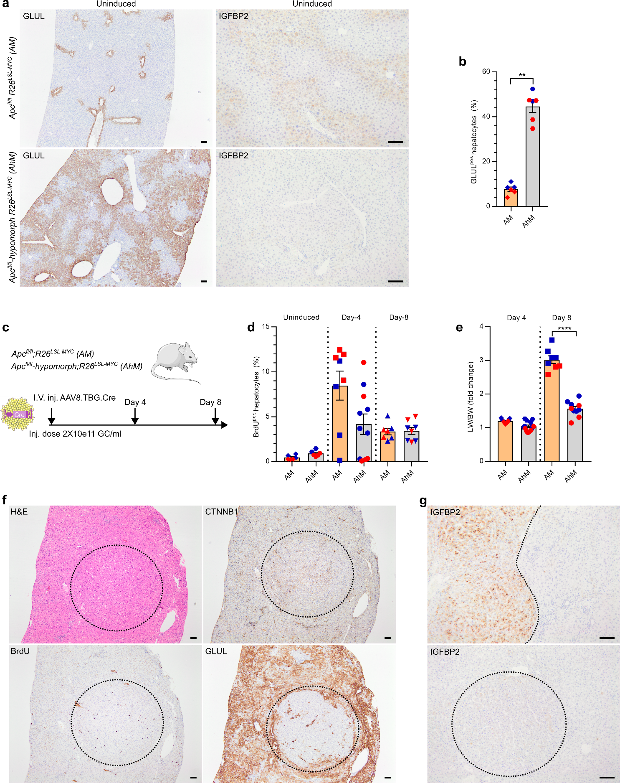
Extended Data Fig.11
Related to Fig.5
Extended Data Fig. 11: Modelling Wnt-driven growth in an Apc-hypomorphic liver. a, GLUL and IGFBP2 IHC in uninduced livers (no administration of AAV8.TBG.Cre). Scale bars, 100 μm.b, Quantification of GLUL^{pos} hepatocytes in uninduced mice from a. n=6 per genotype. Two-tailed Mann–Whitney test, **P=0.0022. c, Schematic representing the liver-specific murine model for the activation of acute hypomorphic-Apc^{fl/fl} and R26^{LSL-MYC} in the liver. d, Quantification of BrdU^{pos} hepatocytes in livers from indicated mice. Biological replicates—uninduced: n=9; Day 4: AM n=8, AhM n=11; Day 8: AM n=7, AhM n=8. e, Fold change in liver-to-body weight ratios of indicated mice. Biological replicates—uninduced: n=6; Day 4: AM n=11, AhM n=14; Day 8: AM n=9, AhM n=10. One-way ANOVA and Tukey’s multiple comparisons test, ****P=0.0001. f–g, Aged uninduced Apc^{fl/fl}-hypomorphic liver. Dashed line, tumour boundary. GLUL, CTNNB1, BrdU and IGFBP2 immunohistochemistry, and haematoxylin and eosin (H&E) stain. Scale bars, 100 μm. In b,d–e, data are mean ± s.e.m. Males, blue points; Females, red points.

Slide 12
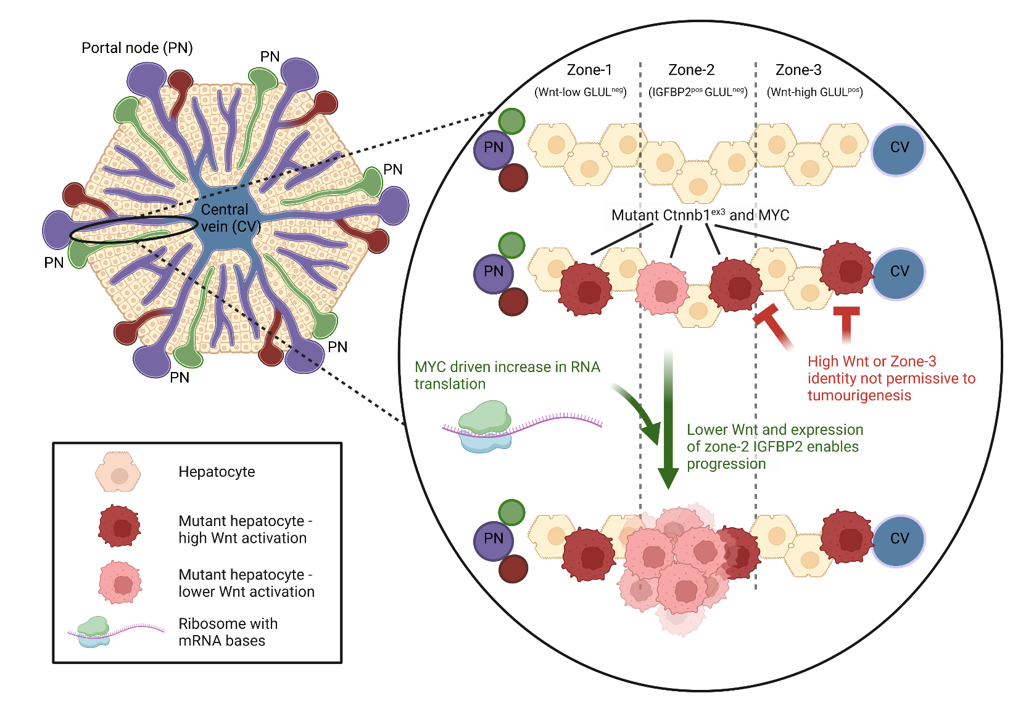
Extended Data Fig.12
Extended Data Fig. 12: Graphical model of mutant-β-Catenin and MYC driven tumourigenesis. Mutant hepatocytes in the hepatic lobule need to avoid a high Wnt, zone-3 fate, as this is not permissive to tumourigenesis; reduced Wnt and IGFBP2 expression synergise with MYC driven RNA translation to support proliferation. PN = portal node (a vasculature structure composed from the portal vein (purple), hepatic artery (red) and bile duct (green)), CV = central vein (blue). Created with BioRender.com.

