Slide 1
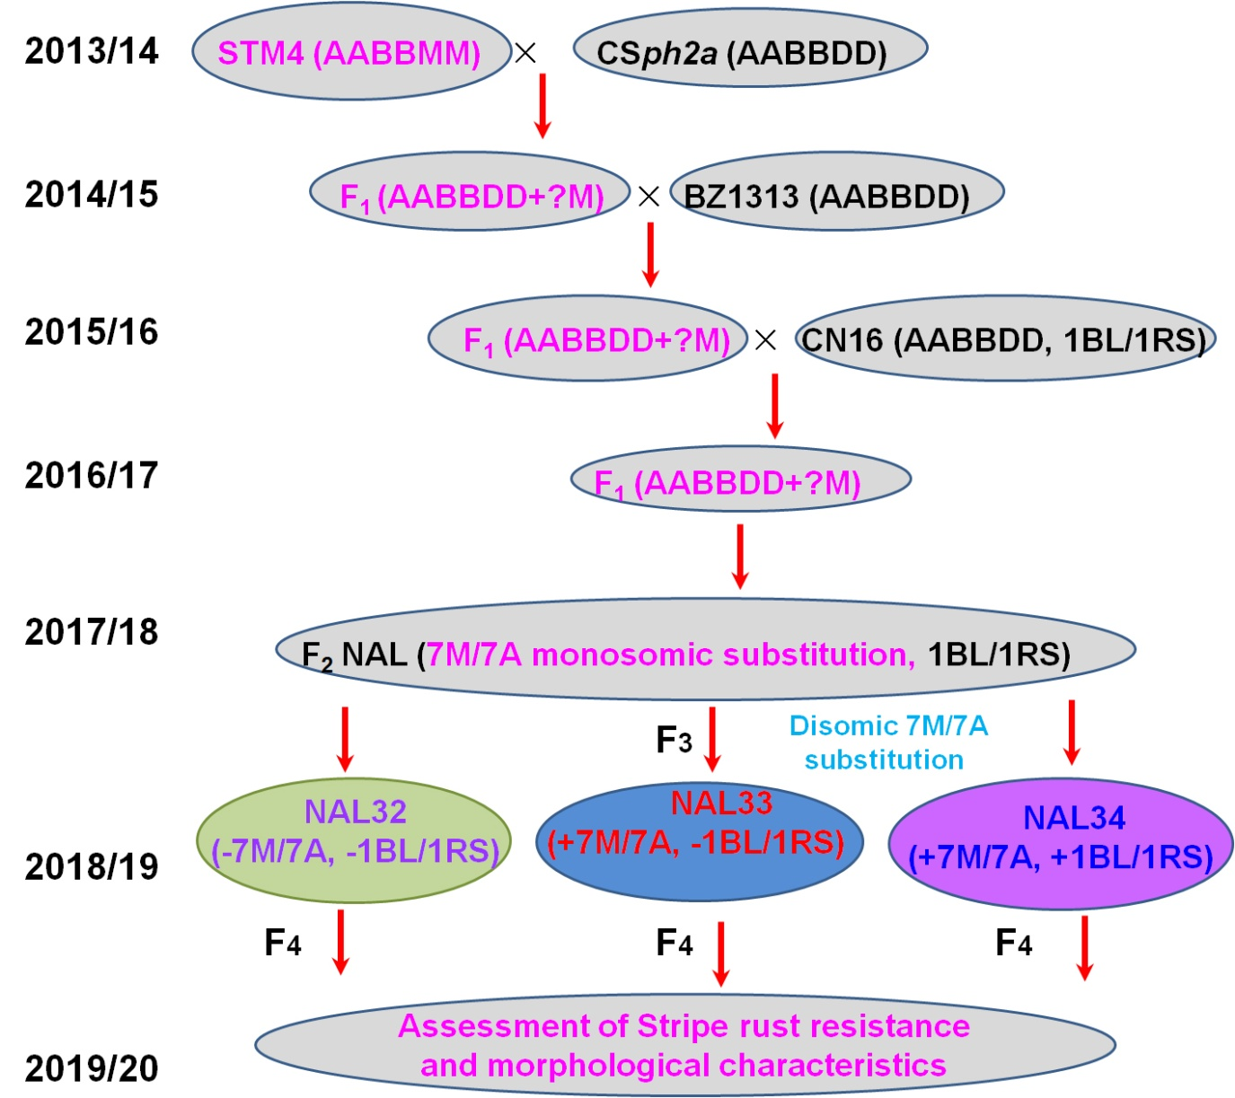
Fig. S1. Development and selection process of three NAL sister lines.

Slide 2
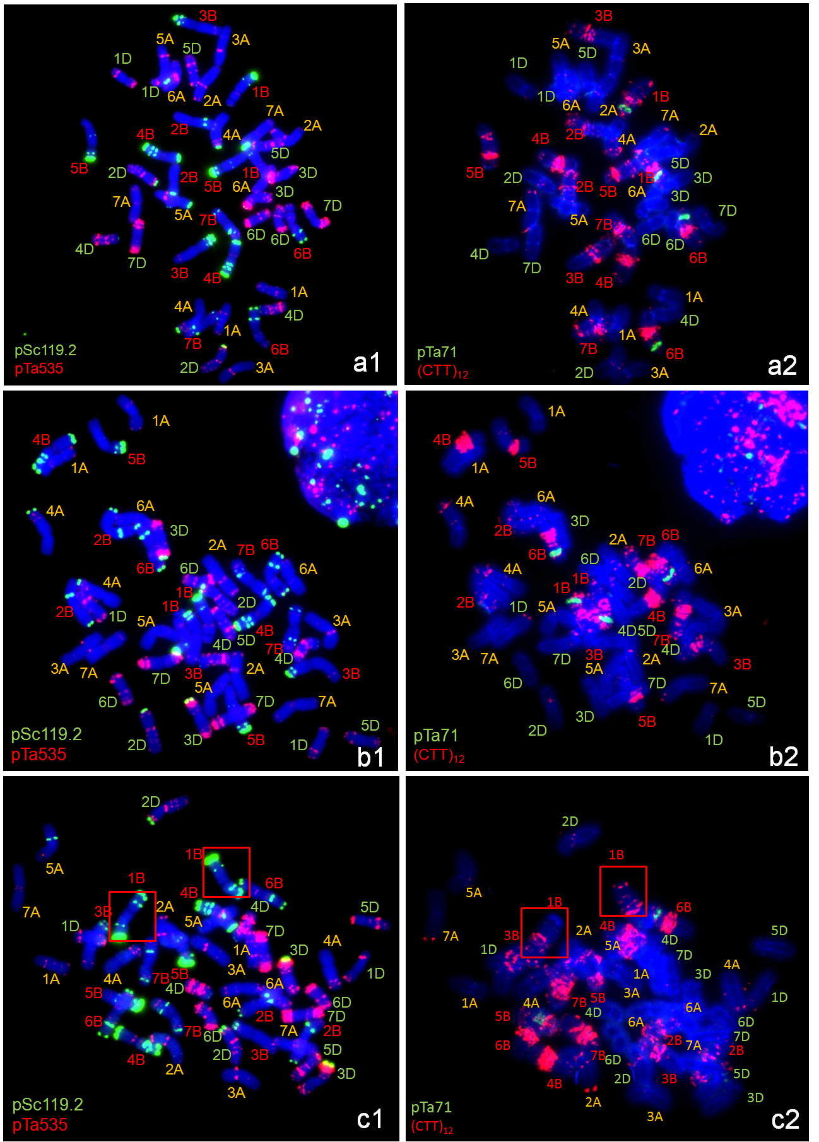
Fig. S2. Non-denaturing fluorescence in situ hybridization of common wheat parents CSph2a (non-1BL/1RS translocation line; a1, a2), BZ1313 (non-1BL/1RS translocation line; b1, b2), and CN16 (1BL/1RS translocation line; c1, c2), using probes pSc119.2/pTa-535 (a1–c1) and (CTT)₁₂/pTa71 (a2–c2). Red pane in c1 and c2 indicate 1BL/1RS translocation chromosomes.
.

