Slide 1
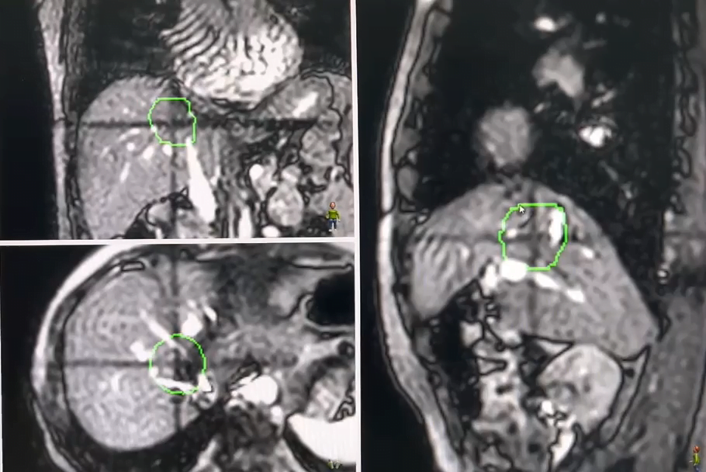
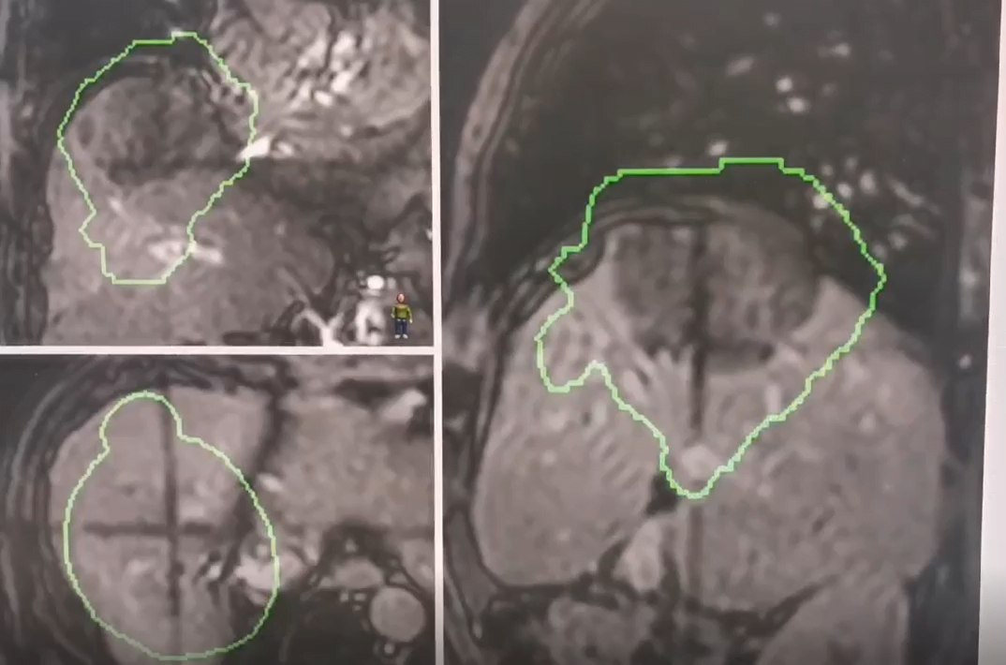
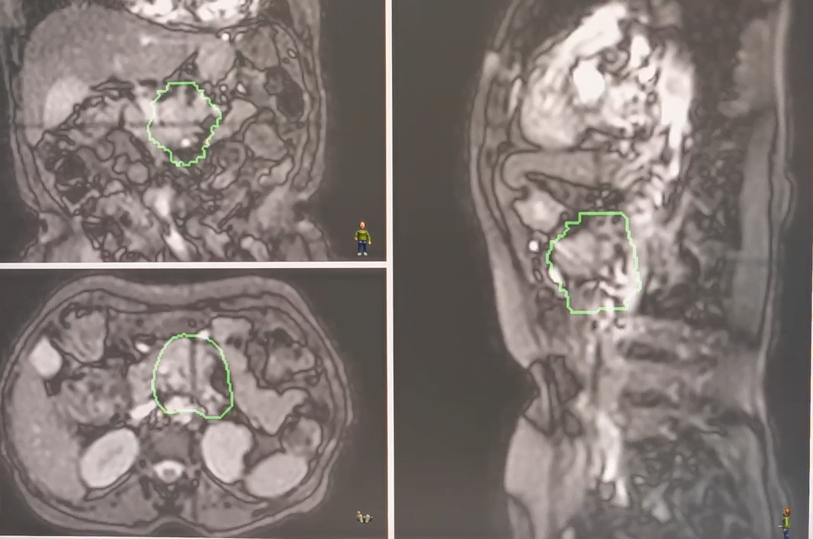
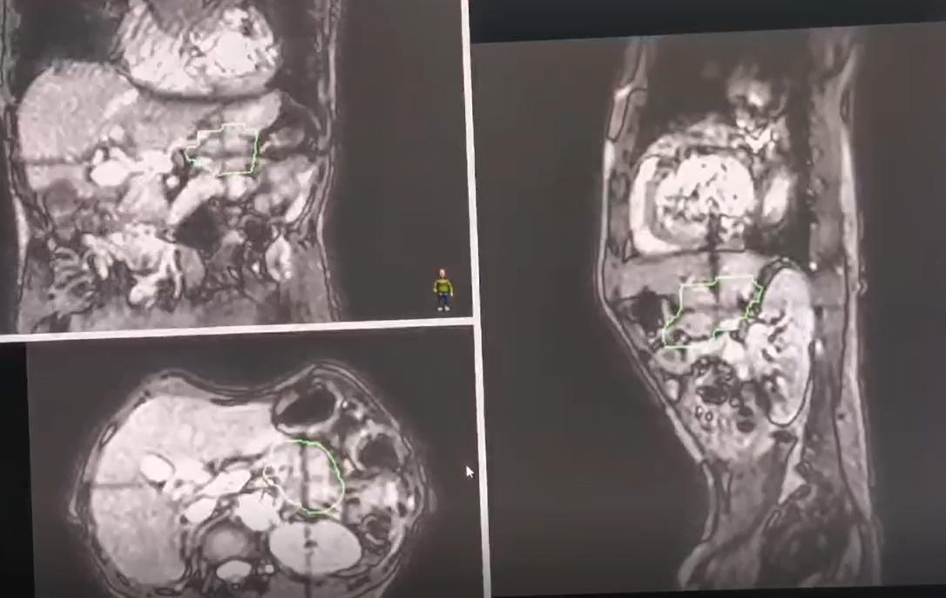
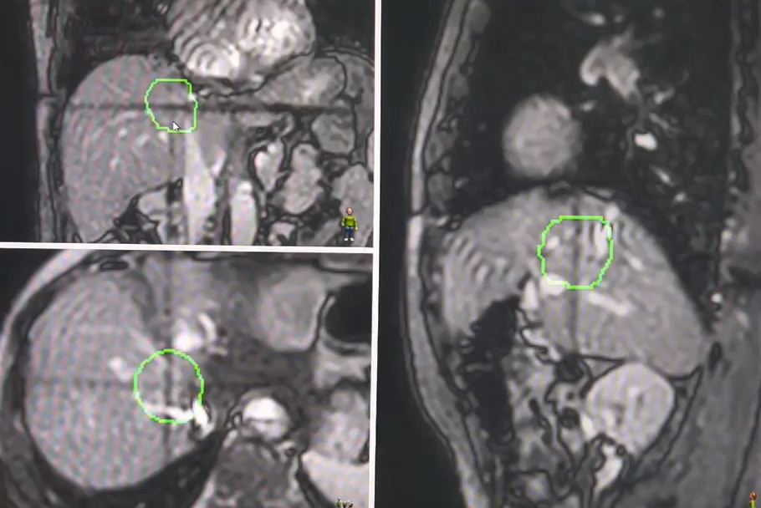
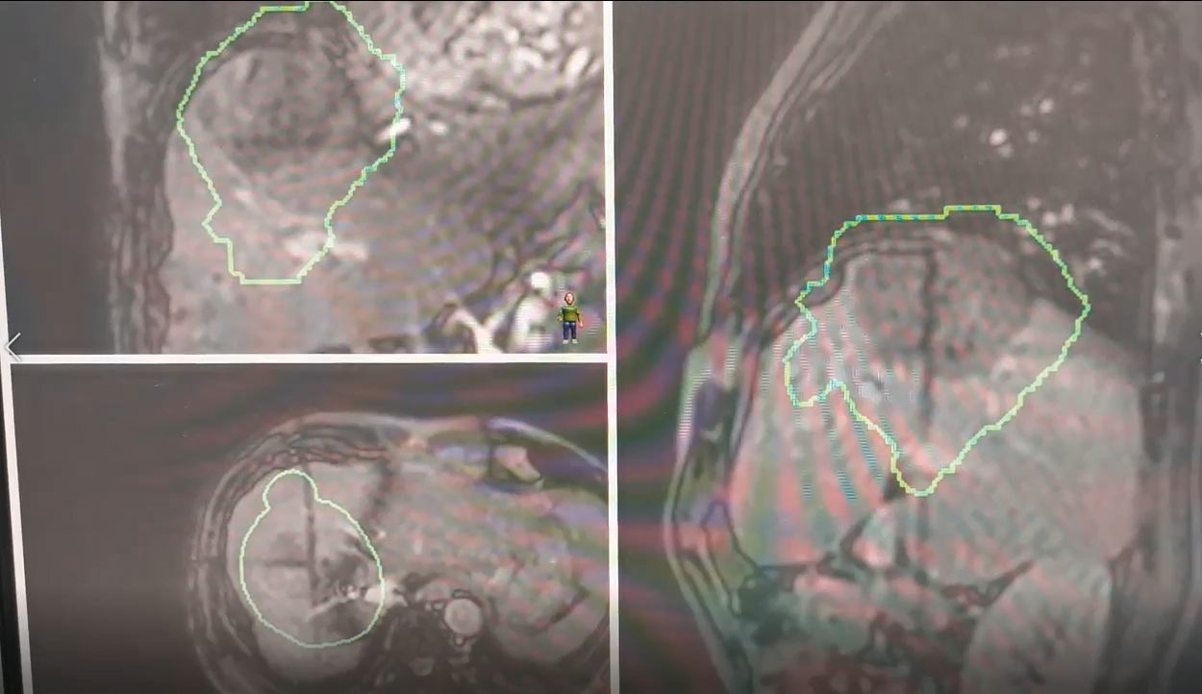
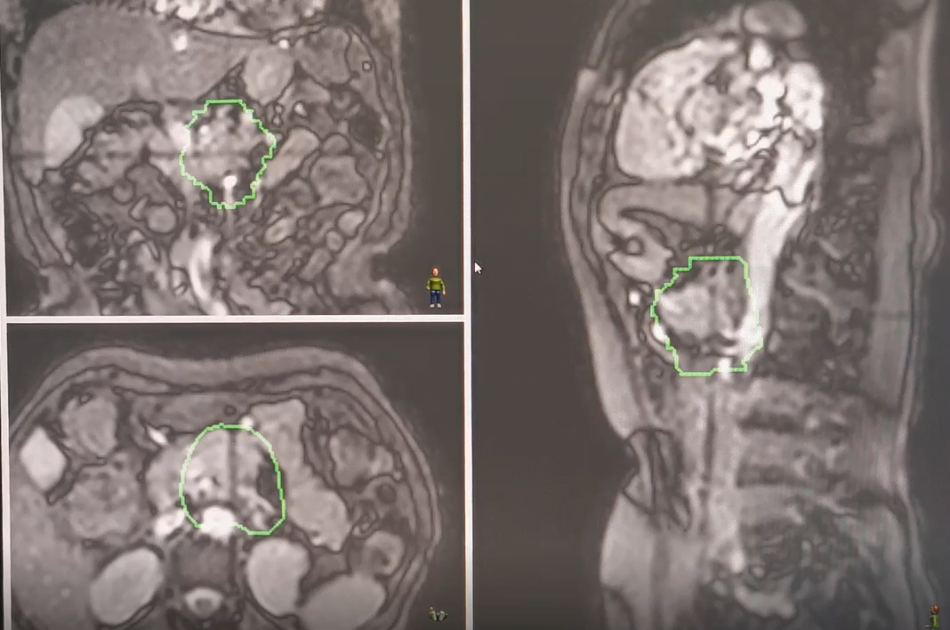
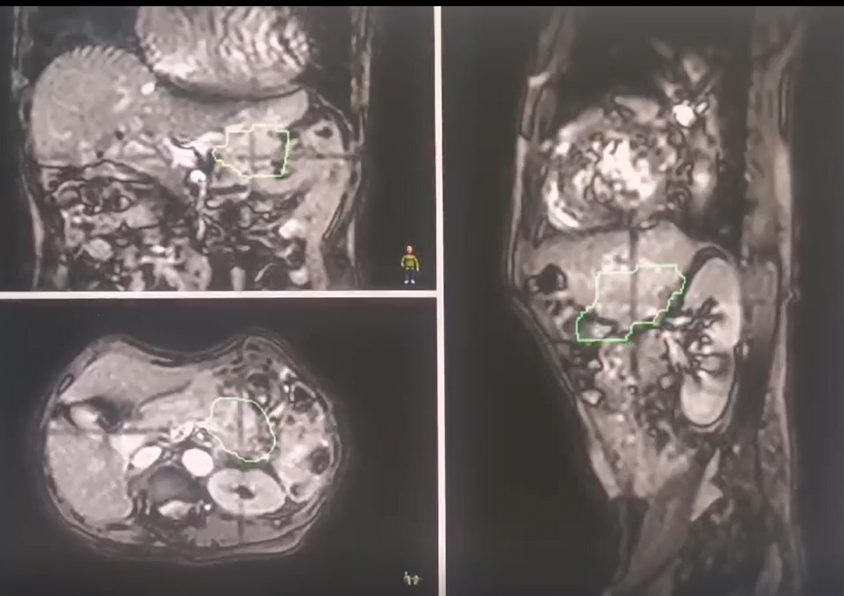
Patient A
Patient B
Patient C
Patient D
MRI-before enhanced
MRI-after enhanced
Additional file 1. Dynamic images of magnetic resonance scanning before (up panel) and after (bottom panel) injection of contrast agent in 4 patients.(green lines indicate the internal gross target volume [IGTV], that is, the area that envelopes the motion of the gross tumor volume).

