Slide 1
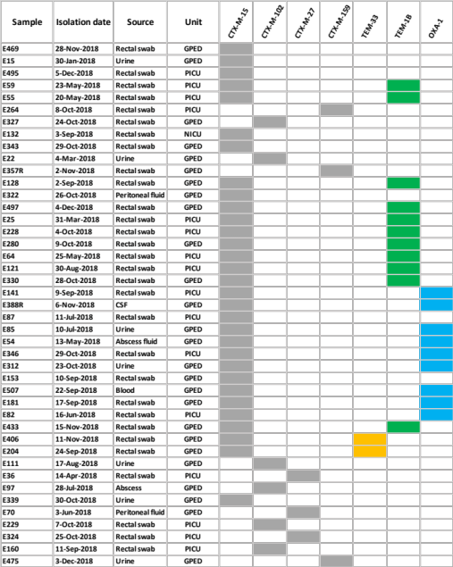
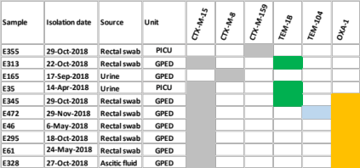
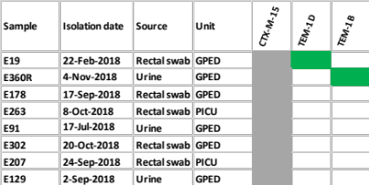
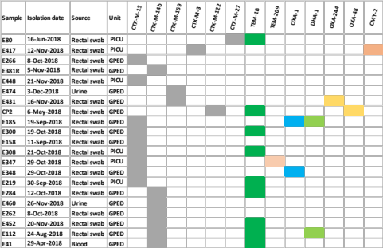
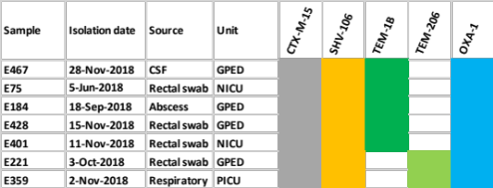
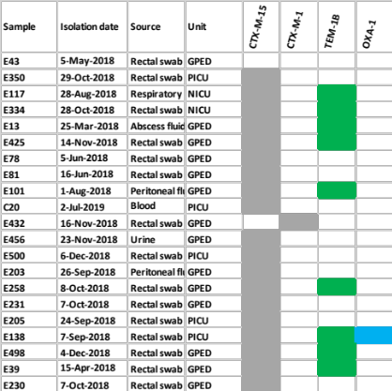
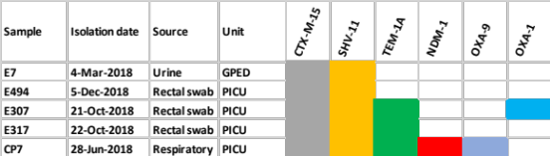
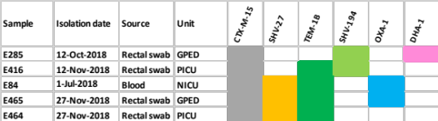
Supplemental figure. Phylogenetic relatedness among 5 major E. coli and 3 major K. pneumoniae sequence types isolated from screening and clinical specimens in Qatari children
E. coli – ST131
E. coli – ST1193
I
E. coli – ST73
II
E. coli – 38
K. pneumoniae – ST307
E. coli – ST10
K. pneumoniae - ST268
K. pneumoniae – ST45

