Slide 1
Fig. S1
a
(fold)
BxPC-3
b
(fold)
MIA PaCa-2
SEMA3C mRNA
relative expression
SEMA3C mRNA
relative expression
control
siRNA
SEMA3C
siRNA1
SEMA3C
siRNA2
pcDNA
blank
pcDNA
SEMA3C

Slide 2
Fig. S2
a
BxPC-3
control siRNA
control siRNA
SEMA3C siRNA1
SEMA3C siRNA1
Number of cells
SEMA3C siRNA2
SEMA3C siRNA2
Number of cells
CD133 PE-A
c-Met FITC-A
b
MIA PaCa-2
pcDNA blank
pcDNA blank
pcDNA SEMA3C
pcDNA SEMA3C
Number of cells
Number of cells
CD133 PE-A
c-Met FITC-A

Slide 3
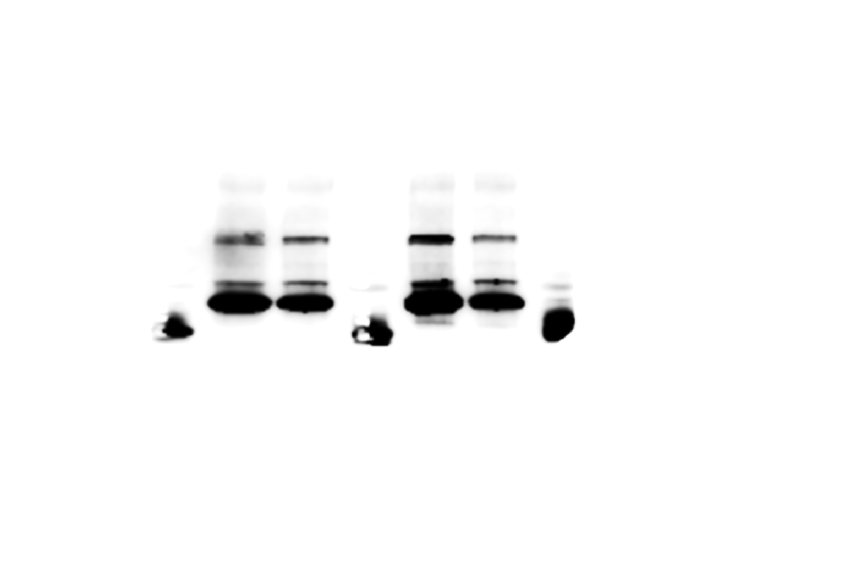
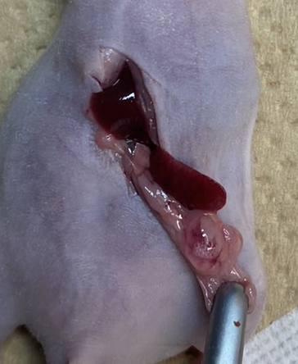
Fig. S3
a
PKCY
b
PKCY
control
shRNA
SEMA3C
shRNA
(%)
*
SEMA3C
p=0.01
β-actin
The frequency of
sphere forming cells
*
(fold)
SEMA3C expression
normalized by β-actin
control
shRNA
SEMA3C
shRNA
control
shRNA
SEMA3C
shRNA
c

Slide 4
Fig. S4
(g)
*
p=0.01
control shRNA
Body weight
*
control
SEMA3C
shRNA
control shRNA
GnP
SEMA3C
shRNA
0
7
14
21
days after transplantation

