Slide 1
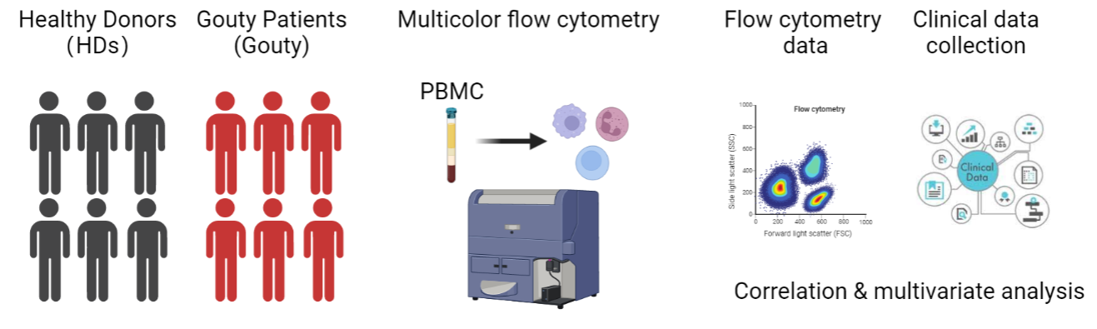

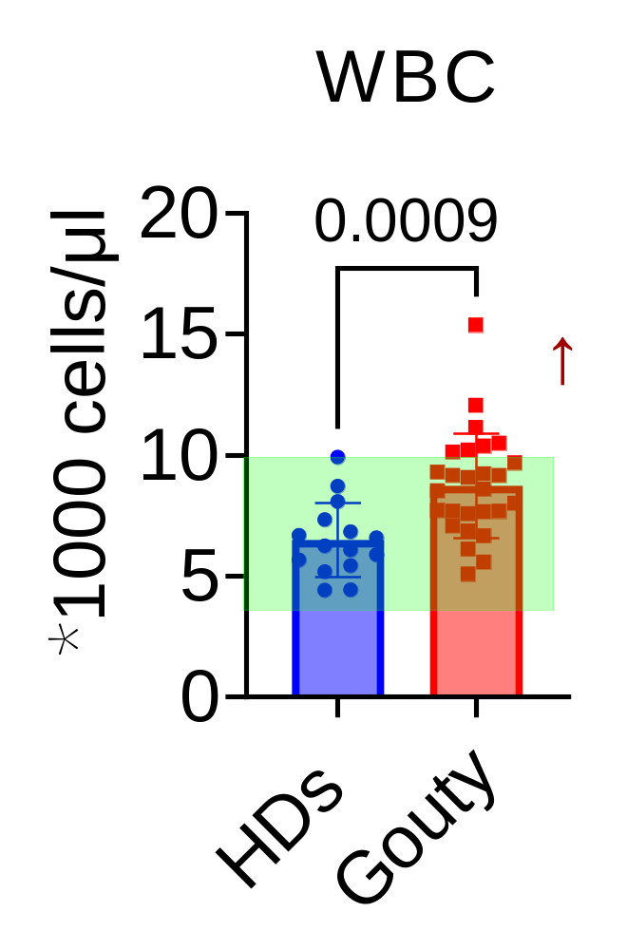
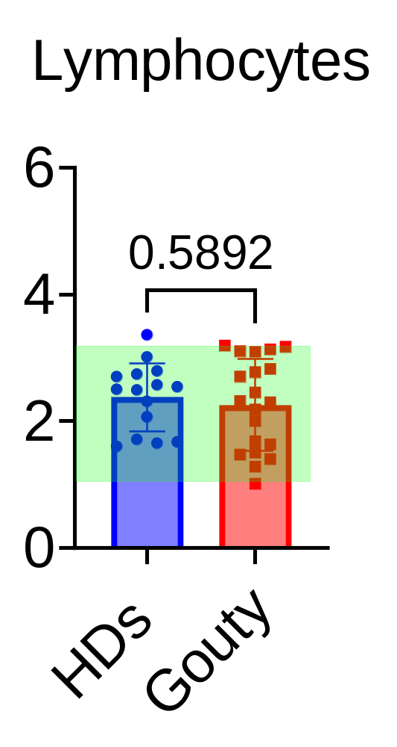
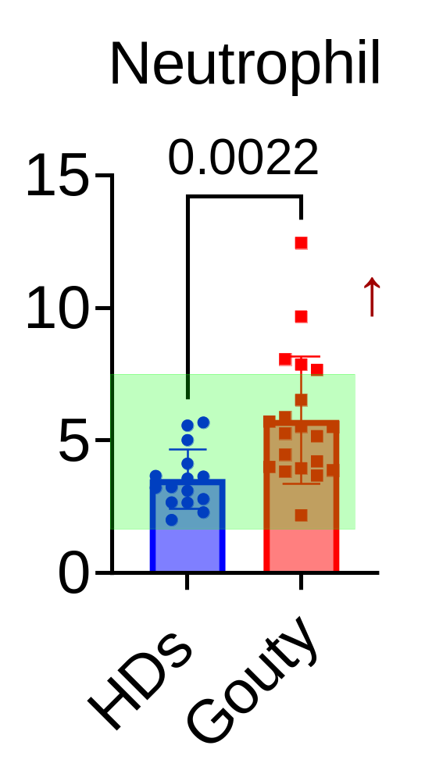
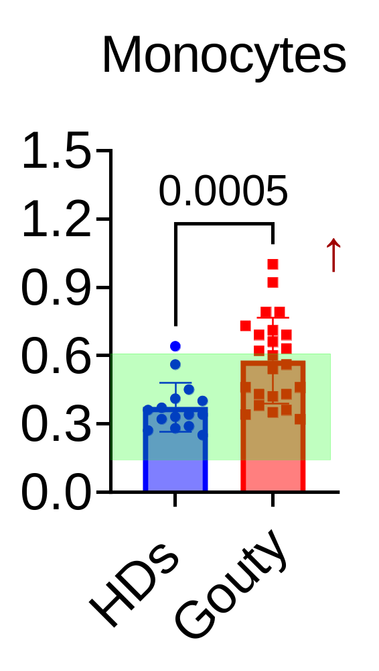
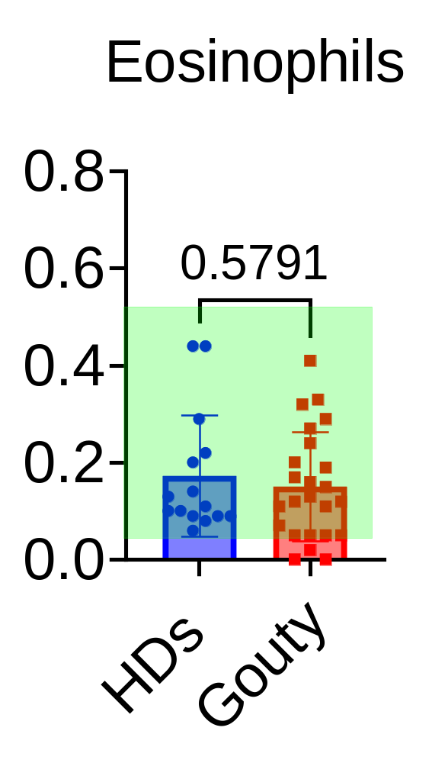
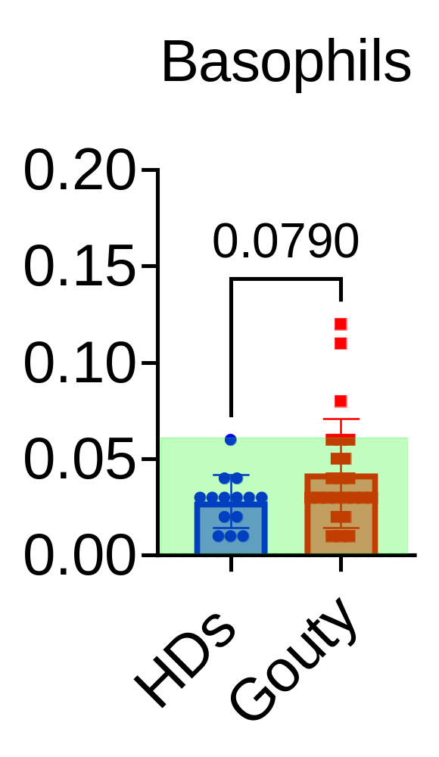
A
B
C
N=28；
Red border: PDR<0.05;
*P<0.05; **P<0.01; ***P<0.001;
Figure S1. Demographic and clinical information.
A: Schematic of techniques performed on blood samples;
B: Quantification of key clinical parameters in gouty patients. Each dot represents a gouty patient; Normal test ranges are indicated in green areas;
C: Spearman correlation and hierarchical clustering of gouty indicated features and clinical parameters of gouty patients;.

Slide 2
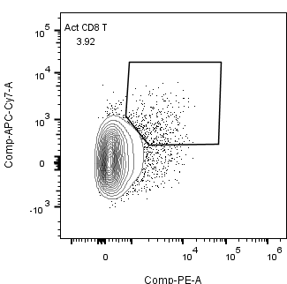
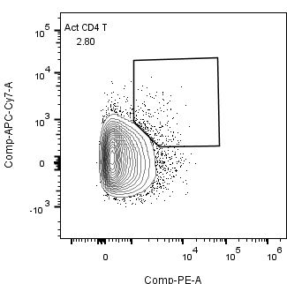
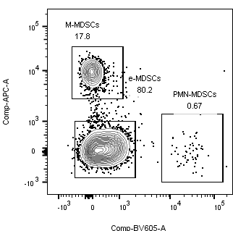
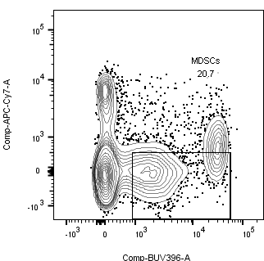
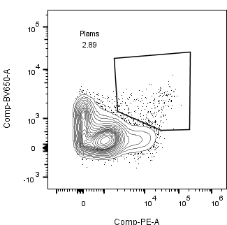
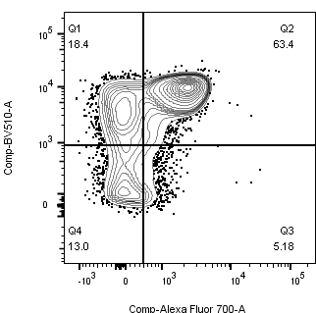
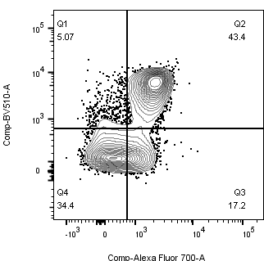
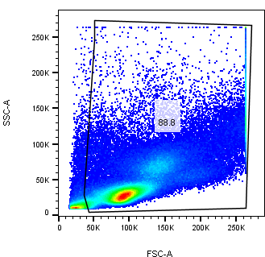
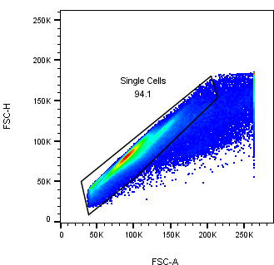
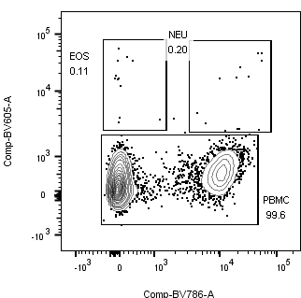
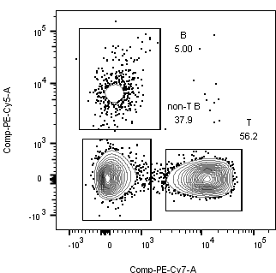
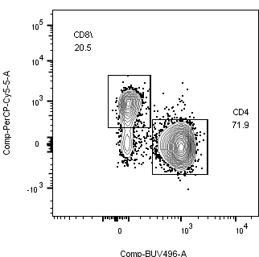
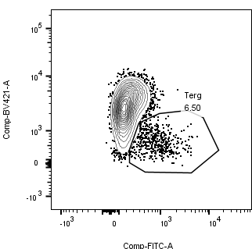
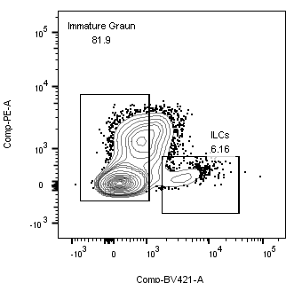
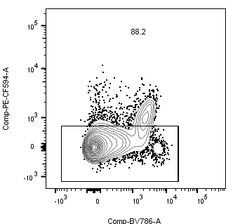
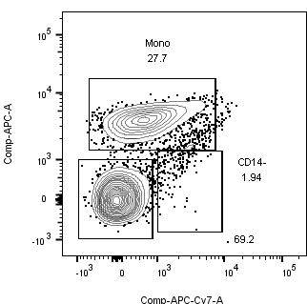
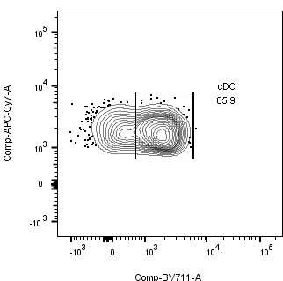
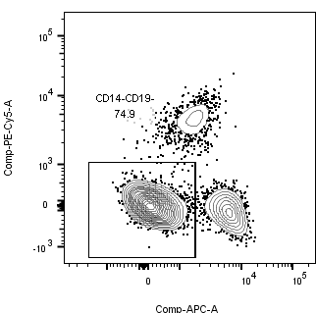
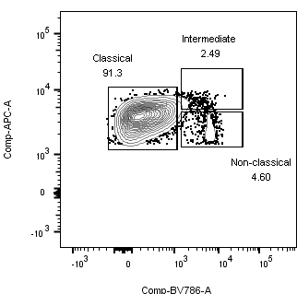
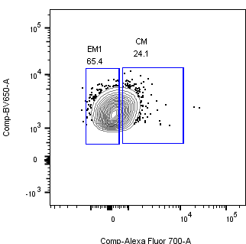
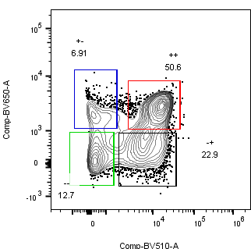
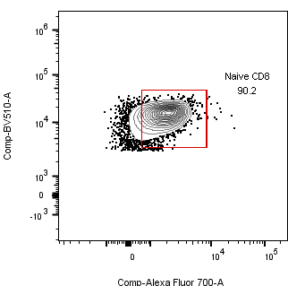
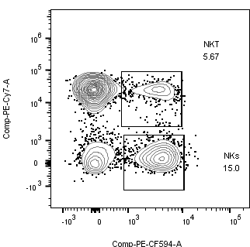
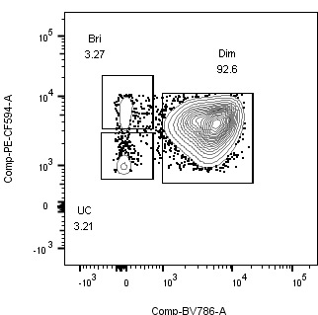
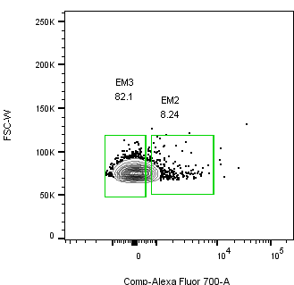
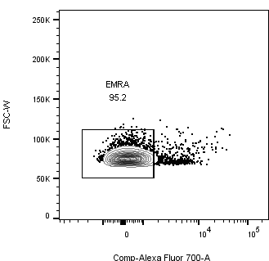
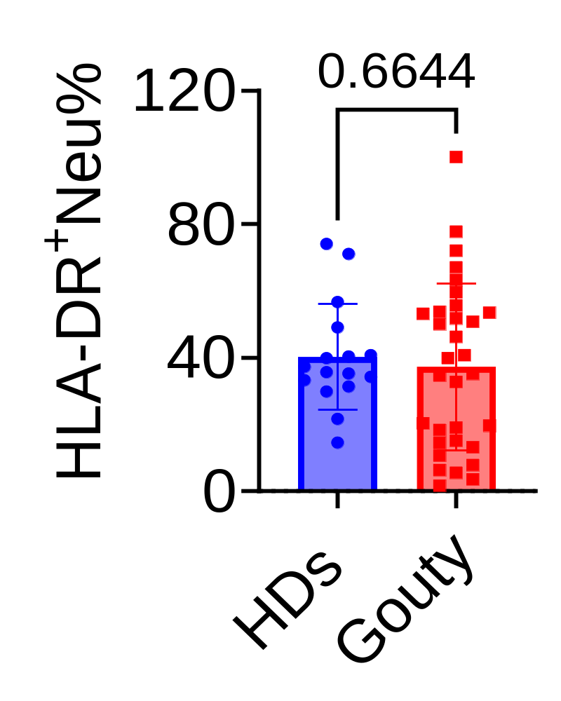
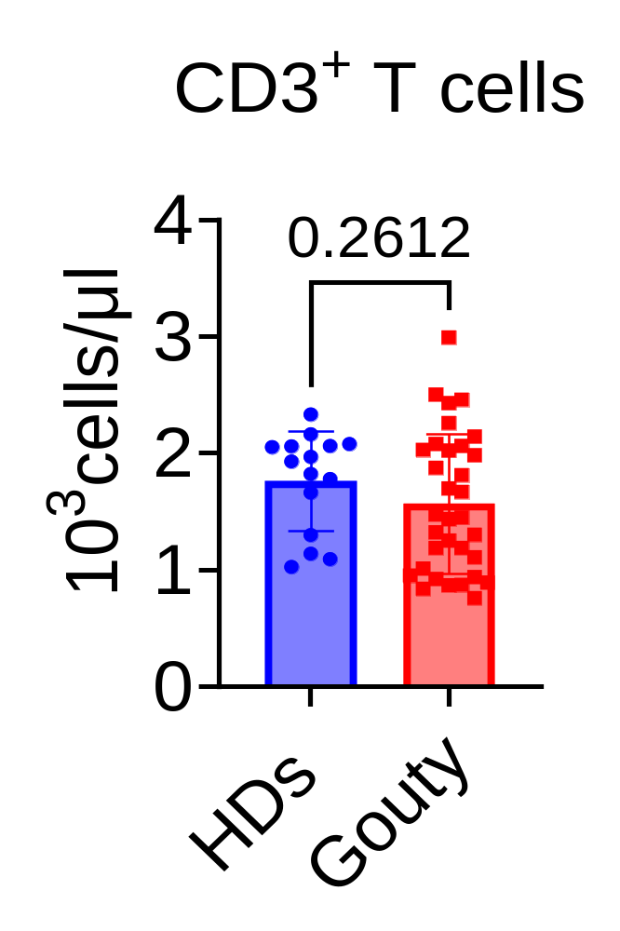
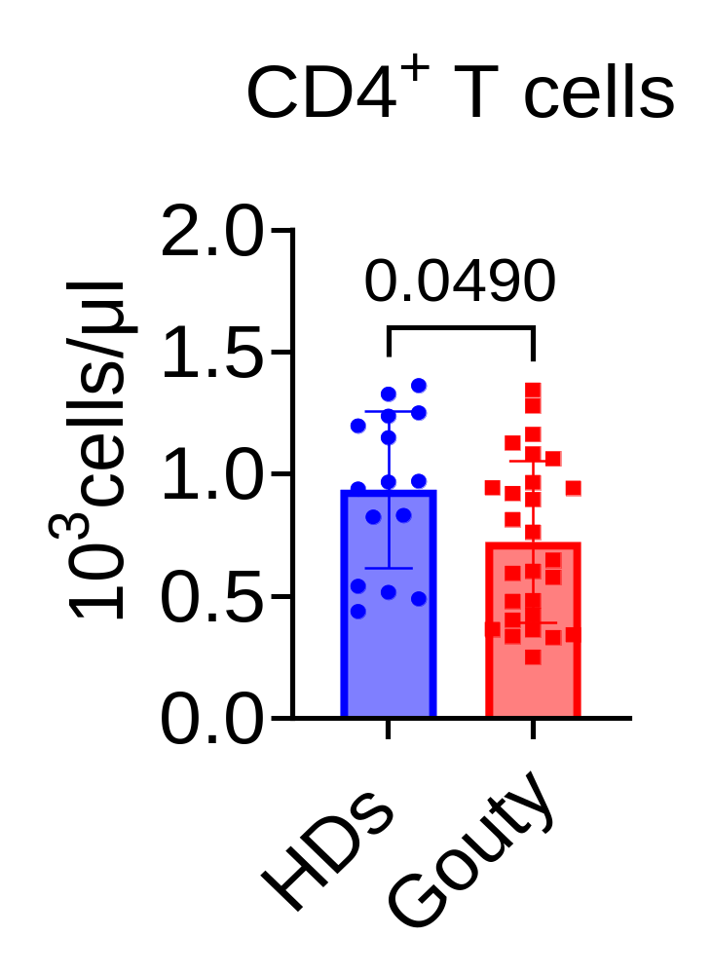
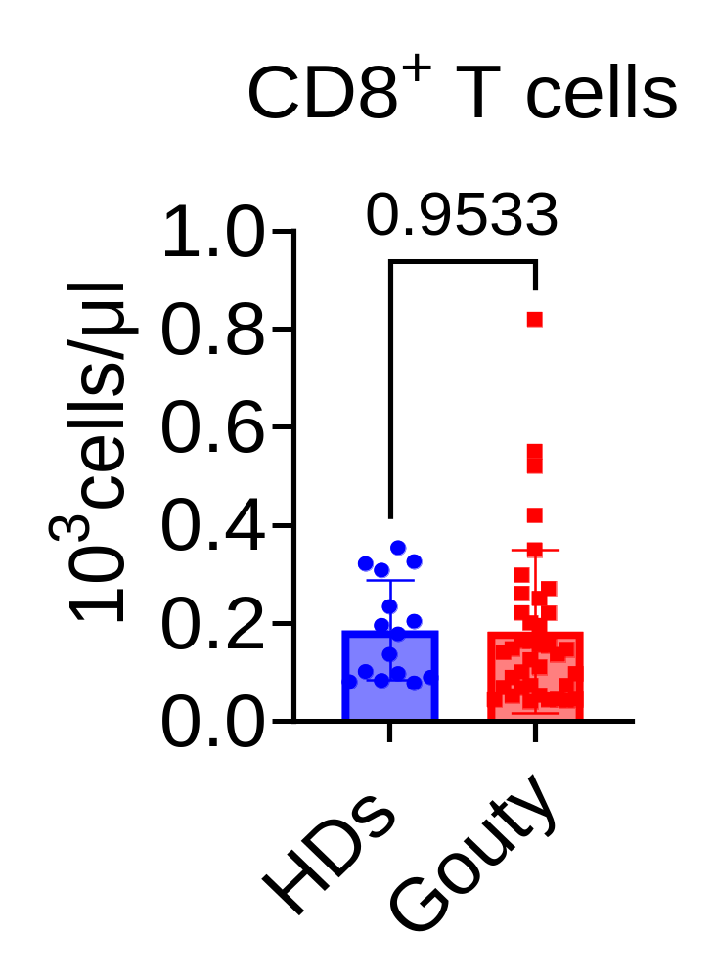
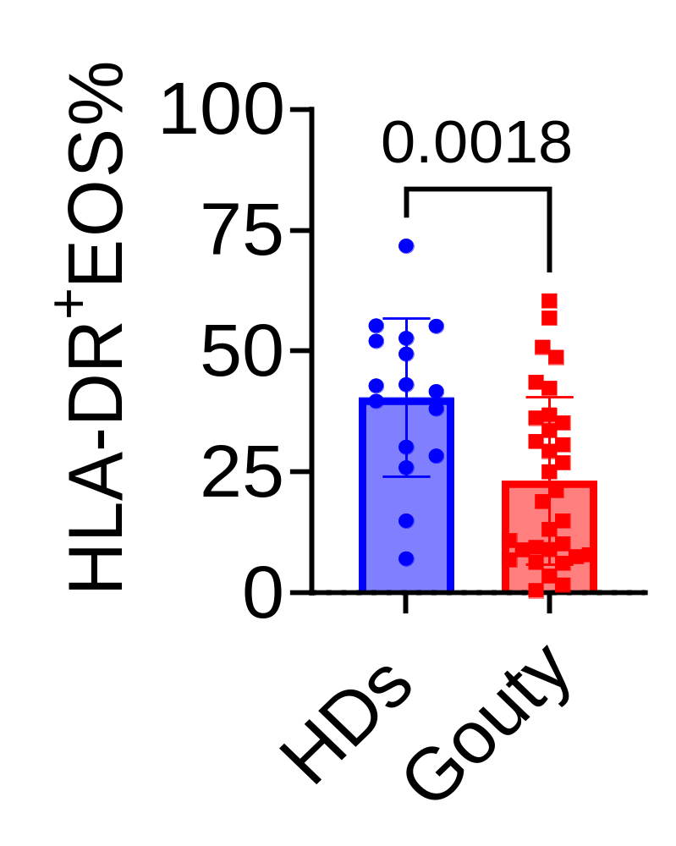
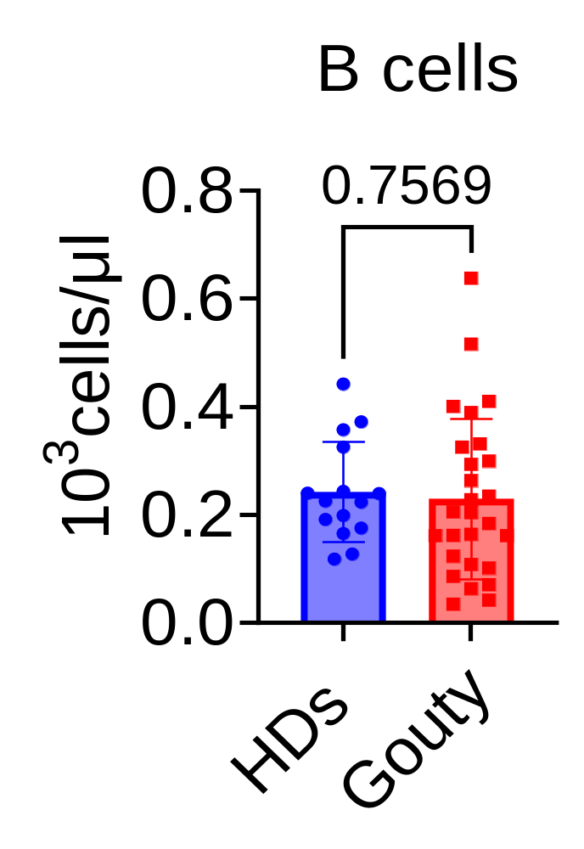
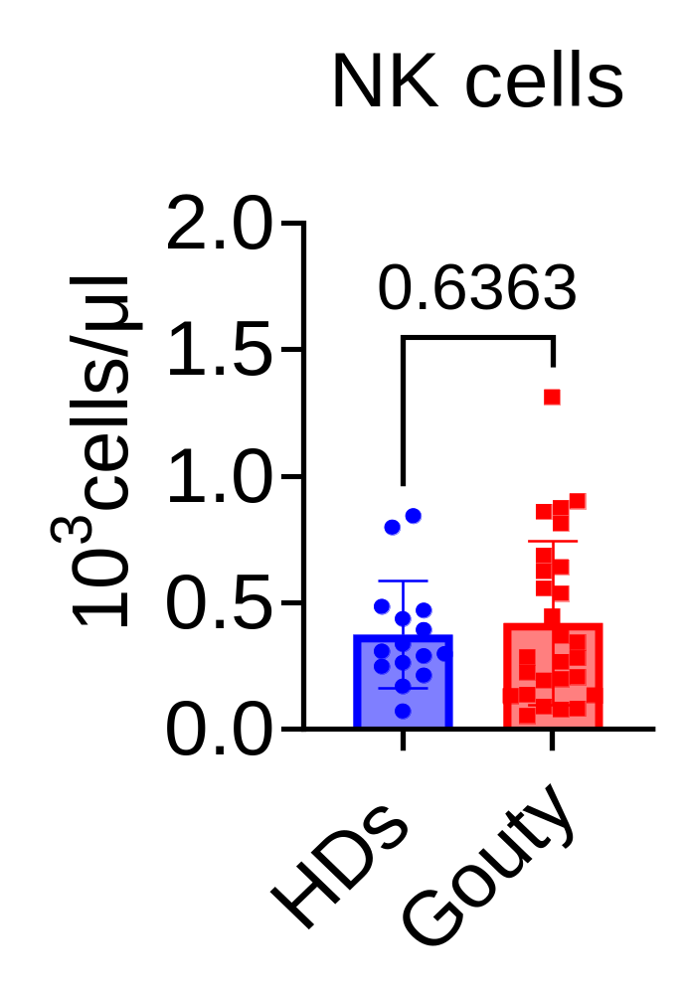
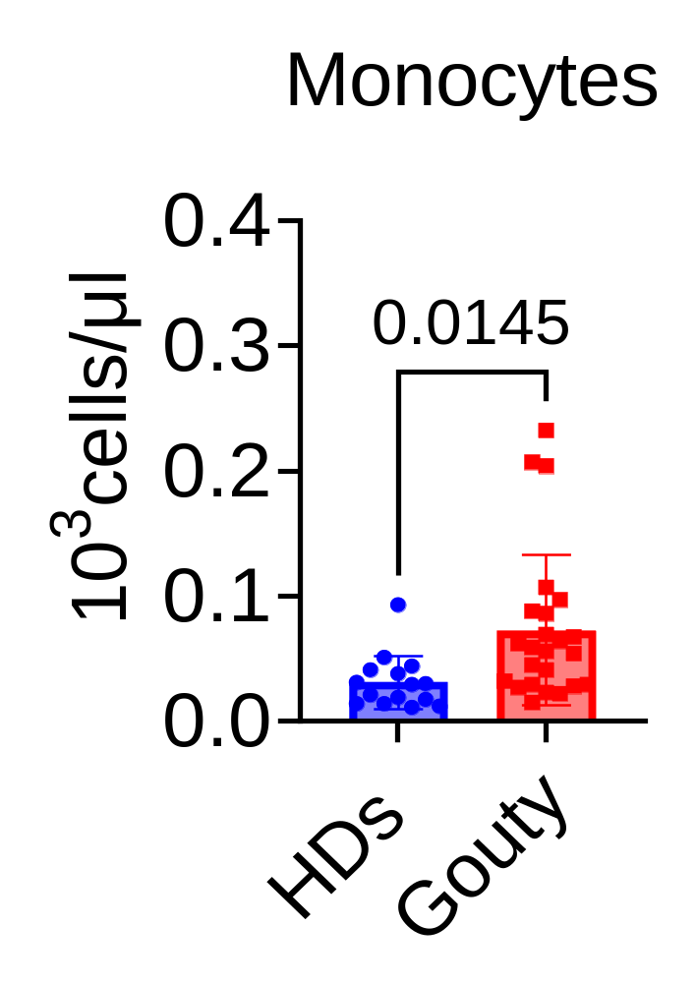
A
B
Act CD8 T
Act CD4T
Penal
CD3 | PE-cy7
CD4 | BUV496
CD8 | PerCP-Cy5.5
CD19 | PE-cy5
CD14 | APC
CD15 | BV605
CD16 | BV786
HLA-DR | APC-cy7
CCR7 | AF700
CD45RA | BV510
CD27 | BV650
CD127 | BV421
CD56 | PE594
CD38 | PE
CD11b | BUV396
FITC | CD25
CD11c | BV711
HLA-DR
HLA-DR
M- MDSCs
CD38
CD38
PMN- MDSCs
MDSCs
CD27
Plasmablast
CD14
HLA-DR
CD45RA
Tem
CD45RA
Tem
e MDSCs
CD15
CD11b
CD38
B cells
CCR7
CCR7
Eos
Neu
CD8 T
Treg
CD19
T cells
CD8
CD127
CD15
Non T/B
CD4 T
CD16
CD3
CD4
CD25
Immature Graun
Monocytes
HLA-DR
cDC
CD38
ILCs
CD56
CD14
CD127
CD16
HLA-DR
CD11c
C-Mono
Inter-Mono
CD19
CD14
CD27
Tcm
CD27
CD45RA
T naive
Nc-Mono
T em1
CD14
CD16
CCR7
CD45RA
CCR7
NKT
NK^{Bri}
FSC-W
T em2
FSC-W
T emra
CD3
CD56
NKs
NK^{Uc}
NK^{Dim}
T em3
CCR7
CCR7
CD56
CD16
C
D

Slide 3
Figure.S2. Gating strategy used for flow cytometric analyses of immune cell subsets
A-B: Gating strategy used for flow cytometric analyses；
C: Frequencies of HLA-DR⁺EOS cells and HLA-DR⁺NEU cell subsets as indicated;
D: Absolute numbers of major immune subsets including CD3⁺/CD4⁺/CD8⁺ T cells, CD19⁺ B cells, CD56⁺ NK cells, and CD14⁺ monocytes in healthy controls and gouty patients；

Slide 4
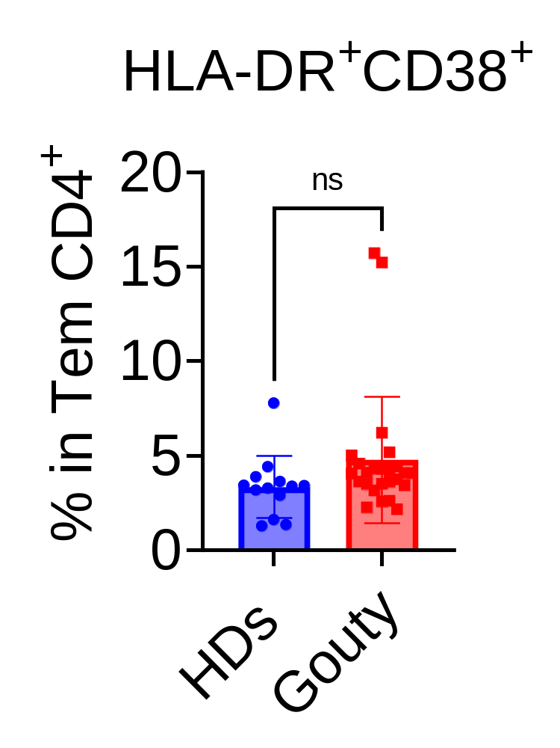
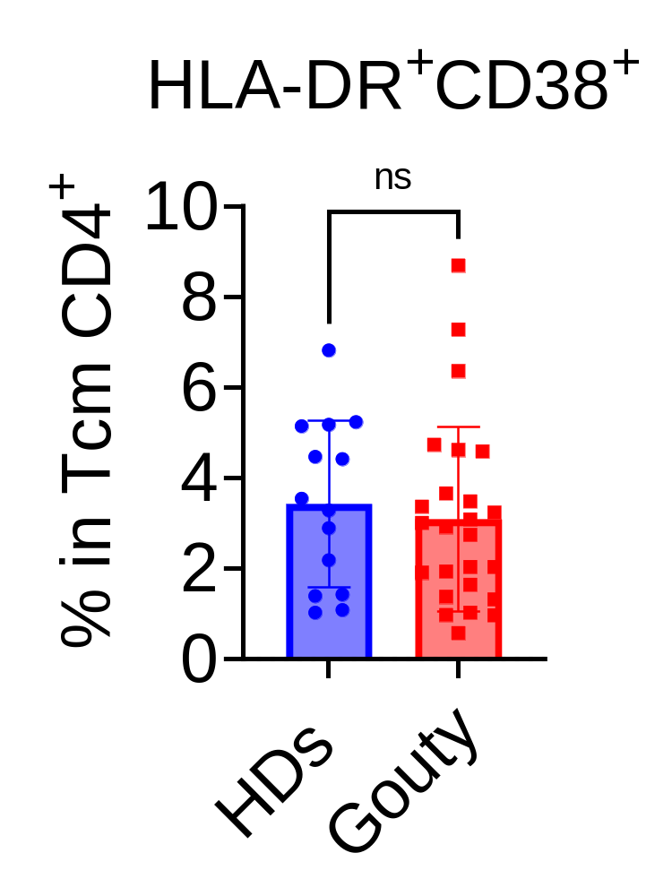
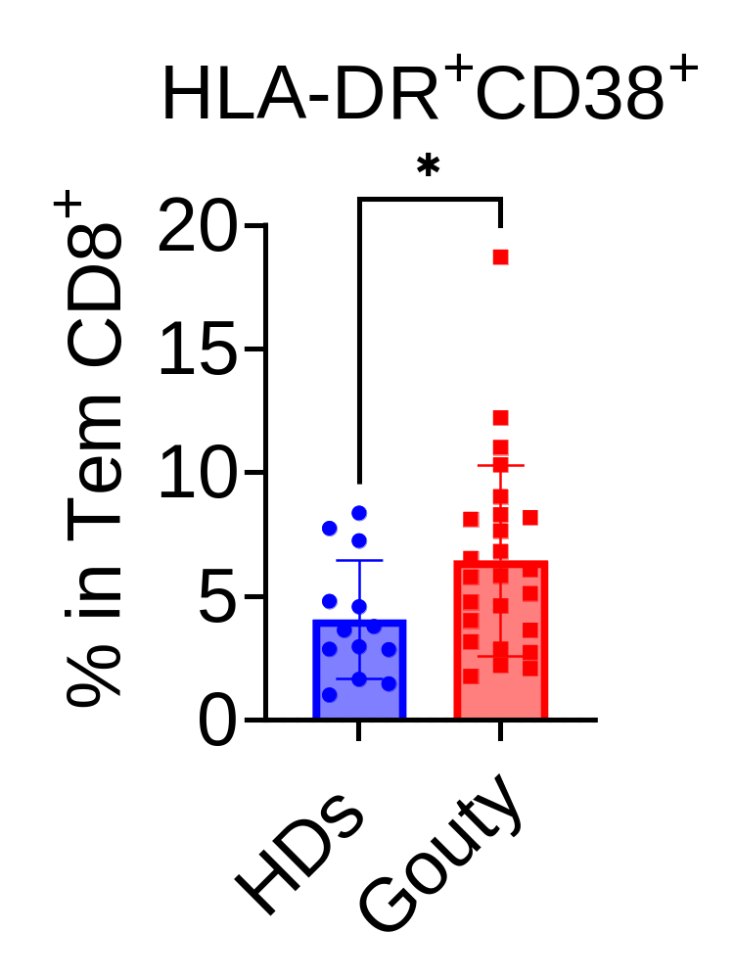
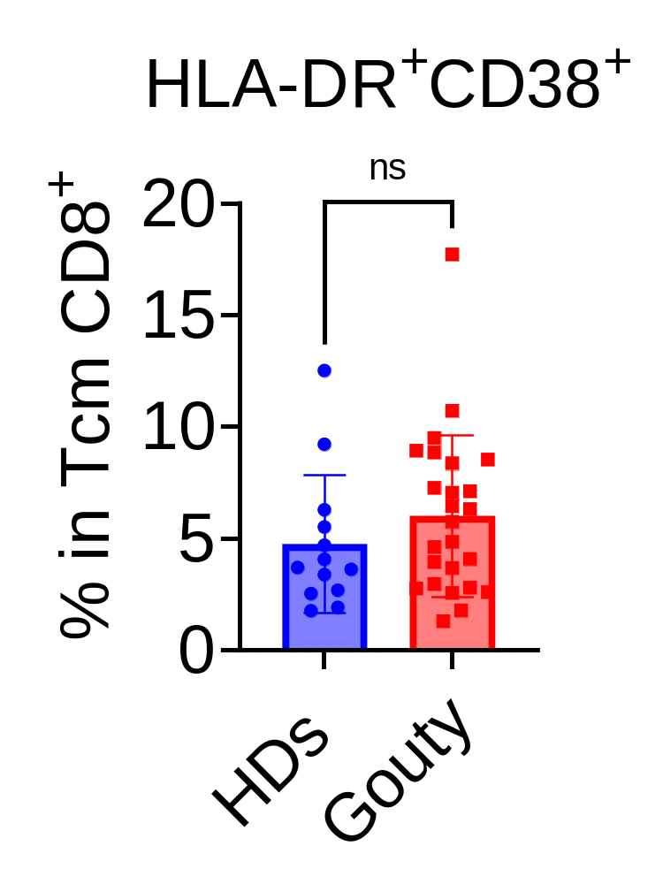
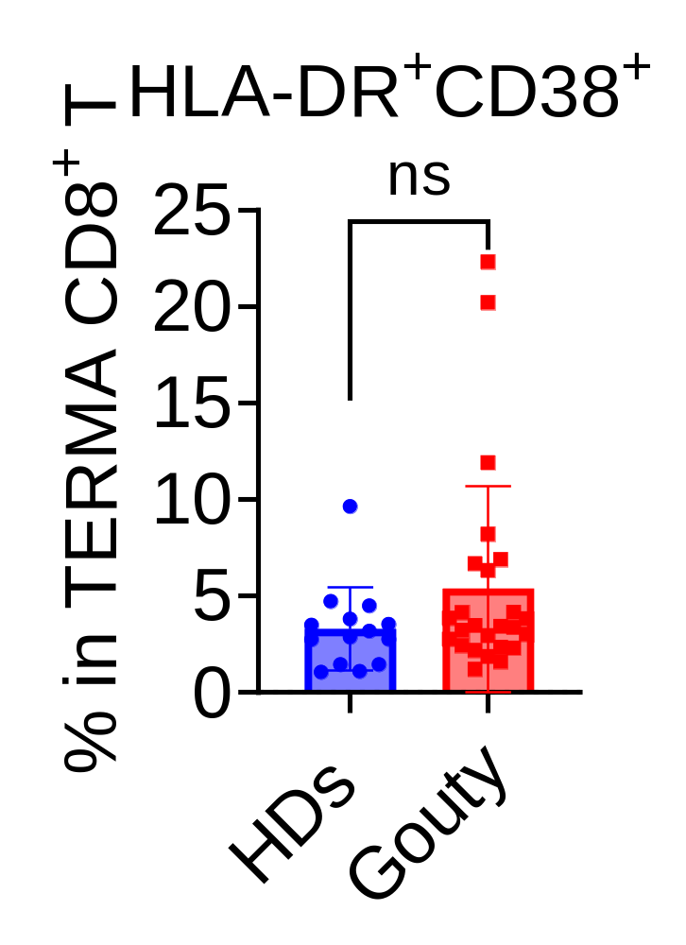
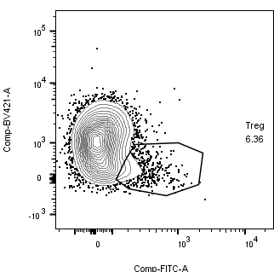
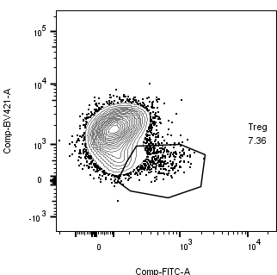
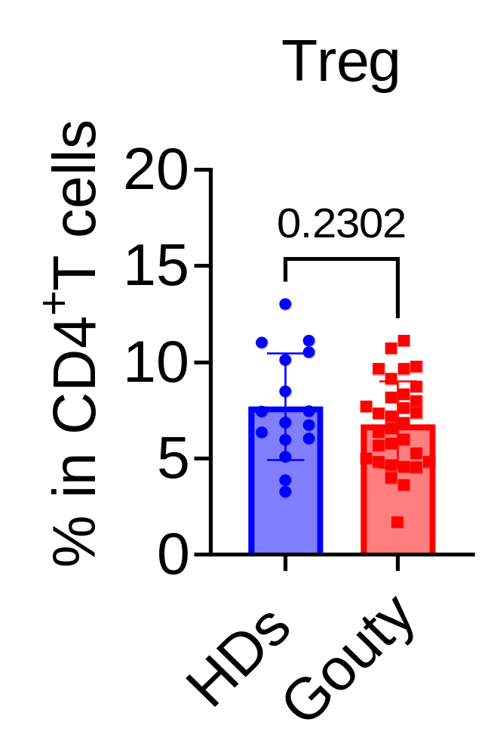
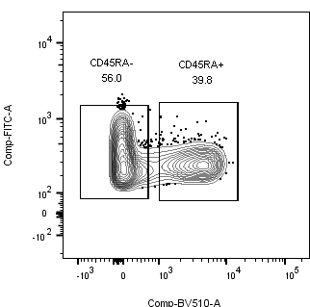


A
Gated on CD8 or CD4
B
CD27
EM1
CM
CD27
Naive
CD45RA
CCR7
CD45RA
CCR7
FSC-W
EM3
EM2
FSC-W
EMRA
CCR7
CCR7
C
HDs
Gouty
CD127
6.36
7.36
CD25
56.0%
77.9%
CD25
39.8%
18.0%
CD45RA
Figure S3. Extended T immune subset characterization during gouty patients.
A: Representative flow cytometry plots of the gating strategy for CD4⁺ or CD8⁺ T cell subsets; B: Frequency of HLA-DR⁺CD38⁺ cells among different stages of the CD4⁺ or CD8⁺ T cells. TCM, central memory T cells; TEM, effector memory T cells; TEMRA, CD45RA+ effector memory T cells; C: Representative flow cytometry plots and statistical chart of Treg cells.

