Slide 1
Supplementary Figure 1 | Expression levels of GPR39 in siRNA-treated CuFi-1 cells.
The expression of GPR39 was analyzed using real-time PCR. Data are shown as mean ± S.E.M. (N=3).

Slide 2
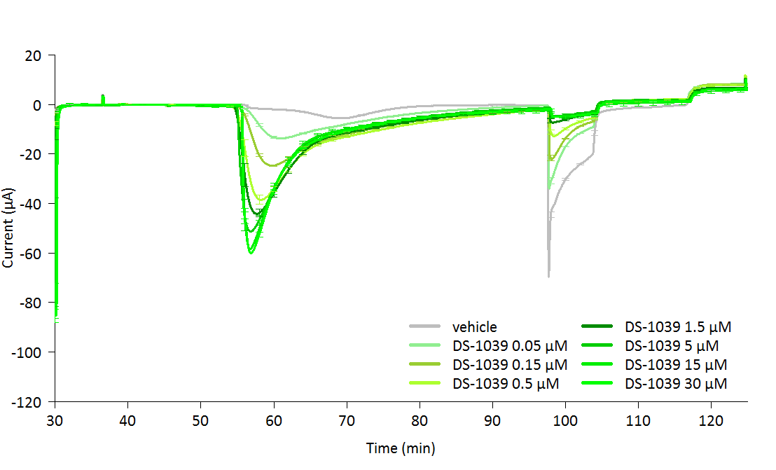
a
30 μM Amiloride
↓
Compounds
↓
ΔF508/G542X
10 μM UTP
↓
20 μM Bumetanide
↓
↑
20 μM CFTR_{inh}-172
↑
4 mM BaCl₂
(basolateral)
↑
4 mM BaCl₂
(apical)
↑
10 μM Ani9
↑
10 μM ZnSO₄
b
DS-1039 (μM)
0
0.05
0.15
0.5
1.5
5
15
30
Supplementary Figure 2 | Short circuit currents in CFBE cells with ΔF508/G542X mutation
(a) Currents were recorded from CFBE cells carrying ΔF508/G542X mutation (class II/I). (b) DS-1039 significantly induced a Cl⁻ current at concentrations as low as 0.05 μM. **P < 0.01 versus the vehicle group (Dunnett's test). Data are shown as mean ± S.E.M. (N=3).

Slide 3
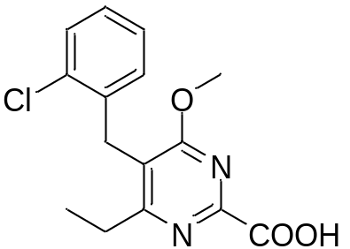
a
b
mEC₅₀ = 0.72 μM
c
d
ASB25485
ASB25485 (mg/kg)
Wild type
GPR39 knockout
Supplementary Figure 3 | GPR39 agonists dose-dependently enhance tear secretion through GPR39.
(a) Structure of DS-1039 analog [5-(2-chlorobenzyl)-4-methoxy-6-ethylpyrimidine-2-carboxylic acid]. (b) Concentration-response curve of ASB25485 with 10 μM ZnSO₄ in calcium mobilization in mouse bronchial cells. (c) Effects of ASB25485 on tear secretion in mice. Data are mean ± S.E.M., n = 8. Statistical significance was determined using Dunnett’s test. **P<0.01. (d) The mechanism of GPR39 agonist activity on tear secretion in mice was analyzed. The tear secretion-enhancing activity of GPR39 agonists was observed in WT mice, but not in GPR39 KO mice. Data are mean ± S.E.M., n = 8. Statistical significance was determined using Dunnett’s test. **: P < 0.01.

Slide 4
GPCR ID | Agonist activity | Antagonist activity
ADCYAP1R1 | 2% | 2%
ADORA3 | 1% | 9%
ADRA1B | 0% | 2%
ADRA2A | 0% | 5%
ADRA2B | -2% | -8%
ADRA2C | 0% | -4%
ADRB1 | -1% | -5%
ADRB2 | 0% | 5%
AGTR1 | -1% | 7%
AGTRL1 | 0% | 0%
AVPR1A | 0% | -2%
AVPR1B | 1% | 9%
AVPR2 | 1% | 3%
BDKRB1 | -1% | 2%
BDKRB2 | 2% | 5%
BRS3 | 1% | 5%
C3AR1 | 0% | 9%
C5AR1 | 0% | 4%
C5L2 | -1% | 3%
CALCR | -3% | 1%
CALCRL-RAMP1 | 1% | -9%
CALCRL-RAMP2 | -1% | -9%
CALCRL-RAMP3 | 3% | 9%
CALCR-RAMP2 | 3% | 9%
CALCR-RAMP3 | 0% | -2%
CCKAR | 0% | -9%
CCKBR | 1% | 3%
CCR10 | -1% | -4%
CCR1 | -3% | 3%
CCR2 | 1% | -3%
CCR3 | 1% | -14%
CCR4 | 3% | 13%
CCR5 | 1% | -7%
CCR6 | 0% | 6%
CCR7 | 2% | -1%
CCR8 | 0% | -12%
CCR9 | 1% | -1%
CHRM1 | 0% | -3%
CHRM2 | -1% | 3%
CHRM3 | 0% | 0%
CHRM4 | 3% | 11%
CHRM5 | 1% | 6%
CMKLR1 | 0% | 2%
CNR1 | 2% | 10%
CNR2 | 8% | 12%
CRHR1 | 1% | 6%
CRHR2 | 0% | 2%
CRTH2 | -1% | -1%
CX3CR1 | 0% | 7%
CXCR1 | 0% | 9%
CXCR2 | 2% | 0%
CXCR3 | -3% | -8%
CXCR4 | 7% | -11%
CXCR5 | -2% | 1%
CXCR6 | 2% | -17%
CXCR7 | 0% | 1%
GPCR ID | Agonist activity | Antagonist activity
DRD1 | -2% | 9%
DRD2L | -1% | 7%
DRD2S | 1% | 1%
DRD3 | 1% | 0%
DRD4 | -2% | 3%
DRD5 | 1% | 10%
EBI2 | 0% | -3%
EDG1 | 1% | -4%
EDG3 | 2% | 6%
EDG4 | -1% | 1%
EDG5 | 0% | 4%
EDG6 | -9% | 9%
EDG7 | -1% | -4%
EDNRA | 0% | 3%
EDNRB | 1% | 5%
F2R | 2% | 5%
F2RL1 | 1% | 1%
F2RL3 | 3% | 7%
FFAR1 | -1% | -2%
FPR1 | 0% | 14%
FPRL1 | 0% | 4%
FSHR | 3% | 2%
GALR1 | 2% | 1%
GALR2 | 0% | -2%
GCGR | 0% | 3%
GHSR | 0% | 2%
GIPR | -4% | -4%
GLP1R | 0% | 2%
GLP2R | 0% | 14%
GPR1 | 0% | 1%
GPR103 | 0% | -1%
GPR109A | -2% | -2%
GPR109B | 0% | 1%
GPR119 | 1% | -3%
GPR120 | 2% | 17%
GPR35 | 2% | 16%
GPR92 | -3% | -2%
GRPR | 0% | 9%
HCRTR1 | 0% | 1%
HCRTR2 | 0% | 5%
HRH1 | -1% | 1%
HRH2 | 3% | 16%
HRH3 | 0% | 7%
HRH4 | 0% | 4%
HTR1A | 2% | 11%
HTR1B | 7% | 3%
HTR1E | 10% | -4%
HTR1F | 1% | -2%
HTR2A | 2% | -2%
HTR2C | 0% | 12%
HTR5A | 0% | 5%
KISS1R | -1% | 7%
LHCGR | -3% | -7%
LTB4R | 0% | 12%
MC1R | -2% | 2%
MC3R | -1% | 5%
GPCR ID | Agonist activity | Antagonist activity
MC4R | 4% | 16%
MC5R | -2% | 6%
MCHR1 | 0% | 11%
MCHR2 | -2% | -5%
MLNR | 1% | 3%
MRGPRX1 | -1% | -1%
MRGPRX2 | 0% | -2%
MTNR1A | -4% | 6%
NMBR | 1% | 1%
NMU1R | 1% | 2%
NPBWR1 | 2% | 6%
NPBWR2 | 3% | 5%
NPFFR1 | -1% | 11%
NPSR1B | 1% | 10%
NPY1R | 0% | 6%
NPY2R | 0% | 3%
NTSR1 | -1% | -13%
OPRD1 | 0% | 2%
OPRK1 | 1% | 10%
OPRL1 | 1% | 2%
OPRM1 | 0% | -10%
OXER1 | -1% | 5%
OXTR | 0% | 5%
P2RY1 | -4% | 2%
P2RY11 | -1% | 0%
P2RY12 | 3% | 8%
P2RY2 | -2% | 2%
P2RY4 | 1% | 19%
P2RY6 | -1% | 0%
PPYR1 | 2% | 11%
PRLHR | -1% | 2%
PROKR1 | 1% | -1%
PROKR2 | 0% | -4%
PTAFR | -1% | -4%
PTGER2 | -2% | -8%
PTGER3 | -1% | 2%
PTGER4 | 1% | 5%
PTGFR | 0% | 8%
PTGIR | 0% | 6%
PTHR1 | 0% | 1%
PTHR2 | 0% | 3%
RXFP3 | -2% | -9%
SCTR | 1% | 3%
SSTR1 | 0% | 5%
SSTR2 | 0% | 5%
SSTR3 | 1% | 1%
SSTR5 | -1% | 3%
TACR1 | -1% | 0%
TACR2 | 1% | 4%
TACR3 | 0% | -3%
TBXA2R | -2% | -4%
TRHR | 0% | 8%
TSHR(L) | -2% | 3%
UTR2 | 0% | -3%
VIPR1 | 0% | -2%
VIPR2 | 0% | 6%
Supplementary Table 1 | Agonist and antagonist activities of 30 μM DS-1039 for 168 GPCRs
Percentage activity was calculated relative to the basal and maximal (for agonist) or EC80 (for antagonist) control agonist values for each GPCR target.

Slide 5
 | Spec. | %Inhibition
ATPase, Na+/K+, Heart, Pig | pig | 18
Cholinesterase, Acetyl, ACES | human | 8
Cyclooxygenase COX-1 | human | 2
Cyclooxygenase COX-2 | human | -11
Monoamine Oxidase MAO-A | human | -3
Monoamine Oxidase MAO-B | human | 3
Peptidase, Angiotensin Converting Enzyme | rabbit | 5
Peptidase, CTSG (Cathepsin G) | human | 4
Phosphodiesterase PDE3 | human | -12
Phosphodiesterase PDE4 | human | -6
Protein Serine/Threonine Kinase, PKC, Non-Selective | rat | -24
Protein Tyrosine Kinase, Insulin Receptor | human | -9
Protein Tyrosine Kinase, LCK | human | 14
Adenosine A1 | human | 8
Adenosine A2A | human | -2
Adrenergic α1A | rat | 22
Adrenergic α1B | rat | -4
Adrenergic α1D | human | -4
Adrenergic α2A | human | 6
Adrenergic α2B | human | 6
Adrenergic β1 | human | -4
Adrenergic β2 | human | -3
Androgen (Testosterone) | human | 1
Angiotensin AT1 | human | 1
Bradykinin B2 | human | -15
Calcium Channel L-Type, Benzothiazepine | rat | 2
Calcium Channel L-Type, Dihydropyridine | rat | 5
Calcium Channel L-Type, Phenylalkylamine | rat | 7
Calcium Channel N-Type | rat | -3
Cannabinoid CB1 | human | 15
Cannabinoid CB2 | human | -4
Chemokine CCR1 | human | -3
Chemokine CXCR2 (IL-8RB) | human | -2
Cholecystokinin CCK1 (CCKA) | human | 13
Cholecystokinin CCK2 (CCKB) | human | 25
Dopamine D1 | human | 6
Dopamine D2L | human | 2
Dopamine D2S | human | 12
Endothelin ETA | human | 11
Estrogen ERα | human | 2
GABAA, Chloride Channel, TBOB | rat | 6
GABAA, Flunitrazepam, Central | rat | -8
GABAA, Ro-15-1788, Hippocampus | rat | -15
GABAB1A | human | 12
Glucocorticoid | human | 8
Glutamate, AMPA | rat | -16
Glutamate, Kainate | rat | 1
Glutamate, Metabotropic, mGlu5 | human | 5
Glutamate, NMDA, Agonism | rat | 3
Glutamate, NMDA, Glycine | rat | 1
Glutamate, NMDA, Phencyclidine | rat | -3
Glutamate, NMDA, Polyamine | rat | 5
Glycine, Strychnine-Sensitive | rat | 5
Histamine H1 | human | 2
Histamine H2 | human | -19
Leukotriene, Cysteinyl CysLT1 | human | -8
Melanocortin MC1 | human | 2
Melanocortin MC4 | human | 2
Muscarinic M1 | human | 9
Muscarinic M2 | human | -1
Muscarinic M3 | human | 0
Muscarinic M4 | human | 3
Neuropeptide Y Y1 | human | -12
Nicotinic Acetylcholine | human | 0
Nicotinic Acetylcholine α1, Bungarotoxin | human | 4
Opiate δ1 (OP1, DOP) | human | 5
Opiate κ(OP2, KOP) | human | 9
Opiate μ(OP3, MOP) | human | 7
Platelet Activating Factor (PAF) | human | -18
Potassium Channel [KATP] | hamster | 3
Potassium Channel hERG | human | 4
PPARγ | human | 14
Progesterone PR-B | human | -1
Serotonin (5-Hydroxytryptamine) 5-HT1A | human | 0
Serotonin (5-Hydroxytryptamine) 5-HT1B | human | 9
Serotonin (5-Hydroxytryptamine) 5-HT2A | human | 9
Serotonin (5-Hydroxytryptamine) 5-HT2B | human | 3
Serotonin (5-Hydroxytryptamine) 5-HT2C | human | -13
Serotonin (5-Hydroxytryptamine) 5-HT3 | human | 0
Sodium Channel, Site 2 | rat | -21
Tachykinin NK1 | human | 9
Transporter, Adenosine | guinia pig | 3
Transporter, Dopamine (DAT) | human | 13
Transporter, GABA | rat | 3
Transporter, Norepinephrine (NET) | human | 8
Transporter, Serotonin (5-Hydroxytryptamine) (SERT) | human | 8
Vasopressin V1A | human | 3
Supplementary Table 2 | Activities of 10 μM DS-1039 for 87 primary targets in enzyme and radioligand binding assay
Percentage activity was calculated relative to the basal and maximal positive control values for each target.

Slide 6
 | CL,plasma | Vdss,plasma
 | (mL/min/kg) | (L/kg)
Mouse | 2.0 | 0.2
Rat | 0.3 | 0.2
Cynomolgus monkey | 4.1 | 0.3
Human | 1.16 | 0.364
Supplementary Table 3 | PK parameters in animals and estimated PK parameters in human

