Slide 1
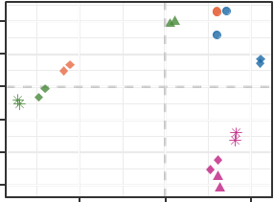
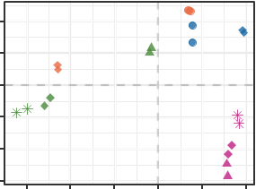
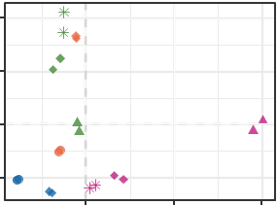
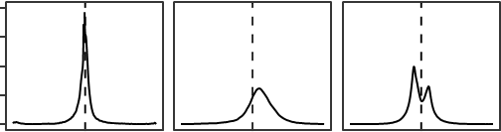
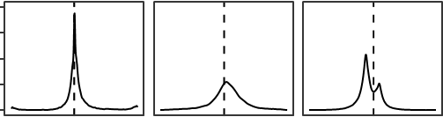
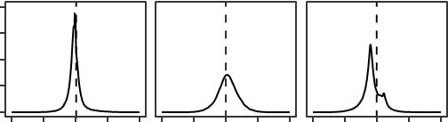
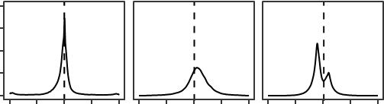
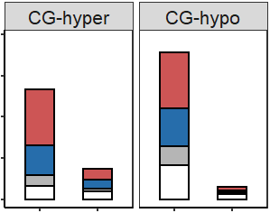
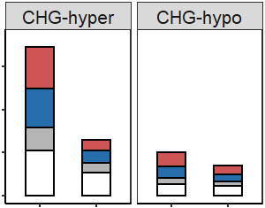
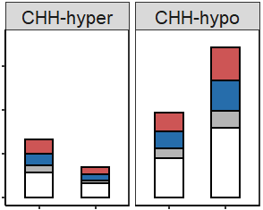
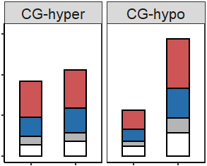
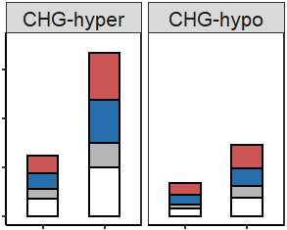
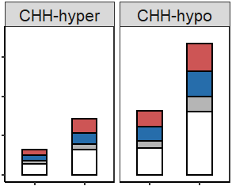
a
mCG
mCHG
mCHH
20
MZ-GE
SY-GE
20
MZ-GE
SY-Z
20
MH-E
MZ-Z
MH63
MH-S
MH-S
SY-GE
ZS97
10
MZ-Z
SY-Z
10
MZ-Z
MH-Z
SY63
0
10
MZ
PC2 (32.53%)
MH-Z
0
PC2 (15.06%)
MH-S
−10
MH-E
PC2 (27.74%)
MH-Z
ZS-E
0
ZS-S
Cell type
ZS-E
−10
MH-E
MZ-GE
Egg
−20
ZS-Z
ZS-Z
SY-GE
Sperm
ZS-S
−20
ZS-S
−10
ZS-Z
Zygote
−30
−30
SY-Z
ZS-E
GE
−20 0 20
−30 −20 −10 0 10 20
0 20 40
b
PC1 (42.56%)
PC1 (38.13%)
PC1 (21.04%)
mCG
mCHG
mCHH
c
mCG
mCHG
mCHH
8
MH (E–S)
8
MH (E) –ZS (S)
6
6
Density
4
4
2
2
0
0
8
ZS (E–S)
8
ZS (E) –MH (S)
6
6
Density
4
4
2
2
0
0
–1
0
1
–1
0
1
–1
0
1
–1
0
1
–1
0
1
–1
0
1
d
Fractional difference
Fractional difference
8000
7130
9000
10354
75000
85460
Gene
5347
50000
48202
Intergenic
4000
6000
TE-gene
DMR numbers
3881
3047
2112
25000
32961
TE
1485
625
3000
17163
0
0
0
MH (E ̶ S)
ZS (E ̶ S)
MH (E ̶ S)
ZS (E ̶ S)
MH (E ̶ S)
ZS (E ̶ S)
MH (E ̶ S)
ZS (E ̶ S)
MH (E ̶ S)
ZS (E ̶ S)
MH (E ̶ S)
ZS (E ̶ S)
15000
14411
15000
16689
90000
100502
10000
9197
10611
10000
60000
DMR numbers
5643
6198
7250
42831
48747
5000
5000
3420
30000
19663
0
0
0
ZS (E) ̶ MH (S)
MH (E) ̶ ZS (S)
ZS (E) ̶ MH (S)
ZS (E) ̶ MH (S)
MH (E) ̶ ZS (S)
ZS (E) ̶ MH (S)
ZS (E) ̶ MH (S)
MH (E) ̶ ZS (S)
MH (E) ̶ ZS (S)
MH (E) ̶ ZS (S)
MH (E) ̶ ZS (S)
ZS (E) ̶ MH (S)
Extended Data Figure 1. DNA methylomes of inbred and/or hybrid rice gametes, zygotes, and globular embryos. (a) PCA analysis of DNA methylomes of gametes, zygotes and globular embryos (GE) of MH63 and ZS97 inbred and hybrid lines. Different rice varieties are denoted by colors, different cell-types by shapes. (b) Density plot of methylation difference at 50-bp windows between sperm and egg of MH63 [MH (E ̶ S ),upper panel] and ZS97 [ZS (E ̶ S ), lower panel]; (c) methylation levels between MH63 egg and ZS97 sperm [MH (E) ̶ ZS (S), upper panel], and between ZS97 egg and MH63 sperm [ZS (E) ̶ MH (S), lower panel]. (d) DMR numbers of 50-bp windows of egg versus sperm in MH63 and ZS97(upper, in the same genotypes; lower, between the 2 genotypes). DMRs in gene body, intergenic, TE-genes and TEs are indicated by red, blue, grey and white, respectively.

Slide 2
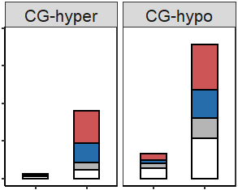
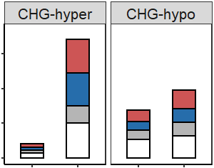
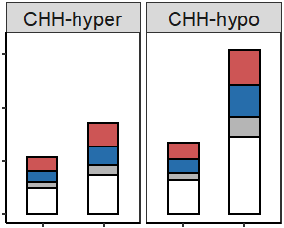
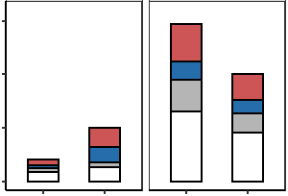
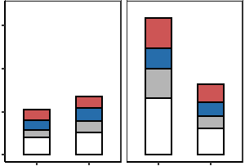
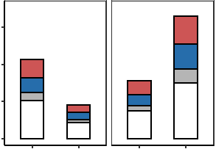
a
Gene
TE
b
mCG
mCHG
mCHH
1.0
1.0
6
MH (Z–E)
0.8
0.8
4
mCG
0.6
0.6
Density
0.4
0.4
2
0.2
0.2
0
MH (Z–S)
0
0
4
0.25
1.0
Density
0.20
0.8
2
mCHG
0.15
0.6
0
0.10
0.4
4
ZS (Z–E)
0.05
0.2
Density
0
0
2
0.10
0.5
0
0.08
0.4
ZS (Z–S)
0.06
0.3
mCHH
0.2
4
0.04
Density
0.02
0.1
2
0
S
E
Z
S
E
Z
0
S
E
Z
S
E
Z
0
–1
0
1
MH63
ZS97
MH63
ZS97
–1
0
1
–1
0
1
c
Fractional difference
12000
10685
9000
10246
60000
61451
9000
5852
40000
34303
DMR numbers
5384
6000
MH63
6000
4130
20000
21618
26989
3000
385
1970
3000
1256
0
0
0
3000
2941
6000
6342
60000
65760
2000
2010
4000
3265
40000
42705
DMR numbers
1011
2101
2713
18174
31006
ZS97
1000
409
2000
20000
0
Z–E
Z–S
Z–E
Z–S
0
Z–E
Z–S
Z–E
Z–S
0
Z–E
Z–S
Z–E
Z–S
Gene
Intergenic
TE-gene
TE
Extended Data Figure 2. DNA methylation in the gametes and zygotes of the hybrid parental lines. (a) Boxplots showing the CG, CHG, and CHH methylation levels in genes and transposable elements (TEs) of sperm (S), egg (E) and zygote (Z) cells of the MH63 and ZS97 varieties. Values are averages from the two replicates. (b) Density plot showing the frequency distribution of methylation difference at 50-bp windows between zygote and egg (Z – E) and between zygote and sperm (Z – S) in MH63 (MH) and ZS97 (ZS). (c) Differentially methylated regions (DMRs) between zygote and egg (Z – E), and between zygote and sperm (Z – S) in MH63 (upper panel) and ZS97 (lower panel). DMRs numbers and distributions (gene body, red; intergenic, blue; TE-genes, grey; and TE, white) are indicated.

Slide 3
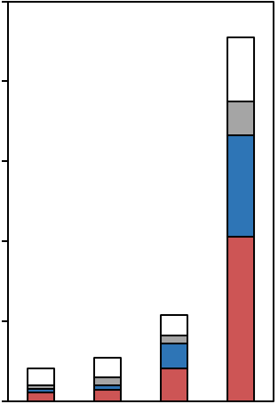
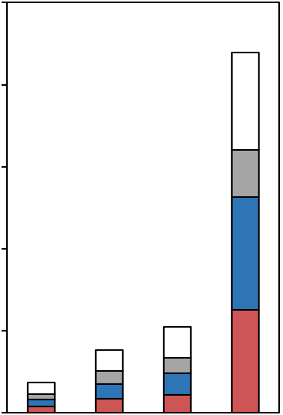
a
Zygote vs Egg
b
Zygote vs Sperm
CG
590
199
180
2664
265
138
CG
11575
533
465
13935
2198
2973
(52.5%)
(65.8%)
(53.4%)
(42.5%)
CHG
2233
362
861
9001
749
1297
CHG
9289
1021
1626
26528
4293
5672
(29.6%)
(36.6%)
(38.6%)
(43.1%)
MZ (Z) – MH (E)
SY (Z) – ZS (E)
MZ (Z) – ZS (S)
SY (Z) – MH (S)
MH (Z) – MH (E)
ZS (Z) – ZS (E)
ZS (Z) – ZS (S)
MH (Z) – MH (S)
c
Hyper CG DMR
Hyper CHG DMR
2500
2198
5000
4293
Number of DMRs
Number of DMRs
199
265
533
362
749
1021
0
0
SY (Z) – ZS (E)
SY (Z) – ZS (E)
MZ (Z) – MH (E)
MZ (Z) – ZS (S)
SY (Z) – MH (S)
MZ (Z) – MH (E)
MZ (Z) – ZS (S)
SY (Z) – MH (S)
Gene
Intergenic
TE-gene
TE
Extended Data Figure 3. Conserved DMRs between inbred and hybrid zygotes relative to the gametes. (a) Venn diagrams showing the overlapping of hyper DMRs between hybrid zygotes (MZ zygote [MZ (Z)], SY63 zygote [SY (Z)]) and inbred zygotes (ZS97 zygote [ZS (Z)], MH63 zygote [MH (Z)]) versus female gametes (ZS97 egg [ZS (E)], MH63 egg [MH (E)]); (b) overlapping of hyper DMRs between hybrid zygotes (MZ zygote [MZ (Z)], SY63 zygote [SY (Z)]) and inbred zygotes (ZS97 zygote [ZS (Z)], MH63 zygote [MH (Z)]) versus male gametes (ZS97 sperm [ZS (S)], MH63 sperm [MH (S)]). (c) Numbers of the overlapping hyper DMRs between hybrid zygote and inbred zygote versus gametes. DMRs in gene body, intergenic, TE-gene and TE regions are denoted by red, blue, grey and white, respectively.

Slide 4
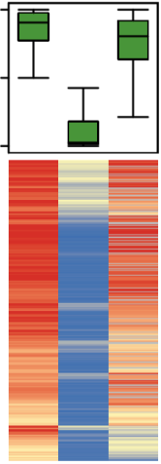
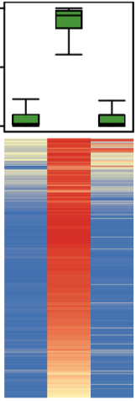
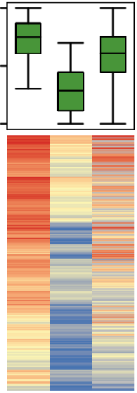
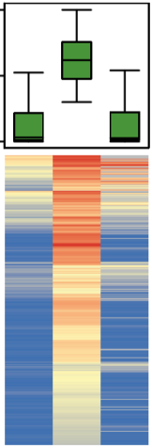
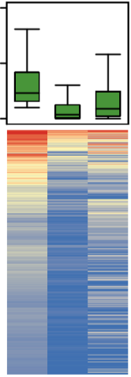
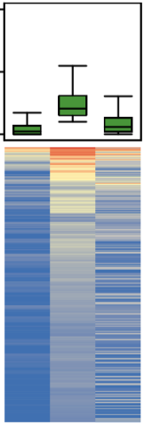

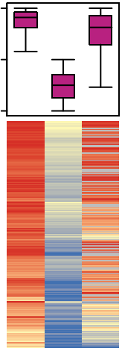
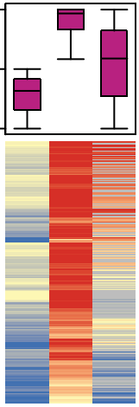
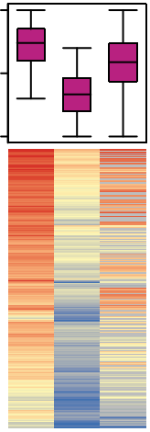
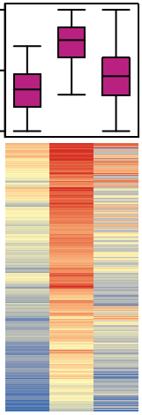
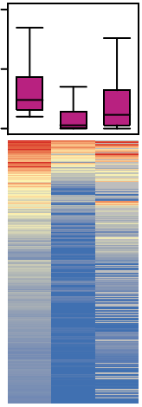
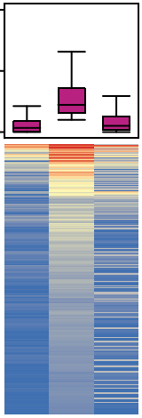
a
mCG
mCHG
mCHH
1
n = 5347
n = 7130
1
n = 10354
n = 3047
1
n = 32961
n = 48202
0.5
0.5
0.5
0
0
0
mC
1
MH63
0.5
0
Egg
Egg
Egg
Egg
Egg
Egg
Sperm
Sperm
Sperm
Sperm
Sperm
Sperm
Zygote
Zygote
Zygote
Zygote
Zygote
Zygote
b
mCG
mCHG
mCHH
1
n = 1485
n = 625
1
n = 3881
n = 2112
1
n = 17163
n = 85460
0.5
0.5
0.5
0
0
0
ZS97
Egg
Egg
Egg
Egg
Egg
Egg
Sperm
Sperm
Sperm
Sperm
Sperm
Sperm
Zygote
Zygote
Zygote
Zygote
Zygote
Zygote
Extended Data Figure 4. Zygotic methylation levels of the egg versus sperm DMRs in MH63 and ZS97.
Boxplots and heatmaps showing the methylation levels of the egg-sperm DMRs in egg, sperm, and zygote of MH63 (a) and ZS97 (b). The numbers (N) of DMRs between egg and sperm at CG, CHG, and CHH contexts are indicated.

Slide 5
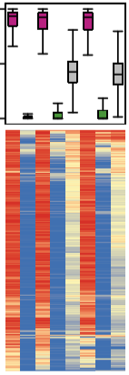
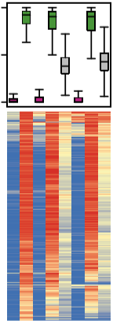
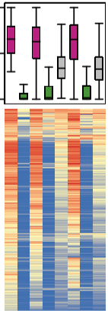
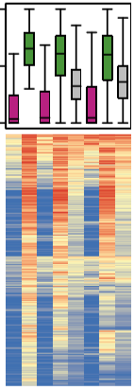
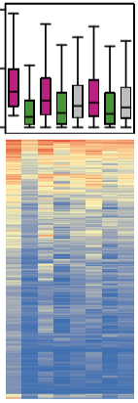
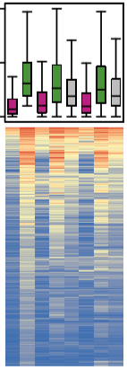
CG DMRs
CHG DMRs
CHH DMRs
9311 > NIP
9311 < NIP
9311 > NIP
9311 < NIP
9311 > NIP
9311 < NIP
1
(n = 9315)
(n = 5858)
1
(n = 6482)
(n = 6220)
1
(n = 9824)
(n = 9250)
0.5
0.5
0.5
0
0
0
mC
1
0.5
0
Nip
N9
9N
Nip
N9
9N
Nip
N9
9N
Nip
N9
9N
Nip
N9
9N
Nip
N9
9N
9311
9311
9311
9311
9311
N9 (Nip)
9311
N9 (Nip)
9N (Nip)
N9 (Nip)
9N (Nip)
N9 (Nip)
9N (Nip)
N9 (Nip)
9N (Nip)
N9 (9311)
9N (Nip)
N9 (Nip)
9N (Nip)
9N (9311)
9N (9311)
9N (9311)
9N (9311)
N9 (9311)
N9 (9311)
N9 (9311)
N9 (9311)
9N (9311)
N9 (9311)
9N (9311)
Extended Data Figure 5. Maintenance of parental allelic-specific methylations in the reciprocal hybrids of NIP and 9311. Boxplots and heatmaps showing the paternal and maternal methylation levels of the DMRs between Nip and 9311 in the reciprocal hybrids N9 (Nip×9311, Nip as female and 9311 as male) and 9N (9311×Nip, 9311 as female and Nip as male). N9 (9311) indicated paternal-allele-specific methylation in NIP×9311, N9 (Nip) indicated maternal-allele-specific methylation in Nip×9311, 9N (Nip) indicate paternal-allele-specific methylation in 9311×Nip, 9N (9311) indicate maternal-allele-specific methylation in 9311×Nip. The numbers (N) of the hyper (9311 > Nip) or hypo (9311 < Nip) DMRs between 9311 and Nip at CG, CHG and CHH contexts are indicated.

Slide 6
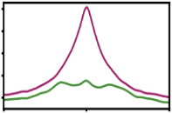
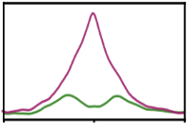
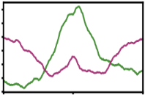
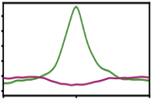
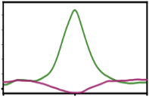
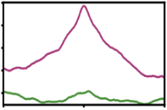
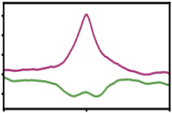
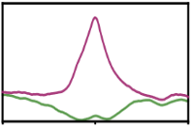
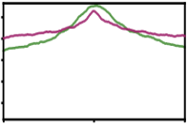
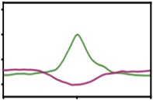
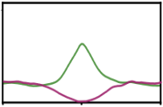









a
H3K27ac
H3K4me3
H3K9me2
120
40
MH
ZS
Egg (MH) > Sperm (ZS)
40
30
CG-DMRs (n = 8,850)
Relative enrichment
120
70
Egg (MH) < Sperm (ZS)
20
40
CG-DMRs (n = 5,487)
–2Kb
Centre
2Kb
–2Kb
Centre
2Kb
b
H3K27ac
H3K4me3
H3K9me2
60
60
MH
ZS
Egg (MH) > Sperm (ZS)
20
20
CHG-DMRs (n = 6,063)
Relative enrichment
80
80
Egg (MH) < Sperm (ZS)
20
20
CHG-DMRs (n = 3,319)
–2Kb
Centre
2Kb
–2Kb
Centre
2Kb
c
Chr01:24213400-24213900
Chr01:36422650-36422950
Chr02:9518400-9518600
Chr06:6537100-6537250
ZS-E
MH-S
SY-Zygote
SY-Z
mat
mCG
pat
SY-GE
SY-GE
mat
pat
ZS-Se
MH-Se
H3K4me3
SY-Se
mat
pat
d
OsMH_01G0376900
OsMH_01G0571900
OsMH_02G0153200
OsMH_06G0112400
ZS-E
Chr09:6781250-6781700
Chr08:17448700-17449050
Chr10:19591150-19591500
Chr07:10018850-10019100
MH-S
SY-Zygote
SY-Z
mat
mCG
pat
SY-GE
SY-GE
mat
pat
ZS-Se
MH-Se
H3K4me3
SY-Se
mat
pat
OsMH_09G0103900
OsMH_08G0251900
OsMH_10G0292500
OsMH_07G0176500
Extended Data Figure 6. Parental allelic-specific methylations associated with specific histone marks in the parental lines. (a, b) H3K27ac, H3K4me3 and H3K9me2 modifications of the CG (a) and CHG (b) DMRs between MH63 egg and ZS97 sperm MH63 and ZS97 seedlings, upper panel indicate the hyper DMRs (MH63 Egg > ZS97 Sperm), lower panel indicate the hypo DMRs (MH63 Egg < ZS97 Sperm). (c, d) Genome browser screenshots showing the paternal (pat) and maternal (mat) allelic-specific methylation in hybrid SY63 zygote and globular embryo (GE) and H3K4me3 in MH63, ZS97, and SY63 seedling (Se) of the CG hyper (c) and hypo (d) DMRs between MH63 sperm and ZS97 egg. ZS egg (ZS-E), MH sperm (MH-S), SY63 Zygote (SY-Z), SY63 globular embryo (SY-GE), maternal (mat) and paternal (pat) alleles of SY63 Zygote, GE, and seedling (Se). H3K4me3 ChIP-seq signal (RPKM scale 0 to 600). Magenta for data from ZS97, Green for data from MH63.

Slide 7
























a
9311
NIP
9311×NIP
NIP×9311
9311
4
NIP
9311 > NIP
2
CG-DMRs
(n = 77,701)
0
H3K4me3 relative enrichment
3
9311 < NIP
2
CG-DMRs
(n = 59,895)
1
0
b
–2Kb
Centre
2Kb
NIP
–2Kb
Centre
2Kb
9311
9311×NIP
NIP×9311
9311
4
NIP
2
9311 > NIP
CHG-DMRs
(n = 44,899)
0
3
H3K4me3 relative enrichment
2
9311 < NIP
1
CHG-DMRs
(n = 41,477)
0
c
–2Kb
Centre
2Kb
NIP
–2Kb
Centre
2Kb
3
9311
9311×NIP
NIP×9311
9311
2
NIP
9311 > NIP
1
CHH-DMRs
(n = 38,352)
0
H3K4me3 relative enrichment
4
9311 < NIP
2
CHH-DMRs
(n = 22,968)
0
–2Kb
Centre
2Kb
–2Kb
Centre
2Kb
Extended Data Figure 7. H3K4me3 levels of the DMRs between NIP and 9311 in the parental lines and the reciprocal hybrids. H3K4me3 levels of the CG (a), CHG (b), and CHH (c) DMRs between 9311 and NIP in 9311, NIP, 9311×NIP and NIP×9311 plants. Upper panels, hyper-DMRs (9311 > NIP); lower panels, hypo-DMRs (9311 < NIP). In the hybrids, the parental allele-specific H3K4me3 levels are shown.

Slide 8




a
ZS-S1
1
ZS-S2
0.9
ZS-S3
0.8
MH-S1
0.7
MH-S2
0.6
MH-S3
0.5
SY-GE3
SY-GE1
SY-GE2
MH-E1
MH-E2
MH-E3
ZS-E3
ZS-E1
ZS-E2
SY-Z1
SY-Z2
SY-Z3
MZ-GE3
MZ-GE1
MZ-GE2
MZ-Z3
MZ-Z1
MZ-Z2
ZS-S1
ZS-S2
ZS-S3
ZS-E3
ZS-E1
ZS-E2
SY-Z1
SY-Z2
SY-Z3
MZ-Z3
MZ-Z1
MH-E1
MZ-Z2
MH-E2
MH-S1
MH-E3
MH-S2
MH-S3
SY-GE3
SY-GE1
SY-GE2
MZ-GE3
MZ-GE1
MZ-GE2
b
MH63
ZS97
SY63
MZ
c
SY-Z vs. ZS-E
MZ-Z vs. MH-E
Egg
GE
Sperm
Zygote
200
2199
2611
6118
6636
20
150
10
–log10 (padj)
PC2 (9%)
100
0
–10
50
–20
–25
0
25
50
75
0
PC1 (81%)
–10
–5
0
5
10
–10
–5
0
5
10
d
log2 (Fold Change)
SY-Z up
(2611)
2010
601
6035
MZ-Z up
(6636)
SY-Z down
(2199)
1515
685
5434
MZ-Z down
(6118)
ethylene−activated signaling pathway
protein−chromophore linkage
DNA replication
photosynthesis
programmed cell death
photosynthesis, light harvesting in PS I
DNA unwinding involved in DNA replication
circadian rhythm
DNA replication initiation
protein refolding
microtubule cytoskeleton organization
photosynthesis, light harvesting
DSB repair via break-induced replication
hexose metabolic process
calcium-mediated signaling
response to heat
mitotic cell cycle
L−arabinose metabolic process
cell morphogenesis
PS II assembly
0
female meiotic nuclear division
0
2
4
6
1
2
3
4
−log10 (P-value)
−log10 (P-value)
Extended Data Figure 8. Transcriptomic analysis of the reciprocal hybrid zygotes. (a) Heatmap and Spearman coefficients of RNA-seq replicates of MH63 sperm (MH-S) and egg (MH-E), ZS97 sperm (ZS-S) and egg (ZS-E), SY63 zygote (SY-Z) and globular embryo (SY-GE), and MZ zygote (MZ-Z) and globular embryo (MZ-GE). Three biological replicates are shown. (b) PCA analysis of transcriptomes of MH63 and ZS97 sperm and egg cell and the reciprocal hybrids (SY63 and MZ) zygotes as well as globular embryos. For each sample, three biological replicates were produced. (c) Volcano-plot showing the differentially expressed genes (DEGs) identified in SY63 zygote versus ZS97 egg (upper), MZ zygote versus MH63 egg (lower). |log2 (Fold Change)| > 1 and p-adj < 0.01. (d) Venn diagrams and GO enrichment analysis of the commonly up-regulated (n = 601) and downregulated (n = 684) genes in hybrid zygotes versus eggs (SY63 zygote versus ZS97 egg and MZ zygote versus MH63 egg).

Slide 9




a
4500
3000
1500
0
Kita-Z_up
Nip-Z_up
DJ-Z_up
SY-Z_up
MZ-Z_up
6000
3000
0
b
SY63
MZ
Nip
Kitaake
Cluster 1
H2A.6
Z-score
–1
0
1
POLD1
H2A.5
CML12
OsWD40-20
RBOHA
WOX5
PHI1
HTA710/H2A
MEL1/AGO
Cluster 2
MCM6
CENH3
HOX2
CycB2.2
TET12
SAUR33
OsDRW1
CIPK16
OsCMT3a
OsHDA714
MCM7
IAA30
H2B.10
H2B.5
RALF3
LEA9
CDPK2
HOP2
RLCK153
Cluster 3
KRP1
POLA4
RNRS2
AGP7
OsMET1b
HTB712
OsGCS1L
MCM10
RBOHI
ZS-E
H2A.8
SY-Z
ZS-S
MZ-Z
Nip-Z
Nip-S
MH-S
MH-E
Nip-E
Kita-S
Kita-Z
Kita-E
Extended Data Figure 9. Analysis of hybrid zygote transcriptomes. (a) Upset-plot showing the overlapping up-regulated genes in Kitaake (Kita-Z, Anderson et al., 2017), Nipponbare (Nip-Z, Rahman et al., 2019), Donjin (DJ-Z, Zhou et al., 2021), SY63 (SY-Z) and MZ (MZ-Z) zygotes versus egg. (b) Heatmap showing the zygotic expressed genes (n = 601, up-regulated genes in the zygotes versus egg) commonly detected in SY63 and MZ zygotes.

Slide 10




a
b
MEGs (1063)
SY63 Zygote
Z-score
1
0.5
0
– 0.5
– 1
MZ Zygote
ZS-E
MH-S
SY-Z
SY(mat)
SY(pat)
MH-E
ZS-S
MZ-Z
MZ(mat)
MZ(pat)
c
mCG
mCHG
mCHH
0.6
0.4
0.15
MH-E
ZS-S
0.4
0.2
MZ
0.2
0
0
0
0.8
0.6
0.15
ZS-E
MH-S
0.4
SY63
0
2kb
0
2kb
0
2kb
-2kb
TSS
TES
-2kb
TSS
TES
-2kb
TSS
TES
d
9.3e−08
5.4e−09
e
0.6
MZ
SY63
0.15
0.4
0.10
0.4
mCHH
mCHH of MEGs promoter
0.05
0.2
0
0
-2kb
TSS
TES
2kb
-2kb
TSS
TES
2kb
0
Maternal
Paternal
MH-E
ZS-S
ZS-E
MH-S
Extended Data Figure 10. DNA methylation levels of the maternal expressed genes (MEG) in the reciprocal hybrid zygotes. (a) Percentages of the paternal and maternal allelic-specific reads separated from the hybrid zygotes (upper, SY63, lower, MZ). (b) Heatmap showing expression patterns of the MEGs identified in reciprocal hybrid zygotes. (c) Metaplots showing DNA methylation levels of the zygotic MEGs (n = 1063) in parental gametes (MH63 egg [MH-E], ZS97 sperm [ZS-S], ZS97 egg [ZS-E], MH63 sperm [MH-S]). (d) Violin plots showing the CHH methylation of the zygotic MEGs (n = 1063) at promoter regions in parental gametes. P-value is calculated by the two-tail t-test. (e) Metaplots showing the parental allelic-specific methylation of the zygotic MEGs at CHH context in SY63 and MZ zygotes.

Slide 11






a
SY (GE) P-ASEGs (903)
MZ (GE) P-ASEGs ( 1150)
b
SY (GE) M-ASEGs (1883)
MZ (GE) M-ASEGs (1680)
Z-score
1
0.5
0
– 0.5
– 1
ZS-E
MH-S
SY-GE
SY (pat)
MH-E
ZS-S
ZS-E
MH-S
SY-GE
SY (pat)
MH-E
ZS-S
MZ-GE
MZ (pat)
SY (mat)
MZ-GE
MZ (pat)
SY (mat)
MZ (mat)
MZ (mat)
c
GE
d
20
350
182
PEG
GE-MEGs (350)
Zygote-PEGs (28)
10
MEG
254
28
log₂(SY_{zs97}/SY_{mh63})
MH or ZS enriched
0
0
0
0
Other
66
0
0
931
-10
0
0
96
0
0
-20
313
102
GE-PEGs
(102)
36
Zygote-MEGs
(1063)
-20
-10
0
10
20
log₂(MZ_{zs97}/MZ_{mh63})
e
Sperm
Egg
Zygote
f
CMT3a
400
Sperm
Egg
CMT3b
300
2.5h Zygote
5h Zygote
9h Zygote
MET1b
TPM
SDG714/KYP
200
DRM2
DDM1a
100
1
2
3
1
2
3
1
2
3
1
2
3
1
2
3
1
2
3
DDM1b
0
MH63
ZS97
MH63
ZS97
SY63
MZ
CMT3a
CMT3b
MET1b
DRM2
OsDDM1a
OsDDM1b
Z-score
SDG714/KYP
-2
0
2
Extended Data Figure 11. Identification of PEGs and MEGs in the reciprocal hybrid globular embryos. (a) Heatmap showing the paternal allelic-specific expressed genes (P-ASEGs; SY63 [n = 903], MZ [n = 1150]) and (b) maternal allelic-specific expressed genes (M-ASEGs; SY63 [n = 1883], MZ [n = 1680]) in hybrid globular embryos (GEs). (c) Identification of GE PEGs and MEGs by scattering analysis of the paternal ASE genes in the reciprocal hybrids (SY63 and MZ). (d) Venn diagrams showing the overlapped PEGs and MEGs between zygotes and GEs in SY63 and MZ. (e) Heatmap showing the expression patterns of the DNA methyltransferase genes (CMT3a/b, MET1b, KYP, DRM2, DDM1a/b) in gametes and the reciprocal hybrid zygotes of MH63 and ZS97. Three replicates are shown. (f) Gene expression levels of DNA methylation –related enzymes (CMT3a/b, MET1b, KYP, DRM2, DDM1a/b) in rice sperm, egg, and zygote (2.5 hap, 5 hap, 9 hap) RNA-seq data reported by Anderson et al., (2017). Error bars indicate means ± SD (n = 3).

