Slide 1
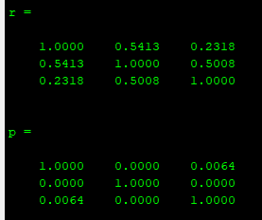
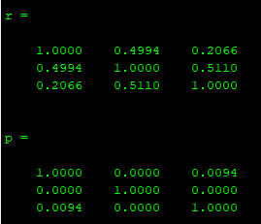
a Bid variability within session
*
*
*
1
*
*
*
*
*
0.3
0.8
0.6
0.2
0.4
Mean Absolute
Deviation (ml H₂O)
rho
0.2
0
0.1
-0.2
-0.4
0
-0.6
Low
Med
High
-0.8
L:M
M:H
L:H
Reward magnitude
Rew. Mag. comparison
L
Bids
H
Notes:
Figure S1. Bid characteristics a, Bid variability within session. b, Within-session bid coherence. c, Bid coherence between sessions. d, Cross-validated mean squared error for lasso regression model. A lasso model was used to eliminate task-irrelevant variables. The arrows indicate the lambda value that is one standard error above the minimum cross-validataed error. This value was used as a cutoff; variables from this model were used in the mixed-effects model in figure 1 and in e. e, Mixed effects model controlling for reward magnitude. Mixed effects model identical to that in figure 1 with reward magnitude was included as a random effect. This model shows the contribution of relevant task variables to bid behavior independent of reward magnitude.

