Slide 1





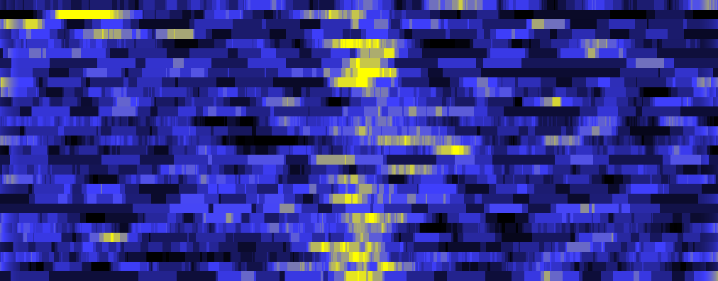
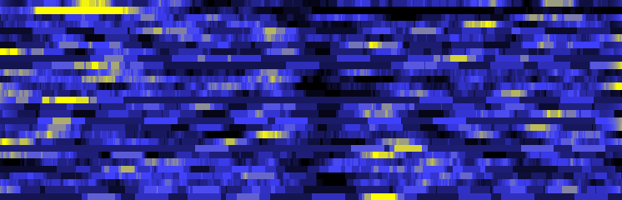
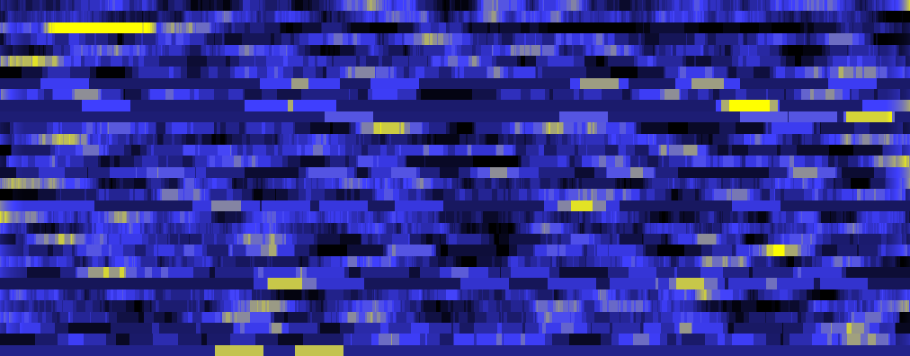
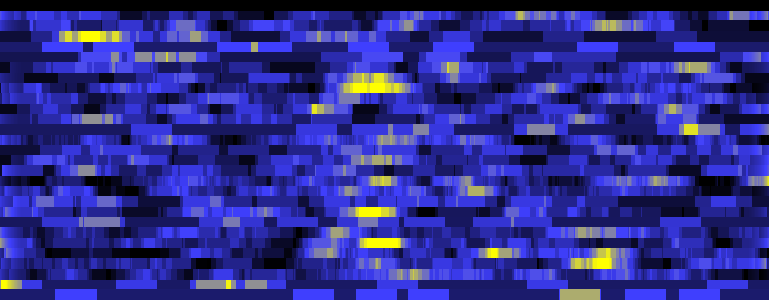

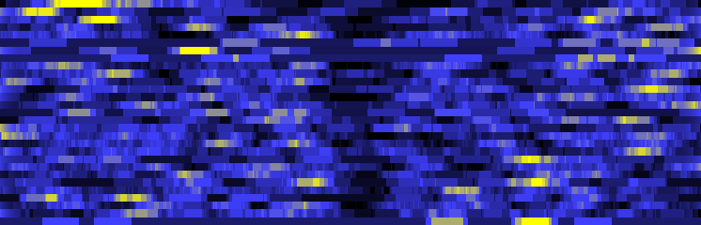
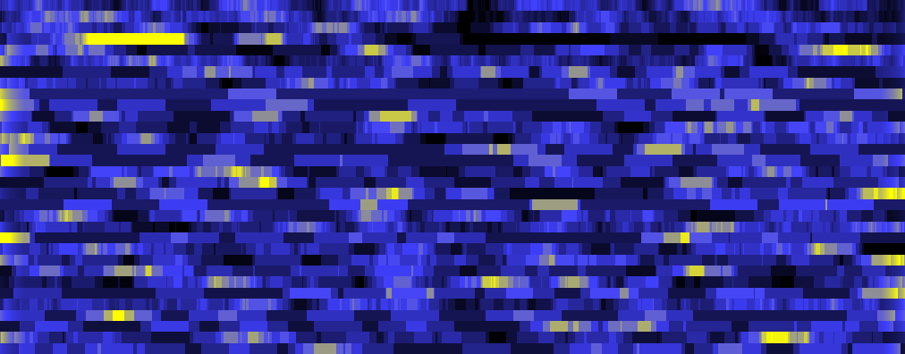
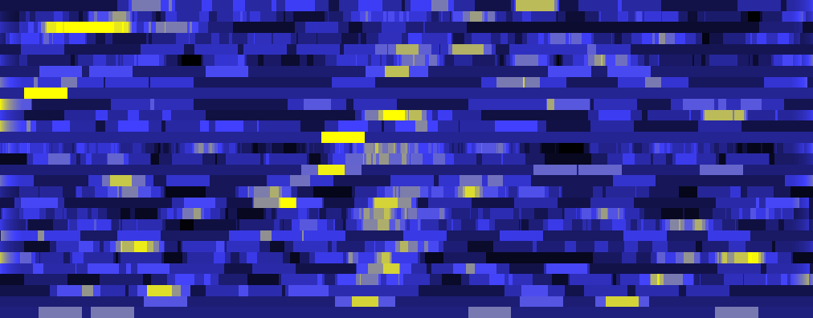

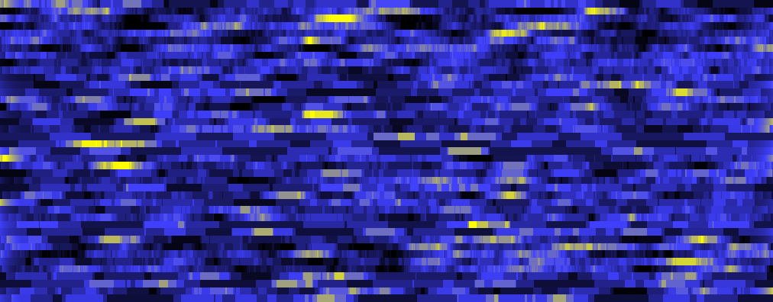
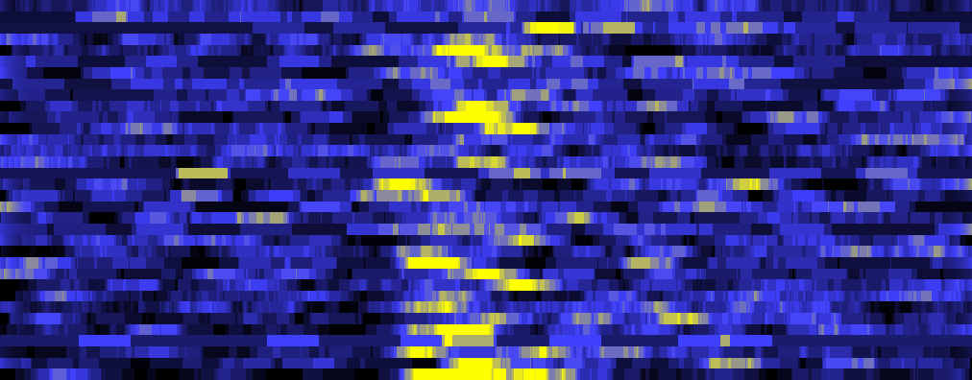
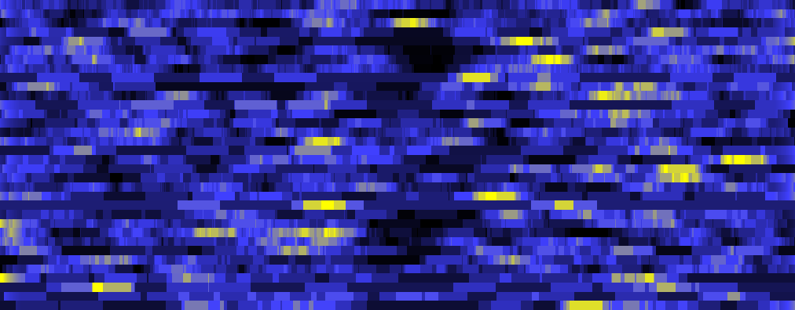
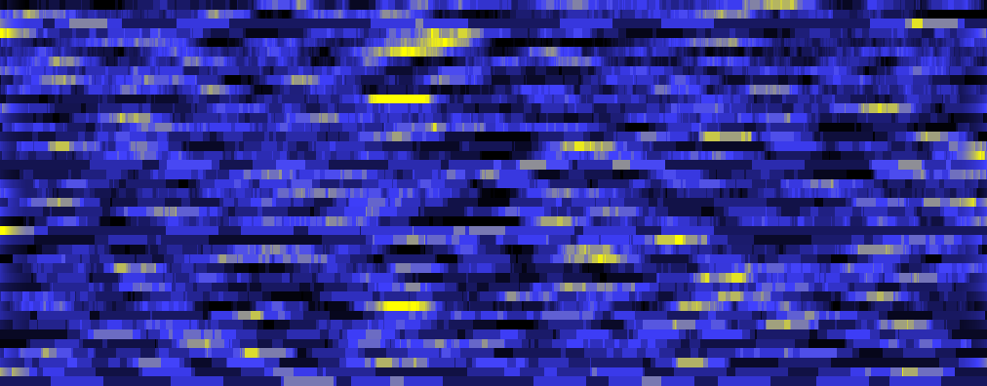
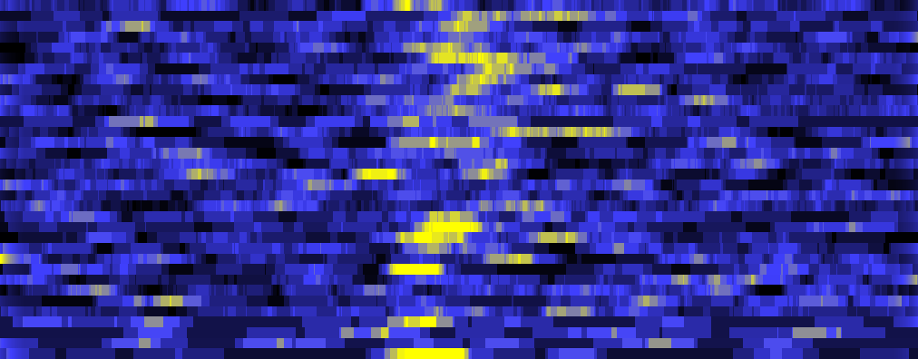
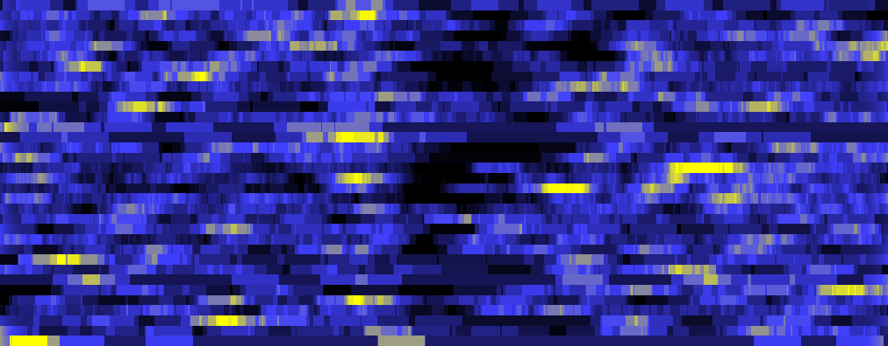


Figure S6
a
b
c
Low Rew.
Med Rew.
High Rew.
0.05
0.2
L
Bids
H
0.1
0.1
0
0
-0.1
-0.05
0
25
30
25
15
20
15
5
10
5
25
30
25
0.4
15
20
15
0.2
5
10
5
0
25
30
-0.2
20
25
15
10
15
5
5
d
-0.5
0
Time (s)
0.5
1
e
-0.5
0
Time (s)
0.5
1
f
-0.5
0
Time (s)
0.5
1
0.05
0.1
0.2
L
Bids
H
0
0.05
0.1
-0.05
0
0
-0.1
-0.05
40
40
40
30
30
30
20
20
20
10
10
10
40
40
40
0.4
30
30
30
0.2
20
20
20
0
10
10
10
-0.2
40
40
40
30
30
30
20
20
20
10
10
10
-0.5
0
Time (s)
0.5
1
-0.5
0
Time (s)
0.5
1
-0.5
0
Time (s)
0.5
1
Notes:
Figure S5: Average traces for each bid-coding neuron for thirds of the bid-space within each reward magnitude (a, low; b, mid; c, high) for Monkey V (a-c) and Monkey U (d-e). Average responses from the lowest third are shown at the bottom to the highest third at the top.

