Slide 1
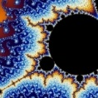

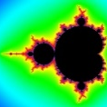

Figure S1
PEe
PEe
Te
PEe
Te
Te
Remaining water budget
Fraction water sacrificed (paid)
Low
Med
High
Monkey bid
Win
Reward magnitude
Competing bid
Trial start
Reward cue
Monkey bidding
Loss
Trial duration (~10-15 s)
Time
Notes:
Figure S7: Task events. Relevant task events are shown as Te; Prediction Error events are denoted as PEe.
Wolfram: I will add the second half of this figure illustrating the response for each relevant prediction error event (PEe) in January. Figures are made but they need to be cleaned up for the publication.

