Slide 1
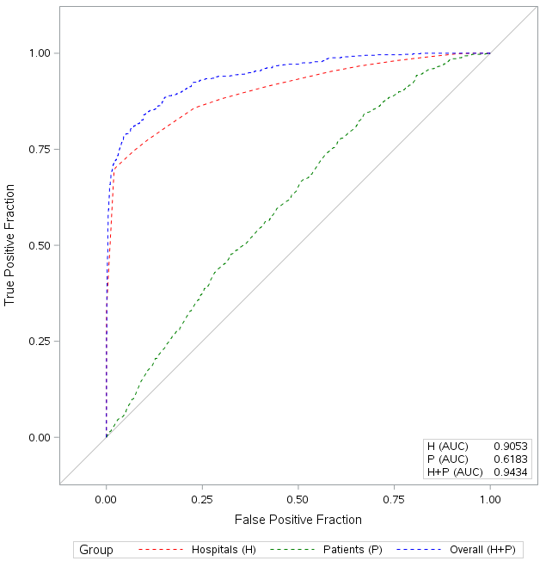
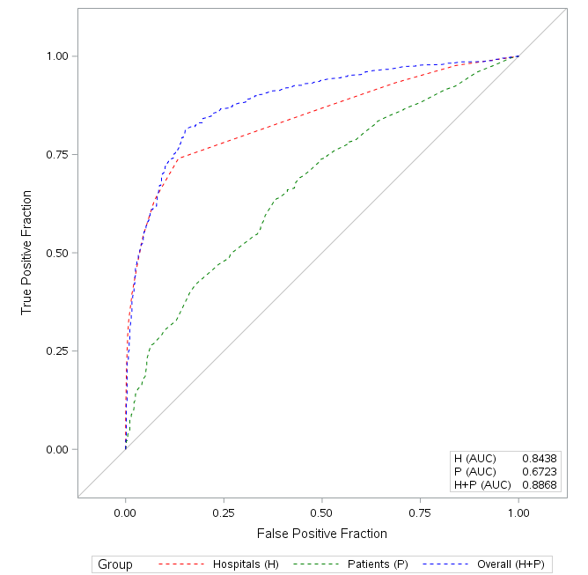
Figure S3 (a,b). ROC curves by comparison groups.
a. 1st comparison: CsA vs TAC
b. 2nd comparison: AntiM vs mTOR (Tac-based therapies)

