Slide 1
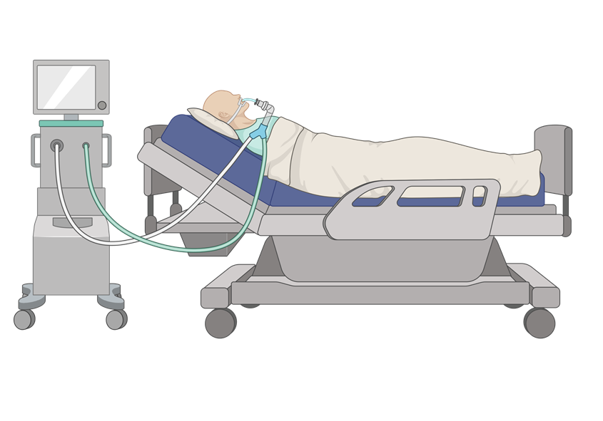


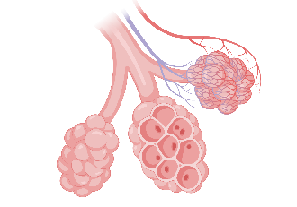
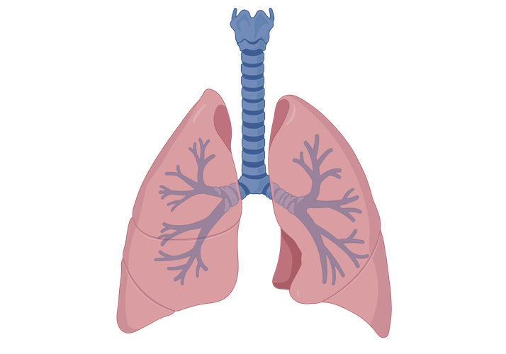
THE IMPACT OF RIGHT VENTRICULAR DYSFUNCTION (RVD) ON THE MORTALITY IN PATIENTS WITH ACUTE RESPIRATORY DISTRESS SYNDROME?
SYSTEMATIC REVIEW AND META-ANALYSIS
N = 9 studies (1861 patients)
1990 – 2020
  5 prospective observational
  2 retrospective
  2 post hoc of RCT
Mortality
  All patients 36.65%
  RVD group 40.66%
  Non-RVD 34.22%
The odd’s ratio of mortality in ARDS with RVD was 1.45.
Need for validated definition to identify RVD in critically ill.
Modalities to diagnose RVD
  2 studies PAC
  4 studies TTE
  1 study TEE
  2 studies either TTE/TEE
391/1861 (21%) had RVD
SEARCH TERMS
RESULTS
DISCUSSION

