Slide 1
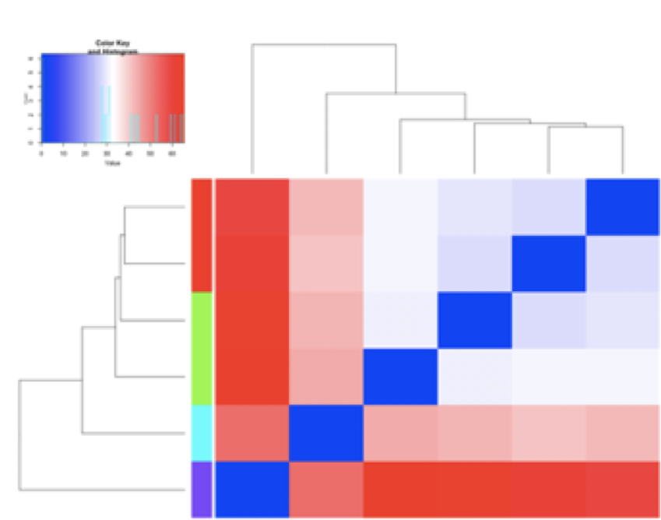
S2_Control
S2_Mite
S1_Control
S1_Mite
R_Control
R_Mite
R_Mite
R_Control
S1_Mite
S2_Mite
S1_Control
S2_Control
Figure S1

Slide 2
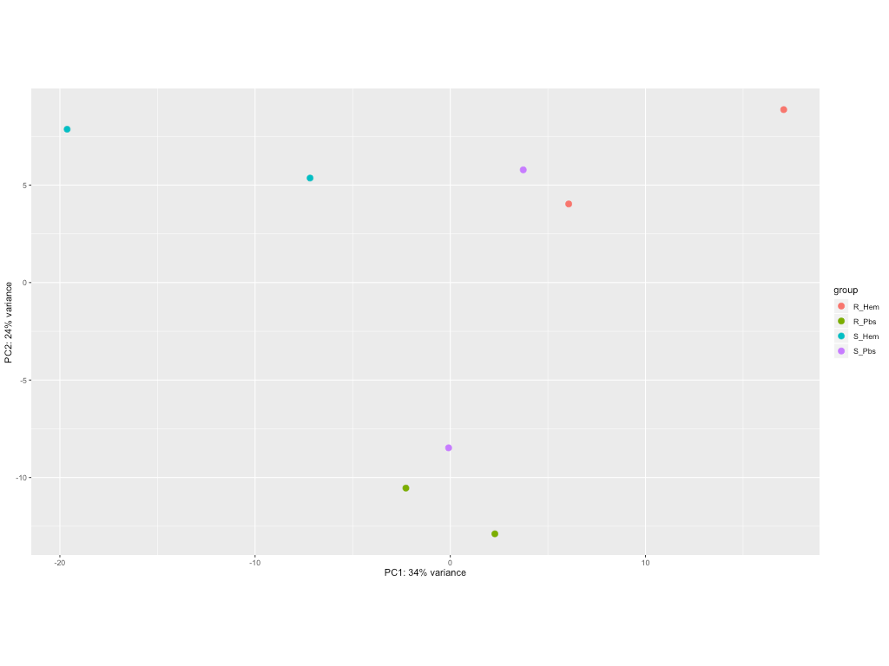
Figure S2

Slide 3
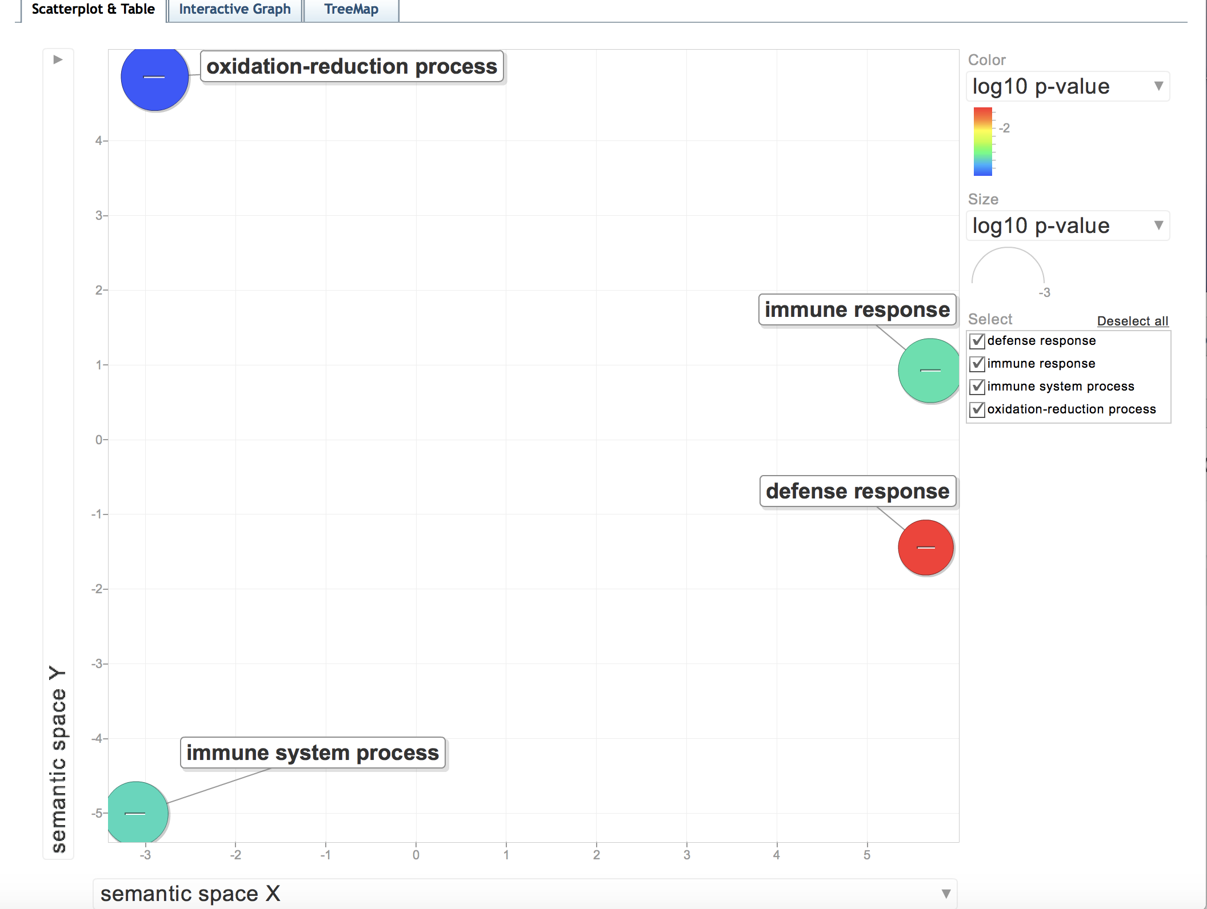
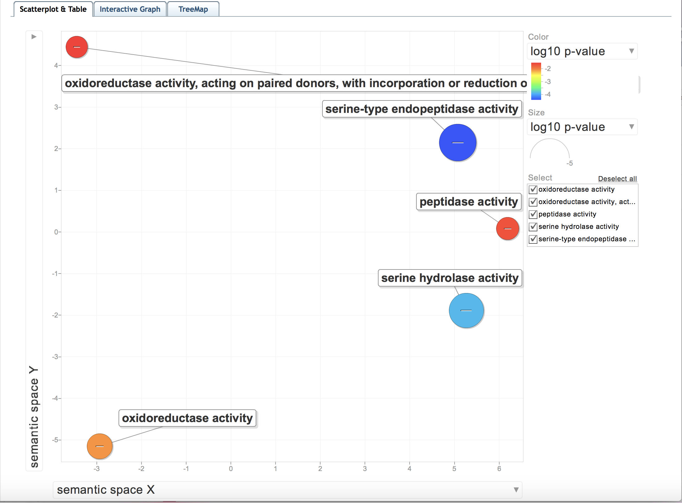
a)
b)
Figure S3

